Slide 1
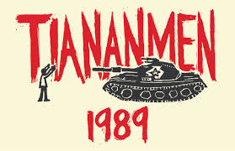

Slide 2
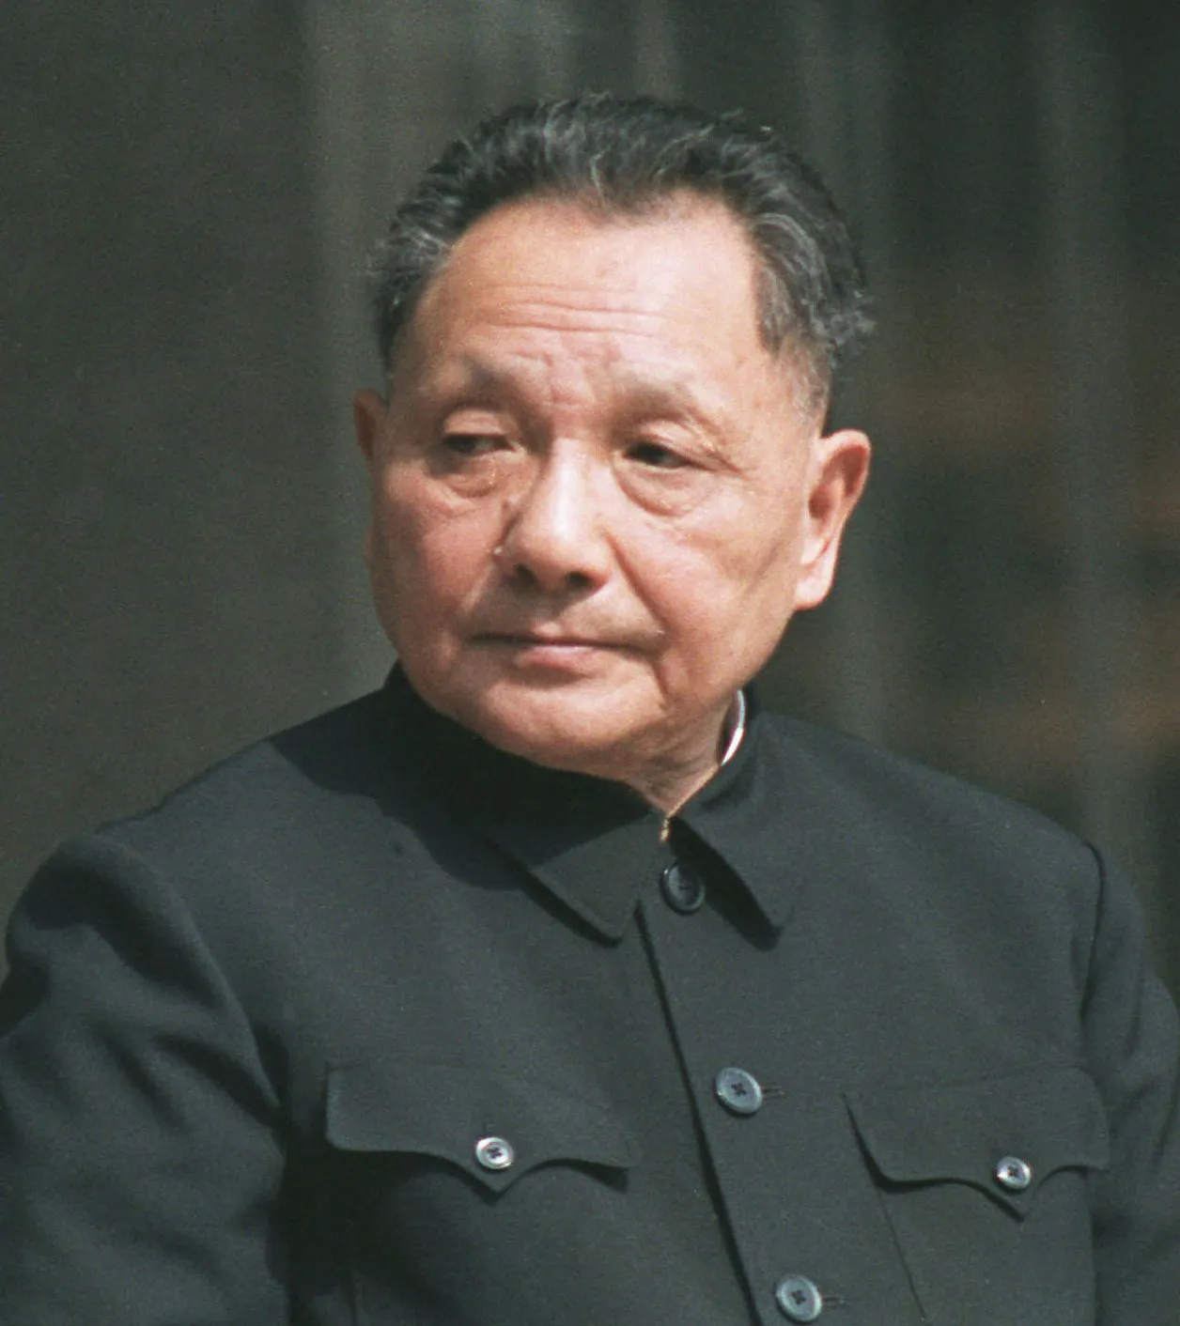
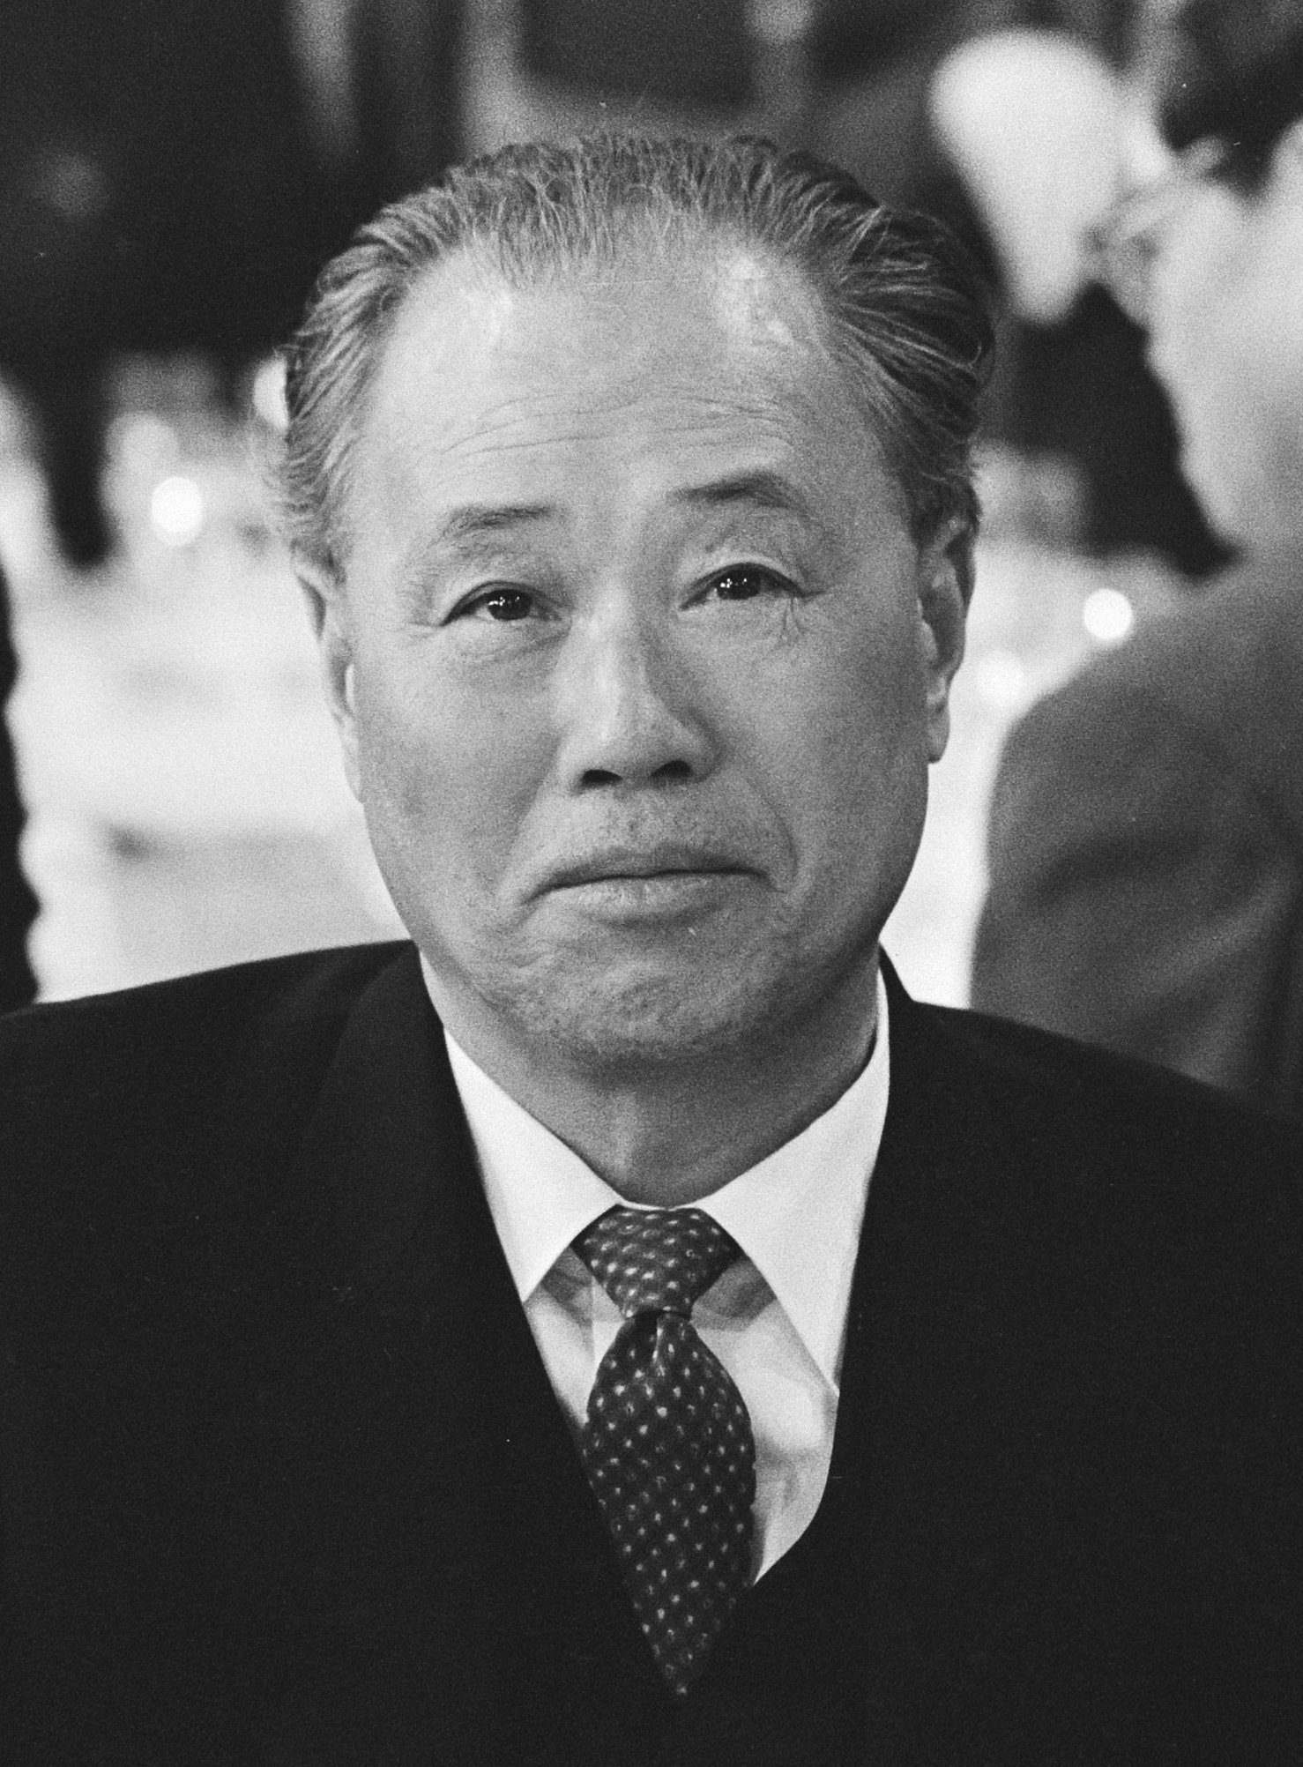
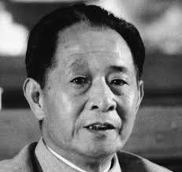
Political Leaders of the Time
Deng Xiaoping
Li Peng
Zhao Ziyang
Hu Yaobang

Slide 3
Deng Xiaoping
Under Mao he was General Secretary of the CCP
Promoted central planning and moderate policies of economic modernization and efficiency

Slide 4
Deng Xiaoping
By 1977 he was Vice Chairman of the CCP and Chief of the PLA General Staff
1978: The Reform and Opening-Up Policy. Ended collectivized agriculture, opened China to foreign investment, decentralized the economy, brought rapid economic growth
He held a tight grip: distain for western democracy and political liberation

Slide 5
Hu Yaobang
General Secretary of the CCP (1980-87)
Supporter of The Reform and Opening Up Programm
Advocate of Political Liberalization

Slide 6
Zhao Ziyang
Premier of China (1980–1987)
Supporter of Deng’s reforms
Supporter of Political Liberalization

Slide 7
Li Peng
Premier of China (1987–1998)
Conservative

Slide 8
The Political Background
a decade of remarkable economic growth brought foreign ideas, liberalism, but also inflation and corruption
this mix of events caused political unrest to the youth, who started to protest for more freedom and rights in 1986-7

Slide 9
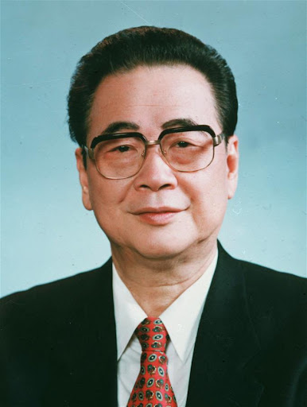
Two Sides
Reformers
Hardliners

Slide 10
The Divide’s Outcome:
Hu Yaobang’s forced resignation in 1987
Zhao Ziyang becomes General Secretary of the CCP (1987-89)

Slide 11
Hu Yaobang dies 15/4/1989

Slide 12
Funeral 22/4/1989

Slide 15
Goddess of Democracy

Slide 16
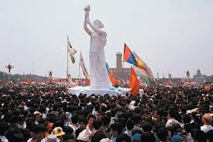
Goddess of Democracy

Slide 17
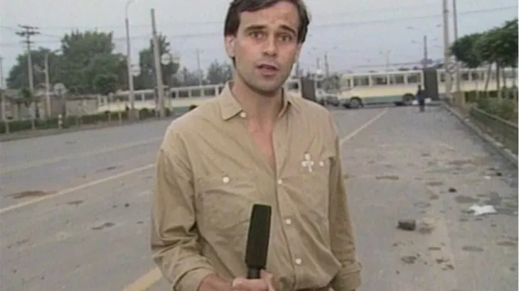
Mikhail Gorbachev’s Visit

Slide 18
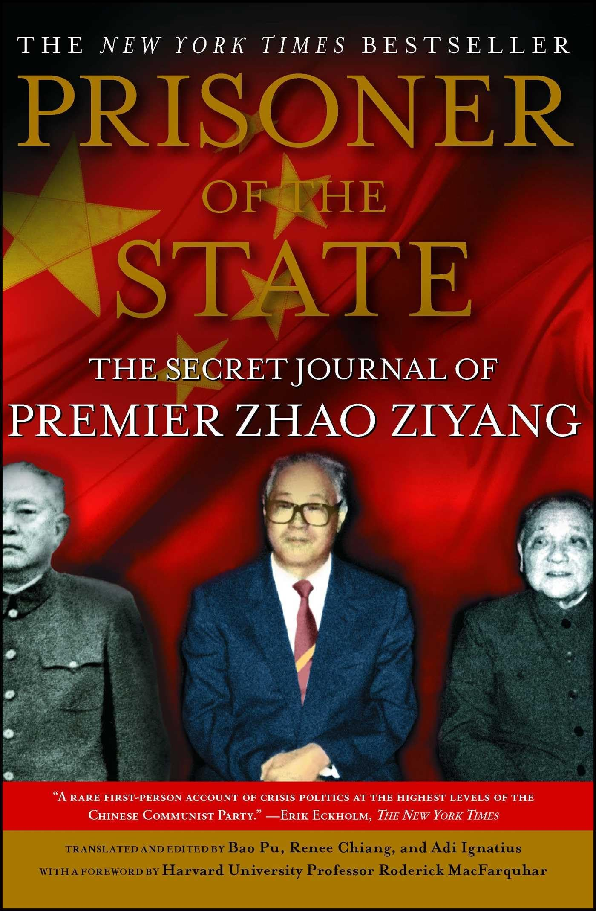
The Fate of Zhao Ziyang

Slide 19
Martial Law

Slide 20
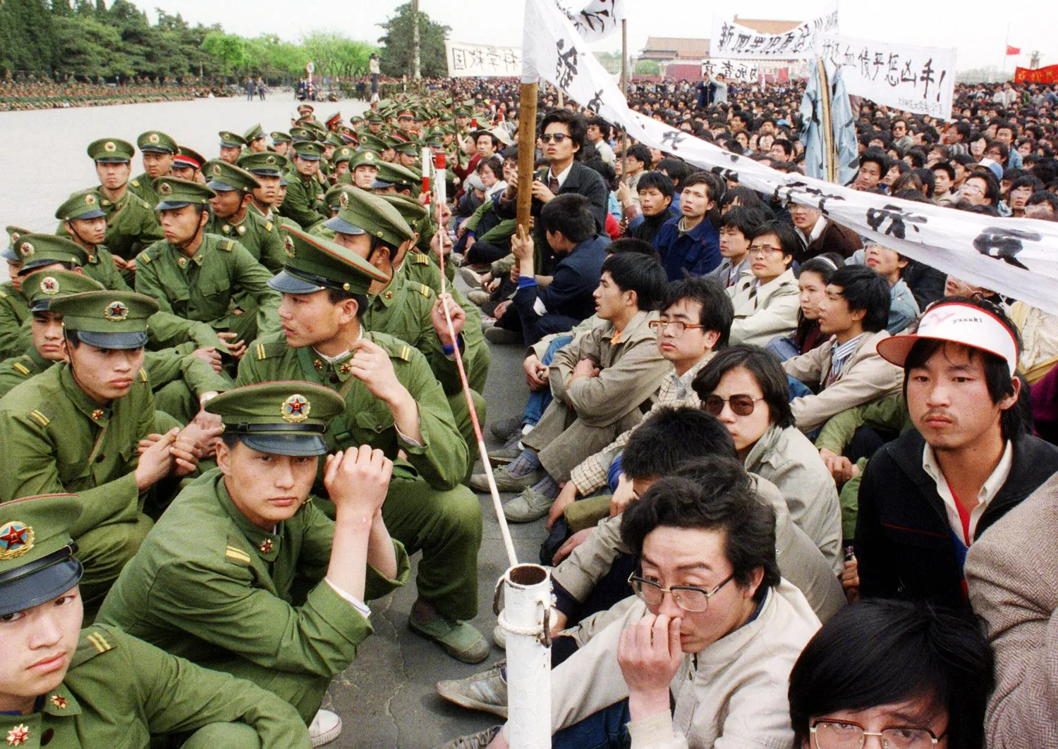
The First Wave

Slide 21
The First Wave

Slide 22
Second Wave: June 3d

Slide 23
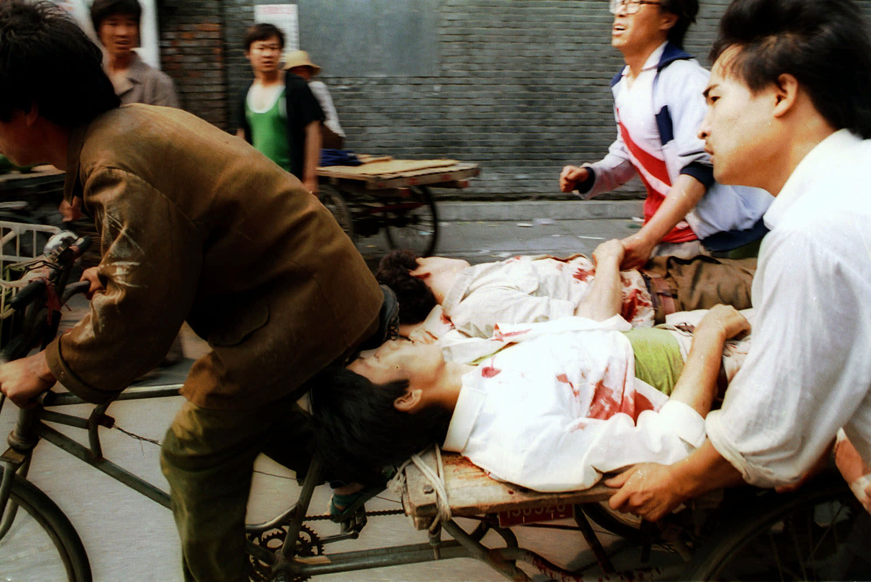
Death Toll: Unknown

Slide 24
Tank Man

Slide 25
Tank Man

Slide 26
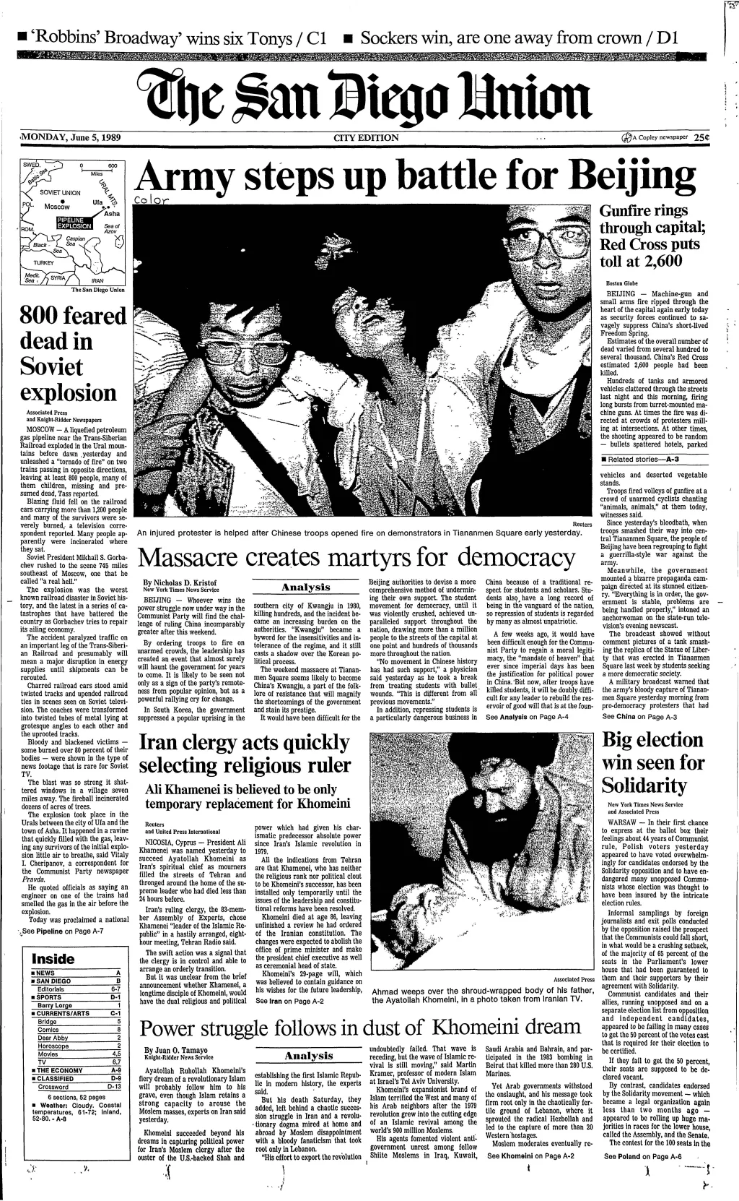
The Aftermath

Slide 27
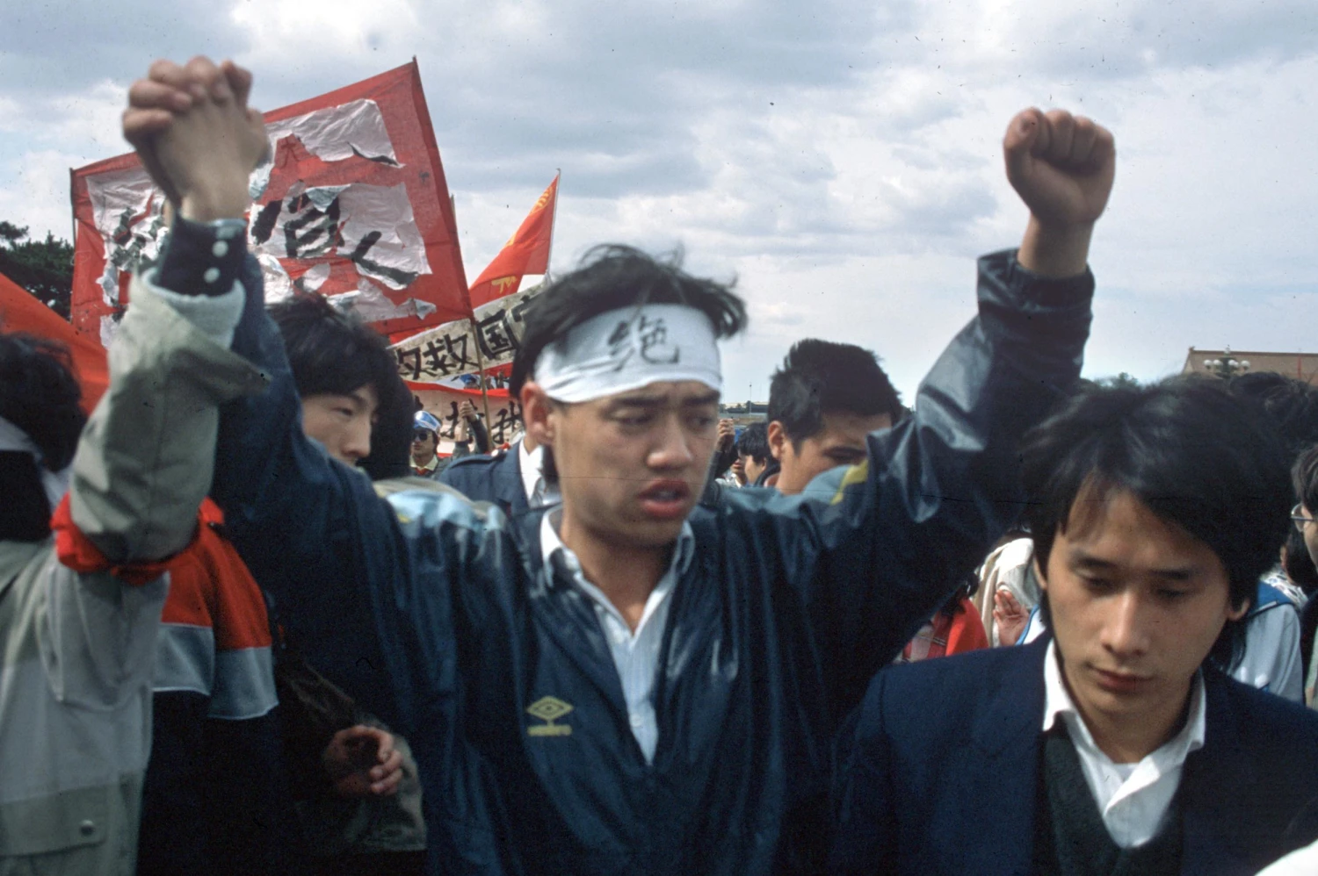
The Aftermath

Slide 28
Censorship:
government minimized its significance, put out a false death toll of 241, including troops
it is only referenced by name or not even that in school books

Slide 29
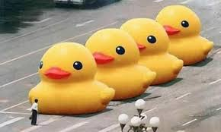
Internet Access to Information

Slide 30
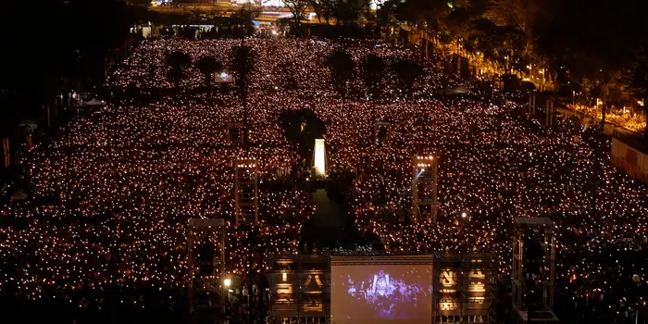
Public Commemoration

Slide 32
Pillar of Shame

