Slide 1
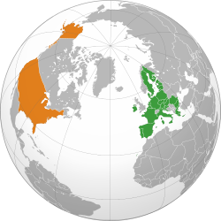
Changes of the International Order
Panteion University, December 19, 2023

Slide 2
What is the role of states in the present international order?
Great powers vs. regional powers
Who are the great powers?
Who can really influence of the order?
How did we get here?
West-East relations
Unviersal norms and rules?
At least it seemed since the end of the CW

Slide 3
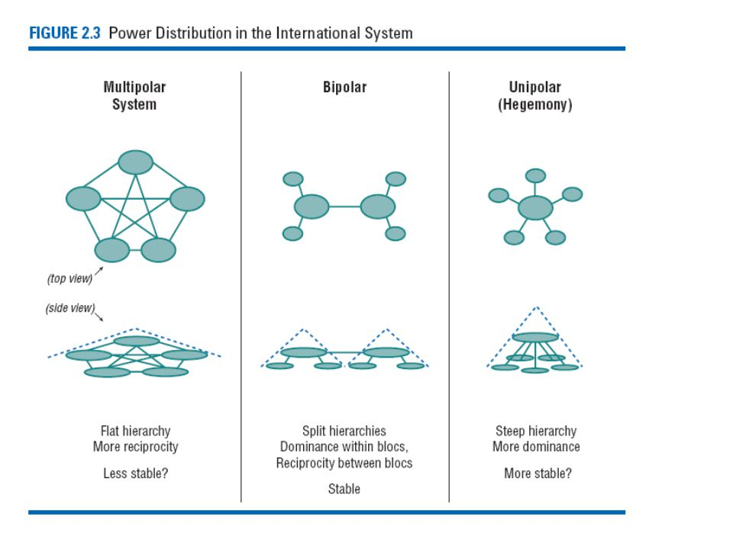

Slide 4
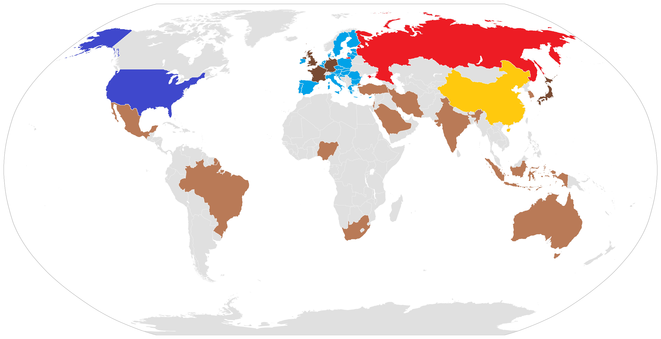
Secondary
Global
Status quo power
Revolutionary great powers
Regional powers

Slide 5
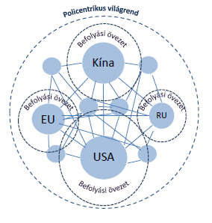

Slide 6
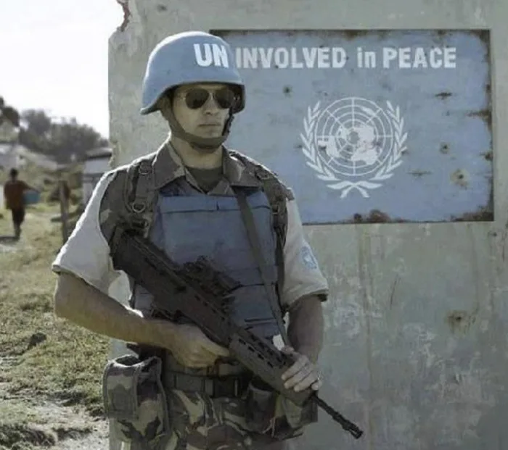
The „brave new world”
End of history?
Whole and free Europe?
Is the new world order indeed universal?
Is it safer?
Is it prosperous?
„Keep Russia out
(and down)”

Slide 7
1. The „New World Order” (1989-2001)
„Victory of democracy”
Unipolar moment
Expansion of the West in the post-soviet space
The hegemony of neoliberal economics – „Washington consensus”
Old-new conflicts – UN and the multilateral military missions

Slide 8
2. Challenges to American „hegemony” (2001-2008)
Islam fundamentalism, international terrorism - GWoT
Bush doctrine and coalition of the willing
Emergence of a multipolar system
Military ambitions of Russia, (China)

Slide 9
3. Return of the economy (2009-2014)
Domestic crisis in the US
EU crisis (started in Greece)
China as a new global power
Failure of the „reset” policy towards Russia

Slide 10
4. Era of parallel threats (2014 – 2020)
2014 Ukraine – back to defense
2015 illegal migration crisis – back to interior
2016 Brexit – what?!?
Regional issues:
Iran
ISIS
Venezuela
Africa

Slide 11
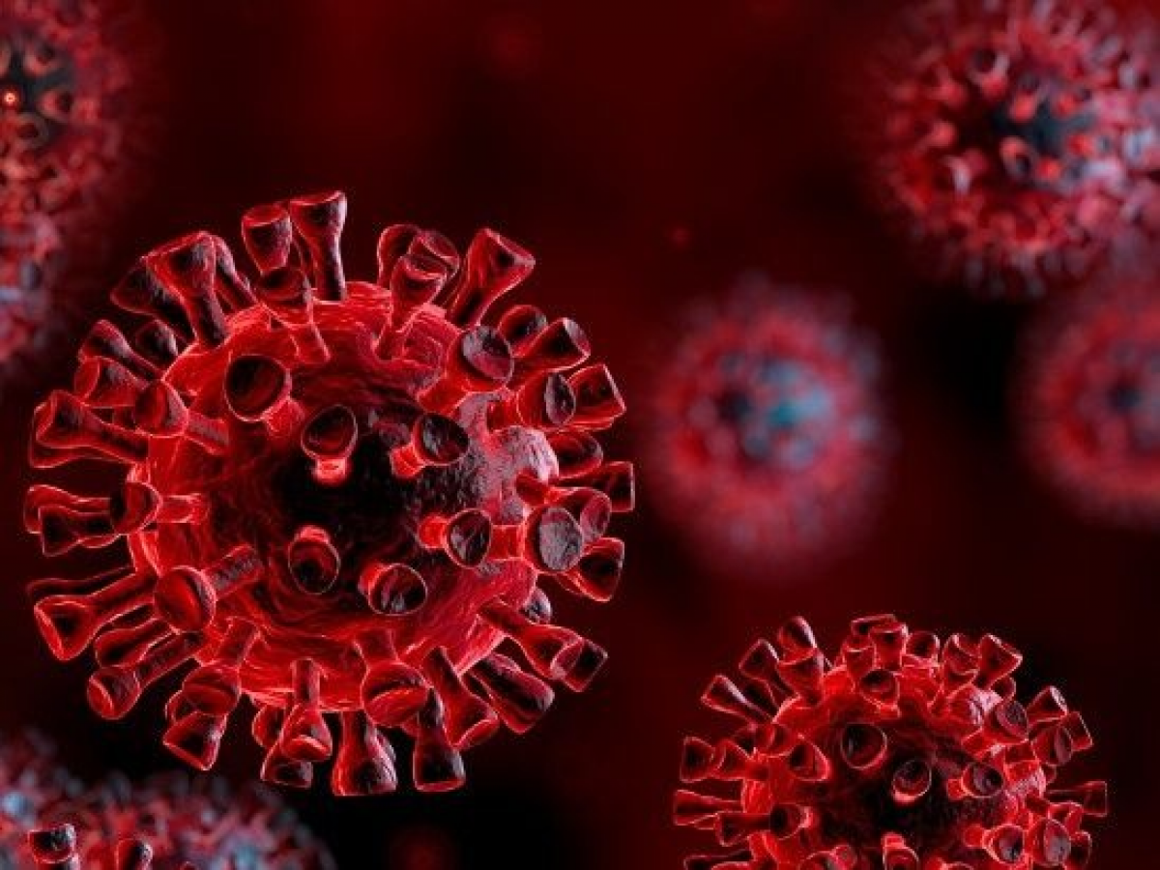
5. Global pandemic (2020 –…)
Changed the thinking
Bipolar vs. multipolar world
Challenges to the LIO
To close or not to close…
But definitely visible deglobalization and the emergence of regional issues and power aspirants
eg. Middle-East
„Global South”

Slide 12
6. The war in Ukraine (2022 –…)
What is at stake?
Regional, or global conflict?
The unity of the EU and Transatlantic Alliance
Global consequences
economic
political

Slide 13
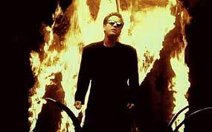
2023…
… is counting
Geopolitics, geoeconomics…
„… we did not start the fire…”

Slide 14
The liberal world order
The difficulties of conceptualizing WORLD order
LIO
Maintained by who and why – hegemonic?
Foreign policy goals of countries
Is it changing?
Is it bad?
Historic exception
SurRealism: world is not as simple
Within the bubble is liberal, outside realist
The EU-US: agenda setters
Where is Russia in it?

Slide 15
Why the LWO is different?
Compared to the hierarchical system of imperial and “vassal or satellite” relations, in which weaker states feel vulnerable and only submit to the stronger because of their survival instincts, the “liberal world order” has brought something new, that the weaker states did not see the key to survival in power, but they believe in defense within a regulated framework of cooperation, thus they can turn to areas most beneficial to them then power maximalization (e.g. wealth).

Slide 16
The liberal core
The is a core:
„World of democracies”; NATO, EU
Universalistic wish for homogeneity – liberal norms
Outside of the core:
Some accept because of benefits, some because of fears (security and welfare)
Some share the benefits of order but not the norms (Turkey?)
Are there really challengers (revolutionary powers) which can provide alternative without logically loosing the benefits?

Slide 17
The equation of the world order in the US logical frame
SurRealist belief that coercion and hard power can maintain an order which is liberal.
The rules maintain the balance
S = L (R1, R2…) +/- IL (O1, O2…)
L = R1 +/- R2…
R1 = +/- H, P, CZ, SK
S: the international system; L: members of the liberal order (the bubble or core); IL: regions outside the liberal core and O the players in these regions. R: regions within the liberal core. Assume that R1 is Central Europe, thus R1 is influenced by the individual countries’ interests in the region.

Slide 18
Who are the players
The more we simplify the more we distance ourselves from the „world order”
E₁ = u{P_{1-∞}} = ~ u{US; EU; C; RU; GS; others}
E₂ = ~ u{US; EU; C; RU; GS}
Same in the simplified „world of democracies”:
E₃ = ~ u{liberal democracies, autocracies}
E₁ > E₂ > E₃

Slide 19
Assumptions regarding the world order
the international system is state-centered and states are self-interested and their interests are derived from their internal endowments („security and money”);
there is an international/world order, institutionalized as a compromise between the self-interested behavior of states;
the international order is anarchic, but it affects its actors and “reconstructs” the network of interests;
within the international order, there are sub-systems in which the “socializing” effect of the order, i.e. and interdependencies are stronger;

Slide 20
Assumptions regarding the world order
(individual) actors in the international order may be more influential, the United States as an example for a modern national interest formation and the EU for a postmodern process;
the validity of the order as a whole is not called into question by the fact that some actors are not equally affected by socialization.
The principles, norms and institutions established in the US-led “North Atlantic design center” will remain attractive until the US (and the West) can credibly represent them.

Slide 21
US Foreign policy and the world order
The United States has been able to define the order because it has placed its maintenance at the top of its foreign policy agenda.
When the order/balance seems less important on the agenda - challengers:
make the members of the order equal and similar (democracy promotion with Bush, or the assertion of democratic superiority with Biden),
or when the US seeks to withdraw from the order and demands more contributions from the other beneficiaries of the order (neo-isolationist and transactionalist thinking with Trump).

Slide 22
The EU
We should not forget what is the goal!
The EU has been:
Peace project
Economic project
And only thirdly a political project

Slide 23
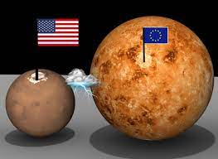
Transatlantic problems
NATO, common problems
Trade (TTIP?)
Defense
Democracy
China and Russia

Slide 24
Russia and the West
Neosoviet dream
EU enlargement
NATO enlargement
RU-China
Global cooperation
non-proliferation
climate
RU too big and energy
is decoupling succesful?

Slide 25
Russia-EU
12 sanctions packages (targeted individual, visa measures and economic sanctions)
See: https://www.consilium.europa.eu/en/infographics/eu-sanctions-russia-ukraine-invasion/
The 12th package will increase restrictions on the oil sector.
Room for international mediation?
China?

Slide 26
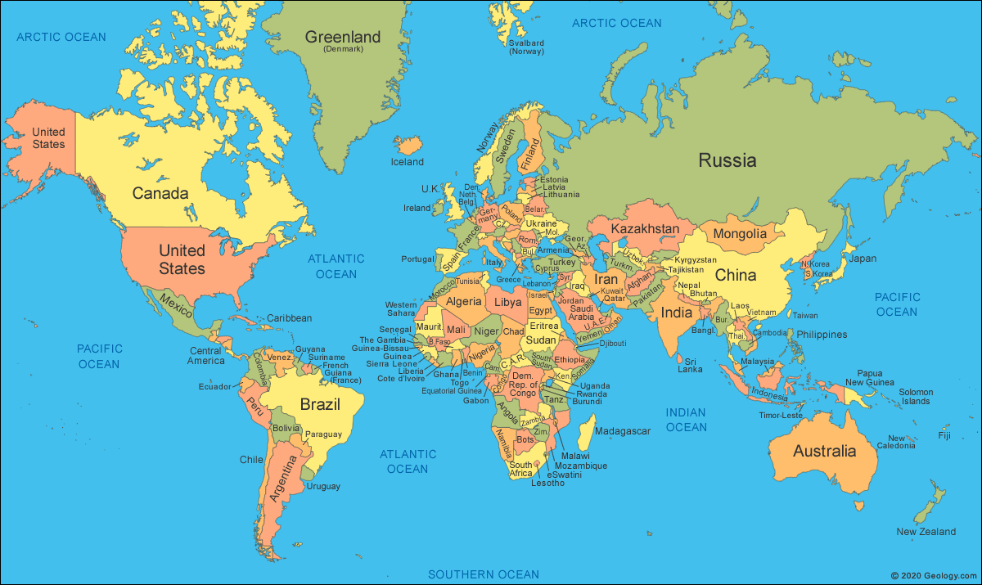
Look at some facts…
Geography and global power projections

Slide 27
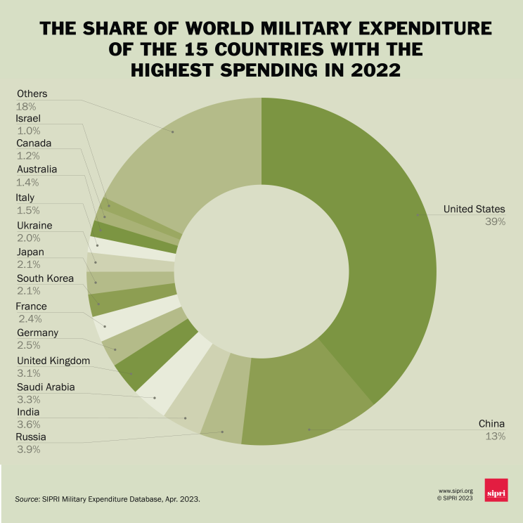

Slide 30
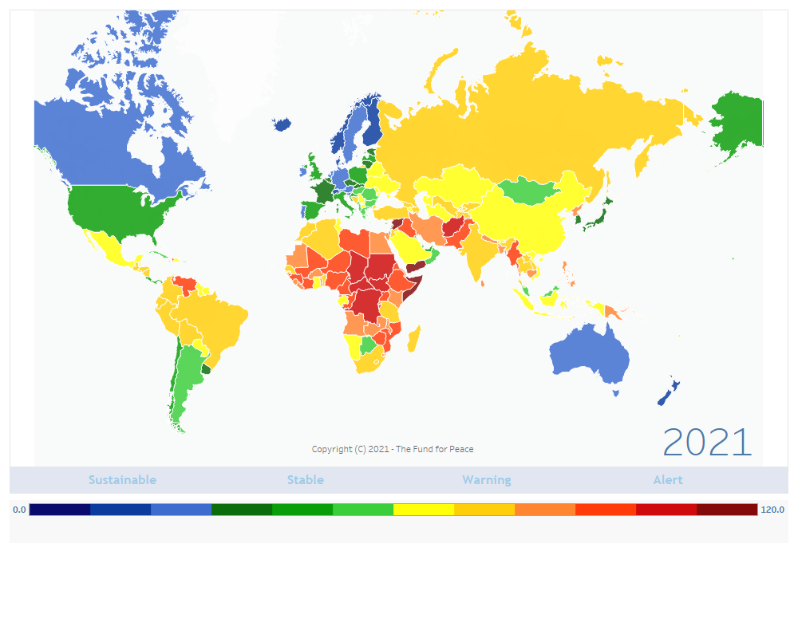
World of democracies?

Slide 31
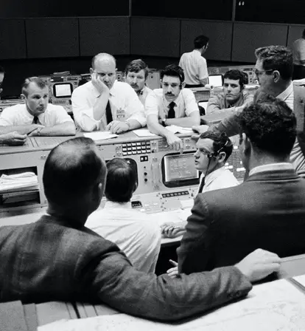
Houston we have a problem…

Slide 32
Unpredictability

