Slide 1
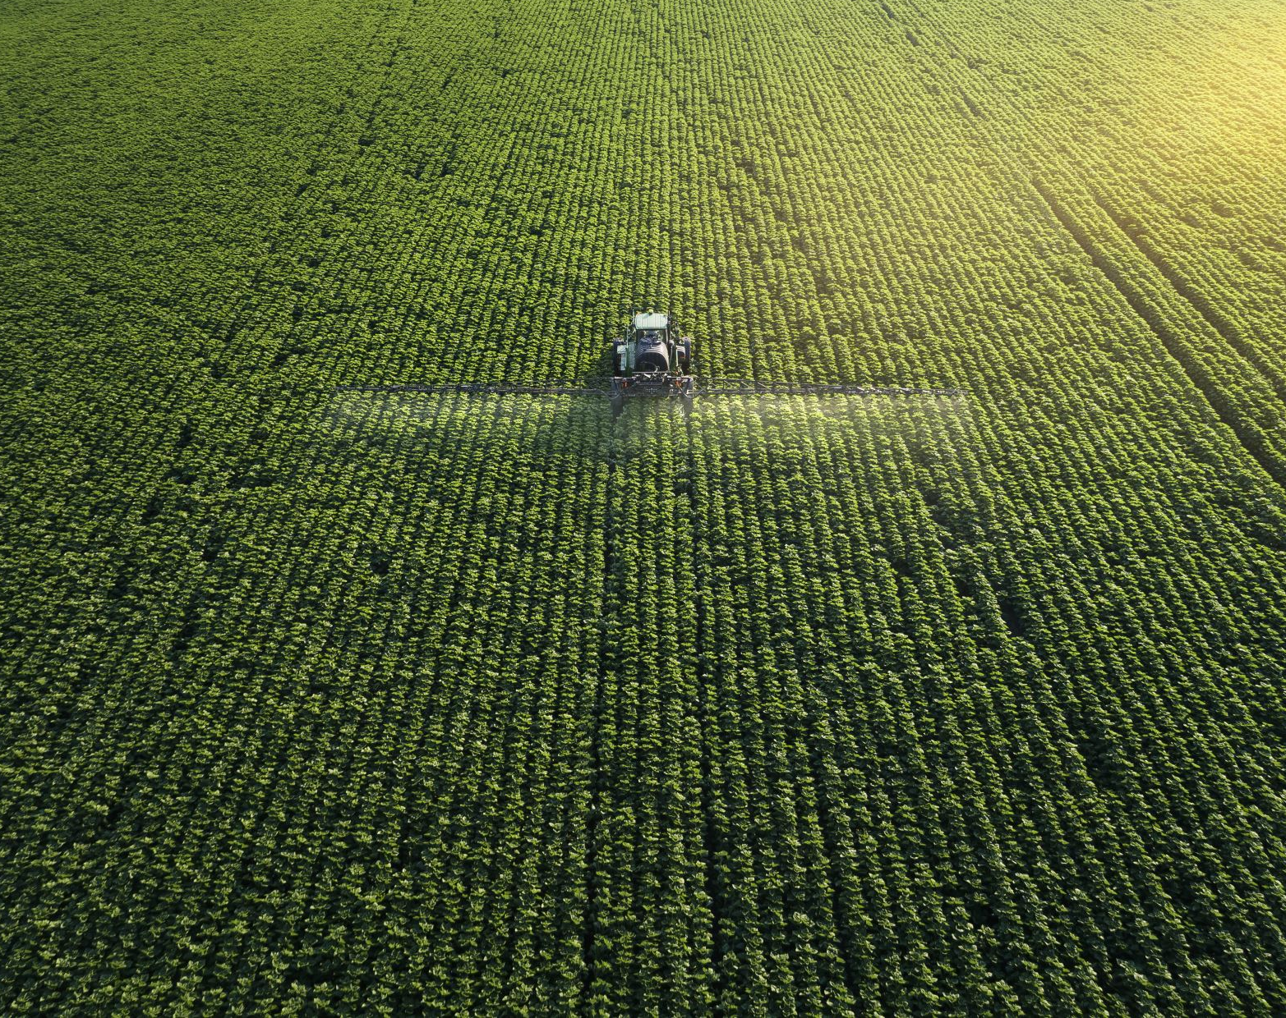
Exploring agriculture-based mitigation in the pursuit of circular economy. Food Tree crops ecosystems as a net sink of CO2
Prof. Kostas Bithas
Environmental and Natural Resources Economics
Institute of Urban Environment and Human resources
Panteion University
3rd Symposium on Circular Economy and Sustainability Chania. Greece 27-29 June. 2022

Slide 2
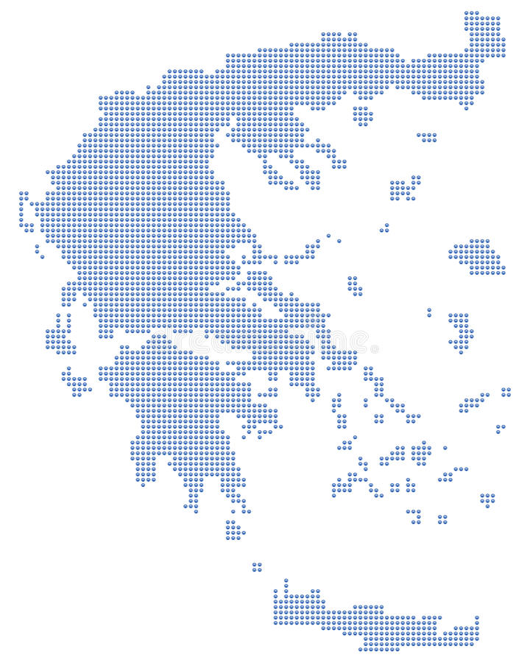
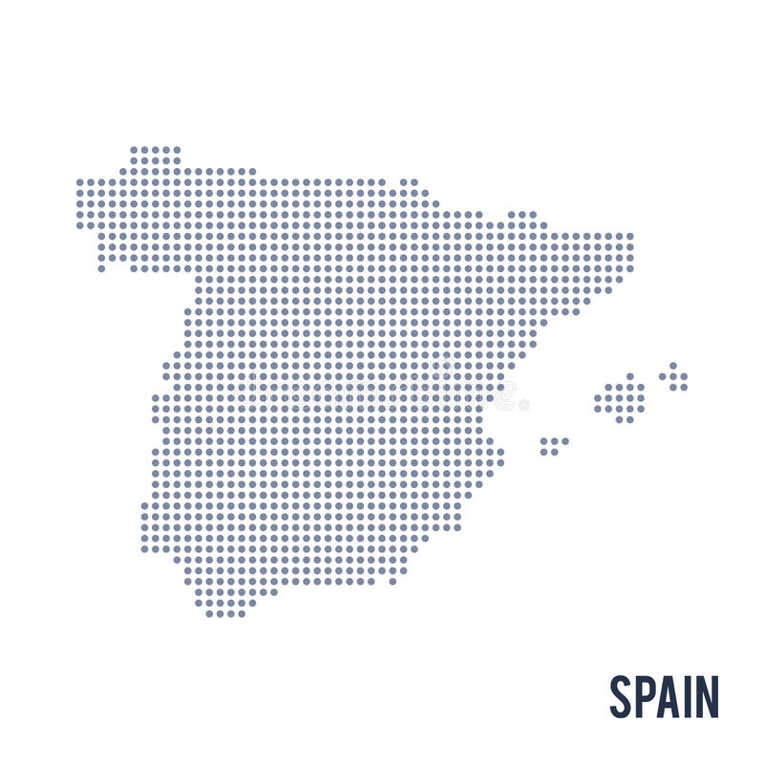
Τhe CLIMATREE project
Coordinator
5 Agricultural Units
Several Agricultural Units
Several Agricultural Units
Notes:
Coordinator:
Institute of Urban Environment and Human Resources (UEHR). Panteion University
Associated Beneficiaries:
AUA(Agricultural University of Athens). Greece
CSIC (Agencia Estatal Consejo Superior de Investigaciones Científicas). Spain
UNIBAS (University degli Studi Basilicata). Italy
TERRA NOVA (TERRA NOVA ENVIRONMENTAL ENGINEERING CONSULTANCY Ltd). Greece
UOWM (Research Committee - University of Western Macedonia). Greece

Slide 3
Nature based climate services are integral components of circular economy
Switching to sustainable practices in agriculture can enhance land-based carbon pools (biomass and soil carbon sequestration).
These practices can be: “cover crops”, “low tillage”, “agroforestry”, “fertigation”, etc.
But how much can these practices help our mitigation efforts?
This is where our ClimaTree project osculates with Circular Economy.

Slide 4
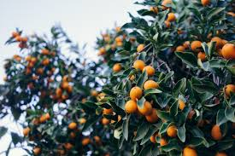
Forests. The inspiration
Removals
Emissions
Removals
Emissions
Tree Cultivations
Forests
Here we have
Removals > Emissions
Let us make
Removals > Emissions

Slide 5
CLIMATREE objectives
A “novel methodology” for estimating CO2 balance on Tree cultivations (case study: S. Europe);
Identification and projection of climatic conditions relevant to CO2 sequestration;
Identification and ranking of mitigation-rich cultivation practices for maximizing CO2 sequestration;
Evaluation of economic benefits arising from the CO2 sequestration; being on ecosystem services ;
Identification of additional ecosystem services arising from tree cultivations.

Slide 6
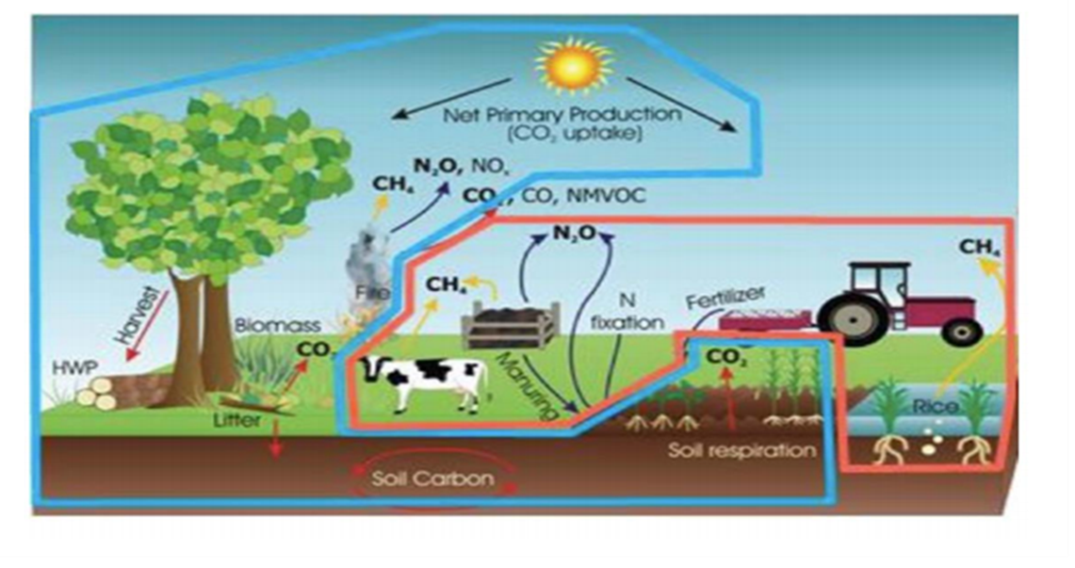
The scope of CLIMATREE
IPCC Framework
LCA Framework
CLIMATREE : IPCC and LCA Frameworks
CLIMATREE : emissions and removals from biological functions and cultivation

Slide 7
High added value Deliverables
A dynamic model with geospatial properties reflecting the CO₂ balance at tree cultivation;
A CO₂ Removal Calculation Algorithm incorporated by an e-tool permitting estimates of CO₂ balance under different “conditions” (land use scenarios. cultivation methods. energy use etc.);
Carbon farming cultivation methods. Identification and ranking;
Economic valuation of the Ecosystem Service of CO₂ sequestration;
A policy framework for exploiting agriculture-based mitigation (e.g., carbon farming).

Slide 8
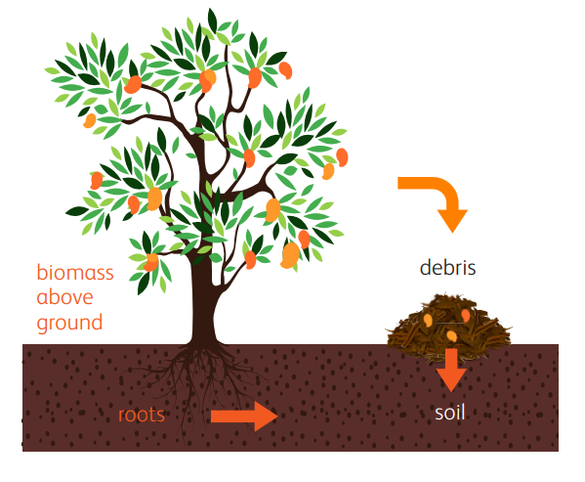
CLIMATREE dynamic model. Long-run perspective
50 years period with annual steps.
Calculation in NUTS 1. 2 or 3 for Italy. Spain and Greece.
Climatic conditions (temperature. rainfall. open pan evaporation) by NASA models. calibrated by Western Macedonia University.
4. Soil characteristics are based on data of LUCAS dataset
CO₂ pools:
Biomass
Debris
Soil

Slide 9
Model estimates : Aggregate Carbon sequestration in 50 years
Total Carbon (in Mt)
 | Greece | Spain | Italy
olive | 27.67 | 220.71 | 36.49
orange | 1.96 | 11.55 | 3.35
apple | 1.35 | 2.95 | 12.71
almond | 0.43 | 14.64 | 1.54
peach | 1.34 | 1.68 | 2.82
~80% of the total carbon sequestration realized in soil
+ 2°C results in negative effect – 17% on carbon sequestration
Vegetated field results increase ≃ 40% in soil carbon sequestration
Keeping pruning on the field can increase sequestration by ≃ 10%
Total Carbon for olives (in Mt)
 | + 0.0 C | +2.0 C | +5.0 C
Greece | 31.69 | 26.20 | 23.31
Spain | 227.65 | 210.84 | 187.58
Italy | 37.52 | 34.78 | 30.94
 | field vegetated | not vegetated
Greece | 27.67 | 16.21
Spain | 220.71 | 124.16
Italy | 36.49 | 21.43
 | keep pruning | remove pruning
Greece | 27.67 | 25.05
Spain | 220.71 | 196.50
Italy | 36.49 | 32.80

Slide 10
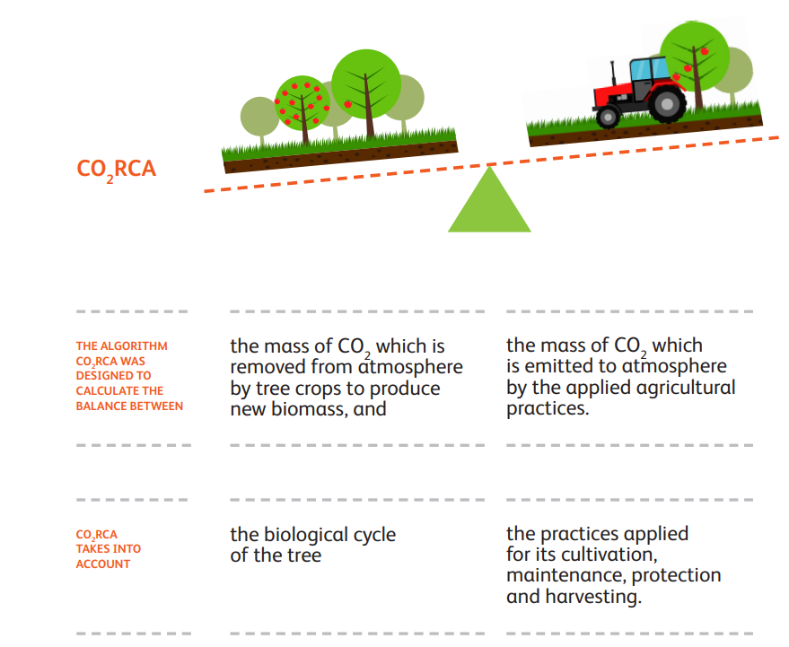
E-tool. CO2 Removal Capacity Algorithm

Slide 11
Practices | IMPACT CATEGORY | IMPLEMENTATION IMPACT
High density plantations | Increase C sink capacity of land | Medium
Canopy management for higher solar interception | Reduction of GHG emissions | Medium
Use of mulching material on the planting row and fertigation | Reduction of GHG emissions | High
Implementation of cover crops between planting rows. | Increase C sink capacity of land | High
Minimum tillage | Increase C sink capacity of land | High
Deficit irrigation | Reduction of GHG emissions | High
Monitoring (meteo/insects) DSS spray | Reduction of GHG emissions | Medium
Recycling in loco pruning residuals | Increase C sink capacity of land | High
Use of renewable energy sources | Reduction of GHG emissions | Low
Recovery of abandon orchards | Increase C sink capacity of land | Medium
Canopy management for high foliage production in olive | Increase C sink capacity of land | Low

Slide 12
Indicative Results
Three alternative management scenarios for Mediterranean countries for 5 tree crops:
1st scenario: Use of conventional practices (fertilizers & pesticides);
2nd scenario: implementation of cover crops, implementation of fertigation;
3rd scenario: implementation of Leguminosae cover crops. application of mulching. application of insects monitoring and mass trapping and alternative use of prunings;
4th scenariο: Based on 3rd scenario and a 20% increase in land area cultivated.

Slide 13
Additional Net Removal (Removals – Emissions) – Greece CO2 ton/hectare
4.35
4.73
6.44
7.23
7.92
3.8
77%
0.9

Slide 14
Additional Net Removal (Removals – Emissions) – Italy CO2 ton/hectare

Slide 15
Additional Net Removal (Removals – Emissions) – Spain CO2 ton/hectare

Slide 16
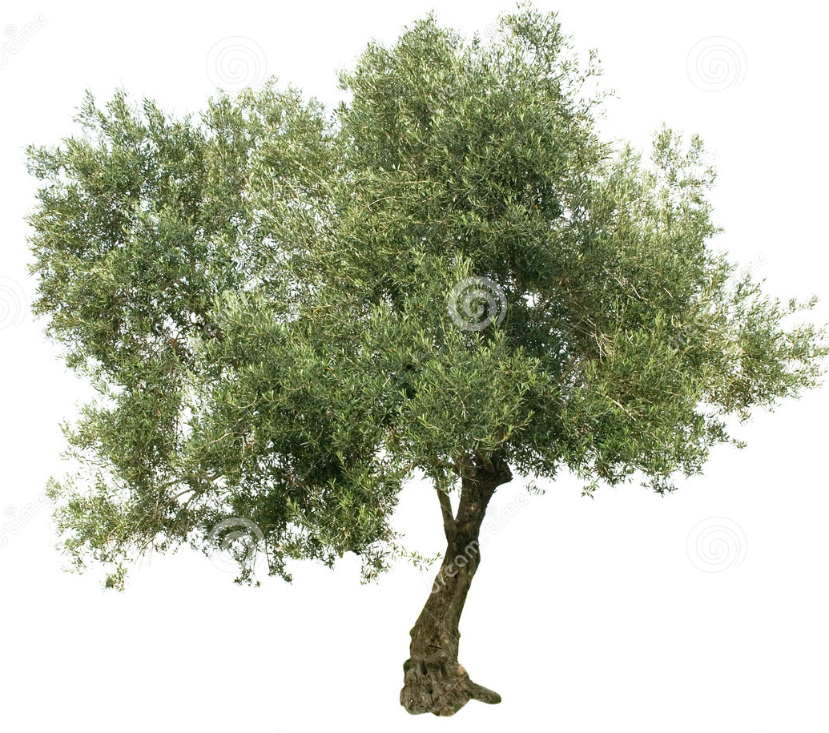
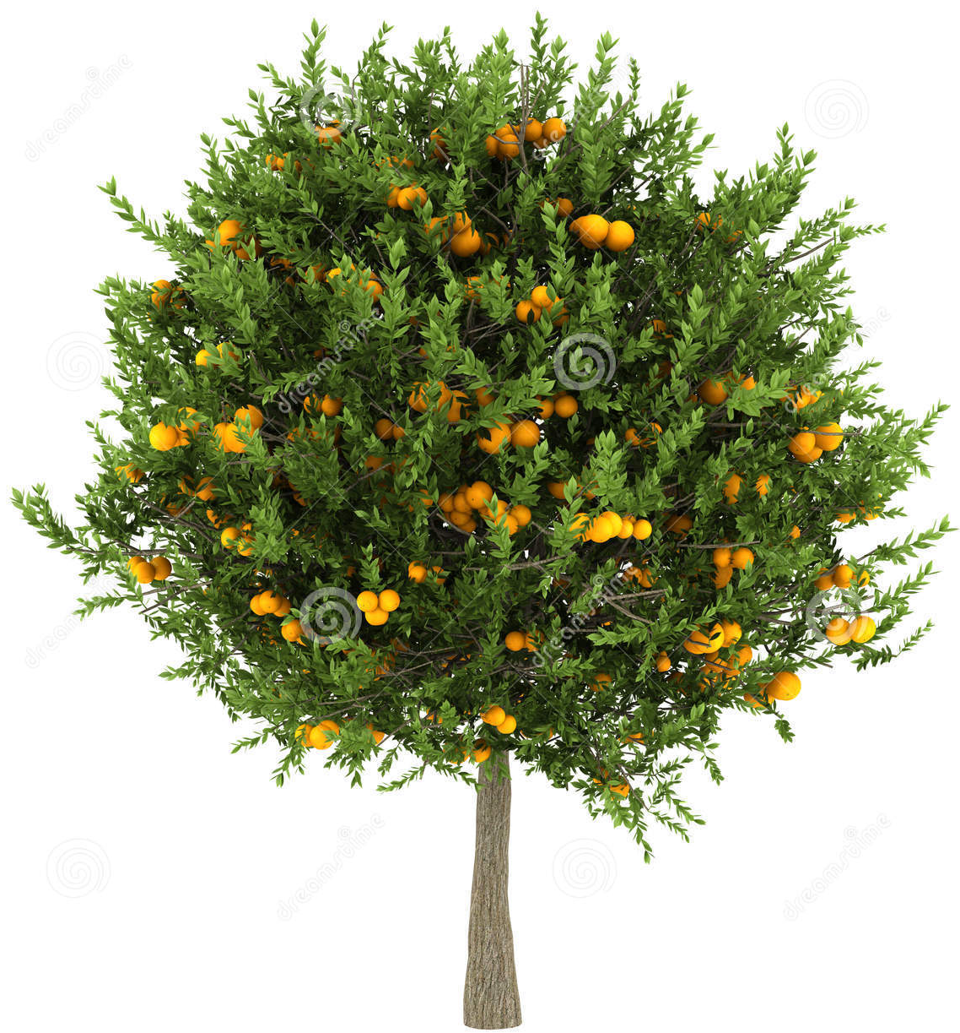
Neutralizing the CO2 emissions of passenger cars. 1 Hectare, 1 year in mitigation rich scenario

Slide 17
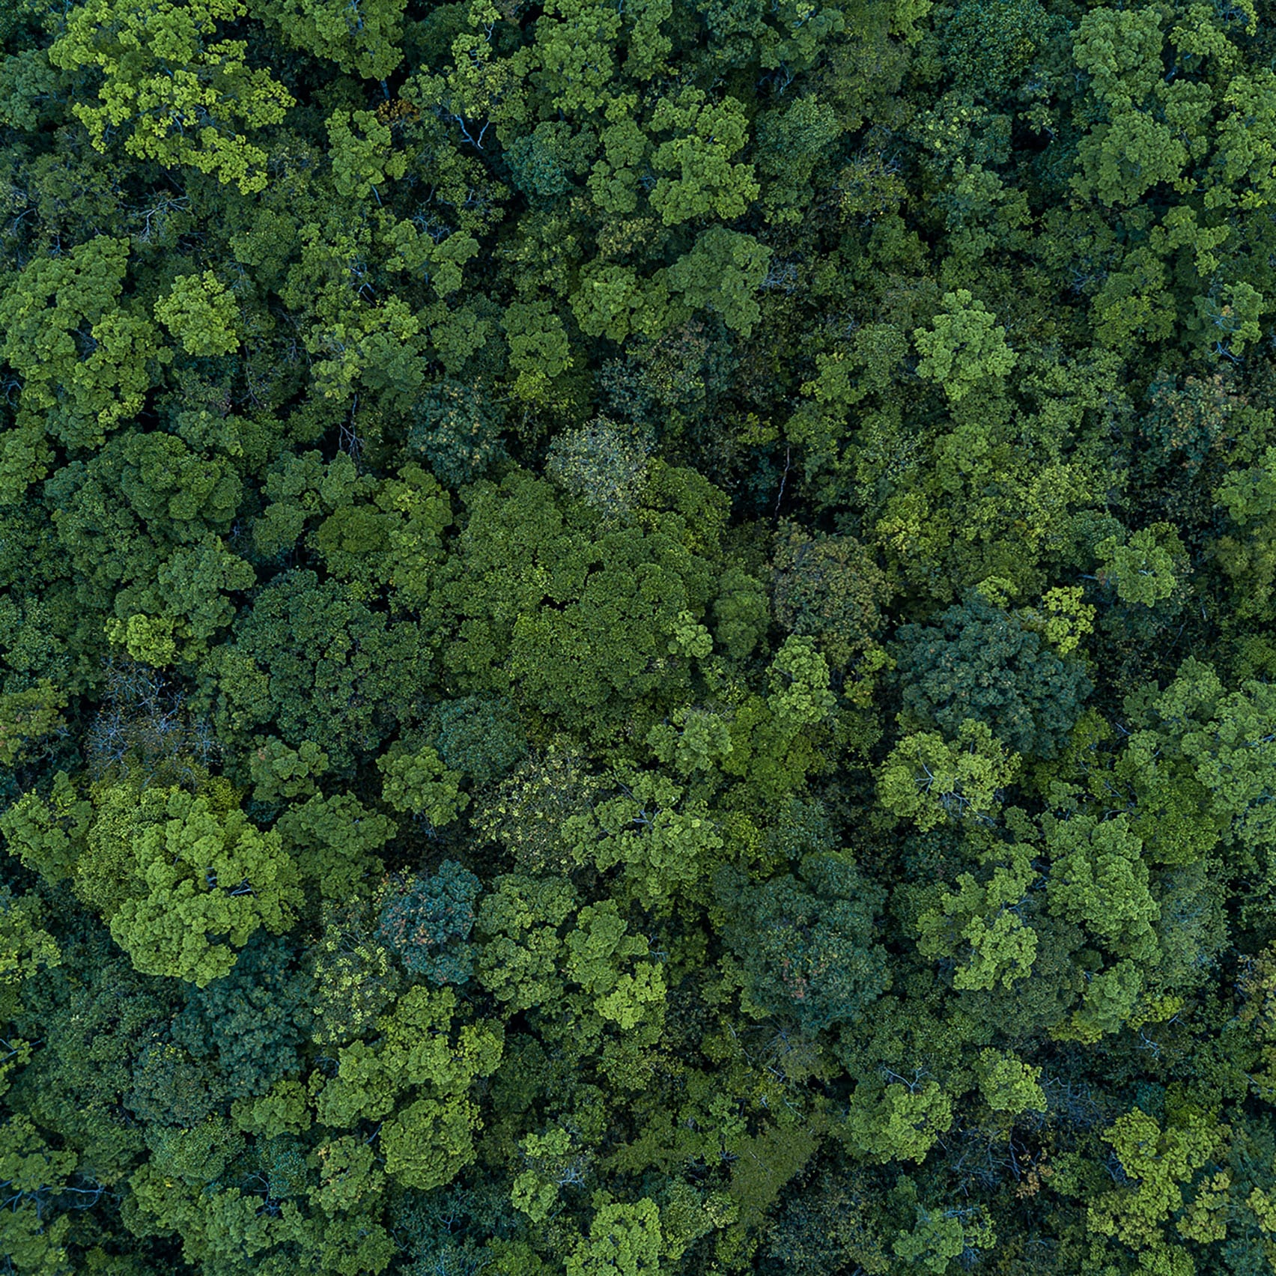
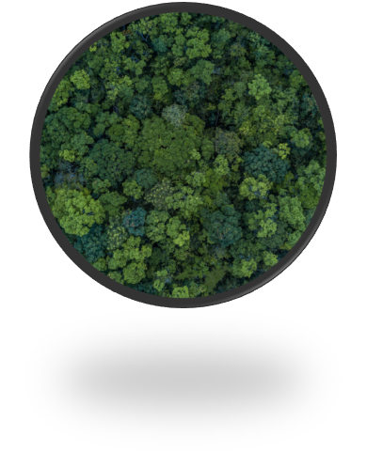
CO2 footprint of human beings neutralized by a farm of 3 Hectares in 1 year
Conventional scenario Medium mitigation scenario High mitigation scenario
High mitigation scenario with a 20% land increase
3 persons 4 persons 6 persons 8 persons
Each farms consists of 1 Ha Olive trees, 1 Ha Orange Trees, and 1 Ha Apple Trees.
Notes:
Eιναι 1 hectare of orange, olive, apple crops όχι μονο ελιά

Slide 18
Aggregate (Existing land use) Net Removal Capacity - Greece

Slide 19
Aggregate (Existing land use) Net Removal Capacity – Spain

Slide 20
Aggregate (Existing land use) Net Removal Capacity – Italy

Slide 21
Aggregate potential to “neutralize” the footprint of human beings – Greece
With an additional 20% land increase
Mitigation as 698,858 persons
(+217,078)
Medium Mitigation Scenario
Mitigation as 559,419 persons
(+77,639)
High Mitigation Scenario
Mitigation as 687,986 persons
(+206,206)
Conventional scenario
Mitigation as 481,780 persons
Mitigating cultivations:
Olive Trees
Orange Trees
Apple Trees
Peach trees
Almond Trees
Change from baseline
Medium Mitigation: 16%
High Mitigation : 43%
20% land increase: 45%
Notes:
481.783 persons
559.419
687.986
698.858

Slide 22
Aggregate potential to “neutralize” the footprint of human beings – Spain
With an additional 20% land increase
Mitigation as 3,726,669 persons
(+1,548,520)
Medium Mitigation Scenario
Mitigation as
2,422,607 persons
(+244,458)
Conventional scenario
Mitigation as 2,178,149 persons
High Mitigation Scenario
Mitigation as
2,817,349 persons
(+639,200)
Mitigating cultivations:
Olive Trees
Orange Trees
Apple Trees
Peach trees
Almond Trees
Change from baseline
Medium Mitigation: 11%
High Mitigation : 29%
20% land increase: 71%
Notes:
2.178.149
2.422.607
2.817.349
3.726.669

Slide 23
Aggregate potential to “neutralize” the footprint of human beings – Italy
With an additional 20% land increase
Mitigation as
872,687 persons
(+834,984)
Medium Mitigation Scenario
Mitigation as 157,208 persons
(+119.505)
High Mitigation Scenario
Mitigation as 351,609 persons
(+313,906)
Conventional scenario
Mitigation as 37,703 persons
Mitigating cultivations:
Olive Trees
Orange Trees
Apple Trees
Peach trees
Almond Trees
Change from baseline
Medium Mitigation: 317%
High Mitigation : 833%
20% land increase: 2215%
Notes:
37.703
157.208
351. 609
872.687

Slide 24
Economic Benefits: Assigning monetary values on CO₂ sequestration
Stated preferences methods;
Willingness to pay for olive oil produced by rich mitigation method;
Certified production;
A market-based framework pertaining to actual marked conditions (purchasing experience of individuals).

Slide 25
The economic value in Greek conditions
Olive oil Value of CO2 sequestration Hectares
1 lit 1,59 € 0,00125
800 lit 1272 € 1 hectare
Yield : 800 lit per hectare
Value of 1 hectare
Greece 1272 €
Italy 1910 €
Spain 1163 €

Slide 26
Valuation of 1 ton of CO2 removed
256 €/ t CO2 CLIMATREE estimates
242 €/ t CO2 Stern Report

Slide 29
Farmers Opportunities
Estimates of (additional) CO₂ sequestration;
Assigning a monetary value to CO₂ sequestration;
Developing incentives within CAP;
Developing Ecolabeling – Carbon farming schemes;
Developing Voluntary Markets for CO₂ sequestration.

Slide 30
Ultimate Contribution to the EU CLIMA objectives
Coupling climate and agriculture policies;
Influence the (Common) Agricultural Policy to integrate Climate Objectives;
Make the EU Climate Policies more informative and rigorous;
Exploiting the mitigation potentials of tree cultivations.

Slide 31
The new Common Agricultural Policy
Eco-schemes
Carbon Farming
Methodologies for assessment CO2 balance
Certification protocols
Monitoring
Incentives modes

Slide 32
Voluntary CO2 markets
The problem of greenwashing;
The development of suitable STANDARDs;
Methodology of ClimaTree under certification;
Next steps
Involvement of stakeholders from agriculture and “industry”,

Slide 33
Nature based mitigation
Cost – effective mitigation
Supporting circular economy

