Slide 1
WHERE ARE THE WOMEN ?
Look around you—where are the women? Whether it concerns a fellow
student, a colleague at work, or the woman who will assist you at a public
service office, the doctor, the lawyer, the journalist, the politician… women,
across the globe, are making a strong presence in the global workforce,
playing significant and active roles. Or perhaps not? ‘Gender inequality,’ the
gender gap, sexism, threats, and the stripping away of human rights all defend
one common goal: destruction. In the end, are women at the top of the
iceberg, or are they increasingly sinking to the bottom of the sea?
So, how do human rights “serve” us? What are they and why do they differ in
the global arena? Can they help women cope with the challenges of the
workplace? This presentation, using social and statistical tools, approaches
the topic of “work – women” today, highlighting the various aspects—both
positive and negative—that women experience in the global work
environment. By highlighting the role, significance, and influence of human
rights, the presentation reveals a comprehensive approach to the current
issue, with the main goal being reflection and critical thinking on your part.

Slide 2
McKinsey’s “Women in the Workplace” report, typically updated annually,examines the progress and challenges women face in the workplace, particularly in leadership and decision-making roles.
Slow Progress in Gender Parity: While there has been some progress in terms of women in leadership roles, overall gender parity remains elusive. Women are still underrepresented, particularly at senior levels.
Leadership Gaps: Despite progress in entry-level positions, the number of women decreases significantly as you move up the corporate ladder. There is a notable drop-off between the first step into management and higher executive roles.
Impact of COVID-19: The pandemic has disproportionately affected women, especially working mothers, with many facing challenges balancing home and work responsibilities. This has contributed to an increased risk of burnout and women leaving the workforce.

Slide 3
Bias and Inequality: Gender bias, discrimination, and stereotypes continue to impede women’s career advancement. This includes challenges in being recognized for leadership potential, which often leads to fewer opportunities for advancement.
Diversity and Inclusion Initiatives: Companies that are more committed to diversity and inclusion tend to have better retention rates and higher levels of employee satisfaction. However, many companies are not fully meeting their diversity targets.
Retention and Advancement: Retention and career growth for women are heavily influenced by support from leaders, flexible working conditions, and having a strong network. Companies that invest in mentorship and sponsorship for women tend to see more women advancing into senior positions.
Calls for Systemic Change: The report stresses the importance of systemic changes in workplace culture, including addressing bias, promoting women’s voices in leadership, and implementing policies that support women’s work-life balance.

Slide 4
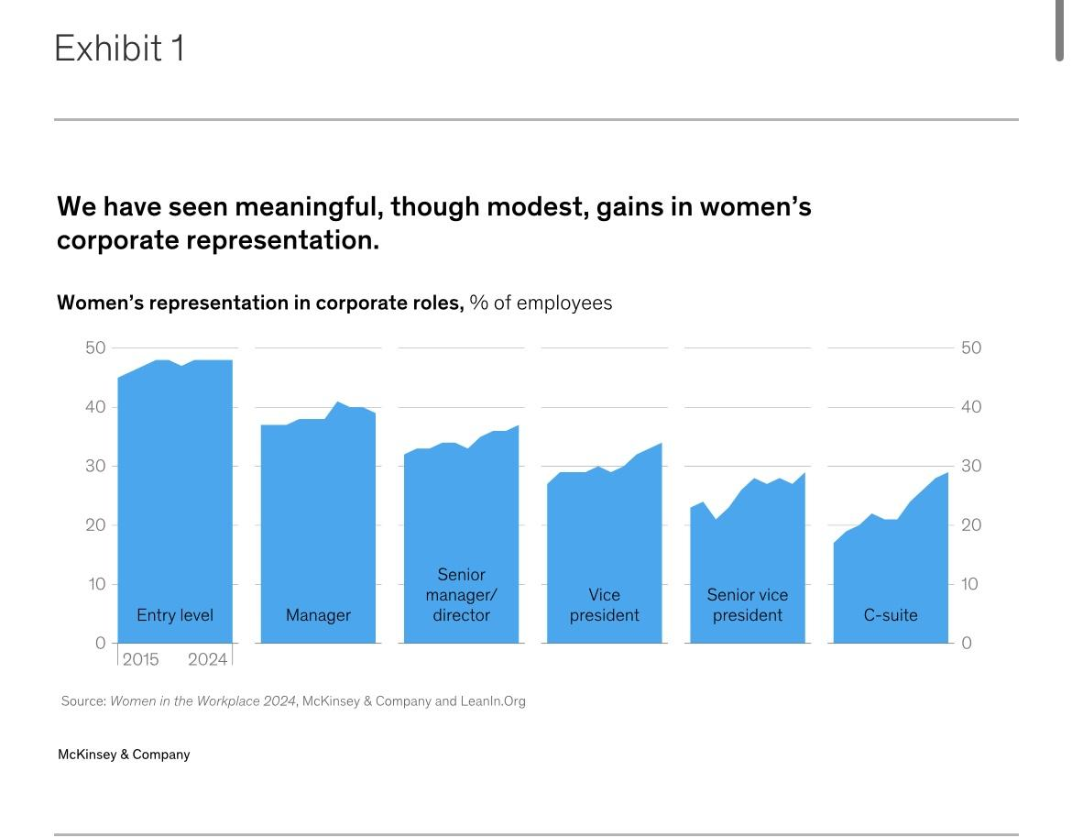

Slide 5
Male Dominance in Journalism and Media
Both articles highlight the significant gender imbalance in journalism and media, particularly in terms of representation, sources, and the portrayal of news.

Slide 6
1. Underrepresentation of Women in Journalism:
• The first article from Medium examines how gender bias manifests in journalism, especially in
editorial and reporting roles. Women are often assigned less authoritative positions, and their voices are
marginalized compared to male journalists.
• The second article from The Conversation discusses how male experts dominate the news.
Research shows that men are cited more frequently than women, even in areas where women have equal or
greater expertise. This trend reinforces the notion that men are more credible, authoritative sources.

Slide 7
2. Male Bias in Expert Commentary:
• Female experts are significantly less likely to be invited as sources for
stories, particularly in fields like politics, economics, and science. The articles
suggest this is largely due to unconscious biases within journalism, which favor
male experts even in areas where women are equally qualified.
• In the The Conversation article, the authors argue that female experts
and journalists should actively seek out opportunities to speak on important
issues, and media outlets need to make a concerted effort to invite more diverse
voices.

Slide 8
3. Structural Barriers and Cultural Norms:
• Both articles touch on cultural and structural barriers that prevent
women from achieving equal visibility. These include unequal access to networks,
mentorship, and editorial influence. In many cases, women in journalism struggle
to gain the same visibility and credibility as their male counterparts.
• The Medium article also highlights how gendered expectations in
news coverage shape the stories that are told, often reducing the role of women to
personal experiences or “soft news” rather than hard-hitting, fact-based reporting.

Slide 9
Despite ongoing efforts toward gender equality, male voices remain
disproportionately dominant in journalism. To achieve more balanced and inclusive
media, both journalists and media organizations must prioritize diverse sources,
ensure equitable representation in editorial positions, and confront the unconscious
biases that perpetuate gender imbalances. By implementing these strategies,
journalism can become a more inclusive field that accurately reflects the
perspectives and expertise of both women and men.

Slide 10
The Euronews article titled “European Leaders in Europe: Where Are They and How
Many Are There?” examines the gender distribution of leadership positions in
European politics.

Slide 11
1. Gender Disparity in European Leadership:
• The article highlights the underrepresentation of women in
leadership positions across Europe. Despite progress, women make up only 33%
of political leaders in Europe.
• This figure is notably low when compared to the overall number of
women in national parliaments, which is closer to 40%, indicating that leadership
roles remain disproportionately held by men.

Slide 12
2. Country Comparisons:
• Some countries have made strides in gender equality in political
leadership. Finland, Denmark, and Iceland are leaders in Europe, with more than
50% of their government leaders being women.
• However, in several other countries, especially in Eastern Europe,
women remain largely absent from top political positions. Countries like Hungary,
Poland, and Slovakia have few or no female leaders.

Slide 13
3. Key Positions and Gender Representation:
• The analysis focuses on leadership roles, including heads of state,
prime ministers, and cabinet ministers. Women hold notable leadership positions
in these areas, but the representation is still skewed.
• Only 8 out of the 27 EU member states have a female head of
government, highlighting the gender gap in the highest political positions.

Slide 14
4. Progress and Challenges:
• The article acknowledges positive changes in recent years, with more
women gaining leadership roles, especially in Scandinavian and Nordic countries.
However, it also points to the persistent challenges women face, such as gender
stereotypes and institutional barriers.
• While some countries have gender quotas to promote female
representation, these quotas often don’t extend to the highest leadership
positions, where men still dominate.

Slide 15
While Europe has seen some progress toward gender equality in political leadership,
gender parity is still far from being achieved, especially in top political offices. There
are clear regional differences, with Northern Europe leading in female
representation, while countries in Eastern and Southern Europe lag behind. There
remains a need for more proactive measures, such as gender quotas and
structural changes, to ensure equal opportunities for women in European leadership
positions.
https://data.ipu.org/women-ranking/
https://www.statista.com/statistics/1058345/countries-with-women-highest-position-executive-power-since-1960/

Slide 16
Women in Politics in Afghanistan:
Women in Afghanistan have faced profound challenges in politics, largely due to patriarchal structures, cultural norms, and political instability. However, there have been significant milestones over the years, especially following the fall of the Taliban in 2001.

Slide 17
Post-Taliban Reforms: After the fall of the Taliban, Afghanistan made strides towards gender equality, with women participating in the national parliament and occupying key governmental roles. In 2004, Afghanistan’s Constitution guaranteed 25% representation of women in parliament.
Challenges Under the Taliban: The return of the Taliban in August 2021 has reversed many of these gains. Women in Afghanistan have faced severe restrictions, including the prohibition of education for girls beyond grade six, and restrictions on their ability to work and move freely. The Taliban’s policies have significantly curtailed the political and social freedom of Afghan women, stripping them of many rights.

Slide 18
Women in Politics in India and in Africa
Historical Progress: India has had female leadership at the highest levels.
Legislative Representation: Women’s representation in India’s parliament has been limited.
Rwanda stands out globally for having the highest percentage of women in parliament.
In countries like South Africa and Ethiopia, women have held significant political positions.

Slide 19
As the world continues to evolve, the presence of women in the workforce becomes
an undeniable force—one that is not simply a shift in numbers, but a testament to the
breaking of barriers. Yet, this presence is not just about filling positions, but about
asserting a fundamental truth: that women, like all people, are entitled to the same
rights, opportunities, and respect in the workplace as anyone else. The question then
isn’t whether women belong in the workforce, but how long we will allow systemic
inequalities to persist. For in the intersection of human rights and professional
equality, the future isn’t just about breaking the glass ceiling; it’s about ensuring that
no one is ever confined by it. The challenge ahead is not merely to achieve equality,
but to redefine a world where equality isn’t a battle, but a given.

Slide 20
Βιβλιογραφία
1 η ΘΕΜΑΤΙΚΗ : https://www.mckinsey.com/featured-insights/diversity-and-
inclusion/women-in-the-workplace#/
2 ΘΕΜΑΤΙΚΗ : https://theconversation.com/male-voices-dominate-the-news-heres-how-journalists-and-female-
experts-can-turn-this-around-160209 https://medium.com/@JennaJo63237273/is-journalism-gender-
dominated-2e579866b823
3 ΘΕΜΑΤΙΚΗ : https://www.euronews.com/2024/08/22/european-leaders-in-
europe-where-are-they-and-how-many-are-there + τα διαγράμματα
https://data.ipu.org/women-ranking/
https://www.statista.com/statistics/1058345/countries-with-women-highest-position-executive-power-since-1960/
ΕΠΙΣΗΣ ΓΙΑ ΤΙΣ ΠΟΛΙΤΙΚΕΣ ΤΩΝ ΓΥΝΑΙΚΩΝ ΣΕ ΑΛΛΕΣ ΧΩΡΕΣ der Quotas
(Publication: Cambridge University Press, 2013).
• Αυτή η μελέτη εξετάζει την πρόοδο των γυναικών στην πολιτική στην
Ινδία και πώς οι πολιτικές ποσοστώσεων έχουν βοηθήσει στην αύξηση της
συμμετοχής τους στα κοινοβούλια και σε κυβερνητικές θέσεις.

Slide 21
4. Rwanda’s Gender Equality in Politics
• Gender Equality and Women’s Empowerment in Africa: Rwanda as a Case Study (Journal of African Politics, 2018).
• Αυτή η μελέτη εξετάζει την εκπληκτική επιτυχία της Ρουάντας στην ενσωμάτωση των γυναικών στην πολιτική διαδικασία και την επίτευξη του
υψηλότερου ποσοστού γυναικών στο κοινοβούλιο παγκοσμίως.
5. Ellen Johnson Sirleaf’s Leadership in Liberia
• This Child Will Be Great: Memoir of a President από την Ellen Johnson Sirleaf. Αυτή η αυτοβιογραφία της πρώτης γυναίκας προέδρου στην Αφρική εξετάζει
τις προκλήσεις και τα επιτεύγματά της στον πολιτικό χώρο.
6. The Challenges of Women in African Politics:
• Women in Politics: African Experiences (African Women’s Development Fund, 2019).
• Αυτή η αναφορά παρέχει μια ανάλυση των πολιτικών και κοινωνικών περιορισμών που αντιμετωπίζουν οι γυναίκες στην Αφρική, εξετάζοντας την πορεία
τους σε χώρες όπως η Γκάνα, η Νιγηρία, και η Αιθιοπία.
7. Gender and Politics in the Middle East (Stimson Center, 2023)
• Μελέτη που αναλύει τον ρόλο των γυναικών στην πολιτική στη Μέση Ανατολή, εξετάζοντας χώρες όπως η Σαουδική Αραβία και η Ιορδανία και τις πρόσφατες προσπάθειες εκσυγχρονισμού.

