Slide 1
Naive Bayes
Probabilistic Text Classification
Andreas Kollias

Slide 2
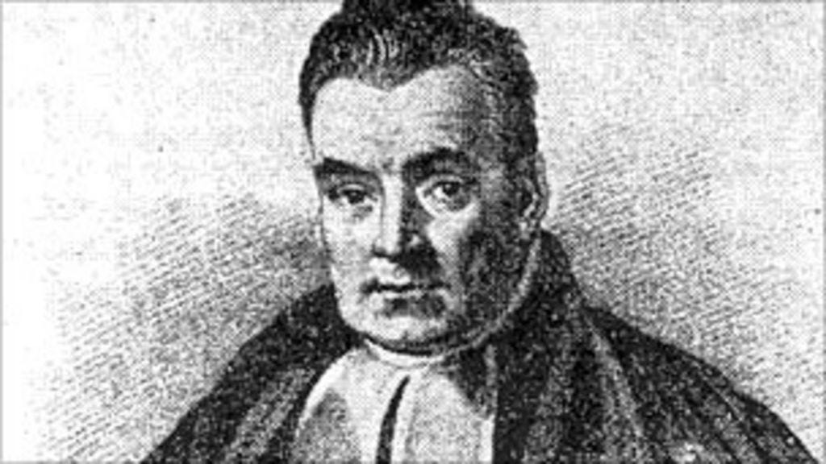
Thomas Bayes
Thomas Bayes (born 1702, London, England—died April 17, 1761, Tunbridge Wells, Kent) was an English Nonconformist theologian and mathematician who was the first to use probability inductively and who established a mathematical basis for probability inference (a means of calculating, from the frequency with which an event has occurred in prior trials, the probability that it will occur in future trials).

Slide 3
Bayes’ Theorem
Where:
P(A∣B) = Probability of A given B (posterior) –Posterior means later in time : subsequent
P(B∣A) = Probability of B given A (likelihood)
P(A) = Initial probability of A (prior)
P(B) = Probability of B overall (evidence)

Slide 4
Bayes’ Theorem in simple terms
Bayes’ Theorem is a way of updating what we believe when we get new information.
It helps us answer questions like:
“How likely is this to be true, now that I’ve seen some evidence?”
You start with what you already know (prior) (P(A) = Initial probability of A), and
you update it using the new data (called the likelihood) (P(B∣A) = Probability of B given A )
to get a new probability (called the posterior) (P(A∣B) = Probability of A given B )
New belief = (How likely the evidence is if it’s true) × (How much you believed it was true before) ÷ (How likely the evidence is overall)

Slide 5
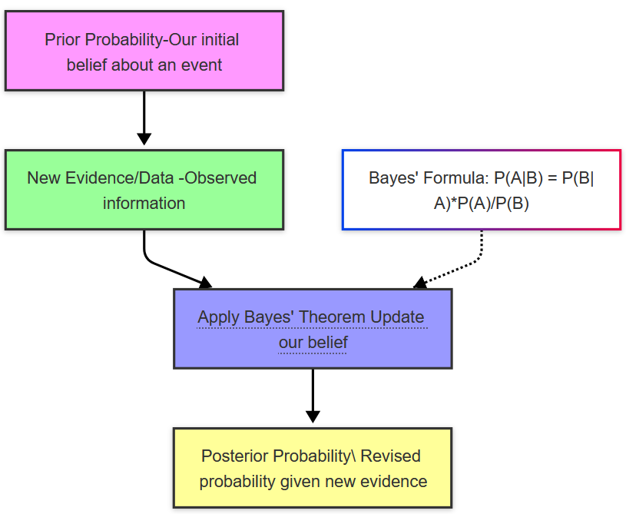
Bayes’ Theorem in simple terms
Everyday Example
Imagine you know:
10% of emails are spam (prior) P(A)=10%
The word "free" appears in 70% of spam emails (likelihood) P(B∣A)
You see an email with the word "free"
— Bayes’ Theorem helps you update the chance that this specific email is spam (posterior) P(A∣B)
It’s like saying: "Now that I’ve seen this clue (word "free"), how does that change my mind regarding the probability this email being spam?"

Slide 6
Bayes’ Theorem in simple terms
P(Spam) — prior probability of spam: 20/50=0.4
P(free | Spam) — probability of word "free" appearing in spam emails: 18/20=0.9
P(free) — probability that any email contains word "free": 29/50=0.58
P(Spam∣free)=(0.9*0.4)/0.58=0.62
There is a 62% chance that an email is spam, given that it contains the word “free.”
Given Information from 50 emails
Count | Value
Emails that are Spam | 20
Emails that are not Not Spam | 30
Spam emails that contain word "free" | 18
Not Spam emails that contain "free" | 11
Emails (total) that contain word "free" | 29

