Slide 1
Understanding K-Means Clustering for Text Documents Grouping Similar Documents Based on TF-IDF word scores
Stats II- Andreas kollias

Slide 2
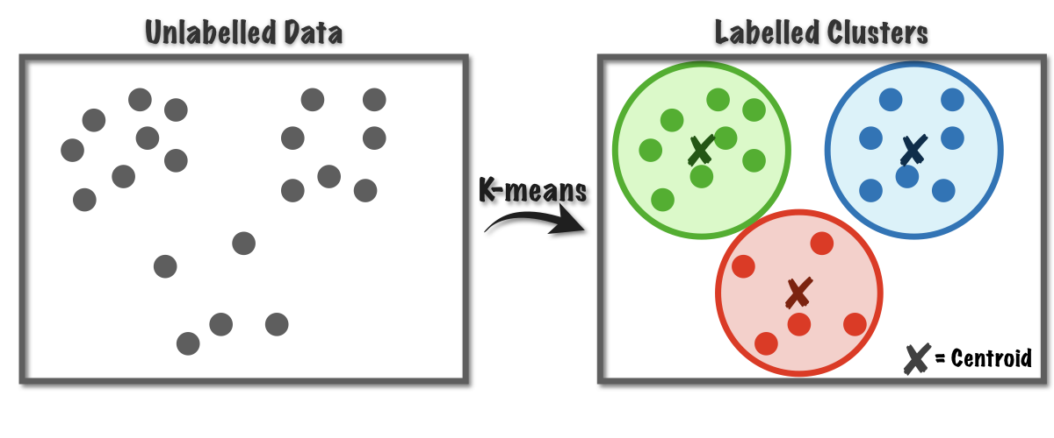
What is K-Means Clustering?
Unsupervised learning algorithm for grouping similar data points.
Unsupervised learning in artificial intelligence is a type of machine learning that learns from data without human supervision.
Unlike supervised learning, unsupervised machine learning models are given unlabeled data and allowed to discover patterns and insights without any explicit guidance or instruction.
Partitions data into k clusters, where each data point belongs to the nearest cluster center.
Works well for numerical data, including text represented as vectors (TF-IDF).
Key idea:
Documents with similar key terms (high TF-IDF scores)
should belong to the same cluster.

Slide 3
Text document pre-processing and TF-IDF word scores

Slide 4
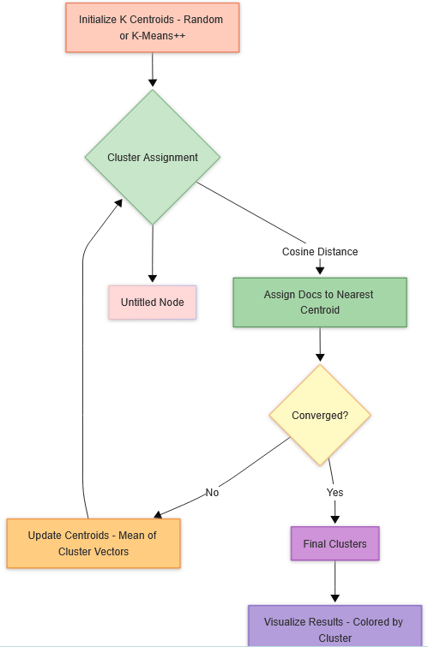
How K-Means Works (Step-by-Step)
Choose K (number of clusters).
Initialize centroids (randomly or using smart selection).
Assign documents to the nearest centroid (using distance metric).
Recalculate centroids (mean of all documents in the cluster).
Repeat until centroids stabilize (convergence).
Visualization:
Before clustering → after clustering (grouped documents).

Slide 5
What is a Centroid in K-Means Clustering?
A centroid is the central point of a cluster in k-means. It represents the average position of all data points (documents) in that cluster.
Key Properties of a Centroid
Mathematical Mean
Calculated as the average of all vectors in the cluster.
For text data (tf-idf vectors), it’s the average of word weights.
Dynamic Position
Changes as documents are reassigned during clustering.
Stabilizes when the algorithm converges.
Virtual Point
May not match any real document.

Slide 6
How Centroids Work in K-Means
Initialization
Randomly pick K documents as starting centroids (or use smarter methods like k-means++).
Assignment Step
Each document is assigned to the nearest centroid (using distance metrics like cosine similarity).
Update Step
Centroids are recalculated as the mean of all documents in their cluster.
Convergence
Stops when centroids no longer move significantly (or after max iterations).

Slide 7
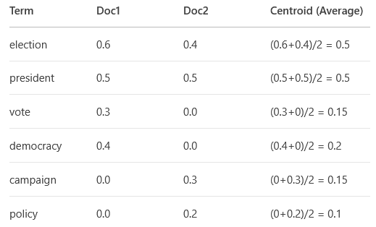
Example with Text Data
TF-IDF Values
Each centroid is the average TF-IDF weight of that word across all documents in the cluster.
Calculated as:
Cluster 1 (Politics):
Doc1: "election vote democracy president"
Doc2: "election campaign policy president“
Interpretation
"election": 0.5 → The word "election" has an average importance of 0.5 in this cluster.
Higher values (e.g., 0.5 for "election") reveal the core theme of the cluster.
Centroid magnitude

Slide 8
How These Numbers Are Used?
New documents containing “election” or “president” will be strongly pulled into this cluster.
Documents with only “vote” or “policy” might belong to other clusters.

Slide 9
Iterative K-Means Assignment with the Corrected Centroid
Current Cluster State:
Centroid: {"election":0.5, "president":0.5, "vote":0.15, "democracy":0.2, "campaign":0.15, "policy":0.1}
Documents:
Doc1: {"election":0.6, "vote":0.3, "democracy":0.4, "president":0.5}
Doc2: {"election":0.4, "president":0.5, "campaign":0.3, "policy":0.2}

Slide 10
Step 1: Assigning a New Document
New Document: {"election":0.7, "president":0.6} (Headline: "Election Update: President Leads Polls")
Calculate Cosine Similarity:
Dot product with centroid: (0.7*0.5 + 0.6*0.5) = 0.35 + 0.30 = 0.65
New doc magnitude: sqrt(0.7² + 0.6²) = sqrt(0.49 + 0.36) ≈ 0.92
Centroid magnitude: sqrt(0.5² + 0.5² + 0.15² + ...) ≈ 0.74 (simplified)
Cosine similarity: 0.65 / (0.92 * 0.74) ≈ 0.95 → Very high!
Result:
Assigned to this cluster (high similarity with centroid).
Measures alignment between the document and centroid.
Higher values = stronger match.
Represents the "length" of the document’s TF-IDF vector.
Normalizes the dot product to account for document size.

