Slide 1
Hierarchical Clustering of Texts: Concepts and Applications
Stats II- Andreas kollias

Slide 2
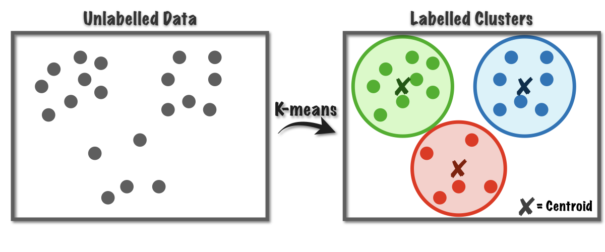
What is Hierarchical Clustering
Understand the logic behind hierarchical clustering.
Learn how it applies to text data (e.g., Documents, articles).
Visualize clusters using dendrograms.
Compare hierarchical clustering to other methods (e.g., K-means).
Walk through a simple example.

Slide 3
What Is Hierarchical Clustering?
Definition: A method of cluster analysis which seeks to build a hierarchy of clusters.
Two types:
Agglomerative (bottom-up): Start with each document as its own cluster, then merge.
Divisive (top-down): Start with one cluster and split recursively.
Output: A dendrogram—a tree-like structure showing cluster merges.

Slide 4
Why Use It for Texts?
Texts (documents) can be represented as high-dimensional vectors.
Useful for:
Grouping similar documents/articles.
Identifying thematic structures.
Creating taxonomies or document maps.
Doesn’t require you to predefine the number of clusters (unlike k-means).

Slide 5
Text Preprocessing Steps
Tokenization (split text into words)
Stopword removal (e.g., "and", "the", "is")
Stemming or lemmatization (optional)
TF-IDF vectorization
Converts text into numerical vectors based on term frequency.

Slide 6
Representing Texts as Vectors
Example Document: “Cats chase mice”
Vocabulary: [cats, chase, dogs, mice]
TF-IDF Vector for Doc 1: [0.8, 0.9, 0.0, 1.0]
Each document becomes a point in a high-dimensional space.

Slide 7
Measuring Similarity
Cosine similarity is commonly used for text:
Cosine distance = 1 - similarity

Slide 8
Linkage Criteria
How to measure the distance between clusters?
Single Linkage: Closest points between clusters
Complete Linkage: Farthest points
Average Linkage (UPGMA): Average distance
Centroid Linkage: Distance between cluster centroids

Slide 9
Agglomerative Clustering Steps
Compute distance matrix for all documents.
Find the pair with the smallest distance.
Merge them into a new cluster.
Update the distance matrix using the chosen linkage.
Repeat until all items are in a single cluster.

Slide 10
Dendrogram
A visual representation of the clustering process.
Vertical axis = distance at which clusters were merged.
You can “cut” the dendrogram at any height to define cluster groups.

Slide 11
Advantages vs. Disadvantages
Advantages:
No need to predefine cluster count
Produces interpretable tree structure
Good for visual exploration
Disadvantages:
Computationally expensive for large datasets
Sensitive to noise and outliers
Cannot fix earlier merge decisions

