Slide 1
A blueprint for assessing the EU's regional transition to bioeconomy
Dr. Panos Kalimeris

Slide 2
Horizon Bio2Reg Consortium
WP1 Assessing regional potential towards circular and systemic bioeconomy model region transition

Slide 3
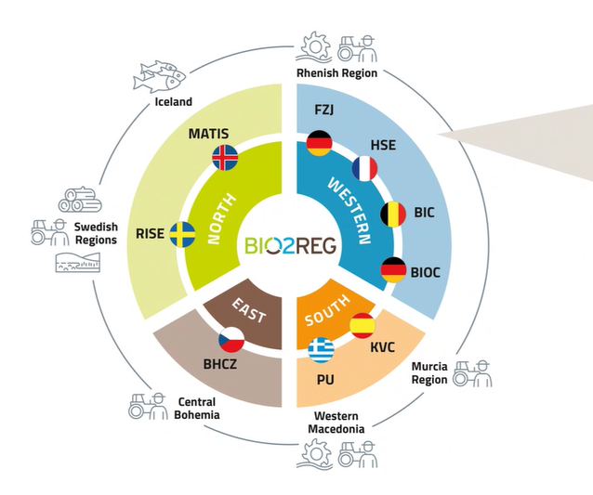
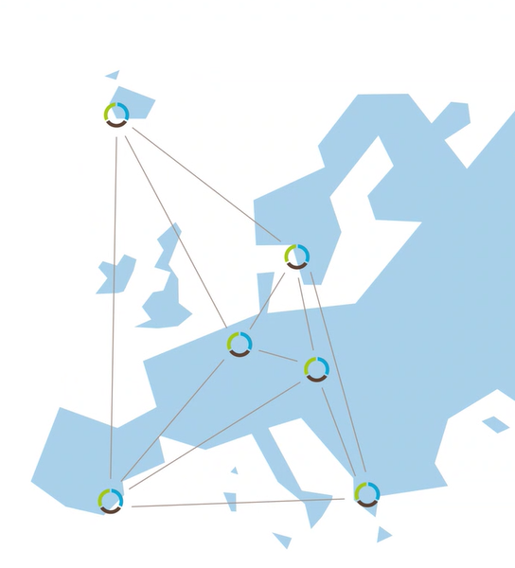
Horizon Bio2Reg Consortium

Slide 4
EU Bioeconomy Strategy & recent developments
Source: https://unece.org/sites/default/files/2024-03/S2d_2_The%20sustainable%20and%20circular%20bioeconomy%20in%20the%20EU.pdf

Slide 5
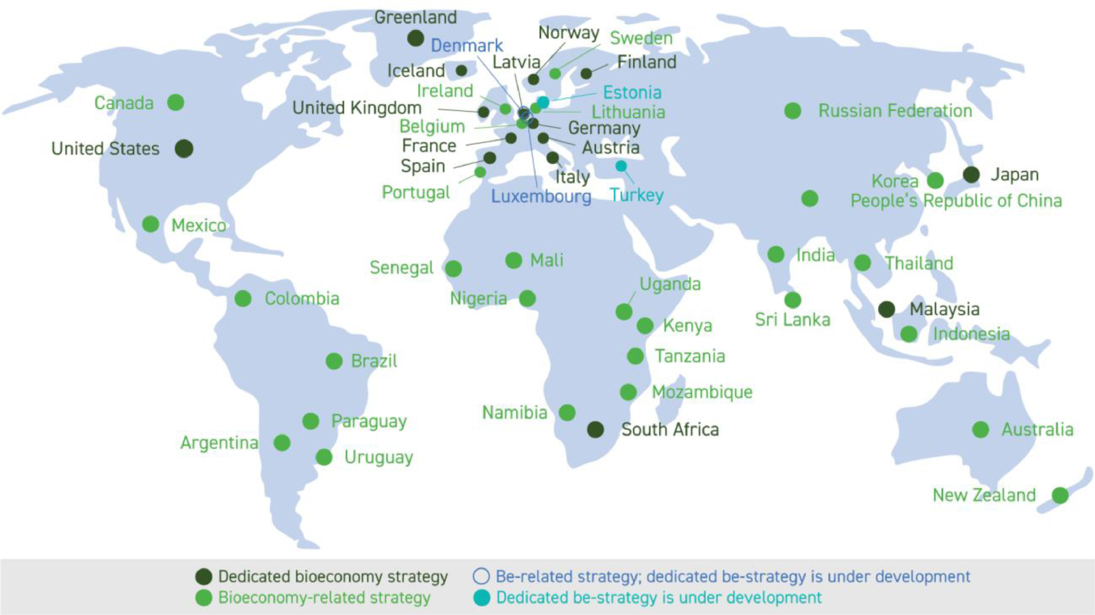
Global Bioeconomy Strategies overview
OECD (2018). Meeting policy challenges for a sustainable bioeconomy. OECD Publishing, Paris. ISBN 978–92–64–29,233–8. Source: https://www.oecd.org/publications/policy-challenges-facing-a-sustainable-bioeconomy-9789264292345-en.htm

Slide 6
Assessing regional potential towards circular and systemic bioeconomy model region transition
The review process – The Steps I
Academic-Scientific Literature e.g. published studies in peer reviewed scientific journals.
Reports, working papers and studies by international organizations, institutions (e.g. World Bank, OECD, FAO, UNEP, etc.) and potential national guidelines and strategies from non-EU countries (e.g. USA, Australia, Canada, etc.)
1st Milestone
Guidelines, reports, working papers and frameworks published by EU and relevant organizations (e.g. JRC, EU and EP publications, other official EU research entities) & EU countries national strategies
4. Relevant EU funded projects and grands on bioeconomy of the last decade (e.g. HORIZON 2020, FP7, LIFE+, Interreg, etc.)
+ input provided by Tasks 1.1 & 1.4

Slide 7
Assessing regional potential towards circular and systemic bioeconomy model region transition
The guidelines
Criteria to select suitable bio-indicators:
Meaningful and clear meaning indicators.
Well-established and already used in other policy frameworks.
Based on timely and frequently collected data
Geographical coverage (EU-regional level in our case – Focus explicitly on NUTS II level!)
Comparable across countries and/or products or sectors
Comparable over time
The data should be openly available (accessible) and clearly documented (transparent)

Slide 8
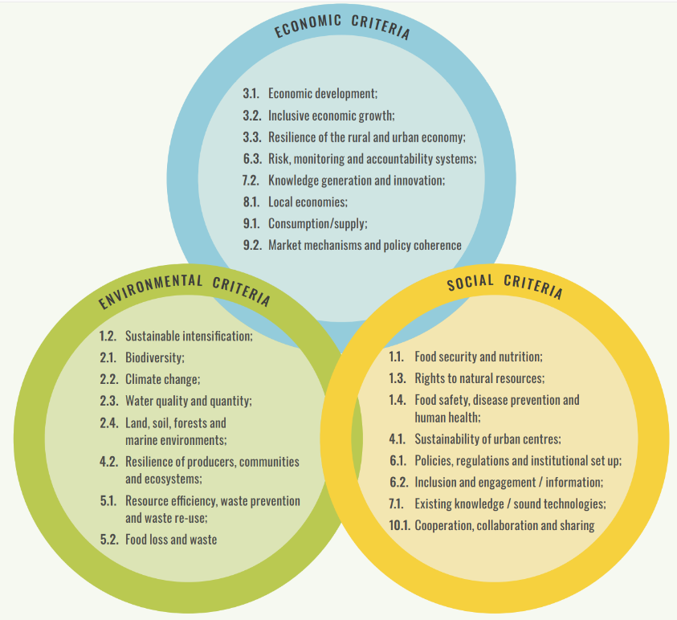
Assessing regional potential towards circular and systemic bioeconomy model region transition
The steps II
Define the borders of the System (EU-Regional Level NUTS II)
Specify criteria to select Indicators! (Both Quantitative & Qualitative)
3 sustainability pillars (FAO)
Prepare a methodology to rank indicators accordingly e.g. TOPSIS method
Further discussion
Regional focus but also a sectoral focus should be introduced
Measuring the bioeconomy in the EU: Closing data gaps is key element to achieve regional bioeconomy. potential (grey?) indicators

Slide 9
Assessing regional potential towards circular and systemic bioeconomy model region transition
The “killing process” | The “traffic light” method
Proposed Indicator | Typology | Type of indicator | Source | EU Regional Availability (Traffic Light Assessment) | Source
A. Economy
e.g., turnover | In thousand €/ year | Quantitative |  | Existing in all EU regions | EU Eurostat
B. Society |  | Qualitative
e.g., employment | In FTEs |  |  | Not available data in All EU-regions
C. Environment |  | Descriptive
e.g., biomass production | In kg/hectare |  | A | Available in some EU regions
e.g., biomass production | In kg/ year |  | B | Grey (potential) indicators

Slide 10
Assessing regional potential towards circular and systemic bioeconomy model region transition
The “killing process” in practice

Slide 11
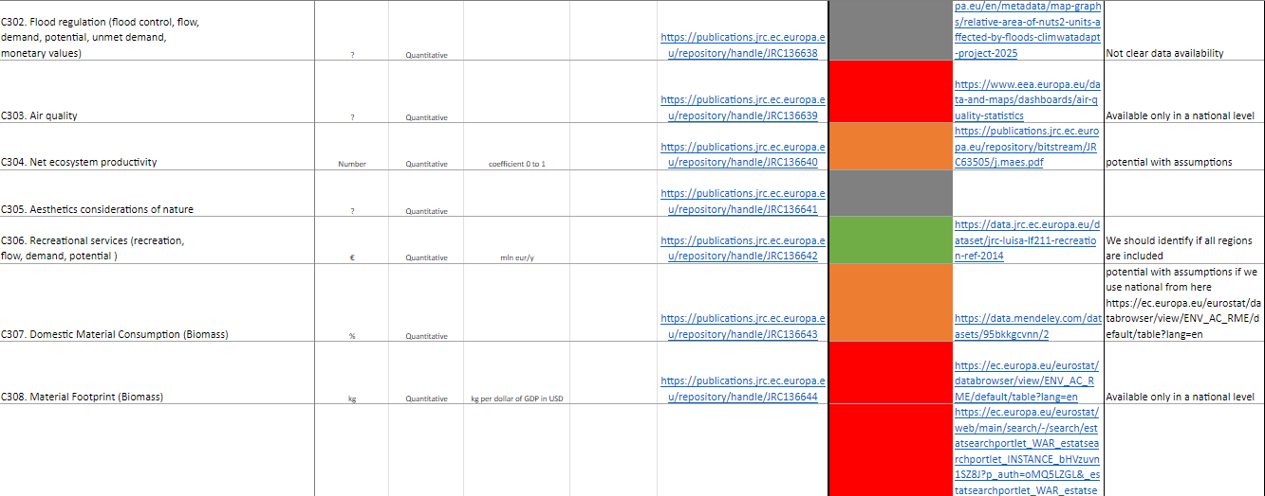
Assessing regional potential towards circular and systemic bioeconomy model region transition
The “killing process” in practice

Slide 12
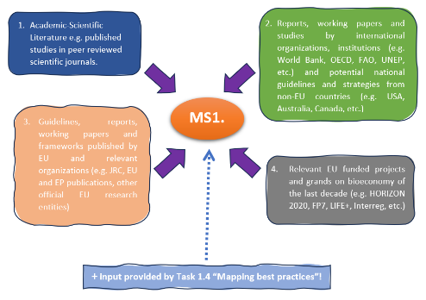
Assessing regional potential towards circular and systemic bioeconomy model region transition
The steps III
General Guidelines & Criteria forming the selection of regional bioeconomy indicators
Final group of Regional bioeconomy indicators
Current State of bioeconomy in EU-regions
Ranking Regions
+ potential input/feedback by Task 1.1 &Task 1.4 & Workshops

Slide 13
Assessing regional potential towards circular and systemic bioeconomy model region transition
The main outcome
Rejected – Data only for national level
No data available | Only assumptions/modelling
Available data for Nuts II
Potential some EU Nuts II regions
Greece
Germany
Sweden
Belgium
France
Spain
Czech Republic
Iceland
Final Ranking/Comparison
Final group of indicators for Nuts II

Slide 14
Assessing regional potential towards circular and systemic bioeconomy model region transition
Plus some qualitative on/off criteria, e.g. :
Is there a published National Bioeconomy Strategy (Yes/No)
Is there a regional Bioeconomy Strategy? (Yes/No)
The main outcome

Slide 15
TOPSIS Methodology and ranking EU regions
The Technique for Order of Preference by Similarity to Ideal Solution (TOPSIS) Multi-Criteria Decision Making (MCDM)
1. The base scenario. Initial equally weights ranking by using TOPSIS. This is the case where all criteria-indicators are equally contributing to the final ranking of all regions. The results of the base scenario are compared with the results of the second step.
2. The weights’ ranking scenario. The second step is the modified TOPSIS ranking, based on the estimated weights, resulting by dataset itself, by using the Shannon entropy weight method. The results of the modified weighted TOPSIS are expected to be more robust and substantial by the results of the initial TOPSIS ranking.

Slide 16
TOPSIS Methodology and ranking EU regions | Economy & Innovation Indicators group
Ranking | Weight ranking (modified TOPSIS) |  | Base scenario (equal weights)
 | Region | Score | Region | Score
1 | ES11-Galicia | 0,465 | FR10-Ile-de-France | 0,514
2 | FR10-Ile-de-France | 0,458 | ES51-Cataluña | 0,367
3 | DEB2-Trier | 0,369 | ES11-Galicia | 0,360
4 | FRH0-Bretagne | 0,316 | ES61-Andalucía | 0,352
5 | ES51-Cataluña | 0,305 | DEB2-Trier | 0,289
6 | ES61-Andalucía | 0,274 | FRH0-Bretagne | 0,270
7 | ES52-Comunitat Valenciana | 0,216 | ES52-Comunitat Valenciana | 0,267
8 | DE60-Hamburg | 0,198 | SE31-Norra Mellansverige | 0,263
9 | SE31-Norra Mellansverige | 0,196 | FRK2-Rhône-Alpes | 0,262
10 | FRK2-Rhône-Alpes | 0,189 | DE60-Hamburg | 0,260

Slide 17
TOPSIS Methodology and ranking EU regions | Society Indicators group
Ranking | Weight ranking (modified TOPSIS) |  | Base scenario (equal weights)
 | Region | Score | Region | Score
1 | FR10-Ile-de-France | 0,947 | FR10-Ile-de-France | 0,896
2 | ES61-Andalucía | 0,697 | ES51-Cataluña | 0,662
3 | ES51-Cataluña | 0,653 | ES61-Andalucía | 0,647
4 | ES30-Comunidad de Madrid | 0,580 | ES30-Comunidad de Madrid | 0,612
5 | FRK2-Rhône-Alpes | 0,539 | FRK2-Rhône-Alpes | 0,592
6 | ES52-Comunitat Valenciana | 0,438 | FRL0-Provence-Alpes-Côte d’Azur | 0,502
7 | DEA1-Düsseldorf | 0,434 | DEA1-Düsseldorf | 0,495
8 | FRL0-Provence-Alpes-Côte d’Azur | 0,414 | DE21-Oberbayern | 0,490
9 | DE21-Oberbayern | 0,414 | ES52-Comunitat Valenciana | 0,480
10 | DEA2-Köln | 0,385 | FRG0-Pays de la Loire | 0,463

Slide 18
TOPSIS Methodology and ranking EU regions | Environment Indicators group
Ranking | Weight ranking (modified TOPSIS) |  | Base scenario (equal weights)
 | Region | Score | Region | Score
1 | ES42-Castilla-La Mancha | 0,504 | ES42-Castilla-La Mancha | 0,480
2 | ES24-Aragón | 0,451 | ES24-Aragón | 0,438
3 | ES61-Andalucía | 0,415 | ES62-Región de Murcia | 0,425
4 | ES41-Castilla y León | 0,386 | ES61-Andalucía | 0,410
5 | SE33-Övre Norrland | 0,357 | ES41-Castilla y León | 0,381
6 | ES62-Región de Murcia | 0,334 | ES43-Extremadura | 0,345
7 | ES43-Extremadura | 0,328 | FRD1-Basse-Normandie | 0,317
8 | IS00-Iceland | 0,324 | FRG0-Pays de la Loire | 0,312
9 | SE32-Mellersta Norrland | 0,294 | FRH0-Bretagne | 0,312
10 | FRD1-Basse-Normandie | 0,287 | SE23-Västsverige | 0,289

Slide 19
TOPSIS Methodology and ranking EU regions | Bioeconomy per sector
(A01) Agricultural sector
Ranking | Weight ranking (modified TOPSIS) |  | Base scenario (equal weights)
 | Region | Score | Region | Score
1 | ES61-Andalucía | 1,000 | ES61-Andalucía | 1,000
(A02) Forestry sector
1 | DE60-Hamburg | 0,804 | DE60-Hamburg | 0,829
(A03) Fishing & aquaculture sector
1 | ES11-Galicia | 0,813 | ES11-Galicia | 0,820
(C10-C12) Food, beverage, and tobacco sector &
(C13-C15) Bio-based textiles sector
1 | FR10-Ile-de-France | 1,000 | FR10-Ile-de-France | 1,000

Slide 20
Assessing regional potential towards circular and systemic bioeconomy model region transition
The steps IV
Strong Bioeconomy Transition
Final Ranking / Comparison
Regional Guide to Bioeconomy in mid-2025
Investigate the potential transition paths of GHG and other EU-regions towards the base model(s) regions, through different scenarios
Moderate Bioeconomy Transition
Soft/Weak Bioeconomy Transition

Slide 21
Assessing regional potential towards circular and systemic bioeconomy model region transition
Conclusions
Extensive literature review (More than 100 studies, reports and working papers)
General and specific guidelines
Using the traffic light assessment, the final selection of bio-indicators
More indicators than expected were found (≈ 800 Indicators!) and the final list narrowed down to 40 essential indicators for the regional NUTS II Level + some extra qualitative ones
EU-wide regional assessment focusing on the 8 countries of the project
MCA Assessment and ranking of NUTS II Regions - various MCA methods will be tested
Potential “champions” and “bioeconomy model regions” revealed

Slide 22
A blueprint for assessing the EU's regional transition to bioeconomy
Thank you for your Attention!
Next week’s assignment:
https://datam.jrc.ec.europa.eu/datam/mashup/BIOECONOMICS/index.html
p.kalimeris@panteion.gr
https://bio2reg.eu/

