Slide 1
HISTORY WORKSHOP ___RAPHAEL SAMUEL ___ORAL HISTORY Προφορική Ιστορία

Slide 2
HISTORY WORKSHOP ___RAPHAEL SAMUEL ___ORAL HISTORY
‘if history was thought of as an activity rather than a profession,
then the number of its practitioners would be legion’.
Raphael Samuel
History Workshop ➔ «περιοδικό σοσιαλιστών ιστορικών» / παράδοση Thompson/93 ____1976 – 1995
1982 ➔ « περιοδικό σοσιαλιστών και φεμινιστριών »
«ΕΡΓΑΣΤΗΡΙ» ➔ ενδιαφέρον για Εργασία [Craft] ➔ ΚΕΝΤΡΟ = RUSKIN COLLEGE
ΣΥΝΕΡΓΑΣΙΑ ΙΣΤΟΡΙΚΩΝ ΚΑΙ ΙΣΤΟΡΙΚΟΙ ΑΠΟ ΤΟΥΣ ΧΩΡΟΥΣ ΔΟΥΛΕΙΑΣ
Ομάδα Ιστορικών του Κομμουνιστικού Κόμματος
ΙΔΙΑΙΤΕΡΗ ΣΥΜΒΟΛΗ
➔ ΤΑ ΣΤΕΝΑ ΟΡΙΑ ΤΗΣ ΕΠΑΓΓΕΛΜΑΤΙΚΗΣ ΙΣΤΟΡΙΑΣ / ΑΚΑΔΗΜΑΪΚΗ ΕΛΙΤ
➔ ΕΥΡΥ ΔΗΜΟΣΙΟ ΑΚΡΟΑΤΗΡΙΟ
Notes:
IGGERS ➔ 122

Slide 3
ΕΠΑΓΓΕΛΜΑΤΙΣΜΟΣ ➔ ΟΔΗΓΕΙ ΣΕ ΚΑΤΑΚΕΡΜΑΤΙΣΜΟ
ΑΝΑΝΤΙΣΤΟΙΧΙΑ ΜΕ ΠΟΛΙΤΙΚΗ & ΚΟΙΝΩΝΙΑ
ΑΚΑΔΗΜΑΪΚΗ ΚΟΙΝΟΤΗΤΑ ➔ ΚΑΠΙΤΑΛΙΣΤΙΚΗ ΚΟΙΝΩΝΙΑ
Ruskin College, originally known as Ruskin Hall, Oxford, is an independent educational institution in Oxford, England.
It is named after the essayist and social critic John Ruskin (1819–1900) and specialises in providing educational opportunities for adults with few or no qualifications.
The college is an affiliate of the University of Oxford; this relationship allows students special privileges such as attending lectures and the use of most facilities.
Mission and purpose
The mission of the college has always been to provide educational opportunities to adults who are excluded and disadvantaged, and to transform the individuals concerned along with the communities, groups and societies from which they come
The mission statement is twofold:

Slide 4
ΣΚΟΠΟΣ
1 ➔that of giving individuals a second chance in education, continues to be achieved by admitting those with few or no formal qualifications to courses of study that can result in, or lead on to, university-level qualifications.
2 ➔ former students say about Ruskin is that it changed their lives ➔ studying in a setting with a strong sense of academic community ➔The college is also transformational because it sees education as a vehicle for progressive social change
Ruskin tends towards a curriculum that has high social relevance, students who want to make a difference in the world, and forms of academic scholarship and research that are engaged and applied.
Ruskin’s mission is also pursued by means of strong historical links, nationally and internationally, with the labour and trade union movement, other social movements and activism around social issues (e.g., anti-ageism), as well as with local communities, for example through the Social Work and Youth and Community work programmes.

Slide 5
Ruskin College – originally known as Ruskin Hall, Oxford
– was established in 1899 specifically to provide educational opportunities for working-class men, who were denied access to university.
It was deliberately placed in Oxford,
the city in which its young American founders, Charles A. Beard and Walter Vrooman, had studied,
because the city symbolised the educational privilege and standards to which ordinary people could never previously have aspired.
It was Walter Vrooman's then wife, Amne (later Amne Grafflin), who financially supported the foundation of the college
Ruskin College ➔ SYMBOL OF WORKER’S EDUCATION
AS a model for labour colleges around the world _
GANDHI made a point of visiting during a brief stay in Oxford in 1931
because he had been so inspired by the writings of John Ruskin on workers' education - just as the college founders had been.

Slide 6
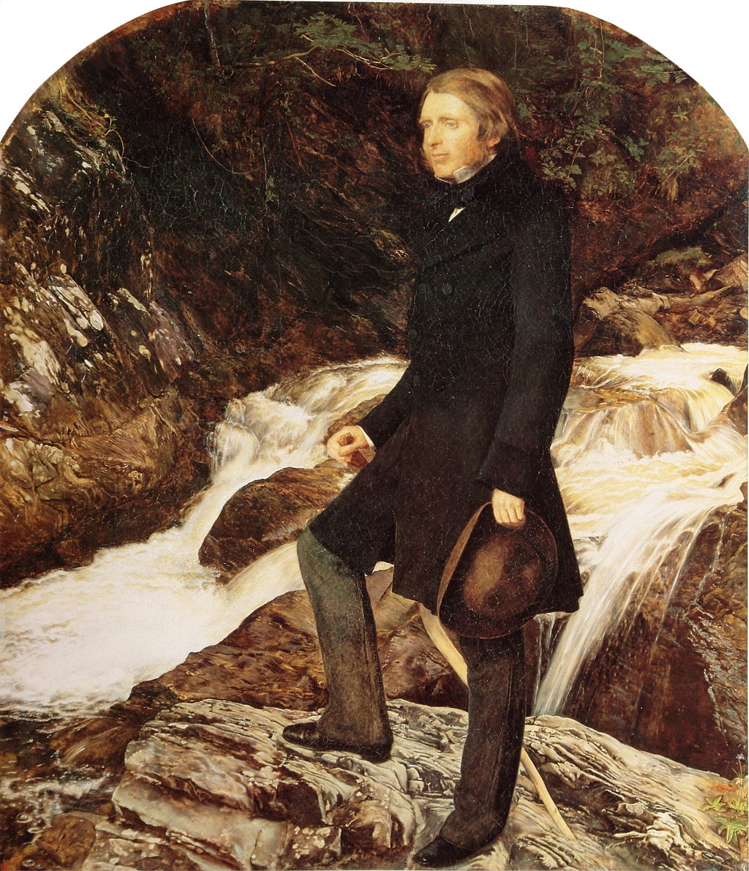
Praising Gothic ornament, Ruskin argued that it was an expression of the artisan's joy in free, creative work. The worker must be allowed to think and to express his own personality and ideas, ideally using his own hands, rather than machinery.
'We want one man to be always thinking, and another to be always working, and we call one a gentleman, and the other an operative;
whereas the workman ought often to be thinking, and the thinker often to be working, and both should be gentlemen, in the best sense.
As it is, we make both ungentle, the one envying, the other despising, his brother; and the mass of society is made up of morbid thinkers and miserable workers. Now it is only by labour that thought can be made healthy, and only by thought that labour can be made happy, and the two cannot be separated".
— John Ruskin, The Stones of Venice vol. II.
John Ruskin, 1819 - 1900
Notes:
John Ruskin painted by the Pre-Raphaelite artist John Everett Millais, 1853–54

Slide 7
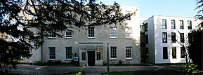
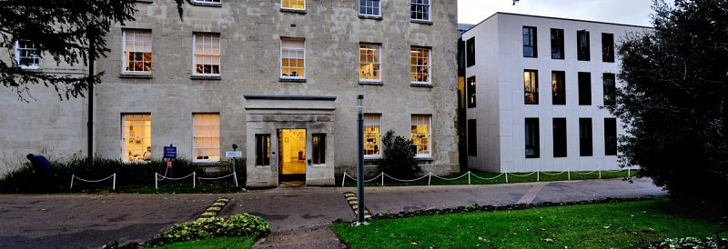
Ruskin's Rookery building which is now the Ruskin College Academic Building
MOTTO ➔ LEARNING TO MAKE A DIFFERENCE 1899

Slide 8
ΡΟΛΟΣ ΓΥΝΑΙΚΩΝ – ΙΣΤΟΡΙΑ ΓΥΝΑΙΚΩΝ
ΣΤΡΟΦΗ ΣΤΗΝ ΚΟΥΛΤΟΥΡΑ
ΕΙΧΕ ΜΙΑ ΑΝΤΙΛΗΨΗ ΠΕΡΙ «ΣΟΣΙΑΛΙΣΤΙΚΗΣ ΙΣΤΟΡΙΑΣ»
ΣΤΕΝΑ ΣΥΝΔΕΔΕΜΕΝΗΣ ΜΕ ΙΣΤΟΡΙΑ ΤΗΣ ΕΡΓΑΣΙΑΣ /ΚΑΠΙΤΑΛΙΣΜΟΣ
ΠΡΟΒΛ ➔ ΤΕΛΕΟΛΟΓΙΑ - ΣΤΑΔΙΑ ➔ ΦΕΟΥΔΑΡΧΙΑ =>> ➔ΣΟΣΙΑΛΙΣΜΟΣ
10 ΧΡΟΝΙΑ ΜΕΤΑ ➔ 1985 ➔ ΑΥΤΟΚΡΙΤΙΚΗ RAPHAEL SAMUEL
ΑΜΦΙΣΒΗΤΗΣΗ ταύτισης ΒΙΟΜΗΧΑΝΙΚΗΣ ΠΑΡΑΓΩΓΗΣ & ΚΑΠΙΤΑΛΙΣΜΟΥ
ΕΜΦΑΣΗ ΣΤΟΝ ΡΟΛΟ ΤΗΣ ΜΗ – ΒΙΟΜΗΧΑΝΙΚΗΣ ΕΡΓΑΣΙΑΣ / ΠΑΡΑΔΟΣΙΑΚΕΣ ΤΕΧΝΕΣ, 19ος
ΑΓΡΟΤΕΣ - ΓΕΩΡΓΙΑ
Notes:
IGGERS 123

Slide 9
ΑΜΦΙΣΒΗΤΗΣΗ ΤΕΛΕΟΛΟΓΙΑΣ
ΕΝΣΩΜΑΤΩΣΗ ΓΥΝΑΙΚΕΙΑΣ ΙΣΤΟΡΙΑΣ
ΑΝΑΓΝΩΡΙΣΗ ΣΧΕΣΕΩΝ ΕΞΟΥΣΙΑΣ ΕΥΡΥΤΕΡΑ – ΟΧΙ ΜΟΝΟ ΤΑΞΙΚΕΣ ΣΧΕΣΕΙΣ
ΜΕΤΑΤΟΠΙΣΗ Ενδιαφέροντος από Εργοστάσιο / βιομηχανία ➔ Ιδιωτική Σφαίρα
Βία και Ανδρική Ταυτότητα

Slide 10
ΓΛΩΣΣΙΚΗ ΣΤΡΟΦΗ
ΔΕΝ ΣΥΜΦΩΝΟΥΝ ότι
«ΔΕΝ ΥΠΑΡΧΕΙ ΕΞΩΤΕΡΙΚΗ ΠΡΑΓΜΑΤΙΚΟΤΗΤΑ ΣΤΗΝ ΟΠΟΙΑ ΝΑ ΑΝΑΦΕΡΕΤΑΙ Η ΓΛΩΣΣΑ»
ΩΣΤΟΣΟ
«Η ΓΛΩΣΣΑ ΤΟΥ ΣΟΣΙΑΛΙΣΜΟΥ … ΠΡΟΗΓΗΘΗΚΕ ΤΗΣ ΕΜΦΑΝΙΣΗΣ ΕΝΌΣ ΣΟΣΙΑΛΙΣΤΙΚΟΥ ΚΙΝΗΜΑΤΟΣ»
ΓΛΩΣΣΑ = ΑΡΕΝΑ ΤΑΞΙΚΗΣ ΠΑΛΗΣ
ΕΝΔΙΑΦΕΡΟΝ ΓΙΑ ΜΗ ΔΥΤΙΚΟ ΚΟΣΜΟ ➔ 1990 ➔ ΑΥΣΤΡΑΛΙΑ / ΙΘΑΓΕΝΕΙΣ * ΛΑΤΙΝΙΚΗ ΑΜΕΡΙΚΗ * ΑΦΡΙΚΗ

Slide 11
ΤΟ ΝΤΡΗΜ ΣΥΝΤΡΙΜ
Θατσερισμός & Κατάρρευση Σοβιετικής Ένωσης – δεκαετία 1980
«η ύπαρξη ενός εργατικού κινήματος ως ένα γεωλογικό δεδομένο του τοπίου (…) δεν μπορεί να θεωρείται πια ως δεδομένη».
1995 ➔ ΝΕΟΣ ΤΙΤΛΟΣ
ΑΦΑΙΡΕΣΑΝ ΑΘΟΡΥΒΑ το “περιοδικό σοσιαλιστών και φεμινιστριών ιστορικών»
Νέες προκλήσεις ➔ Περιβαντολλογικές, Εθνοτικές, Σεξουαλικές κλπ
Οι όροι – Σοσιαλιστής – Φεμινίστρια = ανεπαρκείς

Slide 12
ΑΠΟΤΙΜΗΣΗ
ΥΠΕΡΒΑΣΗ ΣΥΝΟΡΩΝ ΕΠΙΣΤΗΜΟΝΙΚΩΝ ΚΛΑΔΩΝ
Στενή συνεργασία μεταξύ Επαγγελματιών Ιστορικών Και εξω-πανεπιστημιακών
ΧΑΣΜΑ ΕΠΑΓΓΕΛΜΑΤΙΑ ΙΣΤΟΡΙΚΟΥ ΚΑΙ «ΜΗΤΣΟΥ /layman» ??
Τα κατάφεραν ??
Στα 1990/ς οι συνεργάτες του περιοδικού ανήκαν
είτε σε Πανεπιστήμια είτε σε Ερευνητικά Ιδρύματα
Συμβολή ➔ ένα είδος ιστορίας = κοντά στον «Μήτσο»
Λαϊκή Κουλτούρα – πολιτισμική κληρονομία – ιστορία του παρόντος
Notes:
IGGERS 125

