Slide 1
Jaccard similarity
Stats II- Andreas kollias

Slide 2
Jaccard similarity
Jaccard similarity is a common proximity measurement used to compute the similarity between two objects, such as two text documents.

Slide 3
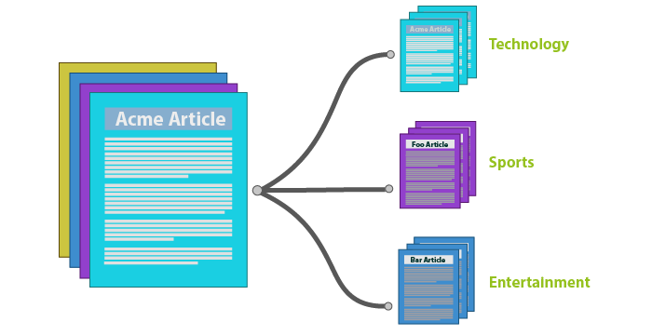
Common Applications of Jaccard Similarity
Document and text similarity
Example: Compare term-frequency vectors to identify documents that discuss similar topics or express similar sentiments.
These vectors may represent different themes (e.g., Economy vs. Healthcare) or tones (e.g., Critical vs. Supportive), enabling clustering or classification based on content or attitude.

Slide 4
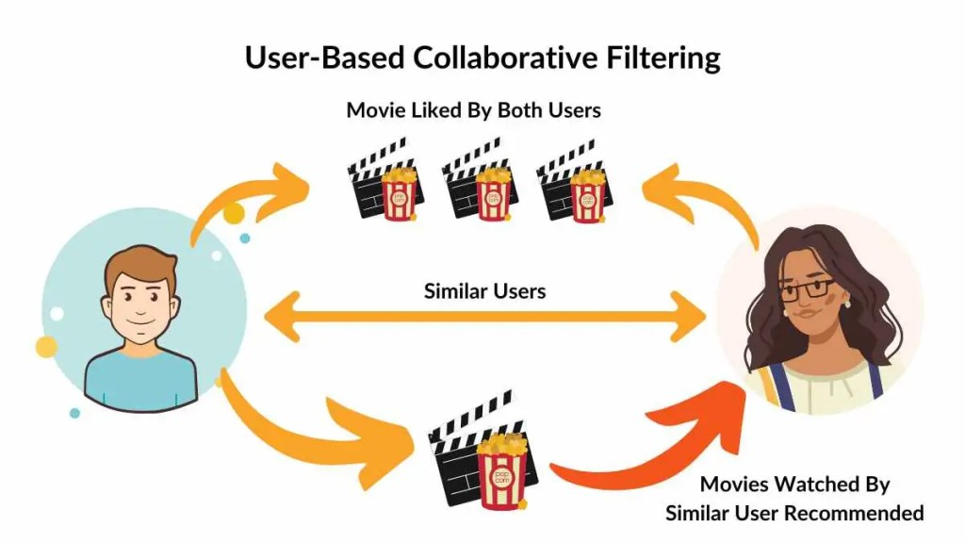
Common Applications of Jaccard Similarity
Recommender systems
Used to find similar users or items based on:
Items users interacted with
Tags or categories
Search behavior
Example: find users who liked a similar set of movies (collaborative filtering*).
*Collaborative filtering is an information retrieval method that recommends items to users based on how other users with similar preferences and behavior have interacted with that item.

Slide 5
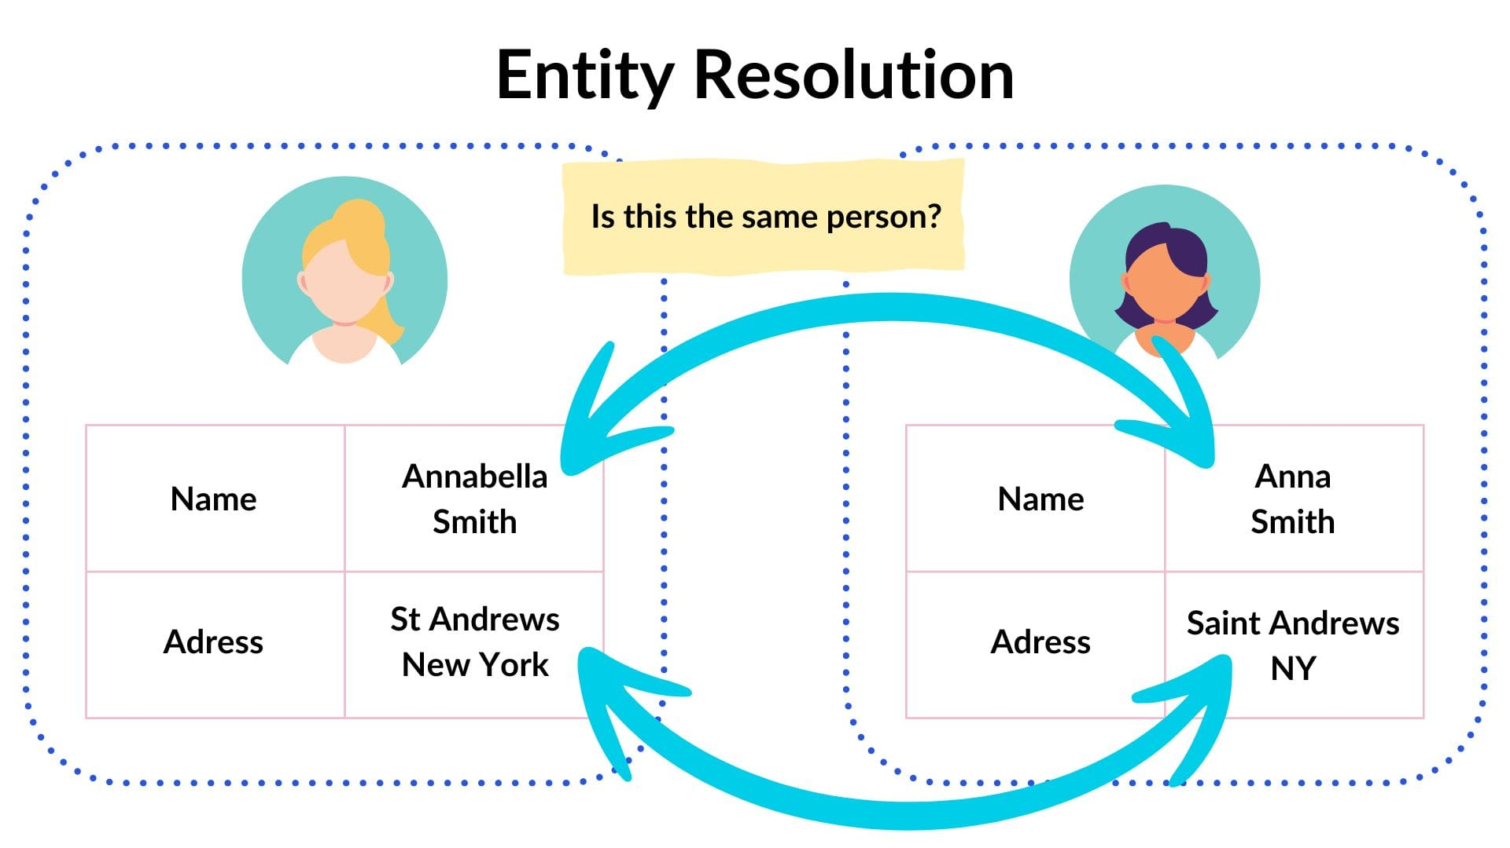
Common Applications of Jaccard Similarity
Entity resolution
Detect whether two profiles represent the same person (based on overlapping attributes like emails, names, or ips).
Example: compare two customer profiles based on shared attributes (email, phone, address).

Slide 6
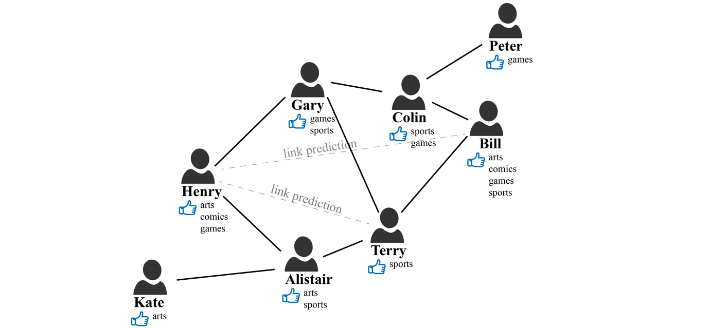
Common Applications of Jaccard Similarity
Social network analysis
Similarity between users based on:
Friends
Likes
Followed pages/groups
Example: find users with overlapping friend lists to recommend new connections.

Slide 7
Jaccard Similarity Index
The index ranges from 0 to 1. Range closer to 1 means more similarity in two sets of data.
Jaccard similarity =
(number of observations in both sets) / (number in either set)
J(A, B) = |A∩B| / |A∪B|

Slide 8
Jaccard Similarity Index
The jaccard similarity is traditionally defined for binary sets (e.g., Presence or absence of words), but it can be generalized to non-binary vectors (like term frequencies) using a min-max formulation.
Text info | DIPLOMACY | WAR | PEACE | ECONOMY
A. Veronika Melkozerova | I was defending the dignity of Ukraine: Zelenskyy addresses bust-up with Trump and Vance | 2025-03-24 | 4 | 3 | 2 | 0
B. Geoffrey Smith | Turkey scrambles to stop financial rout | 2025-03-24 | 0 | 1 | 1 | 8
C. Ketrin Jochecová | EU warns Turkey as Erdoğans repression intensifies | 2025-03-24 | 1 | 1 | 1 | 3

Slide 9
Generalized Jaccard Similarity for Term Frequency Vectors
The jaccard similarity is traditionally defined for binary sets (e.g., Presence or absence of words), but it can be generalized to non-binary vectors (like term frequencies) using a min-max formulation.
Text info | DIPLOMACY | WAR | PEACE | ECONOMY
A. Veronika Melkozerova | I was defending the dignity of Ukraine: Zelenskyy addresses bust-up with Trump and Vance | 2025-03-24 | 4 | 3 | 2 | 0
B. Geoffrey Smith | Turkey scrambles to stop financial rout | 2025-03-24 | 0 | 1 | 0 | 8
C. Ketrin Jochecová | EU warns Turkey as Erdoğans repression intensifies | 2025-03-24 | 1 | 1 | 1 | 3

Slide 10
Generalized Jaccard Similarity for Term Frequency Vectors
If you have two term frequency vectors:
Text info | DIPLOMACY | WAR | PEACE | ECONOMY
A. Veronika Melkozerova | I was defending the dignity of Ukraine: Zelenskyy addresses bust-up with Trump and Vance | 2025-03-24 | 4 | 3 | 2 | 0
B. Geoffrey Smith | Turkey scrambles to stop financial rout | 2025-03-24 | 0 | 1 | 0 | 8
C. Ketrin Jochecová | EU warns Turkey as Erdoğans repression intensifies | 2025-03-24 | 1 | 1 | 1 | 3
The generalized Jaccard similarity is:

Slide 11
Generalized Jaccard Similarity for Term Frequency Vectors
Text info | DIPLOMACY | WAR | PEACE | ECONOMY
A. Veronika Melkozerova | I was defending the dignity of Ukraine: Zelenskyy addresses bust-up with Trump and Vance | 2025-03-24 | 4 | 3 | 2 | 0
B. Geoffrey Smith | Turkey scrambles to stop financial rout | 2025-03-24 | 0 | 1 | 0 | 8
C. Ketrin Jochecová | EU warns Turkey as Erdoğans repression intensifies | 2025-03-24 | 1 | 1 | 1 | 3
Jaccard(A,B)=0+1+0+0/4+3+2+8=1/17=0.058824

