Slide 1
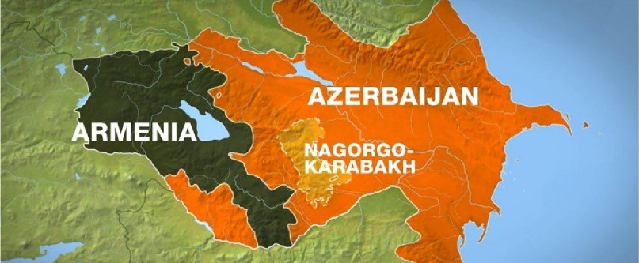
Introduction to Nagorno-Karabakh
Αριστείδης Στεργίου ΑΜ 11230130 Δημήτρης Μυρογιάννης ΑΜ 11230078 Κυριακή Σιαμά ΑΜ 11230153

Slide 2
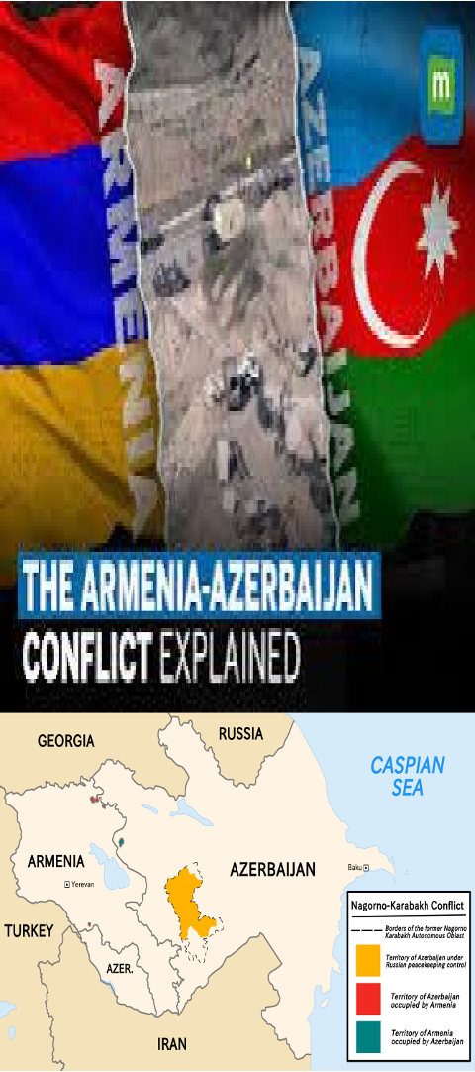
A Region of Geopolitical importance
Population:
Historically inhabited predominantly by Armenias with a significant Azeri minority
Geographical context:
Nagorno- Karabakh is a mountainous region in the South Caucasus, located between Armenia, Azerbaijan and Iran
Early Historical Background:
The region’s tensions trace back to the dissolution of the Russian Empire.

Slide 3
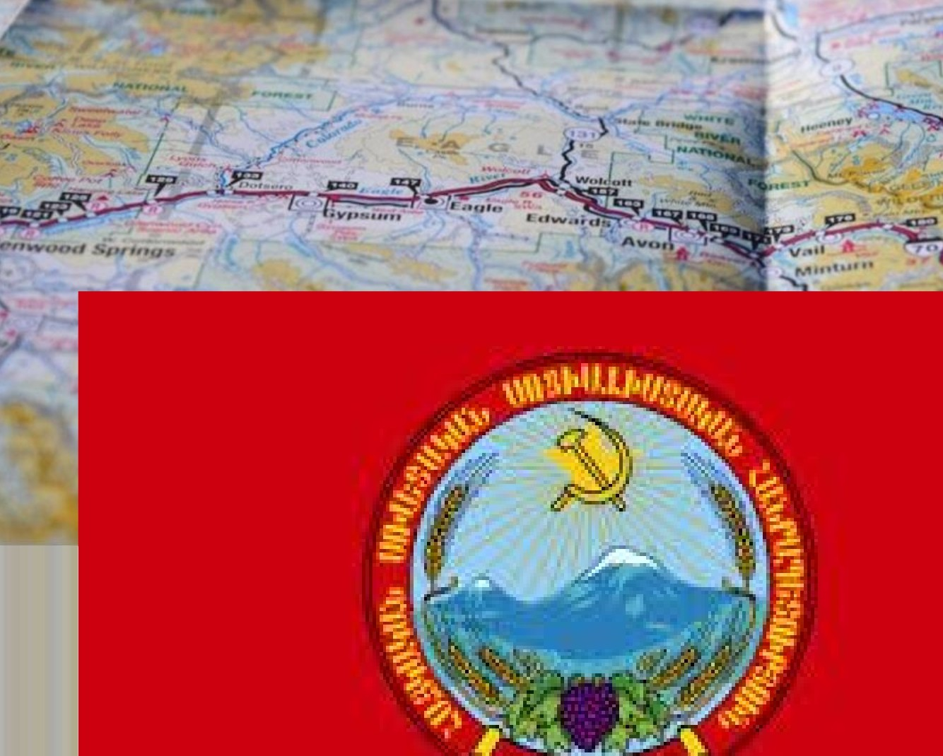
Soviet Era Developments
Nagorno-Karabakh Under Soviet Rule
Autonomous Oblast Formation:
The Soviets established the Nagorno-Karabakh Autonomous Oblast (NKAO) within Azerbaijan in the 1920s.
Armenian Grievances: Demanded integration with Armenia, citing cultural and administrative ties.
Perestroika and Glasnost: Gorbachev's policies reignited Armenian aspirations for unification.

Slide 4
Escalation of Conflict
Operation Ring Azerbaijani-Soviet operation
displaced thousands of Armenians in 1991.
Independence Declarations Both Armenia and Azerbaijan declared independence in 1991, escalating territorial disputes.
Foundation of Nagorno- Karabakh Republic In September 1991, Armenians declared Nagorno-Karabakh as a de facto independent state.
Path to the First Nagorno-Karabakh War

Slide 5
First Nagorno-Karabakh War
KEY EVENTS:
Armenian forces captured major areas; both sides committed atrocities
HUMAN TOLL:
40,000 killed, 70,000 injured, and over 1.1 million displaced
CEASEFIRE AGREEMENT:
The Bishkek Protocol ended active hostilities in 1994.
Conflict and Consequences (1992-1994)

Slide 6
THE 1994 CEASEFIRE AGREEMENT
Mediated by Russia
Territorial Outcomes:
Unresolved Issues
The agreement was brokered by Russia in May 1994, bringing an end to open hostilities between Armenia and Azerbaijan.
Armenian forces retained control over Nagorno- Karabakh and seven adjacent Azerbaijani territories.
The ceasefire failed to address the political status of Nagorno-Karabakh, leaving it a de facto Armenian- controlled region.
Fragility of the Agreement
Frequent ceasefire violations and sporadic clashes highlighted the lack of a robust enforcement mechanism.
ESTABLISHING A FRAGILE PEACE

Slide 7
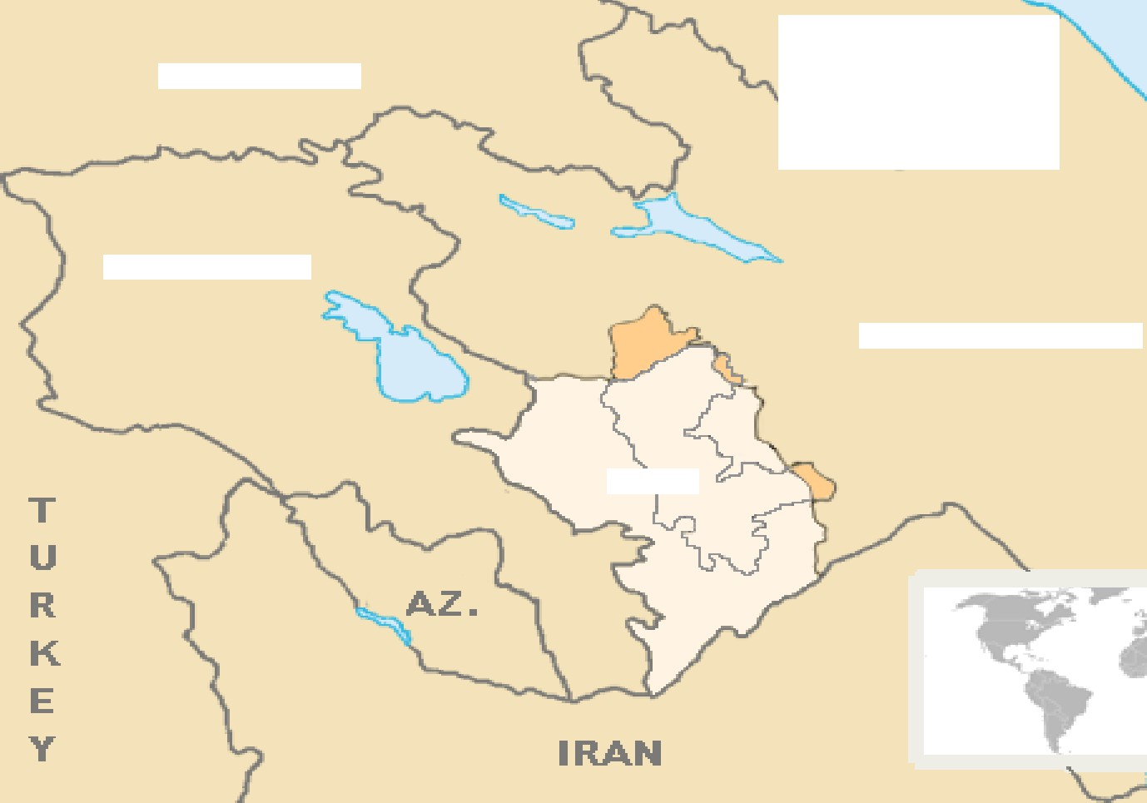
Aftermath and Peace Attempts
Bishkek Protocol: Ceasefire signed in 1994 but tensions remained high.
Georgia
Armenia
Refugee Crisis:
Over 400,000 Armenians and 724,000 Azeris displaced during and after the war.
Azerbaizan
N KR
Ongoing Disputes Nagarno-Karabakh remains
Internationally recognized as part
of Azerbaijan.

Slide 8
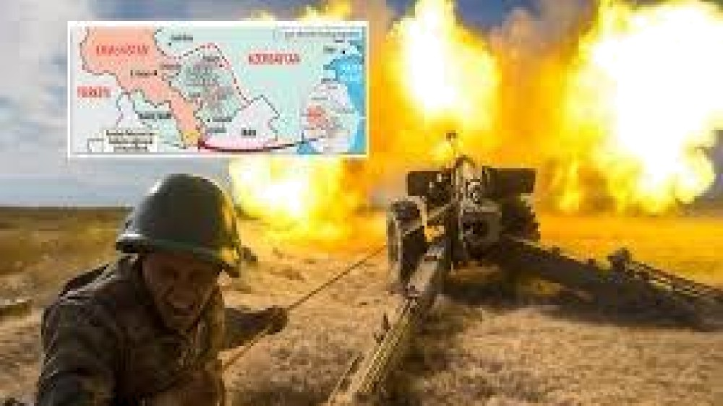
1994-2020: Sporadic Clashes
• Fragile Ceasefire: The 1994 ceasefire leftNagorno-Karabakh under de facto Armeniancontrol but internationally recognized asAzerbaijani territory.
• Diplomatic Deadlock: OSCE Minsk Group(France, Russia, US) failed to achieve lastingpeace despite numerous negotiations.
• Sporadic Clashes: Major escalations occurred in2008, 2016 (Four-Day War), and leading up to the 2020 conflict

Slide 9
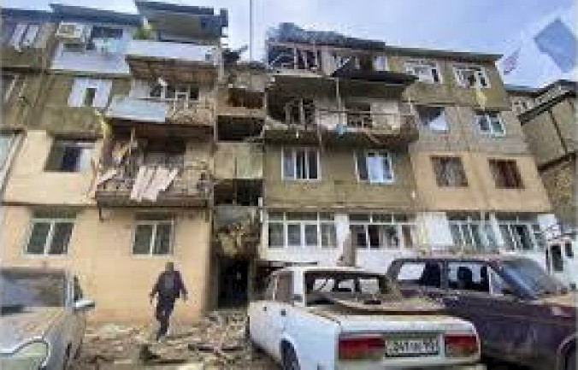
2008 Clash
Violence Escalation
Background
The clashes involved artillery and sniper fire, killing dozens of soldiers from both sides.
Impact on Peace Efforts
In 2008, tensions peaked as both sides engaged in deadly skirmishes along the line of contact.
The 2008 events further derailed peace talks, intensifying hostility and distrust

Slide 10
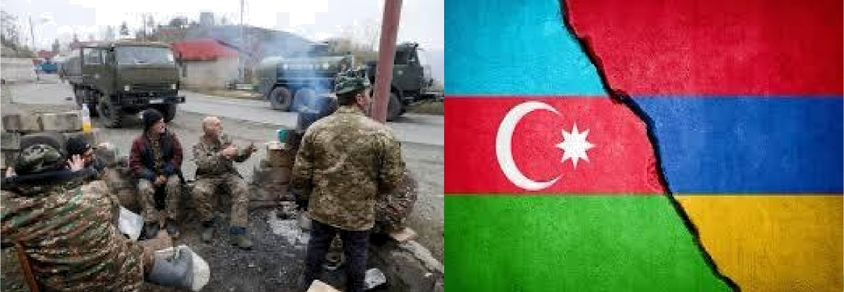
2016 Clash: The Four-Day War
Outbreak of Hostilities
In April 2016, a large-scale conflict erupted over four days, marking the most violent escalation since1994.
Military Actions
The fighting included heavy artillery, tanks, and aerial drones , with significant casualties on both sides.
Outcome
The conflict ended with a ceasefire but left tensions higher than ever, setting the stage for future confrontations

Slide 11
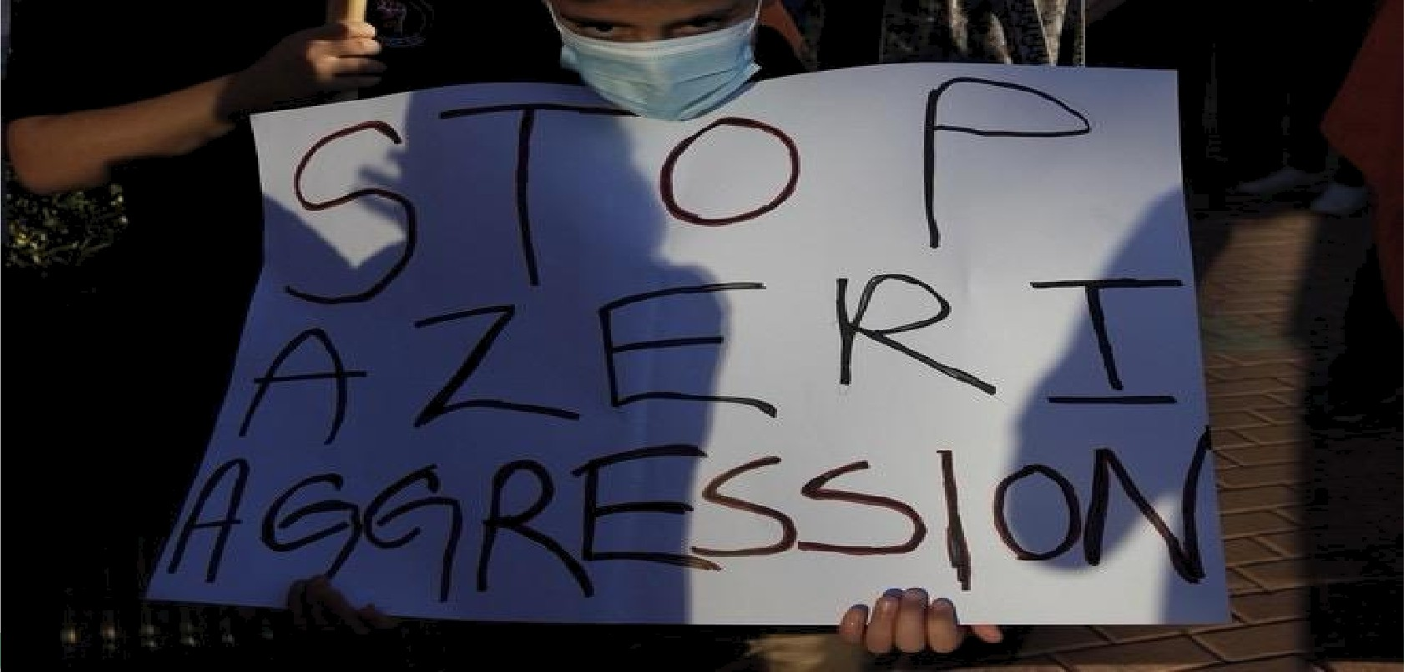
2020 War: The Largest Escalation
Azerbaijan's Offensive: The conflict reignited on September 27, 2020, with Azerbaijan launching a full- scale attack to regain control of Nagorno-Karabakh.
Technological Superiority: Turkish drones and advanced weaponry played a crucial role in Azerbaijan’s
= territorial gains.
The Peace Agreement: On November 9, 2020, a ceasefire brokered by Russia ended hostilities, solidifying Azerbaijan's military victories.
A Turning Point in the Nagorno-Karabakh Conflict

Slide 12
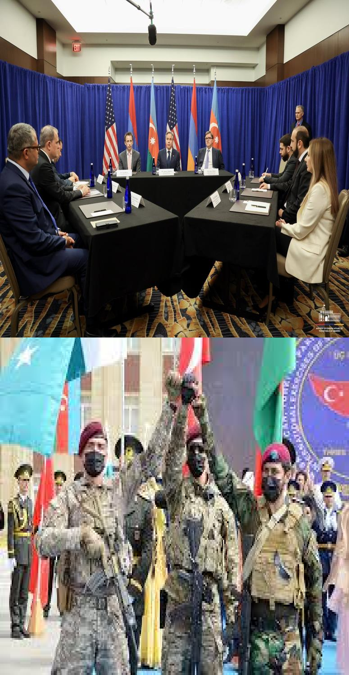
Regional Instability and International Relations
Roles of Russia, Turkey, EU, and USA
Russia, a traditional ally of Armenia, maintains peacekeeping forces inNagorno-Karabakh but faces challenges to its influence.
Turkey has provided significant military and political backing to Azerbaijan, reshaping the regional balance of power.
The EU and the USA call for peaceful solutions, offer humanitarian aid, and facilitate dialogue between Armenia and Azerbaijan
Russia's Role
Turkey's Support for Azerbaijan
Western Diplomacy

Slide 13
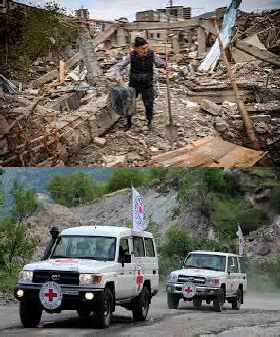
Humanitarian Consequences
Mass Displacement
Over 100,000 ethnic Armenians have fled Nagorno-Karabakh to Armenia, facing severe hardships.
Living Conditions
Displaced individuals face food, medicine, and shelter shortages as aid organisations attempt to meet needs .
Impact on Displaced Populations
Red Cross Assistance
The International Committee of the Red Cross has been active in providing relief, yet the scope of need is overwhelming

Slide 14
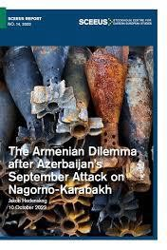
2023 Ceasefire and Current Status
Economic Revival: Reconstruction efforts include building roads, utilities, and housing to rejuvenate local economies and improve living standards
International Mediation: Global actors continue to-push for long-term peace, addressing both security and political concerns.
•International Mediation: Global actors continue to-push for long-term peace, addressing both security and political concerns.
Overview of Recent Ceasefire Agreement

Slide 15
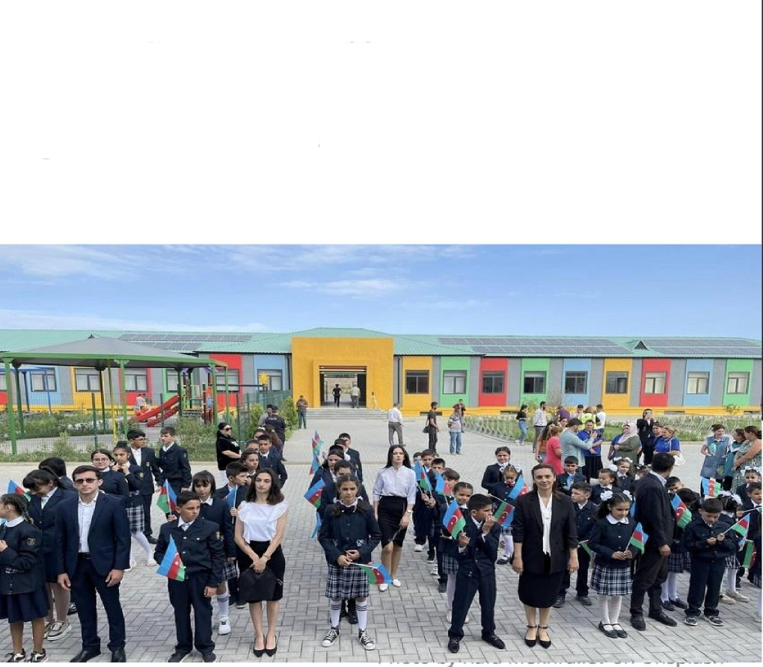
Azerbaijan's Reconstruction and Resettlement Efforts
Village Resettlement: Azerbaijan is actively working to repopulate areas abandoned since the 1994 war, inviting former residents back to rebuild communities.
City and Infrastructure Development: New airports, schools, and universities are under construction to support a stable and modernised life for returnees.
Economic Revival: Reconstruction efforts include building roads, utilities, and housing to rejuvenate local economies and improve living standards.
Revitalizing Abandoned Villages and Supporting Azeri Returnees

Slide 16
Conclusion
The Path to a Lasting Peace
Call for Durable Peace
The international community continues to press for a peaceful resolution that addresses underlying ethnic and political tensions
Regional Impact
The conflict remains a significant challenge for the stability and development of the Caucasus region.
Humanitarian Urgency
Addressing the humanitarian crisis and providing aid for displaced populations is an immediate priority.

Slide 17
References and Sources
supporting Information for the Armenia-Azerbaijan Conflict
Βιβλιογραφία:
Global Conflict Tracker- “Nagorno-Karabakh Conflict” www.cfr.org
«Conflict in Nagorno-Karabakh, Abkhazia and South Ossetia: a legal appraisal»
USC Institude of Armenian Studies- “The May 1994 Ceasefire and How it came about”
www.armenian.usc.edu
Nagorno-Karabakh’s Petition to Nikita Khrushchev

