Slide 1
What lead to the war in Ukraine
A small “dive” into the roots of the on going war
Presentation made by Eleni Kartelia

Slide 2
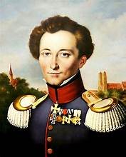
Food for thought...
War is not an independent phenomenon, but the continuation of politics by different means.
- Carl von Clausewitz

Slide 3
A short introduction
The official start of the war in Ukraine is marked by Russia’s invasion of Ukraine in the early hours of February 24, 2022, when Russian President Vladimir Putin announced the launch of a “special operation” in Donbas, a region in eastern Ukraine.

Slide 4
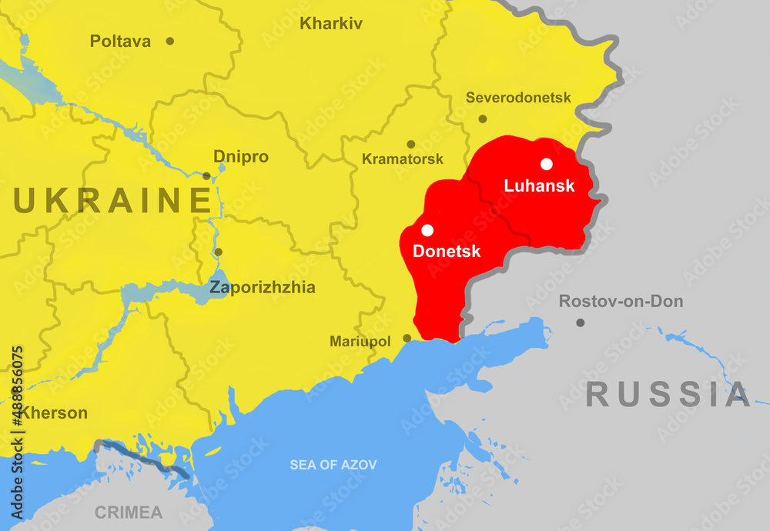
Map of the Donbas region

Slide 5
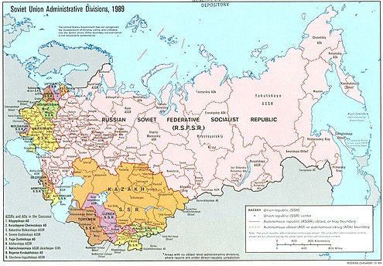
A short introduction of the “official” appearance of Ukraine
After the October revolution of 1917, Ukraine declared its independence in 1919 as The Ukrainian People’s Republic, and after some years, Ukraine became a constituent republic of the Soviet Union when it was formed in 1922. A big mosaic of people with different cultures lived in the USSR

Slide 6
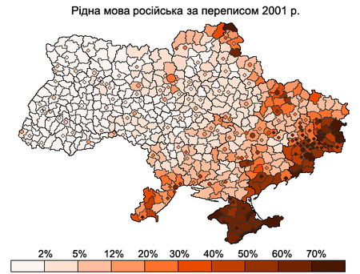
A short introduction
Map of people who declare Russian as their native language for each district or city (in circles)

Slide 7
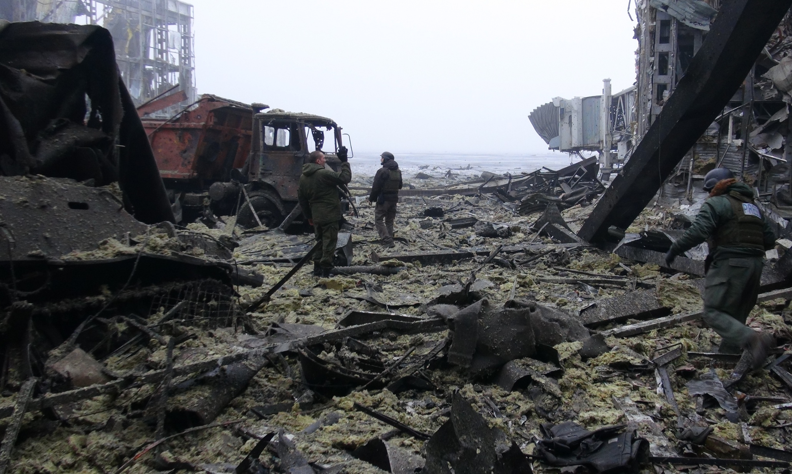
The historical roots that lead to this...

Slide 8
How did we get here?
After the dissolution of the USSR in 1991, with the overthrow of socialism and the establishment of capitalism, tensions between peoples and nationalism began to resurface, but most importantly, like in the rest of the post soviet countries, the opposing parts of the Ukrainian bourgeois started competing over “who’s going to get what” .
Since then and up to the present day, Ukraine has been at the center of intense rivalries between the West and Russia.

Slide 9
How did we get here?
2004:Presidential elections were held, in which the pro-Russian Viktor Yanukovych won the second round. However, the result was annulled by the "Orange Revolution," which was supported and driven by Western forces (USA-EU). As a result, Viktor Yushchenko became President.
During Yushchenko's presidency, Russia cut off natural gas supplies to Ukraine and its transit to the EU twice, in 2006 and 2009.

Slide 10
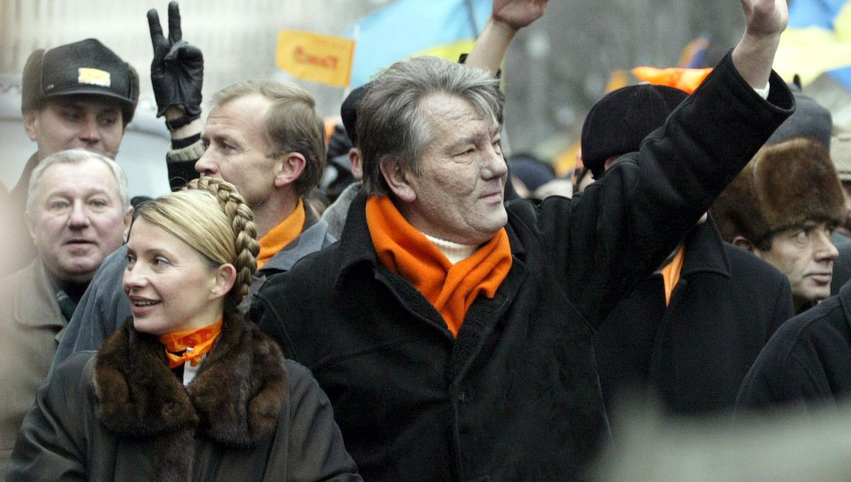

Slide 11
How did we get here?
2008: Following efforts by Yushchenko and Tymoshenko to bring Ukraine into NATO, the two formally request in January that Ukraine be granted a "membership action plan," the first step in the process of joining the alliance.
U.S. President George W. Bush supports Ukraine's membership, but France and Germany oppose it after Russia voices displeasure.
2010: Yanukovych is elected president in February. He says Ukraine should be a "neutral state," cooperating with both Russia and Western alliances like NATO.

Slide 12
How did we get here?
2010: Presidential elections were held in Ukraine, where Yanukovych faced the then Prime Minister Tymoshenko, whose main goals were Ukraine's integration into the EU and NATO. Yanukovych was elected president, with his policy focusing on balancing relations between the West and Russia.
2012-2013: During Yanukovych's presidency, agreements worth billions of dollars were signed between Ukraine and Western energy giants such as Chevron, Eni, Shell, and ExxonMobil for oil and natural gas exploration and extraction rights.

Slide 13
How did we get here?
2013: A few months before the signing of Ukraine's Association Agreement with the EU, Russia exerted immense economic pressure on Kyiv, resulting in the agreement being put on hold.
At the end of the same year, anti-government protests began with active involvement and funding from EU member states and the USA, leading to the coup-like overthrow of Yanukovych's government in early 2014, following the bloody events in Maidan Square.

Slide 14
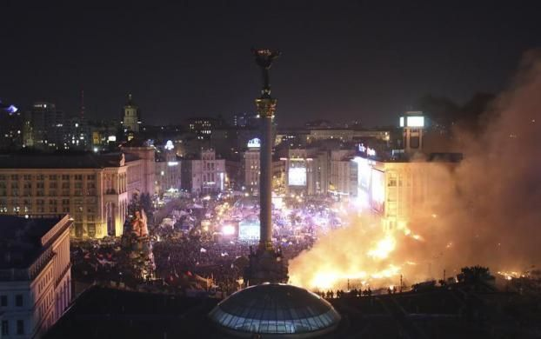

Slide 15
How did we get here?
Some untold things about the “Euromaidan” events:
The active involvement of the USA and EU in the “Euromaidan”, went beyond statements of supports. Their involvement included material assistance as-well.
Victoria Nuland, US Assistant Secretary of State for European and Eurasian Affairs, openly admitted during an event in Kyiv.
“We’ve invested over 5 billion dollars to assist Ukraine in these and other goals, that will ensure a secure, prosperous and democratic Ukraine...”

Slide 16
How did we get here?
The “new” faze in Ukraine during this period:
Western Ukraine: The dominant perspective was that Ukraine should be tied economically, politically and militarily to Western powers such as the US, NATO and the EU
Eastern Ukraine: in contrast, the dominant perspective was that Ukraine should align itself with Russia.
In this context, following a referendum (under the clear influence and pressure of Russia), Crimea was annexed by Russia. Meanwhile, pro-Russian groups declared the regions of Donetsk and Luhansk as People’s Republics, effectively creating a state within a state

Slide 17
How did we get here?
Some untold things about the “Euromaidan” events:
As a strike force in the “Euromaidan” fascist Neo-Nazi organizations such as the “Right Sector” and the “Azov Battalion” were utilized.
Their actions:
From 2014, and even earlier, fascists from these organizations have been robbing, torturing, murdering and executing Russian-speaking citizens.
These organizations , from the very beginning, targeted communists and activists One of their hatred acts was the arson attack on the Trade Unions building in Odessa, which resulted in the death of over 40 people.

Slide 18
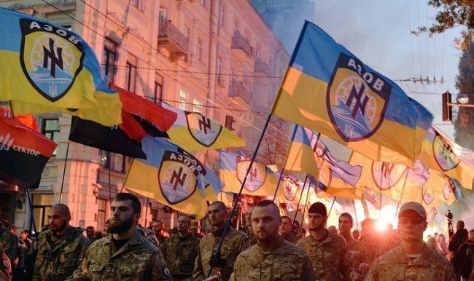

Slide 19
How did we get here?
2015: The Minsk agreement was signed, which provided for a ceasefire between the pro-Russian forces and the Ukrainian government
The agreement didn’t last for long,until the state in cooperation with the nationalist organizations terrorized the locals of eastern Ukraine...

Slide 20
Let’s see the bigger picture
Why Ukraine?
Ukraine possesses:
The third-largest hydrocarbon reserves in Europe, which remain largely untapped.
A vast and unique energy transit pipeline system in the world.
Stations for maintaining natural gas pressure and underground storage facilities.

Slide 21
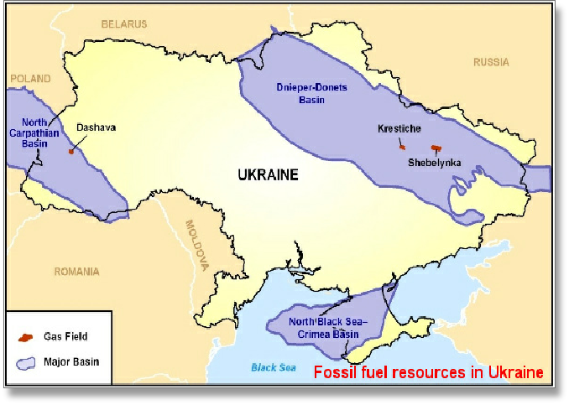

Slide 22
Let’s see the bigger picture
Through this network, especially before the war, Russian natural gas is imported into Europe.
40% of the energy needs of European countries, especially for major industries, are met by Russian natural gas.
Russia supplies one-third of Europe's natural gas needs and is also a key supplier of oil, coal, and other resources.

Slide 23
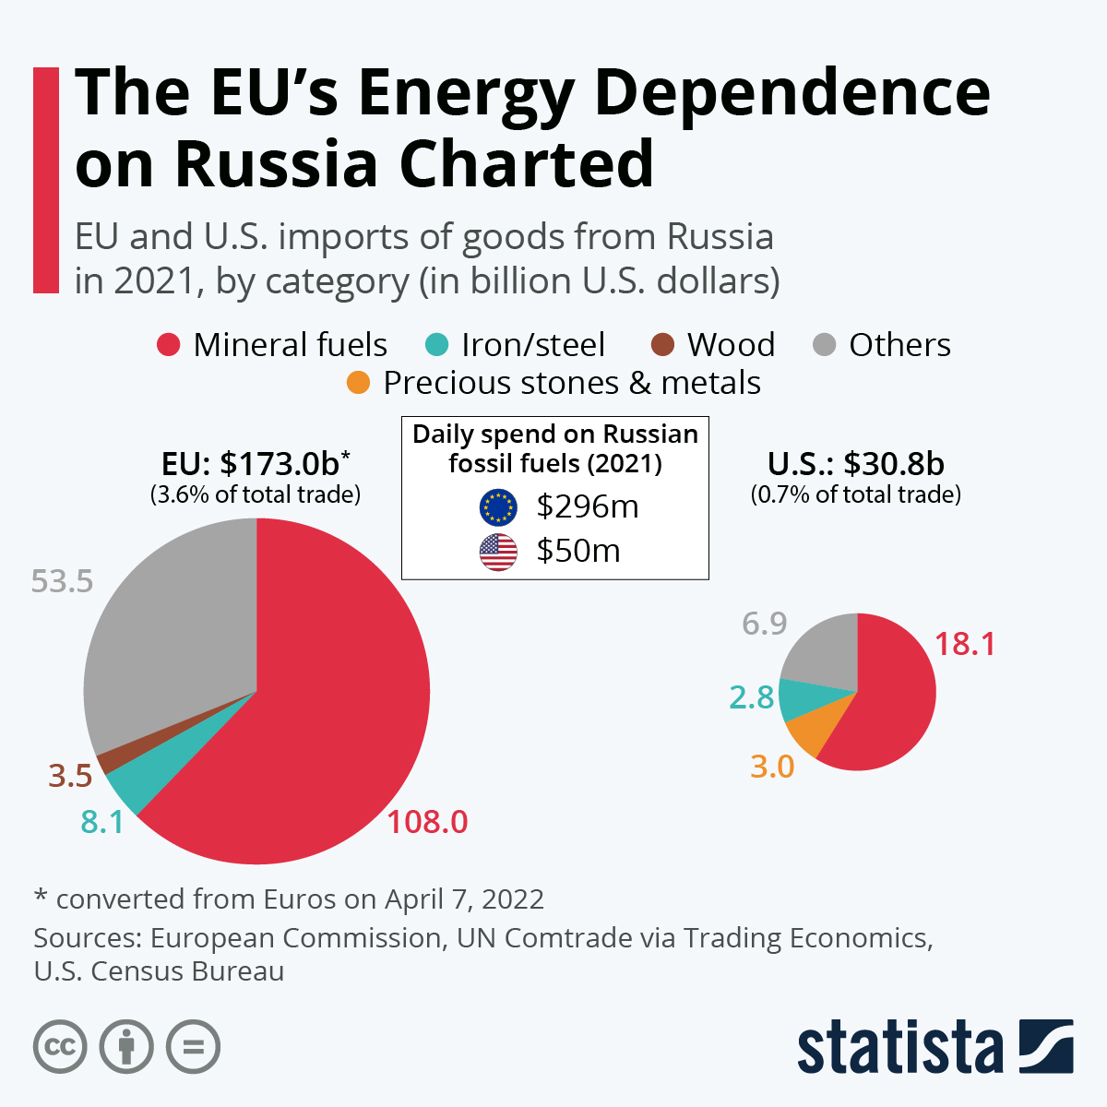

Slide 24
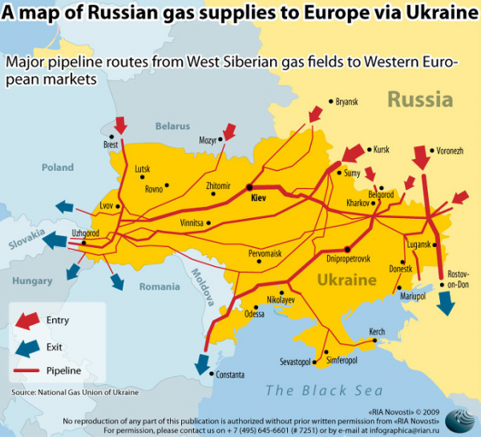

Slide 25
Let’s see the bigger picture
Ukraine also possesses:
a) A significant heavy industry sector and a space program.
b) Vast expanses of arable land that supply China and a large part of Europe.
And lets also keep in mind:
Ukraine serves as a geopolitical corridor between Russia and Europe, as it is strategically located in the middle.

Slide 26
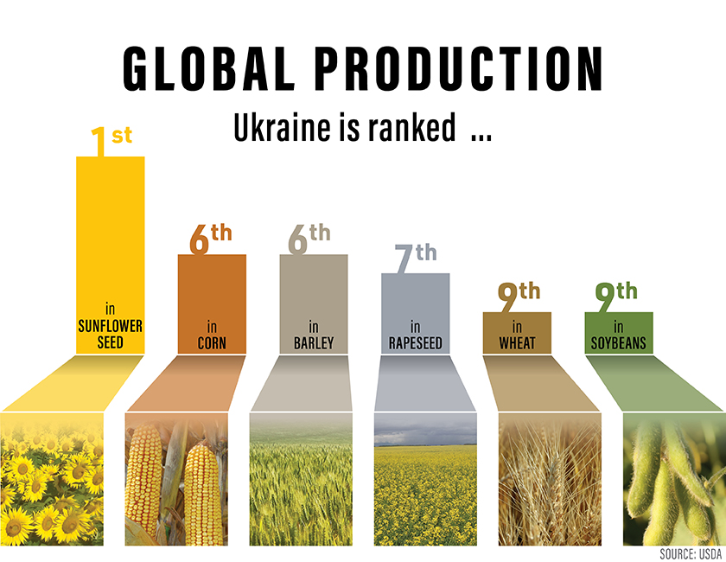

Slide 27
What is hiding behind the conflict​​?
In this context, it becomes clear that the war in Ukraine is driven by the competition among capitalists over how to divide this "lucrative" and profit-rich “pie”.
A small example:
Just before the Russian invasion, the energy industry’s chief lobbyist, the American Petroleum Institute’s Frank J. Macchiarola, announced that “U.S. oil and natural gas producers [could] help” fill any gap in production that resulted from fighting in Ukraine. He said U.S. corporations were positioned to provide what he called “stability.”

Slide 28
How, then, are these rivaleries expressed​​?
-The russian bourgeoise has been trying for years to regain the “lost ground” in its rivalry with the West.
“Fun fact”: based on DW “The United States has pledged and provided the most military assistance to Ukraine for its fight against Russia. According to the IFW, US President Joe Biden's administration has pledged the equivalent of more than €42 billion ($44.7 billion) in military aid to Ukraine since February 2022.”
-The bourgeoise of the Western side, EU and the USA, are similarly striving to expand their economic, political, and military presence in Eastern European countries

Slide 29
A small “comparison” of both sides
Russia is a powerful imperialist force that has participated, directly or indirectly, in a series of imperialist conflicts under various pretexts.
Similarly, NATO is also a strong imperialist force with a long record of interventions carried out "in the name of democracy."
Today, we see this dynamic once again, with Russia invading Ukraine under the banner of "denazification," while the EU and NATO intervene "in the name of democracy."

Slide 30
The starting “sparks” of the war
In 1990, according to the Russian Foreign Minister, NATO pledged to Russia that the alliance would not expand eastward.
However…:
Ιn 1999, Poland, the Czech Republic, and Hungary joined NATO, and in 2004, Latvia, Lithuania, Slovenia, Romania, and Bulgaria also became members.
During this period, discussions began regarding the potential inclusion of Ukraine and Georgia.

Slide 31
Today...
Two years have passed since the formal beginning of the imperialist conflict in Ukraine, marked by the unacceptable Russian invasion and the growing involvement of the US, NATO, and the EU.
The battles on Ukrainian soil continue with unrelenting intensity, shedding the blood of two peoples who once lived peacefully together within the framework of the USSR. Today, the conflict is escalating even further...

Slide 32
Conclusion
Who wins and who loses?
The “winners” in this war, and in every imperialist war, are the big co-operations, companies, weapon industries etc. who will get a “piece of the pie”
The “losers” in these situations are the people, who because of such conflicts have to live under poverty, fear and despair...
The solution, for the people, lies in the struggle against every bourgeois class, against the participation of countries and peoples in imperialist wars

Slide 33
Sources
https://en.wikipedia.org/wiki/Republics_of_the_Soviet_Union
https://www.reuters.com/article/world/timeline-the-events-leading-up-to-russias-invasion-of-ukraine-idUSKBN2KX2AM/
https://en.wikipedia.org/wiki/Ukraine
https://manchesterhistorian.com/2024/us-intervention-in-the-orange-revolution-in-ukraine-and-how-technology-influences-democracy-by-leah-morris/
https://www.wilsoncenter.org/publication/european-mediators-and-ukraines-orange-revolution
https://en.wikipedia.org/wiki/2004_Ukrainian_presidential_election
https://www.npr.org/2022/02/12/1080205477/history-ukraine-russia
https://www.bbc.com/news/world-europe-26079957
https://www.youtube.com/watch?v=rPVs5VuI8XI
https://edition.cnn.com/2022/03/29/europe/ukraine-azov-movement-far-right-intl-cmd/index.html
https://www.peoplesworld.org/article/the-odessa-trade-union-massacre-ten-years-later/
https://www.worldatlas.com/articles/what-are-the-major-natural-resources-of-ukraine.html
https://fas.usda.gov/sites/default/files/2022-04/Ukraine-Factsheet-April2022.pdf
https://en.wikipedia.org/wiki/Russia_in_the_European_energy_sector
https://www.huffingtonpost.gr/entry/ti-einai-neonazistiko-tayma-toe-azof_gr_624eb6b5e4b007d3845faadd
https://www.historynewsnetwork.org/article/documents-show-gorbachev-was-assured-us-wouldnt-ex
https://www.peoplesworld.org/article/u-s-fossil-fuel-monopolies-the-big-winners-in-ukraine-war/

