Slide 1
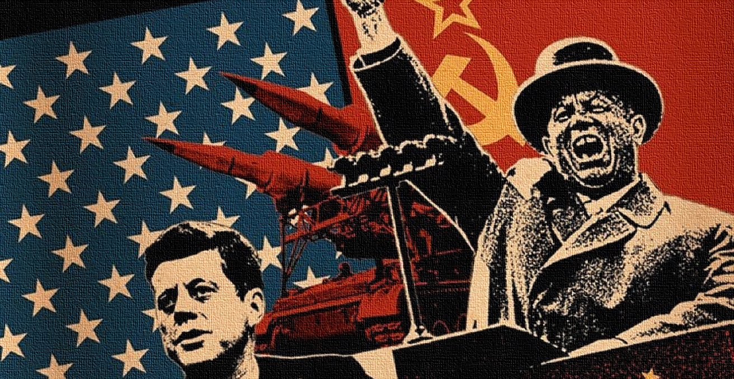
The Cold war How the past shapes the future.
Vitsaxaki Maria Anastasia
International Relations
Panteion University

Slide 2
Table of contents
What is the Cold War-background information
The reasons behind the Cold War
The Berlin Wall
Cold War propaganda
The end of the Cold War
Did the Cold War really end?
The Cold War aftermath

Slide 3
What is the Cold War Background Information
Tensions between the United States and its unlikely ally in the Soviet Union persisted throughout World War II. Western Allied leaders did not forget the initial nonaggression pact made between Soviet Premier Joseph Stalin and Adolf Hitler in 1939. However, Germany’s invasion of the Soviet Union and Japan’s attack on Pearl Harbor created an alliance between the United States and the USSR.
As World War II transformed both the United States and the USSR, turning the nations into formidable world powers, competition between the two increased. Following the defeat of the Axis powers, an ideological and political rivalry between the United States and the USSR gave way to the start of the Cold War. The subsequent race for superior military power sparked an era of espionage, wars over the spread of communism, and a build-up of nuclear arms that threatened global annihilation.

Slide 4
What is the Cold War Background Information
The Soviet Union was determined to have a buffer zone between its borders and Western Europe. It set up pro-communist regimes in Poland, Hungary, Bulgaria, Czechoslovakia, Romania, Albania, and eventually in East Germany.
As the Soviets tightened their grip on Eastern Europe, the United States embarked on a policy of containment to prevent the spread of Soviet and communist influence in Western European nations such as France, Italy, and Greece.
During the 1940s, the United States reversed its traditional reluctance to become involved in European affairs. The Truman Doctrine (1947) pledged aid to governments threatened by communist subversion. The Marshall Plan (1947) provided billions of dollars in economic assistance to eliminate the political instability that could open the way for communist takeovers of democratically elected governments.

Slide 5
The reasons behind the Cold War
Capitalism vs communism
The political and economic systems of the capitalist USA and communist USSR were incompatible. In a capitalist state, the economy is largely free from state control, while the government is democratically elected, and freedom of speech is cherished. In contrast, a communist state is administered from the center, with control of the economy and society strictly in the hands of the Communist Party-led government. Both sides wanted countries to conform to their adopted ideologies for their own gains.
Nuclear arms race
The next major cause of the Cold War was the emergence of nuclear weapons at the end of World War II. As stated previously, World War II ended in Europe by May of 1945 with the defeat of Nazi Germany by the Allied Powers, but the war did not officially end in the Pacific Theater until the atomic bombing of Japan in August of 1945. The United States had developed its atomic weaponry during the final years of the war through its secretive program called the Manhattan Project. With the atomic bombing of Japan, the United States had begun the era of nuclear weapons and the nuclear arms race.

Slide 6
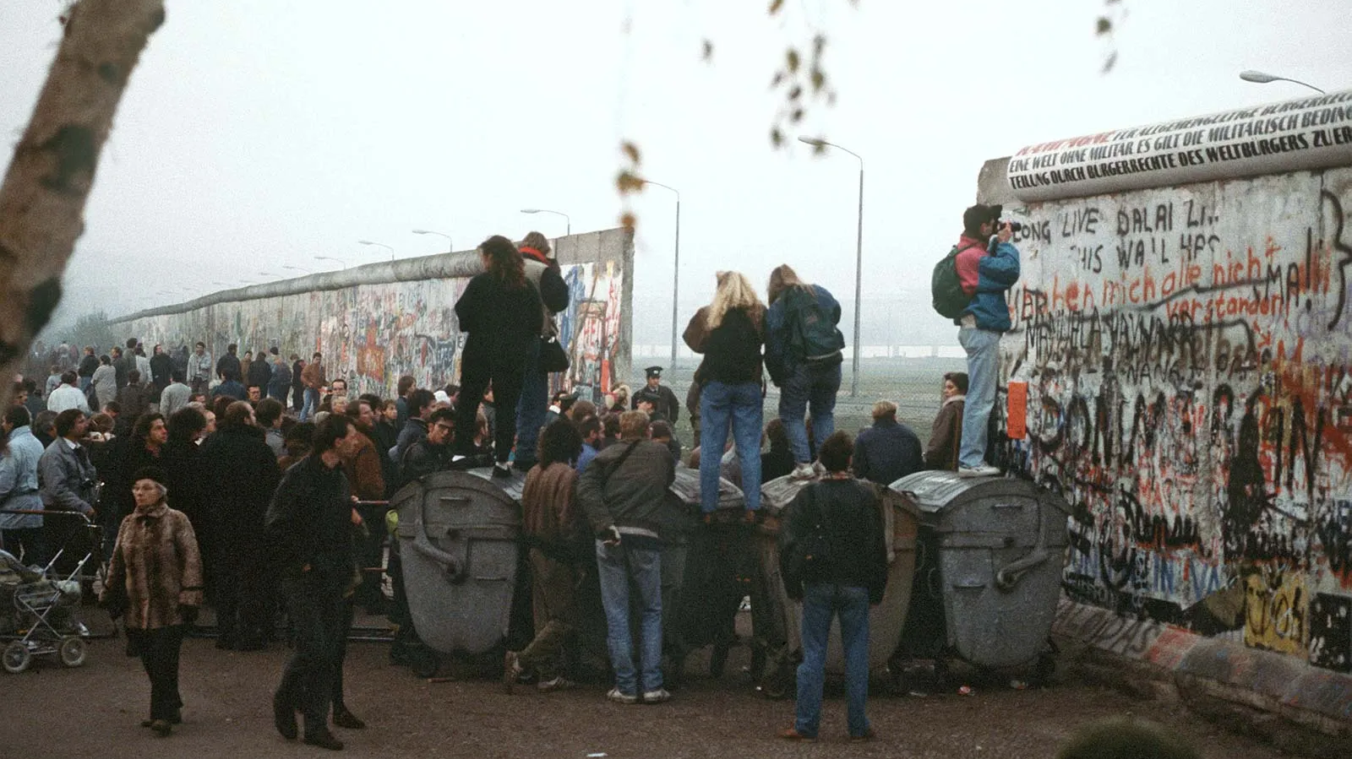
The Berlin Wall came to represent the ideological divisions of the Cold War
Germany became a focus of Cold War politics and as divisions between East and West became more pronounced, so too did the division of Germany. In 1949, Germany formally split into two independent nations: the Federal Republic of Germany (FDR or West Germany), allied to the Western democracies, and the German Democratic Republic (GDR or East Germany), allied to the Soviet Union. In 1952, the East German government closed the border with West Germany, but the border between East and West Berlin remained open. East Germans could still escape through the city to the less oppressive and more affluent West.

Slide 7
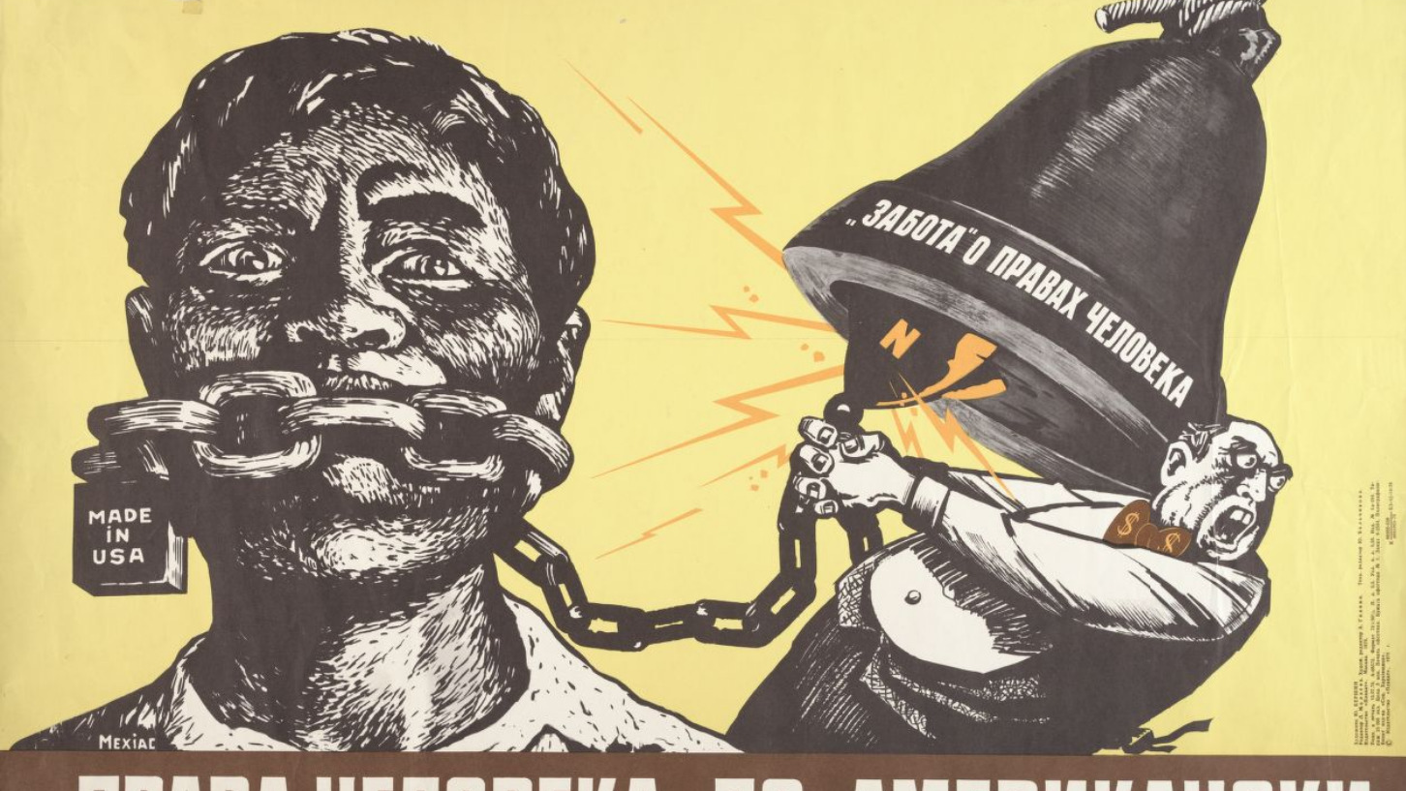
The Cold War propaganda
Both the Soviet Union and the United States and its allies went to great lengths to portray the virtues of the good life supposedly offered by their socio-economic system and to reveal the alleged deficiencies of their rival’s system. The delivery (or suppression) of the news and the slant put on it was everything. Propaganda was the name of the game. The flow of information was tightly controlled by the state and the Communist Party in the U.S.S.R. and the Soviet bloc, and newspapers, radio, and television focused on anti-Western and anti-capitalist stories. The American government and its intelligence agencies used the media, and in particular the radio, to broadcast “uncensored” accounts of the news that were intended not only to inform people behind the Iron Curtain but also to sow discontent and foment opposition to communism. Propaganda also took the form of all manner of art, including literature, music, television, movies, animation, comic books, and posters.

Slide 8
The end of the Cold War
The Cold War truly began to break down during the administration of Mikhail Gorbachev, who changed the more totalitarian aspects of the Soviet government and tried to democratize its political system. Communist regimes began to collapse in eastern Europe, and democratic governments rose in East Germany, Poland, Hungary, and Czechoslovakia, followed by the reunification of West and East Germany under NATO auspices. Gorbachev’s reforms meanwhile weakened his own communist party and allowed power to shift to the constituent governments of the Soviet bloc. The Soviet Union collapsed in late 1991, giving rise to 15 newly independent nations, including a Russia with an anticommunist leader.

Slide 9
Did the Cold War really end?
“The assumption in Washington that the Cold War was over in 1989 was unduly American-centric and ignored Moscow’s historic desire to be seen and respected by the U.S. and Europe as a major power, regardless of ideology. It was never about this conflict between capitalism and communism. It was much more about challenging the hierarchy of global politics and climbing up the hierarchy at the expense of the United States. Gaining acceptance as an equal power, with its own sphere of influence, has been Moscow’s goal—whether under Communist or post-Communist rule—dating to the summit in Yalta, in 1945, of the three Allied leaders in the Second World War”, Sergey Radchenko, an international-relations expert at the School of Advanced International Studies, at Johns Hopkins University said.

Slide 10
The Cold War aftermath
The world changed profoundly in all three areas, as a result of the collapse of the USSR. First, the blocs were no more, especially the eastern European alliance system. The Russian Federation now lacks close allies or clients. Similarly, with no serious external threat, the US receives only limited support from its own friends. Meanwhile, Marxism-Leninism ceased to be a powerful ideology. The Russian Federation from time to time puts forward an anti-liberal ideology or talks about ‘Eurasianism’, but neither provides the basis for an international movement. Nuclear weapons still exist; the US and the Russian Federation have far more than other states. But those play little role in their relationship, and the Russian Federation, with a population now half that of the US, can deploy only weak conventional forces. Major states will disagree and compete. But the Cold War was a product of the 1917 Russian Revolution and the Second World War.

Slide 11
Sources
https://www.jfklibrary.org/learn/about-jfk/jfk-in-history/the-cold-war
https://www.nationalww2museum.org/war/articles/cold-conflict
https://www.britannica.com/event/Cold-War
https://www.bbc.co.uk/bitesize/guides/z8qnsbk/revision/3
https://www.historycrunch.com/causes-of-the-cold-war.html#/
https://www.iwm.org.uk/history/what-was-the-berlin-wall-and-how-did-it-fall
https://explore.britannica.com/study/cold-war-policies-propaganda-and-speeches
https://www.britannica.com/question/How-did-the-Cold-War-end
https://www-historyextra-com.translate.goog/period/cold-war/did-cold-war-us-russia-relations-ever-really-end-soviet-union-america-tensions-nuclear-weapons/?_x_tr_sl=en&_x_tr_tl=el&_x_tr_hl=el&_x_tr_pto=sc&_x_tr_hist=true
https://nebraskastudies.org/en/1975-1999/the-end-of-the-cold-war/#lg=1&slide=1
https://www.newyorker.com/news/daily-comment/does-the-us-russia-crisis-over-ukraine-prove-that-the-cold-war-never-ended

Slide 12
Vitsaxaki Maria Anastasia
Thank you for your attention

