Slide 1



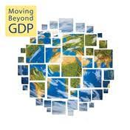

The Welfare – Resources relationship. A beyond GDP approach
Dr. P. Kalimeris

Slide 2
Material Flow Analysis (MFA)
Domestic Material Consumption (DMC)= Domestic Extraction +Imports –Exports
Material Intensity (MI) = DMC/GDP
GDP is the prevailing denominator used to evaluate the economic output of a national economy

Slide 3
Which is the actual output of the economic process?
GDP ?
Low entropy Energy
Economic System:
Capital
Labor
Technology
Economic Welfare-Utility for Human Beings
Low entropy Mass
Waste
Recycling and information (knowledge) flows

Slide 4
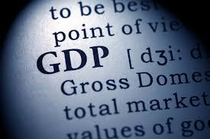

Slide 5
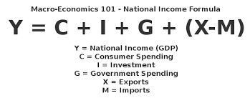
What is Gross Domestic Product?

Slide 6
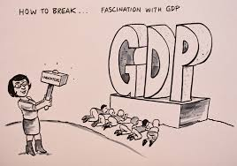
Is GDP a good welfare measurement?

Slide 7
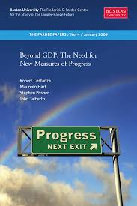
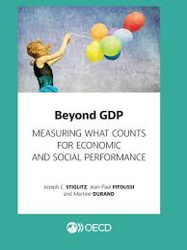
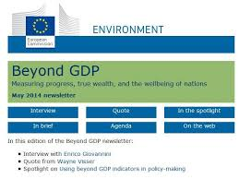

Is GDP a good welfare measurement?

Slide 8
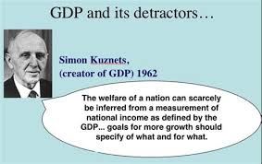
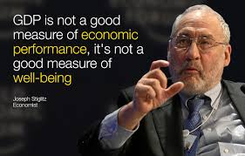
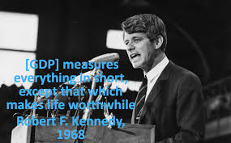
Criticism on GDP

Slide 9
Criticism on GDP
Simon Kuznets admitted early on that the actual welfare of a nation cannot be accurately reflected by the GDP index (Kuznets et al., 1934)
Arthur Pigou recognized that GDP was not appropriate as an “index of total welfare” (Pigou, 1962)
Many scholars have argued that GDP is a specialized tool which is inappropriate for comprehensive evaluation of the socio-economic variables well-being and welfare

Slide 10
Criticism on GDP
In a nutshell, the main criticism on GDP is mainly directed towards its inappropriateness to:
Accurately account the level (in monetary terms) of economic welfare/utility
Incorporate environmental and other externalities of the economic process
Reflect inequalities in income distribution and the poverty level
Measure demographic trends and other socio-economic variables, such as changes in health conditions or on human capital.
Measure socio-economic activities outside the formal economic system
Capture the physical dimensions of the economic process
Capture and evaluate changes in technological progress

Slide 11
Are there any Alternatives to GDP?
Goosens et al. (2007) divide the alternative measurements into three broad categories:
Indicators Adjusting GDP (monetizing environmental and social factors, such as ISEW and GPI)
Indicators replacing GDP (more direct assessment of well-being, such as the HDI)
Indicators supplementing GDP (complement GDP with additional information, such as Income=GDP/capita)

Slide 12
The four alternative to GDP indicators
Composite social indicator measuring well-being (WB) that replaces GDP
Geniuine Progress Indicator (GPI)
Human Development Index (HDI)
Supplementary to GDP, average approximation of well-being (WB) and economic welfare (EW)
Income (GDP/cap.)
Pragmatic extended economic accounts measuring economic welfare (EW), by adjusting GDP
Index of Sustainable Economic Welfare (ISEW)
Pragmatic extended economic accounts measuring economic welfare (EW), by adjusting GDP

Slide 13
4 different levels of analysis
1. GDP per capita
Disaggregated (indexing is required to achieve comparability with GDP)
2. Human Development Index (HDI)
3. Genuine Progress Indicator (GPI)
Aggregated (directly comparable with GDP)
4. Index of Sustainable Economic Welfare (ISEW)

Slide 14
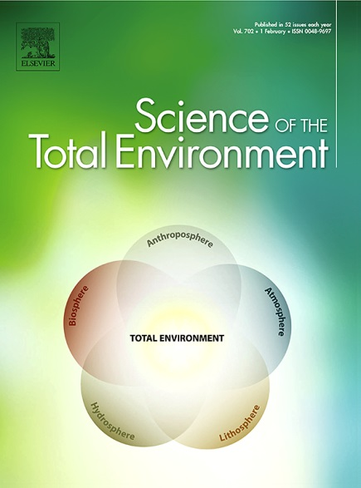
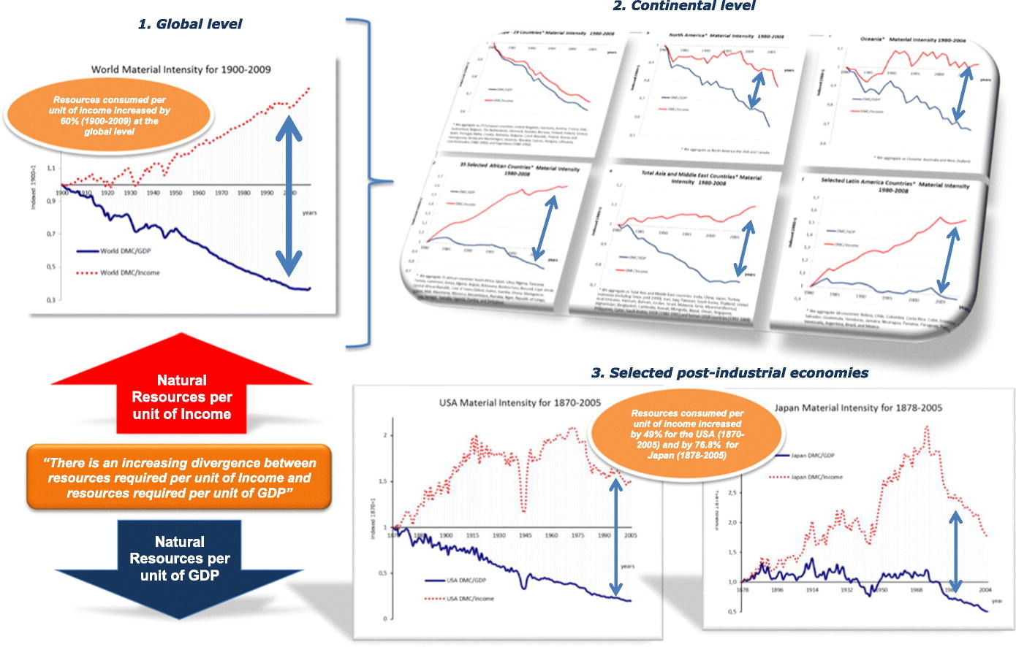
Source: Bithas & Kalimeris (2018): https://www.sciencedirect.com/science/article/pii/S0048969717331194
Indexed DMCt/GDPt indicator compared to indexed indicator DMCt/Incomet

Slide 15
GDP versus Income (GDP per capita) Global Level

Slide 16
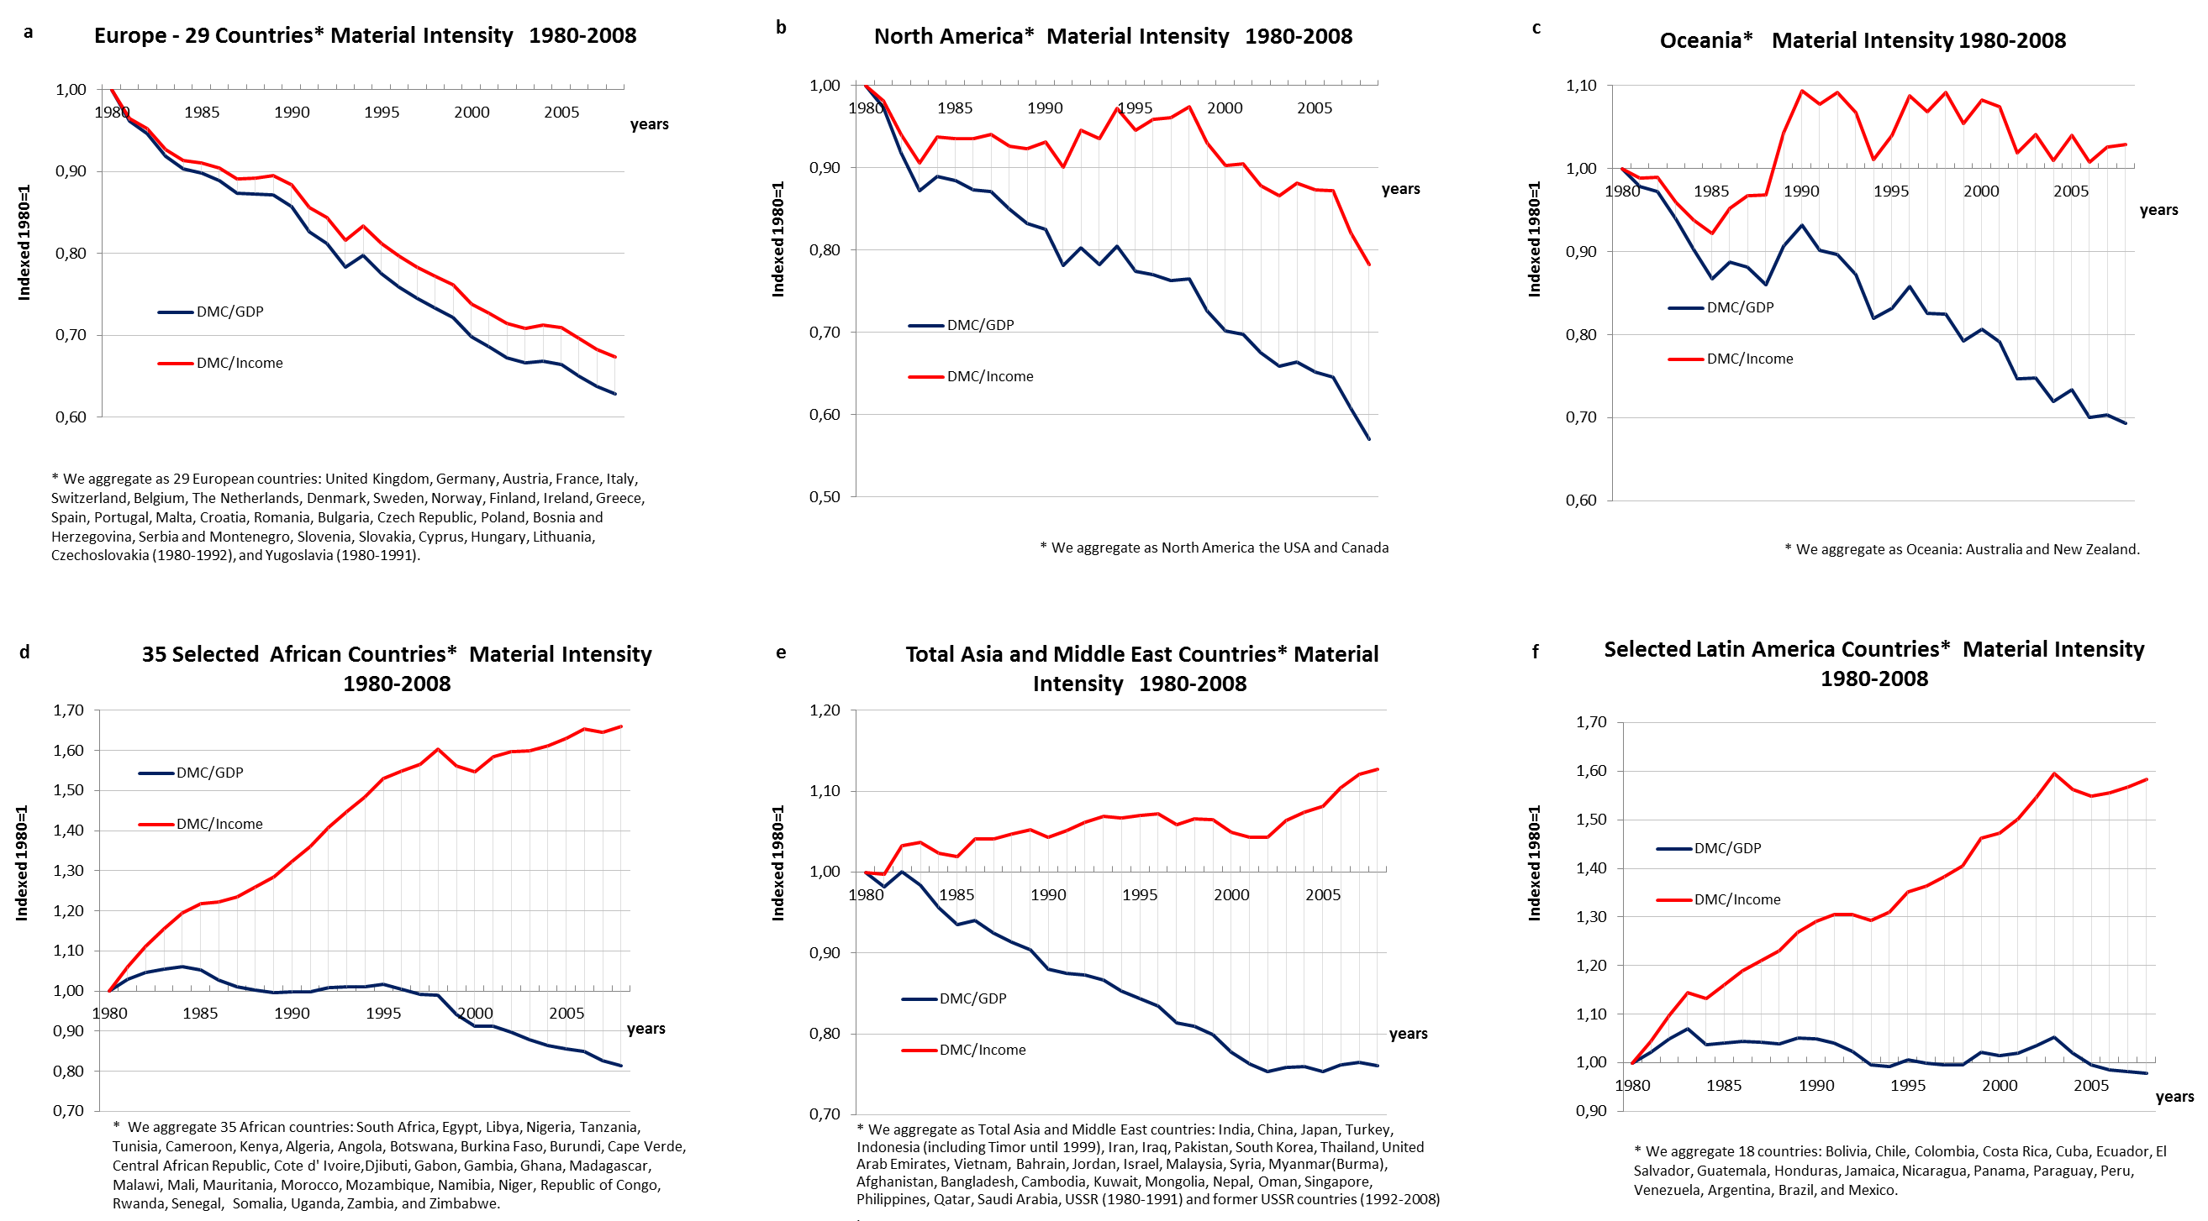
GDP versus Income (GDP per capita) Continental Level

Slide 17
GDP versus Income (GDP per capita) The USA

Slide 18
GDP versus Income (GDP per capita) Japan

Slide 19
GDP versus Income (GDP per capita) India

Slide 20
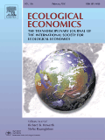
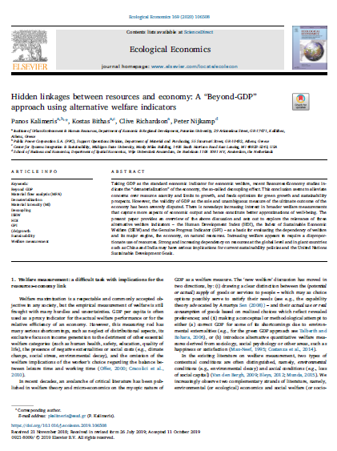
Source: Kalimeris et al. (2020): https://www.sciencedirect.com/science/article/abs/pii/S0921800918318482

Slide 21
GDP versus Alternative Indicators
DMC /GDP with DMC /HDI
DMC /GDP with DMC /ISEW
DMC /GDP with DMC /GPI

Slide 22
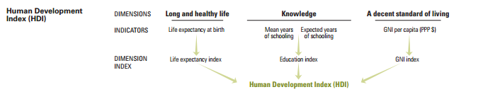
Human Development Index (HDI)
Figure 1. Aspects reflected in the HDI (Source: Human Development Reports, United Nations Development Programme, available at: http://hdr.undp.org/en/content/human-development-index-hdi)

Slide 23
Material Intensity: GDP vs HDI

Slide 24
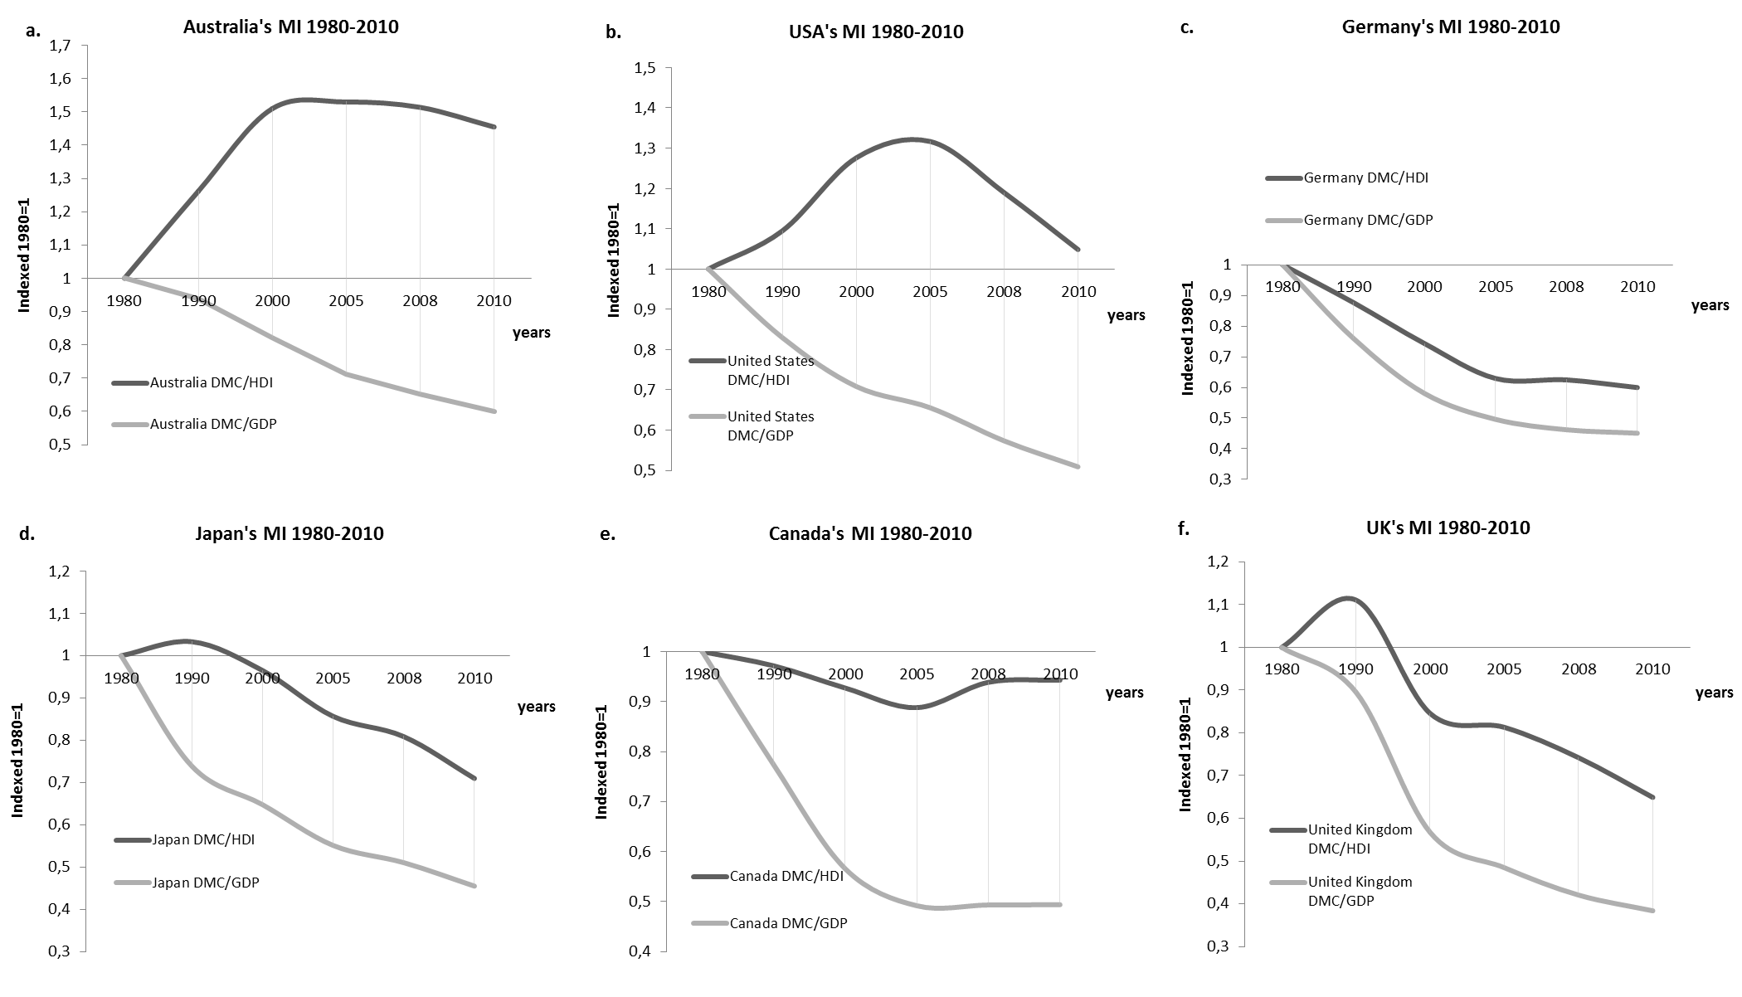
Material Intensity: GDP vs HDI

Slide 25
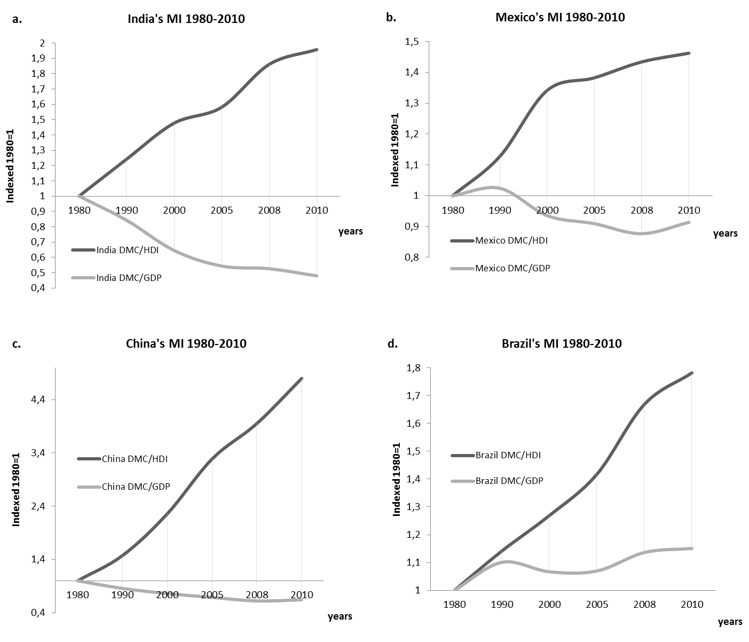
Material Intensity: GDP vs HDI

Slide 26
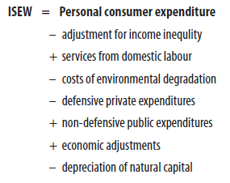
Index of Sustainable Economic Welfare (ISEW)
Figure 2. The ISEW structure. Source: (74-p.24). Available at: http://wupperinst.org/en/a/wi/a/s/ad/1113

Slide 27
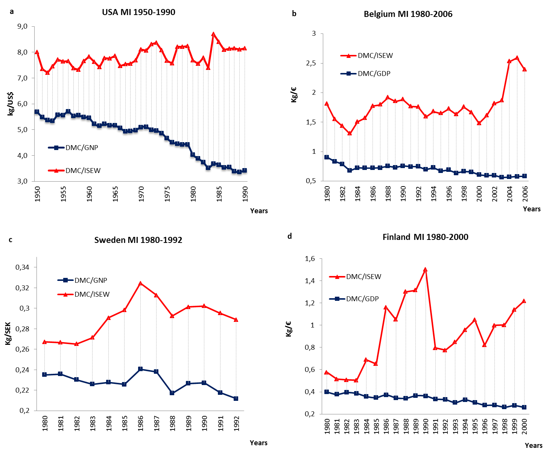
Material Intensity: GDP vs ISEW

Slide 28
Genuine Progress Indicator (GPI)
Figure 3. The GPI structure. Source: 74-p.38). Available at: http://wupperinst.org/en/a/wi/a/s/ad/1113

Slide 29
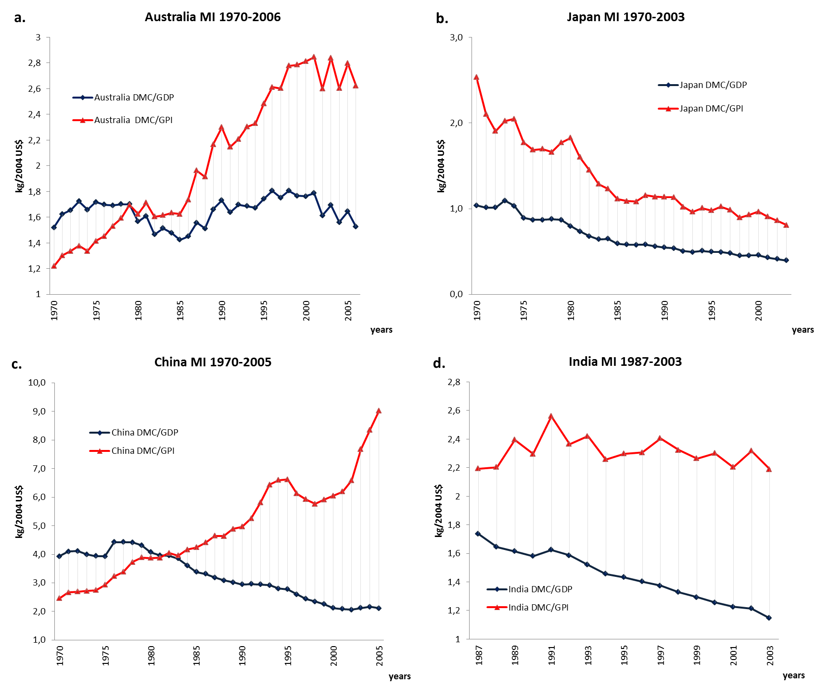
Material Intensity: GDP vs GPI

Slide 30
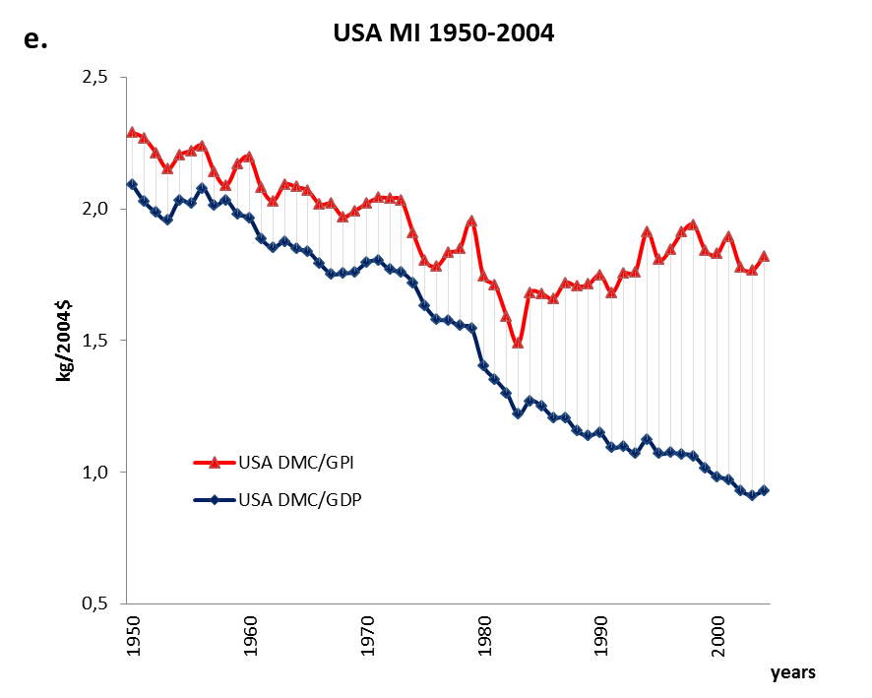
Material Intensity: GDP vs GPI

Slide 31
Conclusions
The natural resources use per unit of GDP is constantly decreasing through time (Decoupling between resources use and GDP)
The natural resources use per unit of welfare* is generally increasing (Coupling between resources use and welfare)
* Welfare as approximated by: GDP per capita, HDI, GPI, and ISEW

Slide 32
Conclusions
Does GDP index reflect properly the welfare produced by the economic system?
Which are the implications by the use of GDP in the MFA, in the context of aggregate scarcity of natural resources and the efficiency of the production process?
“…a misinterpretation today of a phenomenon such as the decoupling effect, might give the wrong signals to policy makers and practitioners, causing irreparable damage to the prosperity of future generations…”

Slide 33
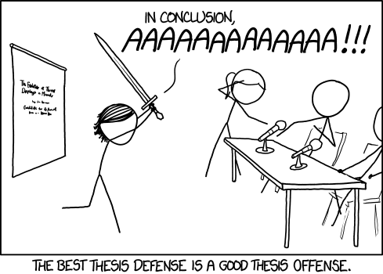

Slide 34
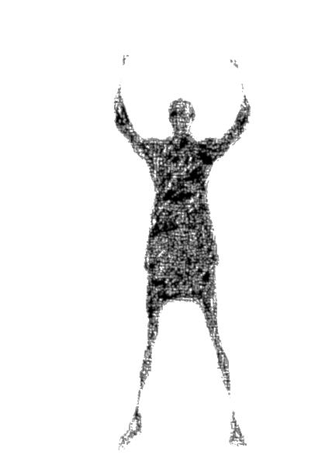
Thank you for your Attention!
For more info please contact: pkalimeris@eesd.gr

