Slide 1
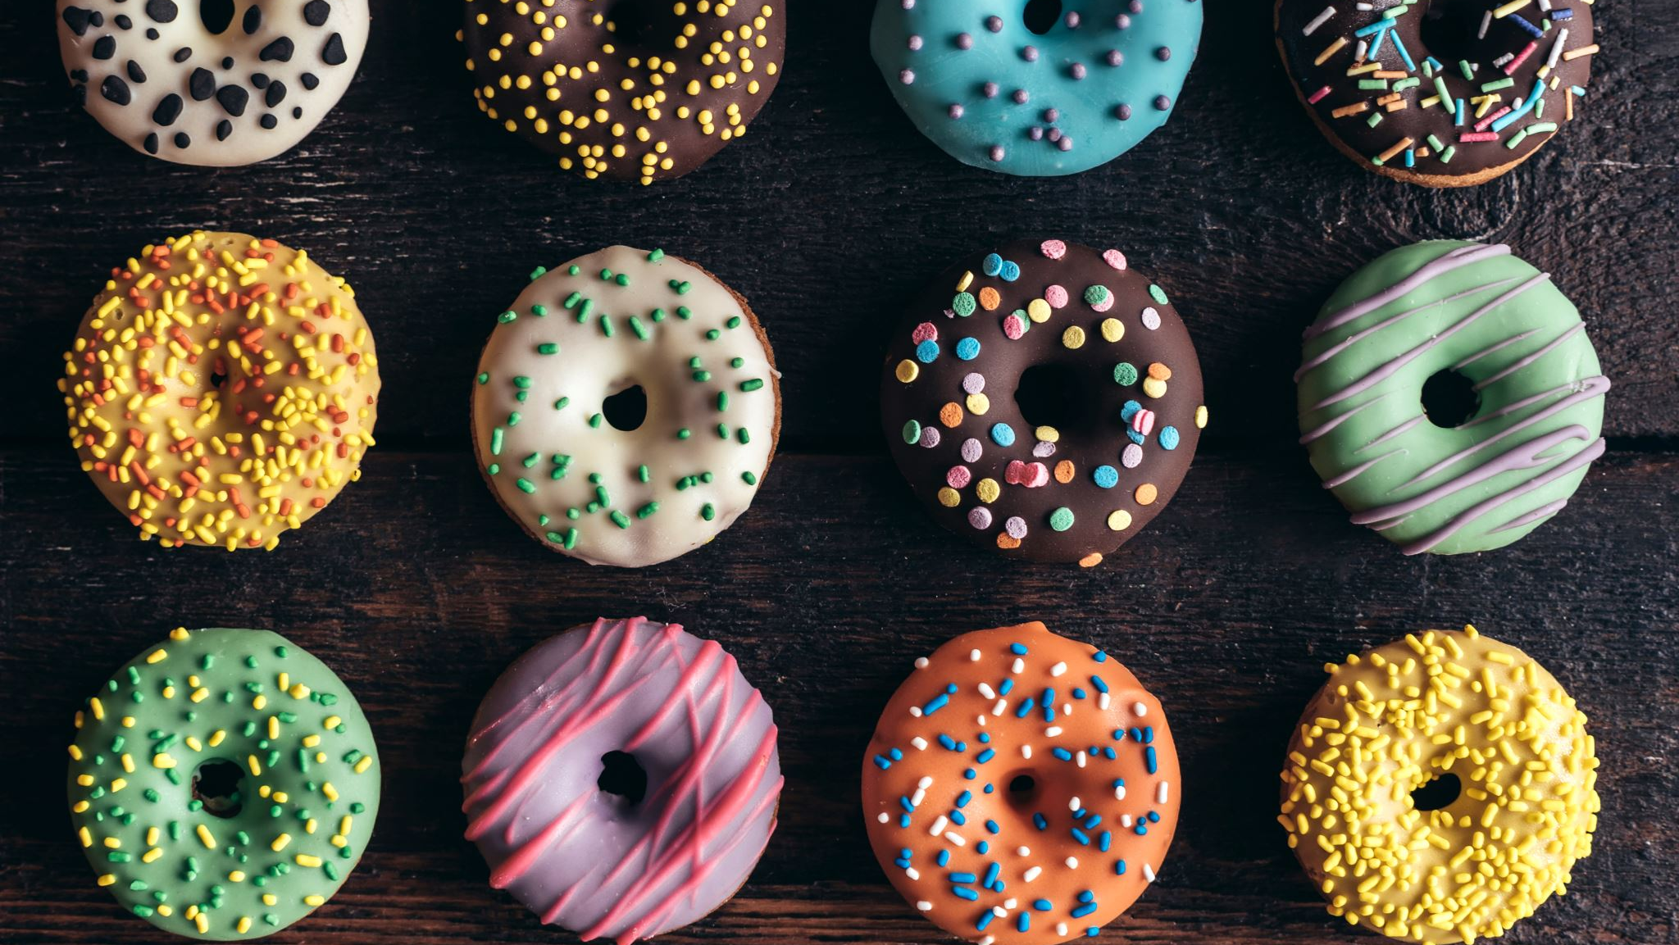
Doughnut of social and planetary boundaries
Fanning, A.L., Raworth, K. Doughnut of social and planetary boundaries monitors a world out of balance. Nature 646, 47–56 (2025). https://doi.org/10.1038/s41586-025-09385-1

Slide 2
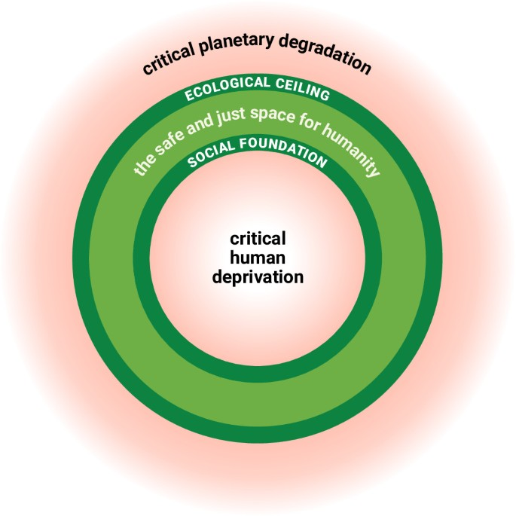

Slide 3
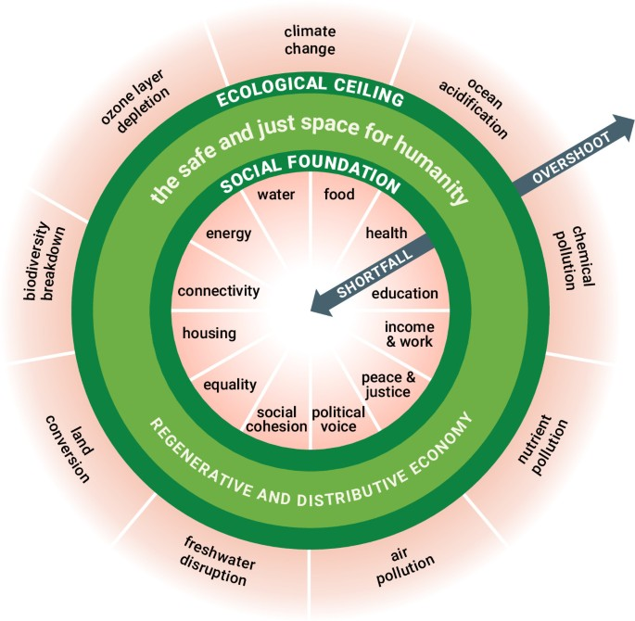

Slide 4
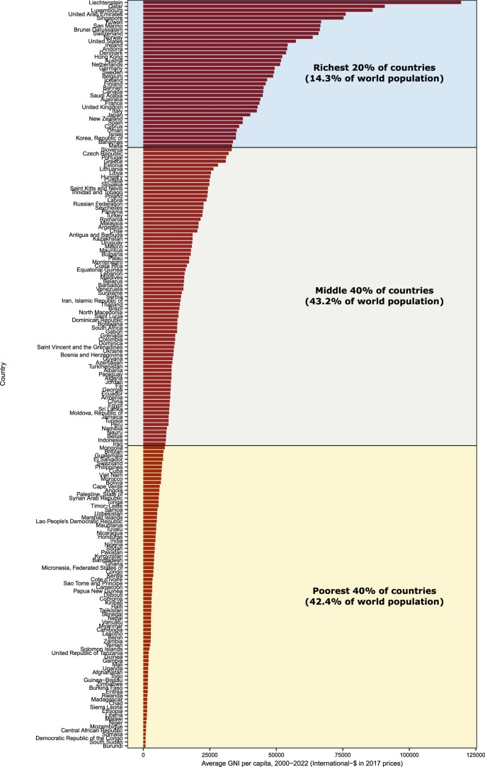
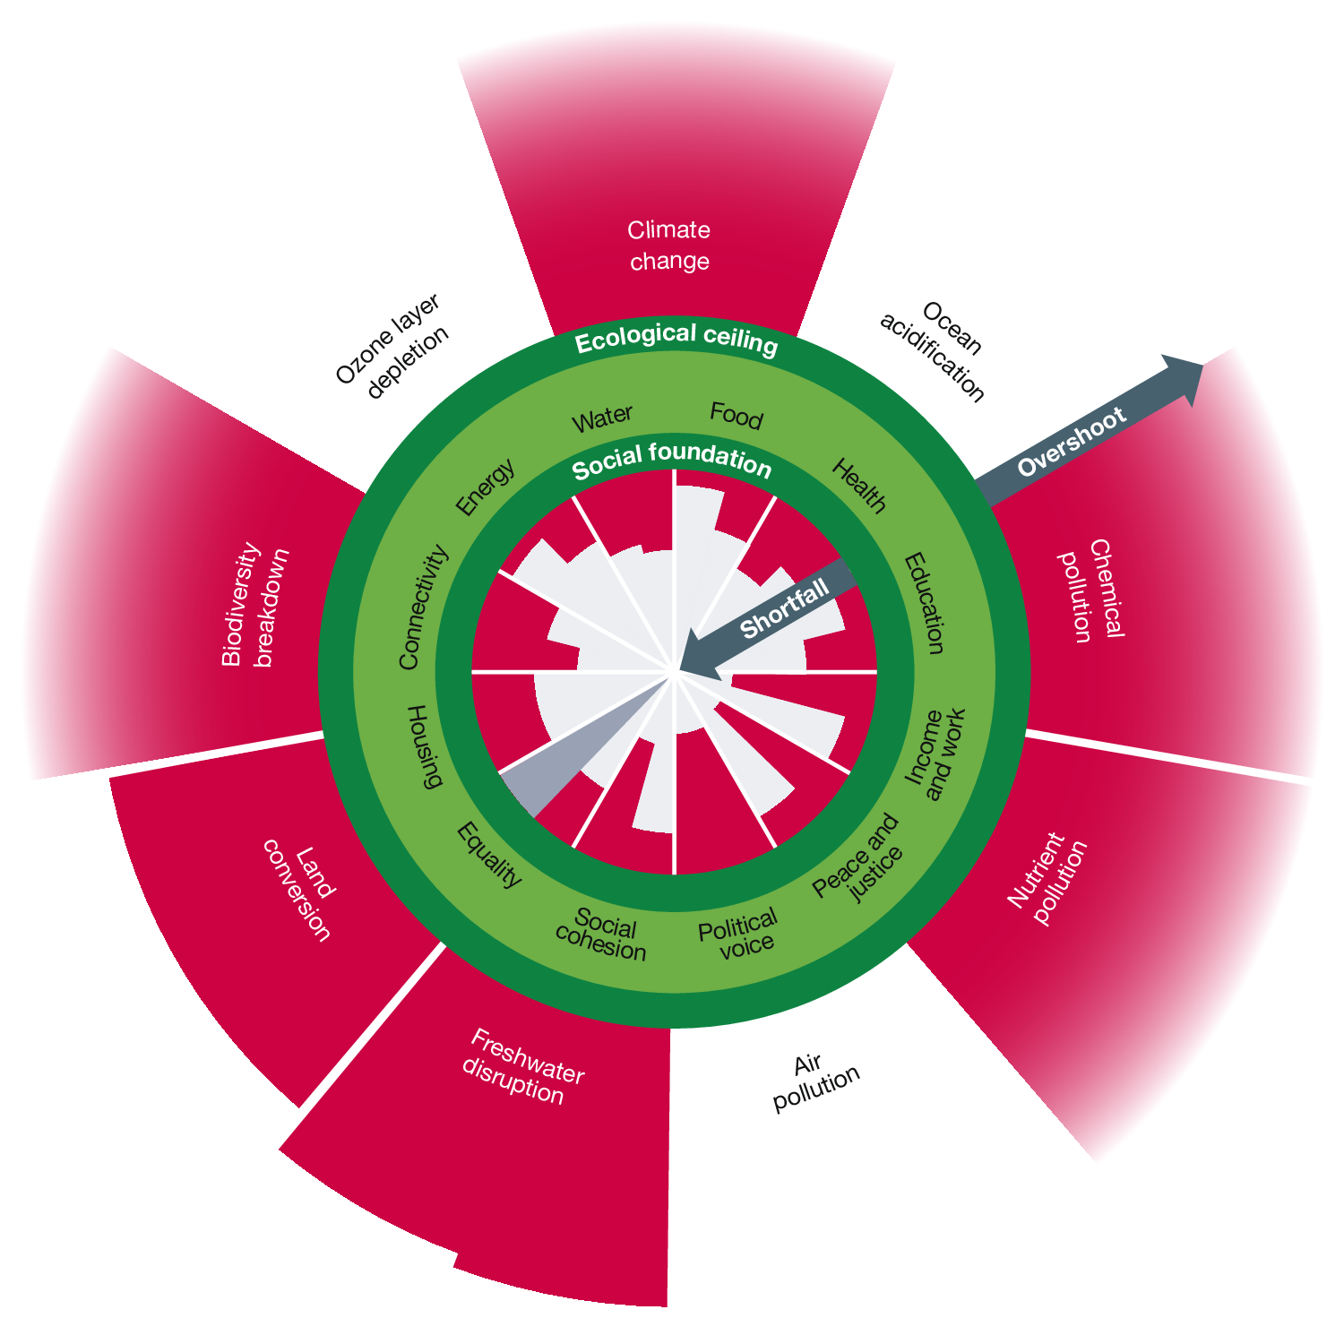
Current (2025) global status of shortfall and overshoot in the Doughnut of social and planetary boundaries

Slide 5
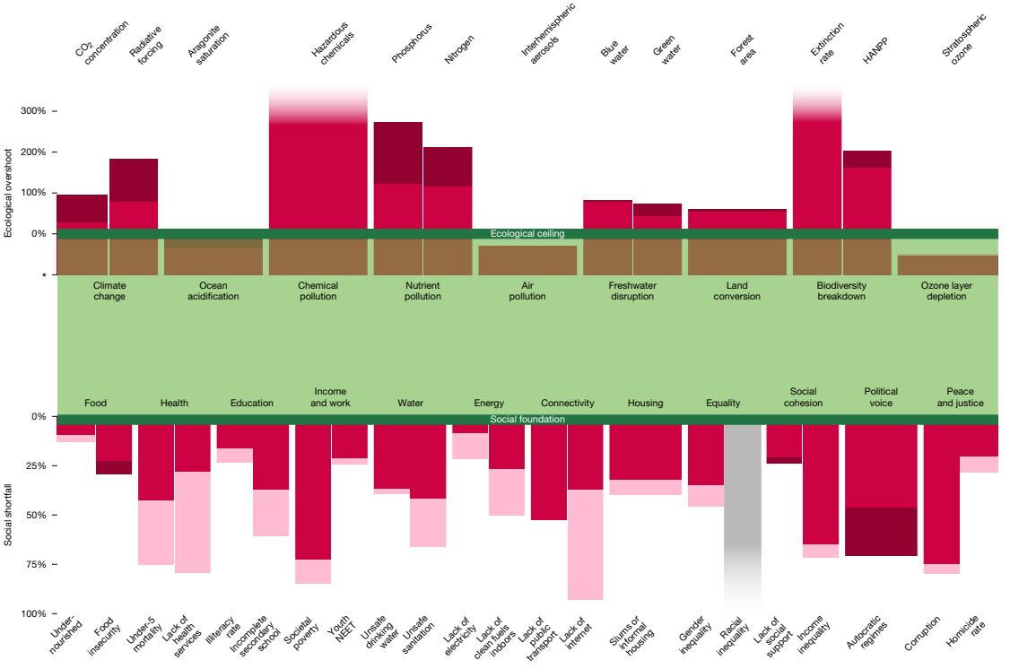

Slide 6
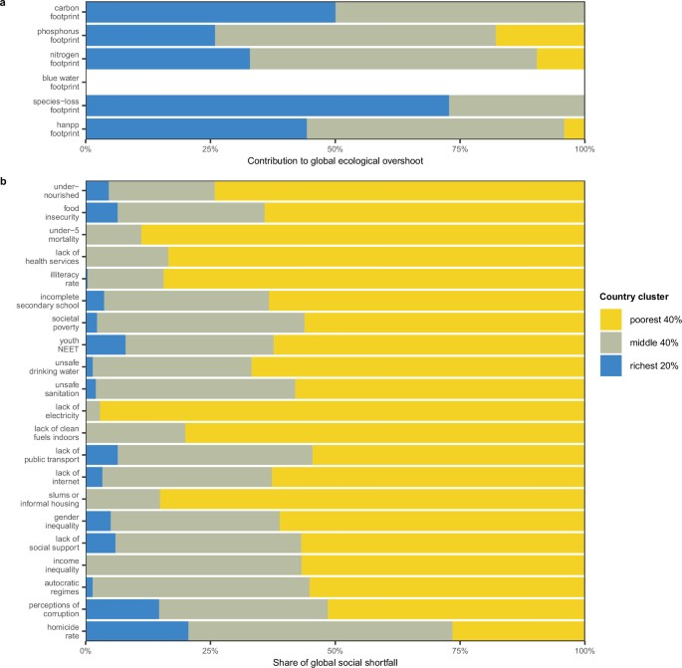

Slide 7
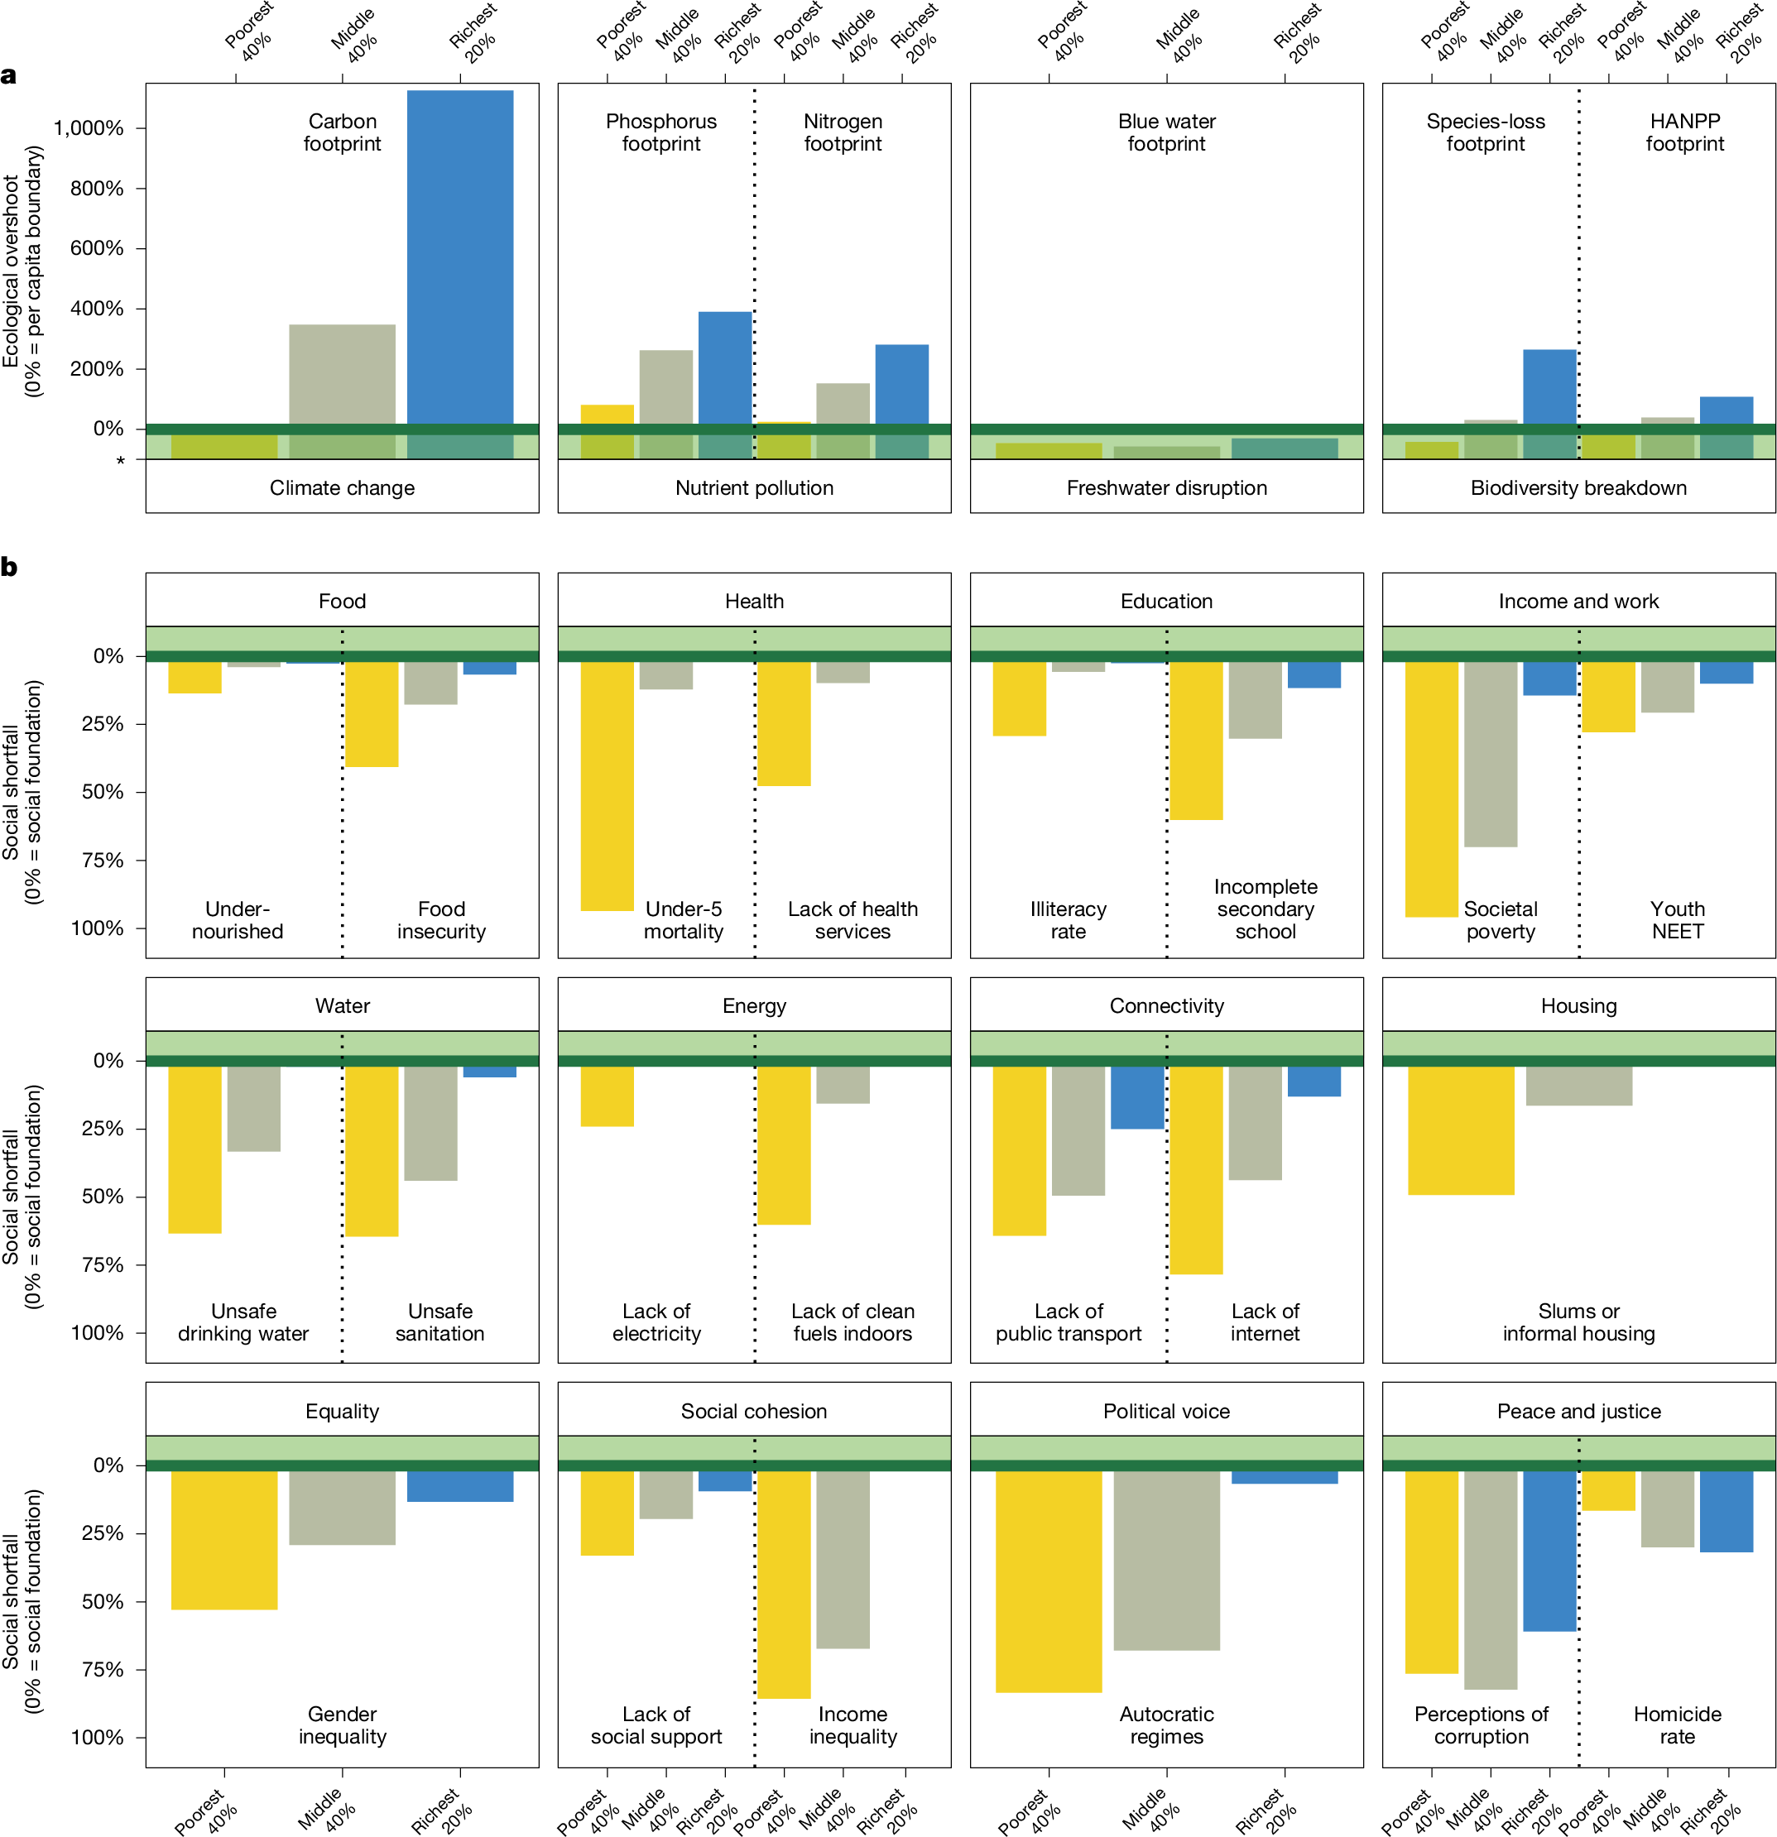

Slide 8
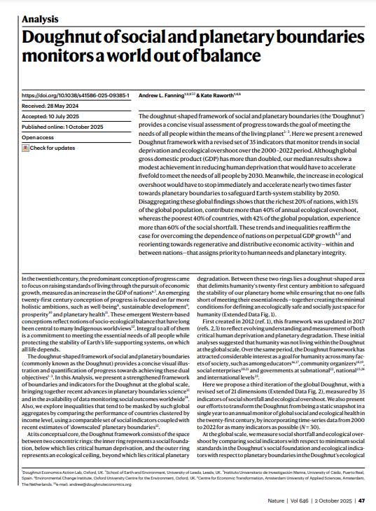
Fanning, A.L., Raworth, K. Doughnut of social and planetary boundaries monitors a world out of balance. Nature 646, 47–56 (2025). https://doi.org/10.1038/s41586-025-09385-1

