Slide 1


Indicators measuring the Environment – Economy relationship
Dr. P Kalimeris

Slide 2
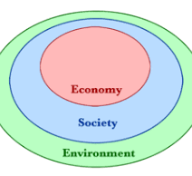
The Ecological Economics perspective

Slide 3
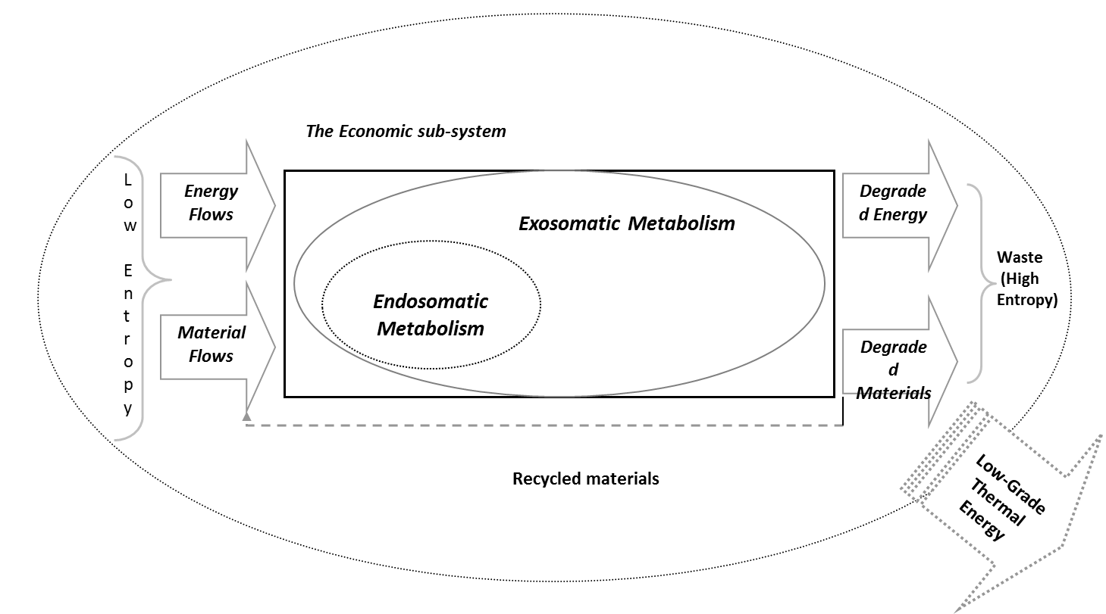

Slide 4
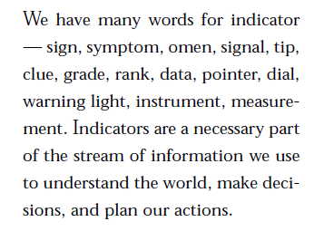
D. Meadows, 1998

Slide 5
Input Indicators
Resource use categories
Output indicators and combinations
Material flow-based indicators
MATERIALS
Biotic Materials
Carbon Footprint
(CO₂+other GHG)
Energy flow-based indicators
ENERGY
Abiotic Materials
Air
Ecological Footprint
CO₂ emissions
Land Use
Water Footprint
WATER
Water
Land area
Land Use
LAND AREA
Water Footprint
“Grey” Water

Slide 6

Accounting Methodologies for both resources inputs and pollution-emissions outputs
Ecological Footprint
Water Footprint
IPAT equation
Material Flow Analysis (MFA)
- Energy Intensity
- Material Intensity
- Emissions Intensity
- Resources Productivity

Slide 7
Accounting Methodologies for pollution-emissions outputs
Environmental Kuznets Curves (EKCs)
Kaya Identity
Carbon footprint
Planetary Boundaries (tracing the limits of biosphere)

Slide 8

1. The Ecological footprint – How it works?
Ecological Footprint accounting measures the demand on and supply of nature.
On the demand side, the Ecological Footprint measures the ecological assets that a given population requires to produce the natural resources it consumes and to absorb its waste, especially carbon emissions.
On the supply side, a city, state or nation’s biocapacity represents the productivity of its ecological assets These areas, especially if left unharvested, can also absorb much of the waste we generate, especially our carbon emissions.
Source: https://www.footprintnetwork.org/resources/data/

Slide 9
1. The Ecological footprint – How it works?
The Ecological Footprint is derived by tracking how much biologically productive area it takes to provide for all the competing demands of people. These demands include space for food growing, fiber production, timber regeneration, absorption of carbon dioxide emissions from fossil fuel burning, and accommodating built infrastructure. A country’s consumption is calculated by adding imports to and subtracting exports from its national production.
All commodities carry with them an embedded amount of bioproductive land and sea area necessary to produce them and sequester the associated waste. International trade flows can thus be seen as flows of embedded Ecological
Footprint.
The Ecological Footprint uses yields of primary products (from cropland, forest, grazing land and fisheries) to calculate the area necessary to support a given activity.
Biocapacity is measured by calculating the amount of biologically productive land and sea area available to provide the resources a population consumes and to absorb its wastes, given current technology and management practices. To make biocapacity comparable across space and time, areas are adjusted proportionally to their biological productivity. These adjusted areas are expressed in “global hectares”. Countries differ in the productivity of their ecosystems, and this is reflected in the Accounts.

Slide 10
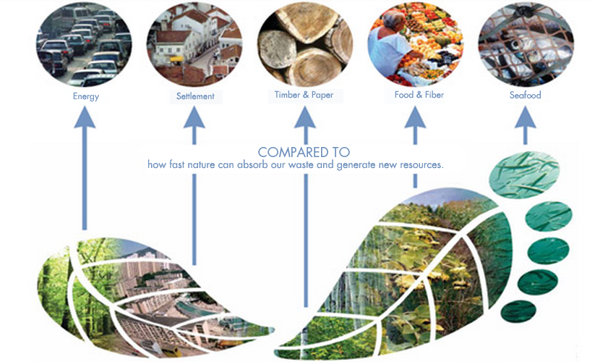

Slide 11
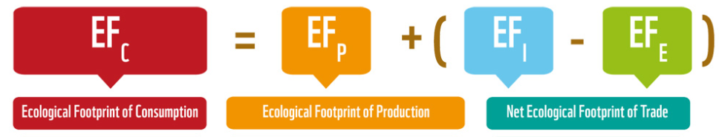
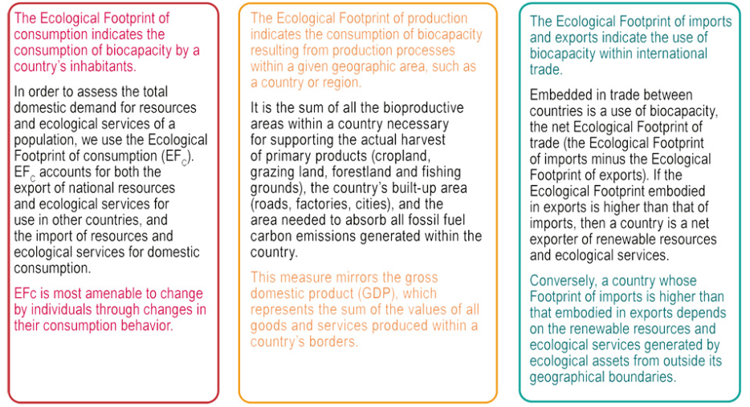

Slide 12
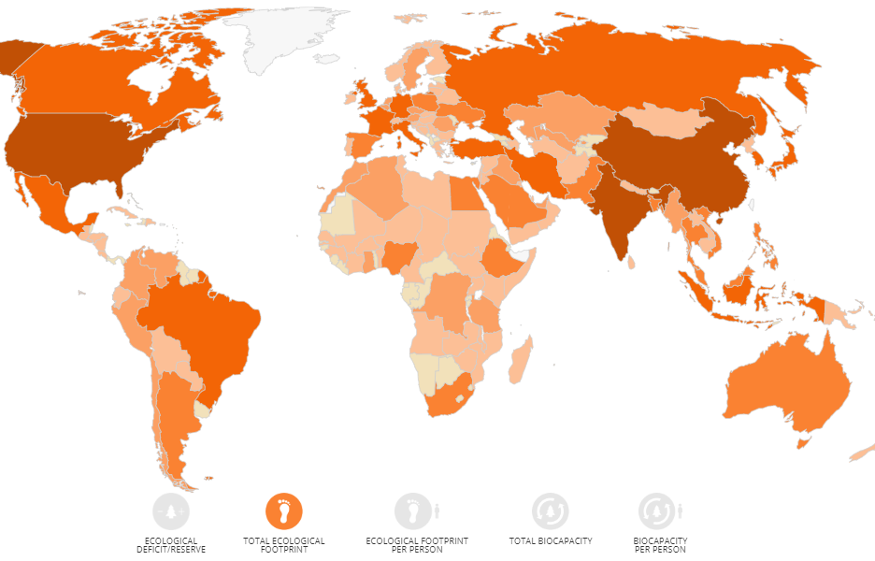
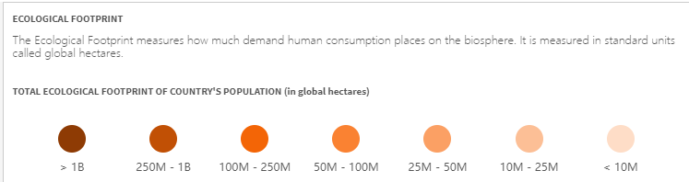

Slide 13
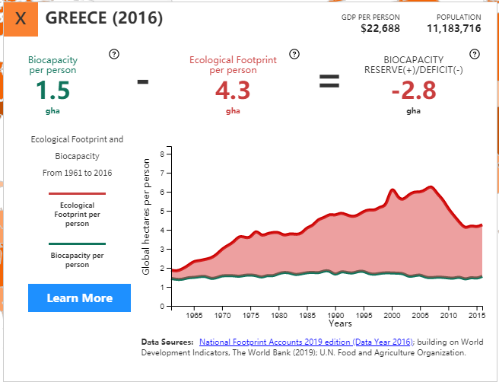

Slide 14
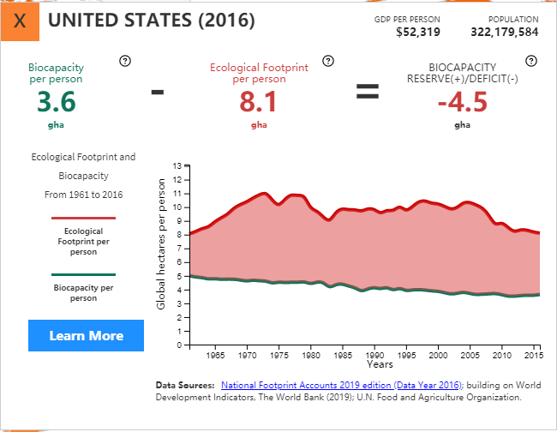

Slide 15
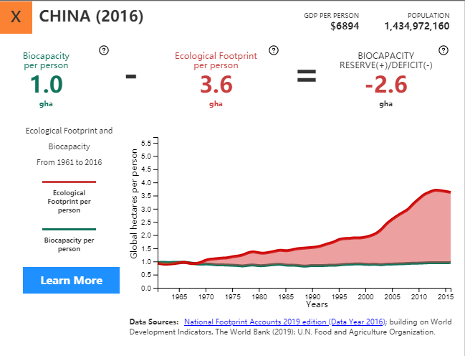

Slide 16
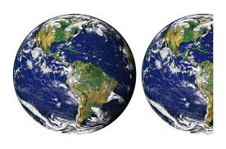
Global Footprint Network estimates that, as of 2014, humanity has been using natural capital 1.7 times as fast as Earth can renew it.
This means humanity's ecological footprint corresponds to 1.7 planet Earths!

Slide 17
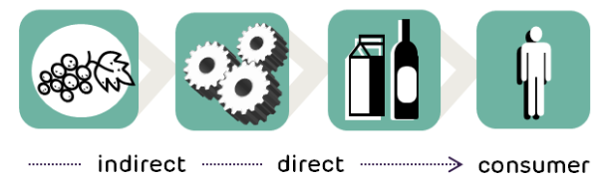
2. The Water Footprint
The water footprint measures the amount of water used to produce each of the goods and services we use.
https://watercalculator.org/
https://www.waterfootprint.org/resources/interactive-tools/personal- water-footprint-calculator/

Slide 18
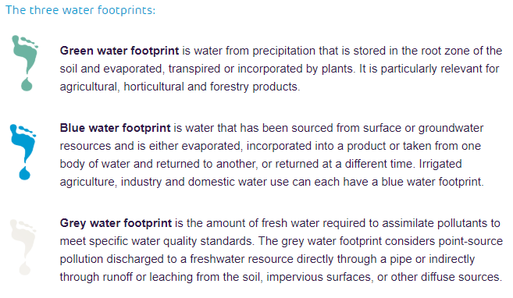



Slide 19
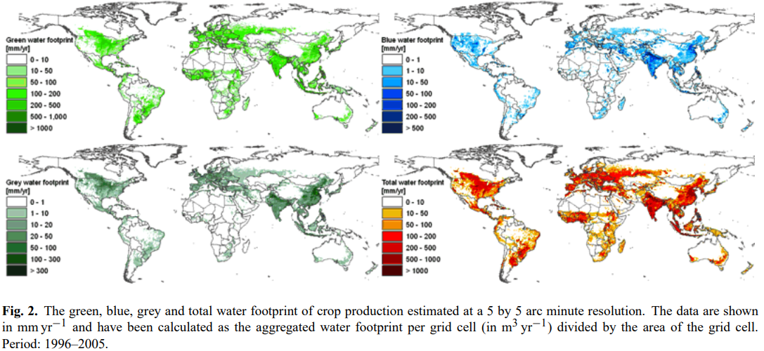
Source: M. M. Mekonnen and A. Y. Hoekstra, 2011. The green, blue and grey water footprint of crops. Hydrol. Earth Syst. Sci., 15, 1577–1600

Slide 20
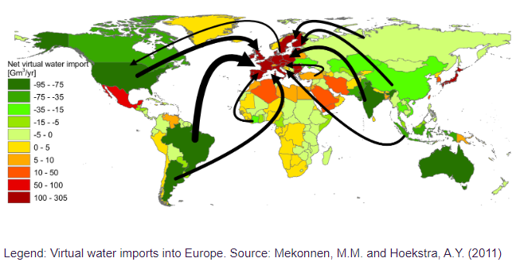

Slide 21
3. The IPAT Identity
The IPAT identity formalises the drivers of the environmental impact:
I = P x A x T
I: impact of human activity on the environment, measured as mass or volume
P: population size
A: per capita affluence, in currency units
T: technology, amount of the resource used or waste generated per unit production

Slide 22

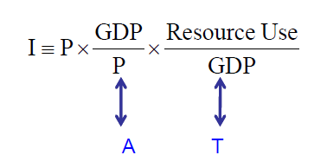
2. The IPAT Identity
T could be resources or waste per GDP. e.g. for the case of resource use, IPAT is translated as:
https://web.mit.edu/2.813/www/Class%20Slides%202008/IPAT%20Eq.pdf

Slide 23

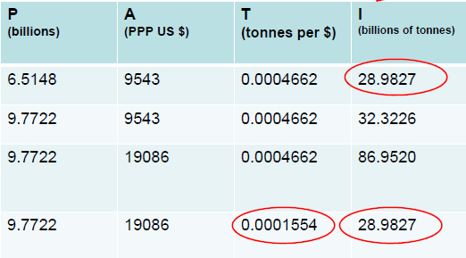
3. The IPAT Identity
Source: UNDP (2007) Tables 1, 5 and 24

Slide 24
4. Material Flow Analysis (MFA)
Material Intensity (MI): DMC^{*1}/GDP
Energy Intensity (EI): DEC^{*2}/GDP
Social or industrial metabolism: DMC/capita; DEC/capita.
Material:fossil fuels; biomass; ores-industrial (non-metallic) minerals; construction (measured in 1000 tons/yr)
Energy=oil; coal; natural gas; hydroelectric, nuclear, and geothermal electricity; bio-fuels (measured in Peta-joule/yr)
^{*1} Domestic material consumption (DMC)=domestic extraction + material imports – material exports
^{*2} Domestic Energy Consumption (DEC)=domestic energy production + energy imports – energy exports

Slide 25
4. Material Flow Analysis (MFA)
Domestic material consumption (DMC)=domestic extraction + *(material imports – material exports)
Domestic Energy Consumption (DEC)=domestic energy production + *(energy imports – energy exports)
*Physical Trade Balance = energy/material imports – energy/material exports

Slide 26
4. Material Flow Analysis
What is (de)coupling?
What is the (De)coupling effect?
Generally speaking, two variables are said coupled if one is driven by the other, making them evolve in proportion (for instance, more of A means more of B); and they decouple when they cease to do so. When coupled, both the driven and driving variables move in step, which means that they evolve over time proportionally. Decoupling refers to a variation over time of the coefficient of proportionality, corresponding to a desynchronization between the two variables tends.
Source: Decoupling Debunked report, 2019

Slide 27
4. Material Flow Analysis
What is relative decoupling?
Relative decoupling, for example between GDP and carbon emissions, refers to a situation where the emissions per unit of economic output (the coefficient of proportionality) declines but not “fast enough” to compensate for the simultaneous increase in output over the same period, resulting in an overall increase in total emissions. As a result, although the economy is relatively less impactful per unit of GDP compared to what it was before, the absolute volume of emissions has nonetheless increased.

Slide 28
4. Material Flow Analysis
What is absolute decoupling?
Absolute decoupling is a situation where, to stay with the same example, more GDP coincides with lower emissions. Relative decoupling becomes absolute decoupling when the growth rate of the economy is overcompensated by the growth rate of efficiency or productivity having to do with the use of natural resources and the generation of pollutions
When decoupling is absolute, environmental pressures decline without a corresponding drop in economic activities, or vice versa, economic activities rise without an increase in environmental pressures.

Slide 29
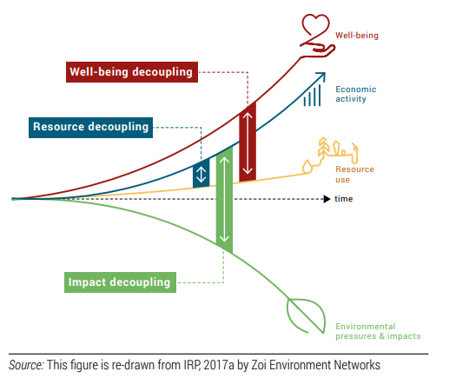

Slide 31
A. Material Intensity for Global Level, the USA, Japan and India

Slide 32
A. Material Social/Industrial Metabolism Global Level, the USA, Japan and India (per capita material consumption)

Slide 33
Β. Energy Intensity for Global Level, the USA, Japan and India

Slide 34
Β. Energy Social/Industrial Metabolism Global Level, the USA, Japan and India (per capita energy consumption)

Slide 35
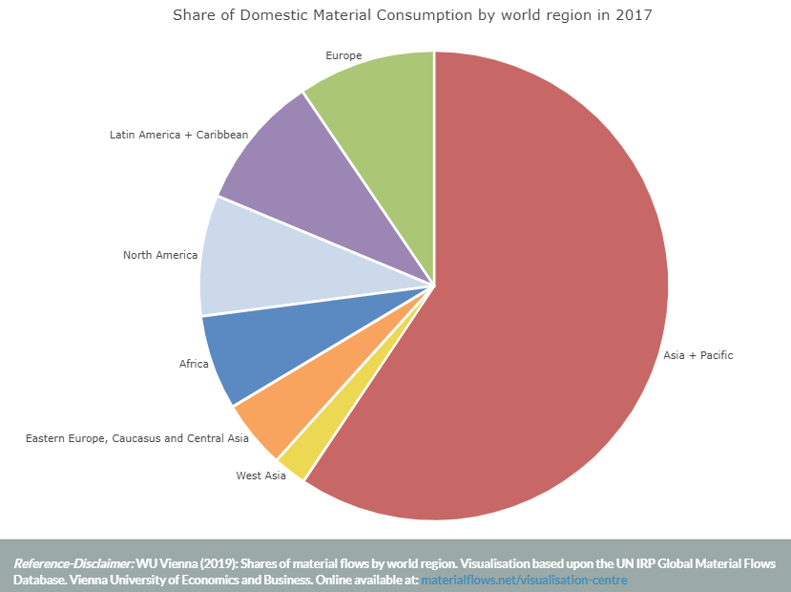

Slide 36

Is then decoupling a reality?
Is it feasible?
https://eeb.org/library/decoupling-debunked/

Slide 38
5. Environmental Kuznets Curve (EKCs) Hypothesis
The environmental Kuznets curve is a hypothesized relationship between environmental quality and economic development: various indicators of environmental degradation tend to get worse as modern economic growth occurs until average income reaches a certain point over the course of development.
The EKC suggests, in sum, that "the solution to pollution is economic growth.“
Source: Wikipedia

Slide 39
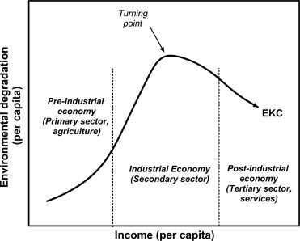
4. Environmental Kuznets Curves’ (EKCs) Hypothesis
Source: Kaika & Zervas, 2013

Slide 40


5. Environmental Kuznets Curve (EKCs) Hypothesis
There is empirical evidence supporting the inverted U-shaped curve as per capita income and/or GDP rise for e.g. water indicators, air pollution (CfCs and CO2), deforestation and ecological footprint.
Resources consumption (e.g. Energy)
Land use
Fisheries
Soil fertility
Ecosystem services
See more here: https://ccep.crawford.anu.edu.au/sites/default/files/publication/ccep_crawford_anu_edu_au/2014-06/ccep1404.pdf
https://steadystate.org/wp-content/uploads/Stern_KuznetsCurve.pdf

Slide 41
6. The Kaya Identity
The total emission level of the greenhouse gas CO2 can be expressed as the product of 4 factors:
human population,
GDP per capita,
energy intensity (per unit of GDP),
carbon intensity (emissions per unit of energy consumed)

Slide 42


6. The Kaya Indentity
https://web.mit.edu/2.813/www/Class%20Slides%202008/IPAT%20Eq.pdf

Slide 43
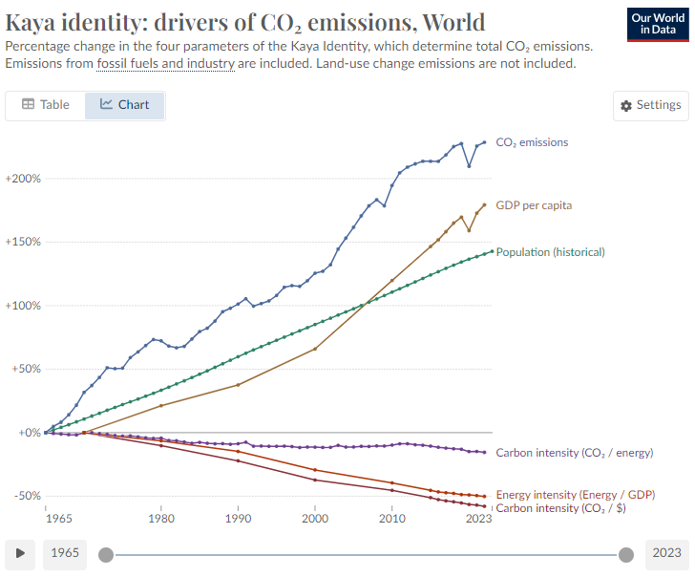
3. The IPAT Identity
https://ourworldindata.org/grapher/kaya-identity-co2

Slide 44

Some more Staff!!

Slide 45
7. The Planetary Boundaries Approach
The planetary boundaries concept presents a set of nine planetary boundaries within which humanity can continue to develop and thrive for generations to come:
Stratospheric ozone depletion
Loss of biosphere integrity (biodiversity loss and extinctions)
Chemical pollution and the release of novel entities
Climate Change
Ocean acidification
Freshwater consumption and the global hydrological cycle
Land system change
Nitrogen and phosphorus flows to the biosphere and oceans
Atmospheric aerosol loading

Slide 46
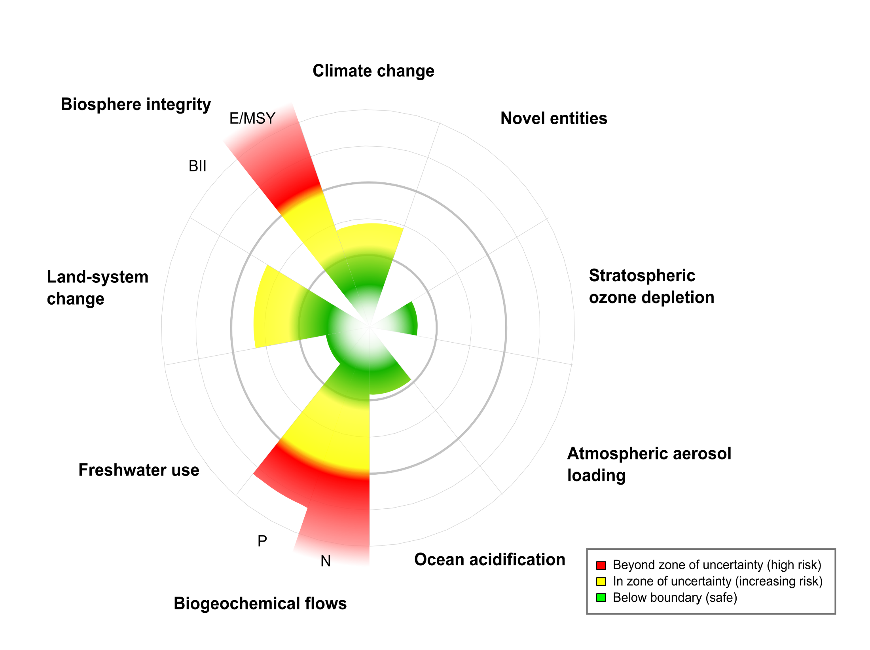
Source: Steffen and others, 16 January 2015, Science

Slide 47
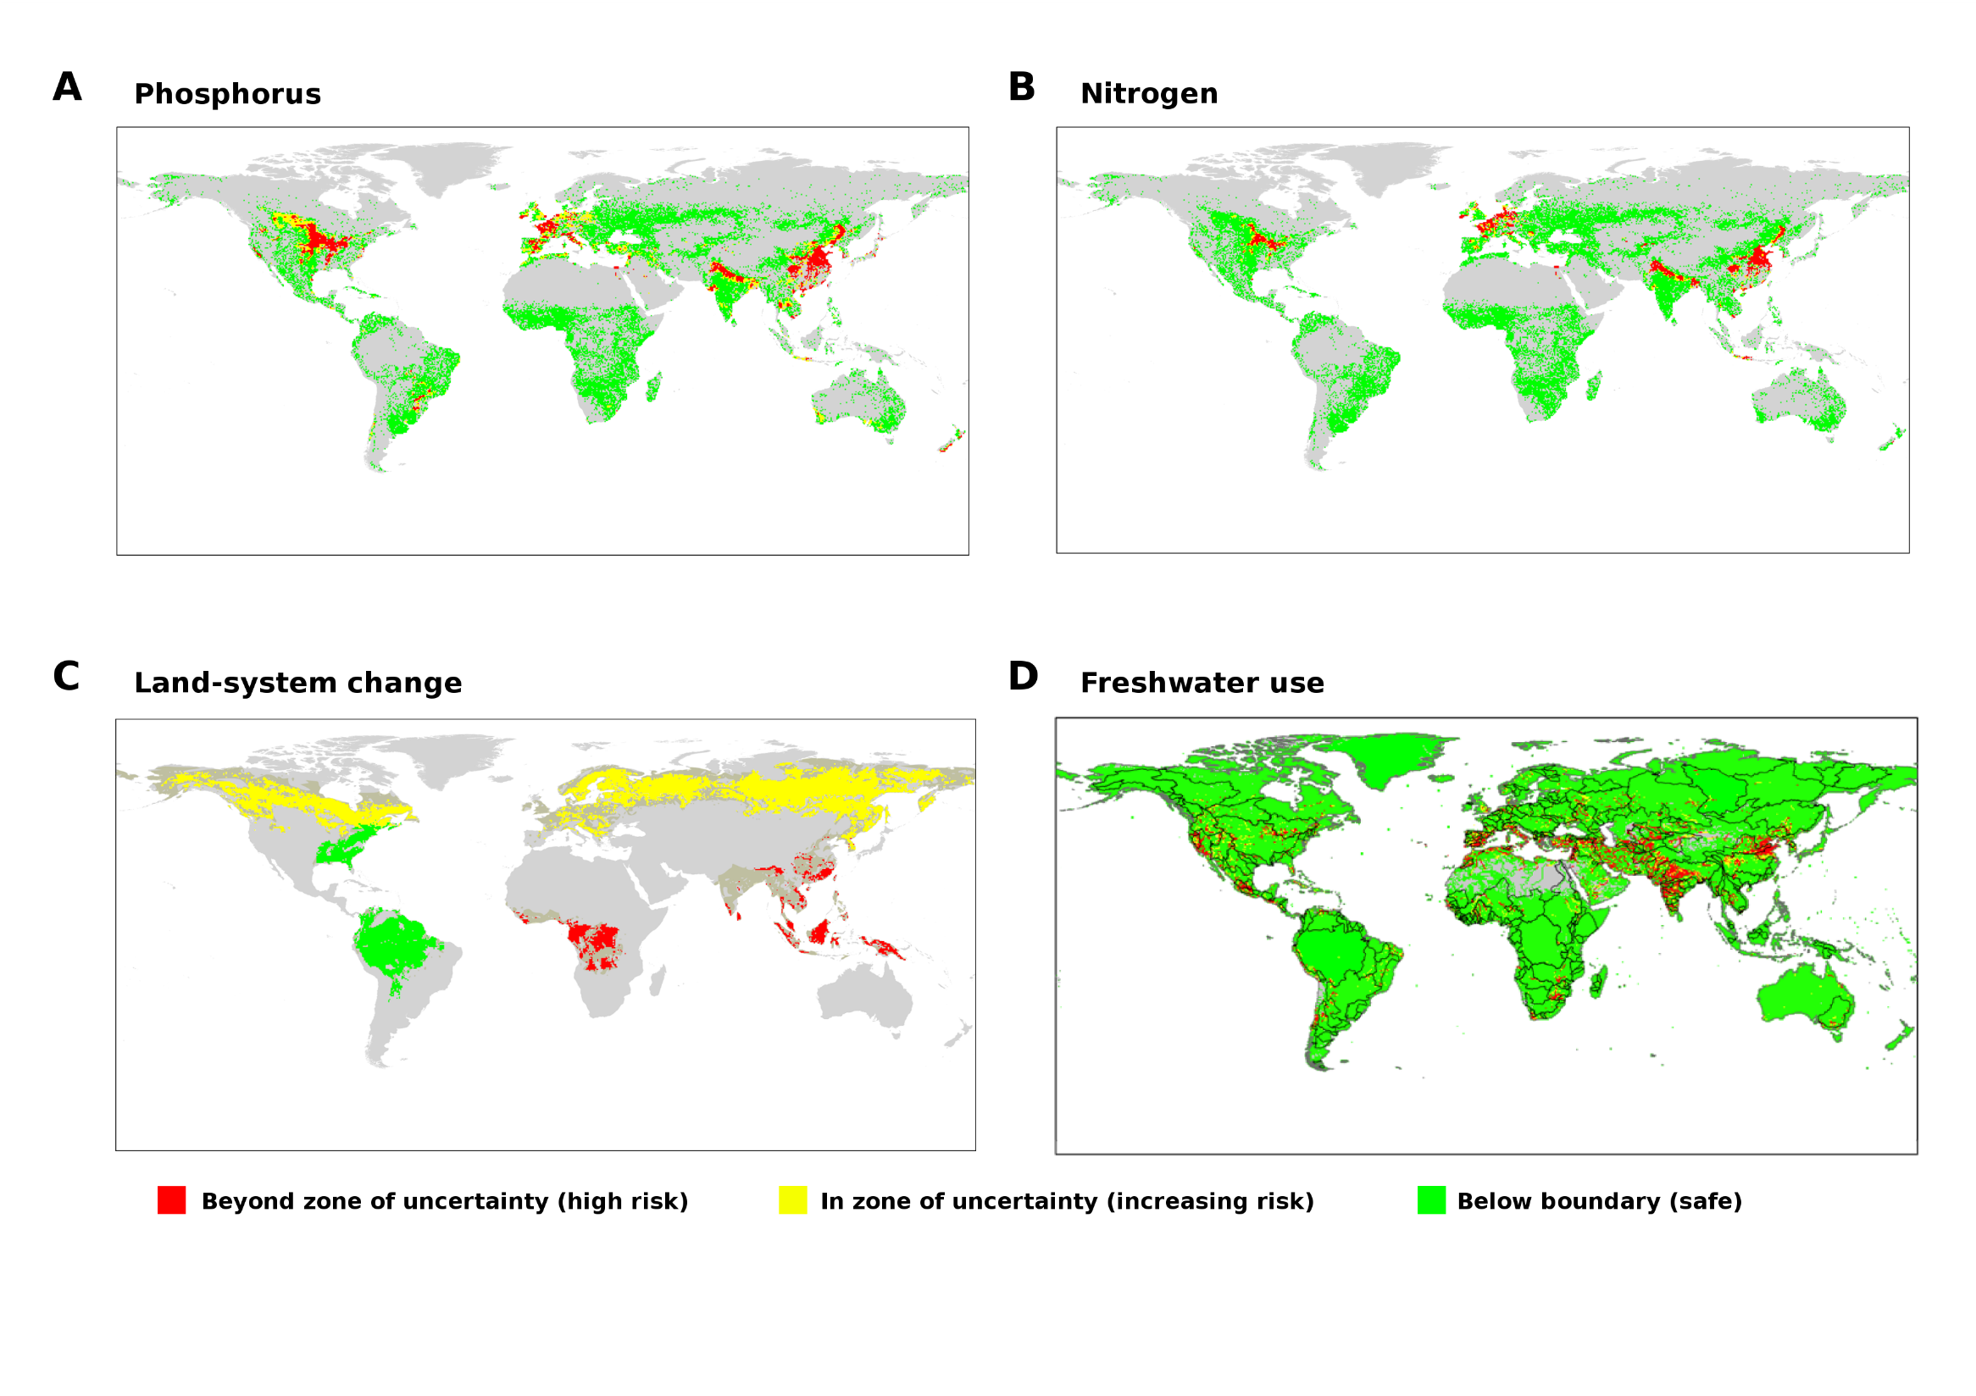

Slide 48
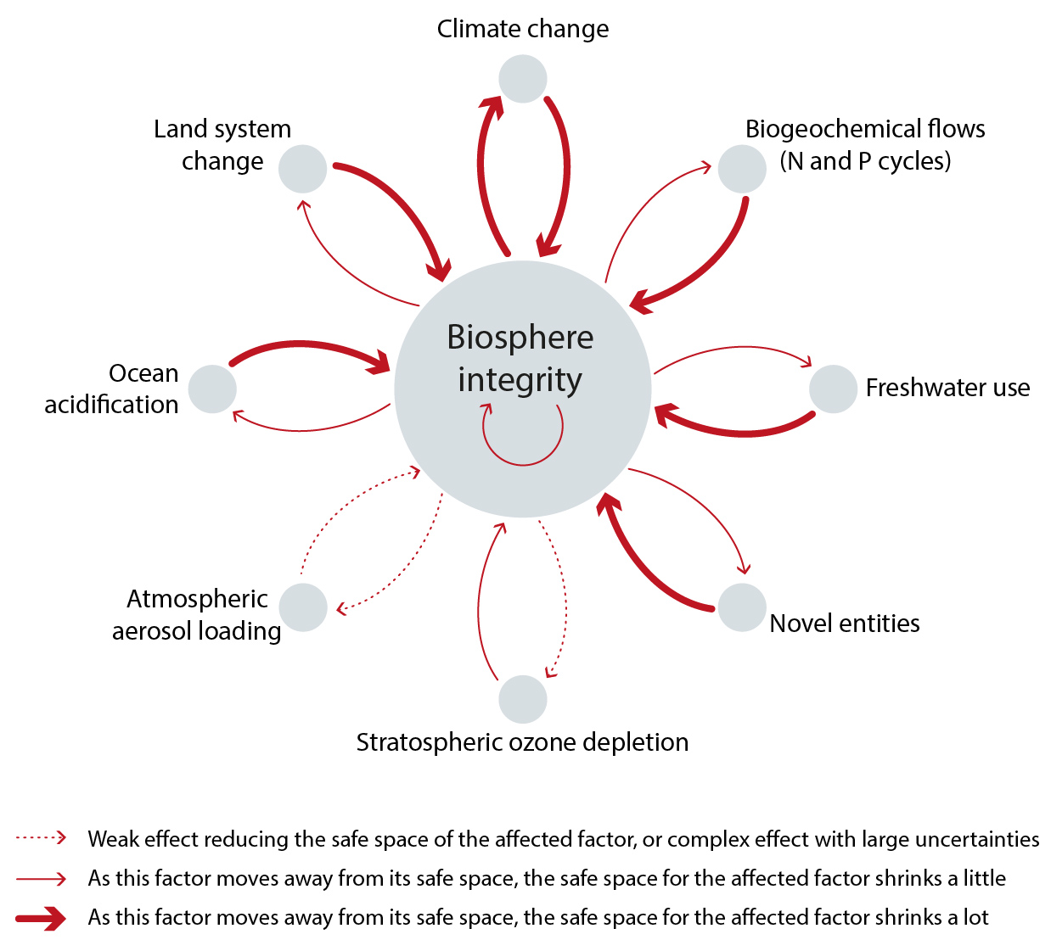
G.M. Mace et al., Approaches to defining a planetary boundary for biodiversity. Global Environ. Change 28, 289-297

Slide 49
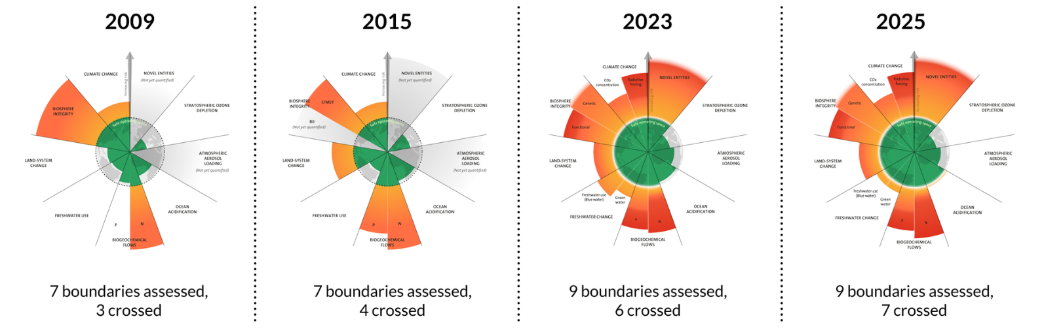
https://www.stockholmresilience.org/research/planetary-boundaries.html

Slide 50
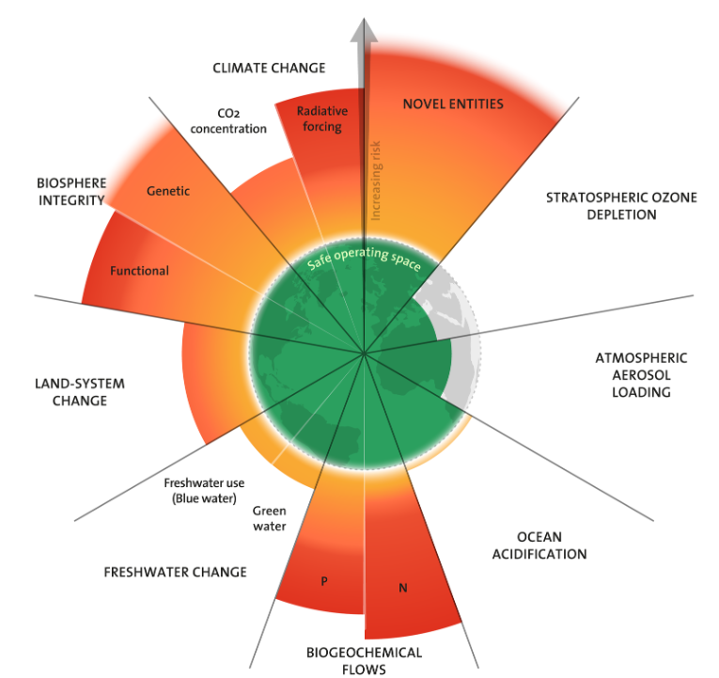
https://www.stockholmresilience.org/research/planetary-boundaries.html
https://www.planetaryhealthcheck.org/#reports-section

Slide 51

Useful Links – Sources:
http://data.footprintnetwork.org/#/
https://mk0eeborgicuypctuf7e.kinstacdn.com/wp-content/uploads/2019/07/Decoupling-Debunked.pdf
https://www.stockholmresilience.org/research/planetary-boundaries/planetary-boundaries/about-the-research/the-nine-planetary-boundaries.html
https://waterfootprint.org/en/water-footprint/what-is-water-footprint/
http://www.materialflows.net/
https://eeb.org/library/decoupling-debunked/
https://www.carbonfootprint.com/calculator.aspx
https://www.planetaryhealthcheck.org/#reports-section

