Slide 1

Temporary Stability, Structural Fragility: Hegemonic Complementarity in Sino-Russian Relations
Dr Yannis Tsantoulis
Athens, Panteion University
16.12.2025

Slide 2
Outline
Introduction
Historical Evolution
The Sino-Russian Puzzle: an overview
Empirical analysis: strategic convergence and latent fractures
Convergence:
Opposition to West
Economic interdependence
Military co-operation
Institutional signalling
Divergence:
Flashpoint I: strategic asymmetries
Flashpoint II: spatial competition
Flashpoint III: institutional divergence
Flashpoint IV: differing strategic temporalities
Conclusion

Slide 3
1. Introduction
Context:
Fragile unipolarity giving way to emerging multipolarity
Systemic volatility driven by rivalries, sanctions regimes, and shifting energy geographies
Erosion of liberal order, rise of revisionism, assertive authoritarianism, and competing governance models
Intensified Sino-American rivalry → strategic hedging, alignment-by-necessity, and coalitions of convenience
Research Question:
How does the post-2022 Sino-Russian relationship reinforce or challenge expectations about alliance fluidity, hegemonic competition, and strategic convergence?
Objective:
Explain the logic behind Sino-Russian alignment
Preliminary remark:
Indications of deepening alignment but structural contradictions limit long-term cohesion

Slide 4
2. Historical Background
From Revolutionary Allies to Strategic Rivals: 1949–1969
Deep Strategic Hostility and Competitive Coexistence: 1969-1991
Post-Cold War Normalisation: 1991–2014
Post-Crimea Strategic Convergence: 2014–2022
Key takeaway
Sino-Russian relations: historically between alliance, rivalry, and pragmatic cooperation
Pattern
Ideology matters less than power, security, and autonomy
Alignments emerge and dissolve according to structural pressures
Asymmetry and mistrust persist beneath periods of convergence

Slide 5
3. The Sino-Russian Puzzle: an overview
Table 1: Sino-Russian relations: an overview of the literature
Categorisation | Scholars (selection)
A de facto alliance | (Karaganov, 2007; Kashin, 2014)
An alliance in the making | (Buzhinky, 2016; Xuetong, 2016; Wenmu, 2016)
Not an alliance | Russian-Chinese Official Documents (2021, 2022, 2023)
Not an alliance and not likely to become one | (Allison, 2019; Hill and Lo, 2013; Mattis, 2018; Trenin, 2019; Ying, 2016; Xie, 2018)
A partnership | (Feng and Huang, 2014; Lukin, 2018; Official Documentation)
An alignment | (Coats, 2019)
Other categorisations (e.g. Authoritarian Axis, Entente) | (Korostikov, 2019; Trenin, 2018; Elings and Sutter, 2018)

Slide 6
3. The Sino-Russian Puzzle
Key perspectives
Axis of Convenience
Deepening Strategic Partnership
Asymmetrical and Tactical Alignment
Key takeaway: Each offers a different interpretation of the logic and durability of the partnership

Slide 7
3. The Sino-Russian Puzzle
The “Axis of Convenience” Perspective
Relationship: pragmatic, tactical, and shallow
Cooperation stems from shared dissatisfaction with Western influence, not deep strategic convergence (Lo, 2018)
Evidence:
Russia’s suspension of arms sales
Russia’s hedging between China and Japan on energy issues
Enduring historical mistrust rooted in the Sino-Soviet split (Radchenko, 2009; Rothschein, 2024)
Key takeaway: Transactional behaviour → incoherent partnership

Slide 8
3. The Sino-Russian Puzzle
The “Deepening Strategic Partnership” Perspective
Relationship: substantive and increasingly institutionalised (Korolev, 2019; Peters, 2023; Sagild and Hsiung, 2024)
Key drivers:
Russia’s turn to China after the 2008 financial crisis
Western sanctions following Crimea (2014)
Evidence:
2001 Treaty of Good-Neighborliness and its renewal in 2022
Expansion of military-technical cooperation and regular joint drills
High-level diplomatic coordination and shared commitment to multipolarity
Coordination in emerging non-Western institutions
Key takeaway: strategic partnership, not a formal alliance

Slide 9
3. The Sino-Russian Puzzle
The “Asymmetrical and Tactical Alignment” Perspective
Relationship: partnership is deepening but uneven (Gabuev, 2022)
China’s dominance has intensified Russia’s dependence
Areas of contestation:
Central Asia: BRI challenges Russia’s traditional influence (Rolland, 2017)
Arctic: China’s ambitions clash with Russia’s sovereignty claims
Evidence
Joint military exercises conceal lingering mistrust over sensitive technologies.
China’s refusal to engage directly in the war in Ukraine
Key takeaway: a strategic but fragile alignment under duress

Slide 10
3. The Sino-Russian Puzzle
Overview:
The debate largely oscillates between two poles:
Tactical convenience
Strategic deepening
But they:
underplay strategic asymmetries and how they shape long-term fragility.
underestimate China’s slow, expansionary rise and Russia’s reactive revisionism
ignore the interaction between asymmetry and divergent strategic time horizons

Slide 11
4. Strategic Convergence and Latent Fractures
Convergence: political and economic
Shared Opposition to Western Primacy (Wilkins, 2012)
Framing of global politics through a multi-polarity narrative
Economic Interdependence and Sanctions-Induced Realignment
Power of Siberia pipeline (38 bcm by 2025); negotiations for Power of Siberia 2 (50 bcm)
China became Russia’s top oil market in 2023
Rising use of renminbi in bilateral trade; advancing de-dollarisation narratives (Skalamera, 2018)
Key takeaway: shared opposition to the West → spill-over to the economic realm

Slide 12
4. Strategic Convergence and Latent Fractures
Convergence: military
Joint exercises as high-visibility signalling:
Naval drills in the Mediterranean (2015) and Baltic Sea (2017)
Joint bomber patrols over the Sea of Japan/East China Sea (2019, 2021)
Major 2023 exercises near Japan, projecting simultaneous pressure in Europe and Asia (Sagild and Hsiung, 2024)
Arms transfers and defence technology (e.g. Russian S-400 air defence systems, Su-35 fighter jets, and aircraft engines sold to China)
Defence dialogues and institutional links (i.e. high level defence consultations, military-to-military communication, etc.)

Slide 13
4. Strategic Convergence and Latent Fractures
Convergence: institutional
Institutional Signalling and Veto Coordination
At the UN Security Council:
China and Russia jointly veto or abstain to block Western-backed resolutions
Within BRICS:
Opposition to Western interventionism
Advocate reform of Western dominated institutions such as the IMF, the World Bank, etc. promoting greater representation
De-dollarisation efforts (Mozias, 2023)
Key takeaway: both cultivate the image of a united non-Western bloc

Slide 14
4. Strategic Convergence and Latent Fractures
Divergence: flashpoint I – strategic asymmetries (energy)
The backbone of the post-2022 alignment, but also its biggest imbalance
Russia’s growing dependence
Russia has redirected most of its oil and gas exports to Asia, especially China (Henderson and Mitrova, 2020)
By 2023:
China became Russia’s largest energy customer, importing 2+ million barrels/day of crude, surpassing Saudi Arabia (IEA, 2023)
Power of Siberia gas flows hit record levels; negotiations for Power of Siberia 2 highlight Moscow’s urgent need for long-term demand
Russia’s bargaining position has weakened dramatically as it sells crude at up to 30% discounts to maintain Chinese demand (Lo, 2021)

Slide 15
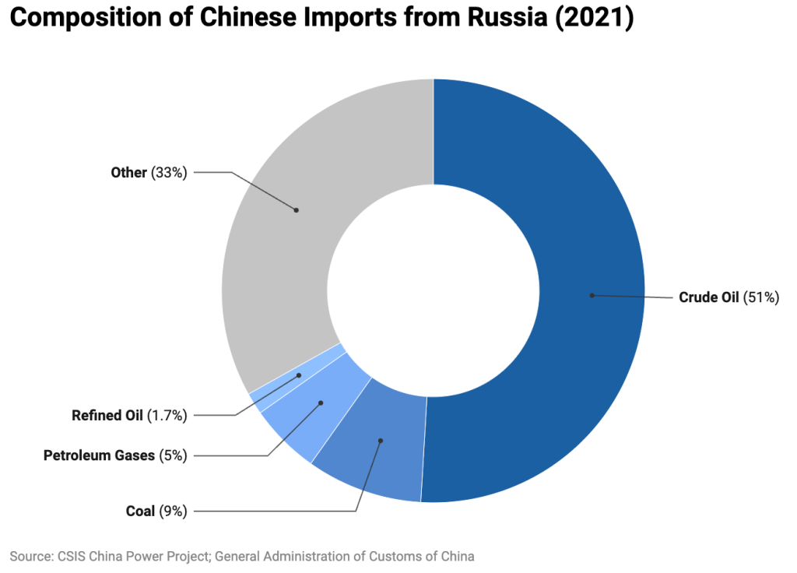
4. Strategic Convergence and Latent Fractures
Divergence: flashpoint I – strategic asymmetries (energy)
Graph 1: Composition of Chinese Imports from Russia (2024)
Source: CSIS (2025).

Slide 16
4. Strategic Convergence and Latent Fractures
Divergence: flashpoint I – strategic asymmetries (energy)
Payments into renminbi, supporting Beijing’s de-dollarisation strategy
RMB use in Russia’s foreign trade rose from <5% pre-war to ~25% in 2023 (Bank of Russia)
Stable supplies at low prices while enhancing financial influence over Russia
Key takeaway:
China: gains diversification, cheap energy, and expanded financial influence
Russia: accepts dependence, with China now accounting for 40%+ of its energy exports
Russia needs China for survival; China needs Russia only for diversification
Functionally compatible but structurally precarious arrangement
Russia risks becoming a “raw material appendage” to China’s industrial economy (Wilson, 2021)

Slide 17
4. Strategic Convergence and Latent Fractures
Divergence: flashpoint I – strategic asymmetries (military)
Expanding Exercises, Limited Interoperability
By mid-2025, China and Russia had conducted 113 joint drills since 2003; over half after 2018
Exercises now span naval, air, ground, and Arctic operations (CSIS, 2025)
High-profile drills, such as Joint Sea 2025 in the Sea of Japan, included simulated submarine attacks and coordinated maritime strikes representing a clear signalling to the U.S. and regional allies (Weitz, 2022)

Slide 18
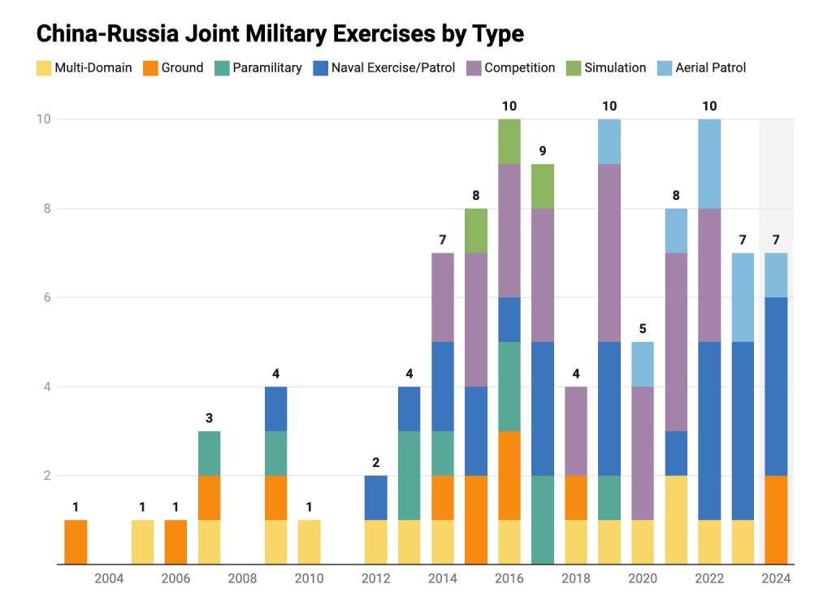
4. Strategic Convergence and Latent Fractures
Graph 2: China-Russia Joint Military Exercises by Type
Source: CSIS (2025).

Slide 19
4. Strategic Convergence and Latent Fractures
Divergence: flashpoint I – strategic asymmetries (military)
But:
Exercises remain scripted and symbolic, focusing on formation sailing, basic live-fire demonstrations, and joint patrols
No integrated command structure, limited logistics coordination, and no sharing of sensitive operational doctrine (Weitz, 2022)
Ceiling: cooperation is designed for visibility, not for genuine war-fighting integration

Slide 20
4. Strategic Convergence and Latent Fractures
Divergence: flashpoint I – strategic asymmetries (military)
Arms Transfers: Expansion with Clear Limits
Russia has sold China Su-35s and S-400 systems, but continues to restrict access to its most advanced technologies (e.g., S-500, hypersonics)
Russia fears reverse engineering and further erosion of its arms-export edge (Peters, 2023)
China’s rapid defence-industrial growth has reduced its dependence on Russian imports as Russian arms exports have declined by 60% (SIPRI, 2025)

Slide 21
4. Strategic Convergence and Latent Fractures
Divergence: flashpoint I – strategic asymmetries (military)
Industrial Dependence and Dual-Use Vulnerabilities
Russia relies heavily on Chinese suppliers for electronics, machine tools, and chemicals used in weapons production
Up to 80% of components in Russian drones originate from China (Reuters, 2025)
This deepens an industrial asymmetry, with China becoming Russia’s essential but cautious provider

Slide 22
4. Strategic Convergence and Latent Fractures
Divergence: flashpoint I – strategic asymmetries (summary)
Key takeaway:
A high-signal, low-integration equilibrium:
Both benefit from the deterrent optics of cooperation
Both avoid the risks of entrapment or doctrinal exposure
But:
deepening structural asymmetries enable tactical convergence but undermine long-term stability
Asymmetry acts as both a driver of cooperation and a latent fault line

Slide 23
4. Strategic Convergence and Latent Fractures
Divergence: flashpoint II – spatial competition (Central Asia)
Historically Russia’s sphere of influence, now shaped by China’s economic power (Peyrouse, 2023)
China’s BRI has transformed regional trade patterns: China’s trade with the region USD 70bn, Russia’s USD 40bn (Wilson, 2021)
Local agency matters
Central Asian governments actively exploit Sino-Russian competition (Allison, 2022)
A fragile division of labour
Russia retains a security role (CSTO, military bases)
China dominates economic influence (BRI, loans, trade)
Key takeaway: a slow structural shift (i.e. China rises as Russia declines) undermining long-term partnership stability.

Slide 24
4. Strategic Convergence and Latent Fractures
Divergence: flashpoint II – spatial competition (Arctic Circle)
Russia
Arctic as a sovereign sphere: i) unilateral control of the Northern Sea Route, ii) military modernisation, iii) expansive resource exploitation (Rowe, 2020)
Soviet bases, advanced missile systems, nuclear icebreakers
China
A “near-Arctic state”; views the region as a global commons (Zhao, 2019)
Multilateral governance, Polar Silk Road integrated into the BRI (Lanteigne, 2022)
Cooperation with contradictions
China finances key Russian energy projects (Yamal LNG, Arctic LNG-2)
Russia fears China’s approach erodes its sovereignty claims (Pepermans, 2022)
Key takeaway: Russian unilateralism vs. Chinese expansion → strategic incompatibility

Slide 25
4. Strategic Convergence and Latent Fractures
Divergence: flashpoint II – spatial competition (Africa)
Russia’s approach: security and coercion
Arms sales, military partnerships, and paramilitary deployments (e.g. Wagner)
Supporting fragile regimes and undermining Western presence (Wezeman et al., 2022)
China’s approach: development and investment
Infrastructure finance, concessional loans, and trade (e.g. FOCAC, BRI projects)
Seeks stable environments to secure long-term economic returns (Brautigam, 2020)
Points of friction
Sudan: Russia’s engagement with military leaders conflicts with China’s need for stability
Mali and CAR: Russian paramilitary activity creates volatility that undermines Chinese commercial goals (Saradzhyan and Wyne, 2018)
Key takeaway: Russia’s disruptive tactics vs. China’s integrative model → incompatible strategies

Slide 26
4. Strategic Convergence and Latent Fractures
Divergence: flashpoint II – spatial competition (summary)
Central Asia, the Arctic, and the Global South: pattern
Temporary complementarity exists only under external pressure
Long-term incompatibility stems from overlapping hegemonic ambitions
Relative gains logic fosters mistrust, not institutionalised cooperation
Key takeaway and prediction (?): Spatial competition is likely the first arena where cracks in the Sino-Russian partnership will surface once systemic constraints ease

Slide 27
4. Strategic Convergence and Latent Fractures
Divergence: flashpoint III – institutional areas of cooperation
Both states use institutions to challenge Western dominance, but their strategies diverge sharply (Bossuyt and Kaczmarski, 2021)
Russia:
uses institutions for symbolic disruption and short-term political signalling
China:
uses institutions for long-term institutional embedding and normative influence

Slide 28
4. Strategic Convergence and Latent Fractures
Divergence: flashpoint III – institutional areas of cooperation (BRICS)
Russia’s approach
BRICS as a geopolitical counterweight to the West
Anti-Western rhetoric and symbolic multipolarity
BRICS used to demonstrate continued relevance amid isolation
China’s approach
BRICS as an economic governance platform aligned with its development and finance agenda
Dominates BRICS’ institutional architecture (e.g. New Development Bank, CRA)
Promotion of the 2023 expansion (Saudi Arabia, Iran, Egypt, UAE, Argentina) as part of a China-centred financial and geopolitical bloc
Key takeaway: a core asymmetry → Russia relies on rhetoric; China builds institutions and shapes multipolarity in institutional terms

Slide 29
4. Strategic Convergence and Latent Fractures
Divergence: flashpoint III – institutional areas of cooperation (UNSC)
UN Security Council: Coordination Without Coherence
2011–2020: Russia and China jointly vetoed 10 resolutions on Syria
Yet their justifications differed:
Russia: sovereignty as a political weapon to counter Western criticism
China: legalistic defence of non-interference (Allison, 2022)
After the 2022 invasion of Ukraine:
Russia uses the UNSC as a stage for disruption of Western narratives
China increasingly abstains, avoiding explicit endorsement of Russia’s war
Key takeaway: tactical, not strategic coordination

Slide 30
4. Strategic Convergence and Latent Fractures
Divergence: flashpoint III – institutional areas of cooperation (SCO)
Russia
Emphasises security, counterterrorism, and military exercises (“Peace Mission”)
SCO enlargement (India, Pakistan, Iran) as a geopolitical move to dilute Western influence
China
Embeds the SCO within the economic architecture of the BRI
Focuses on connectivity, trade, and infrastructure
Shapes the organisation’s long-term direction, raising concerns in Moscow
Key takeaway: imbalance → China expands institutional leadership; Russia clings to security symbolism

Slide 31
4. Strategic Convergence and Latent Fractures
Divergence: flashpoint III – institutional areas of cooperation (summary)
BRICS, the UNSC, and the SCO: pattern
Russia acts as a disruptive, securitising power
China acts as an institution-builder and long-term shaper of global governance
Cooperation persists, but only at a tactical level
Key takeaway: Institutions have magnified divergent strategies and power capacities

Slide 32
4. Strategic Convergence and Latent Fractures
Divergence: flashpoint IV – divergent strategic temporalities
Russia’s Short-Term Revisionism:
Urgency, decline, and need for rapid geopolitical gains
Short-term disruption: Crimea (2014), Syria (2015), Ukraine invasion (2022)
China’s Long-Term, Incremental Strategy:
Predictability and institutional embedding (BRI, Asian Infrastructure Investment Bank, etc.)
Accumulation of influence over decades, not crises
Fears that Russia’s impulsive revisionism could entangle it in destabilising confrontations
Key takeaway: Divergent temporalities → Russia trades stability for rapid geopolitical gains; China avoids destabilising shocks that threaten global integration.

Slide 33
4. Strategic Convergence and Latent Fractures
Temporal Misalignment Across Flashpoints (I, II, III)
Strategic Asymmetries
Russia trades energy at discounts for immediate revenue
China locks in long-term pricing power and RMB-denominated trade
Spatial Competition
Russia uses coercion for quick leverage
China invests in infrastructure with multi-decade returns
Arctic Circle Dynamics
Russia militarises rapidly
China embeds itself through science, governance, and multilateral discourse
Key takeaway: Temporal divergence weakens the partnership as alliances endure when strategic horizons align. Here, they do not…

Slide 34
5. Conclusion
Historical Perspective: A Cyclical Relationship
Sino-Russian ties have cycled through phases of indifference, alliance, rivalry, and strategic partnership (Machaffie, 2022)
Key historical lessons:
1950s alliance collapsed due to ideological and strategic divergences while power asymmetry deepened mistrust
Post-Cold War rapprochement produced tactical cooperation, not deep trust
Post-2014 and post-2022 alignment fits this pattern, but under new systemic constraints

Slide 35
5. Conclusion
Post-2022 Dynamics: Convergence and Limits
The war pushed Russia toward economic, technological, and diplomatic reliance on China
China benefited materially but remained cautious:
Abstentions at the UN
No lethal aid to Russia
Continued engagement with Western markets
Key takeaway: China’s refusal to be entrapped by Russia’s revisionism confirm that systemic shocks intensify alignment but do not resolve structural contradictions

Slide 36
5. Conclusion
Post-2022 Dynamics: Convergence and Limits
The Sino-Russian partnership: a tactical alignment of necessity, shaped by systemic pressure, asymmetric roles, and divergent strategic horizons:
Strategic asymmetries weaken trust
Spatial competition exposes rivalry
Institutional arenas magnify imbalance
Temporal divergence limits long-term stability
Key takeaway: alignments born of necessity rarely transcend their contradictions

Slide 37
5. Conclusion
Policy Recommendations (for the West)
Avoid treating the partnership as a monolithic bloc
It is coherent only under external pressure
Exploit asymmetries
Russia’s economic vulnerability
China’s dependence on global markets
Avoid undifferentiated containment
Overly broad Western pressure risks pushing the two closer
Prepare for temporary alignments during systemic shocks
Crises in Taiwan or energy markets could tighten cooperation even as long-term fragility persists

Slide 38
5. Conclusion
Sino-Russian Partnership:
Emblematic of 21st-century alignments: neither stable alliances nor fleeting conveniences, but tactical convergences shaped by necessity and asymmetry
Beneath the façade of unity lies structural fragility that makes long-term strategic cohesion improbable
A tactical alignment of necessity, not a maturing alliance with institutional depth
Asymmetry: the engine of cooperation and the fault line of collapse
An alignment that is:
deepening but uneven
strategically useful but not durable
cohesive under pressure but fragile in the long run

Slide 39
References (selection)
Allison, R., 2022. Russia, Ukraine and the limits of regional order in Central Asia. International Affairs, 98(5), pp.1657–1676.
Bossuyt, F. & Kaczmarski, M., 2021. Russia and China between cooperation and competition at the regional and global level. Eurasian Geography and Economics, 62(5–6), pp.539–556.
Brautigam, D., 2020. The Dragon’s Gift: The Real Story of China in Africa. Oxford: Oxford University Press.
Cooley, A., 2019. The emerging political economy of OBOR: the challenges of promoting connectivity in Central Asia and beyond. Washington, DC: Center for Strategic and International Studies.
Gabuev, A., 2022. Friends with limits: how far will the China–Russia partnership go? Washington, DC: Carnegie Endowment for International Peace.
Hsiung, C.W. & Røseth, T., 2018. The Arctic dimension in Sino-Russian relations. In: J. Wilson & T.S. Wilkins, eds. Sino-Russian Relations in the 21st Century. Cham: Springer, pp.167–187.
International Energy Agency (IEA)., 2023. Oil Market Report. Paris: IEA.
Kaczmarski, M., 2015. Russia–China Relations in the Post-Crisis International Order. Abingdon: Routledge.
Korolev, A., 2019. On the verge of an alliance: contemporary China–Russia military cooperation. Asian Security, 15(3), pp.233–252.
Kuhrt, N. 2007. Russian Policy Towards China and Japan: The El’tsin and Putin Periods. London: Routledge.

Slide 40
References
Lanteigne, M., 2022. China’s Polar Silk Road: the Arctic and the BRI. The Polar Journal, 12(1), pp.3–23.
Lo, B., 2008. Axis of Convenience: Moscow, Beijing, and the New Geopolitics. Washington, DC: Brookings Institution Press.
Lüthi, L., 2010. The Sino-Soviet Split: Cold War in the Communist World. Princeton, NJ: Princeton University Press.
Machaffie, J.P., 2022. Russian–Chinese cooperation at the United Nations Security Council: Costly signalling and trust building in the strategic partnership. China Report, 58(4), pp.431–447.
Peters, M.A., 2023. Russia–China/China–Russia: Sino–Russian relations in the post-Soviet era. Educational Philosophy and Theory, 55(14), pp.1664–1671.
Radchenko, S., 2009. Two Suns in the Heavens: The Sino–Soviet Struggle for Supremacy, 1962–1967. Washington, DC: Woodrow Wilson Center Press.
Sagild, R.Å. & Hsiung, C.W., 2024. Chinese re-examinations of Russia? The strategic partnership in the wake of Russia’s war against Ukraine. Journal of Contemporary China.
Shinn, D. 2020. ‘Testimony before the U.S.-China Economic and Security Review Commission’, May 8, 2020. Available at: https://www.uscc.gov/sites/default/files/Shinn_Testimony.pdf. (accessed, 21 August 2025)
Wezeman, P.D., Kuimova, A. & Wezeman, S.T., 2022. Trends in International Arms Transfers, 2021. Stockholm: SIPRI.

Slide 41
References
Wilkins, T.S., 2012. ‘Alignment’, not ‘alliance’ – the shifting paradigm of international security cooperation: toward a conceptual taxonomy of alignment. Review of International Studies, 38(1), pp.53–76.
Wilson, J.L., 2021. Russia and China in Central Asia: deepening tensions in the relationship. Acta Via Serica, 6(1), pp.55–90.
Zhao, S., 2023. Multilateralism and the China-Russia nexus: The Shanghai Cooperation Organization. The Pacific Review, 36(1), pp.28–50.

Slide 42
Q&A Session
Why the Sino-Russian Partnership Will Not Become a Full Alliance?
My Thesis (in a nutshell)
1. Different Strategic Goals and Time Horizons
2. No Willingness to Share Military Risks
3. Mistrust Reinforced by the Widening Power Gap
4. Competition in Key Strategic Regions
5. Unequal Economic Relationship
6. Cooperation Driven by External Pressure, Not Shared Vision

