Slide 1
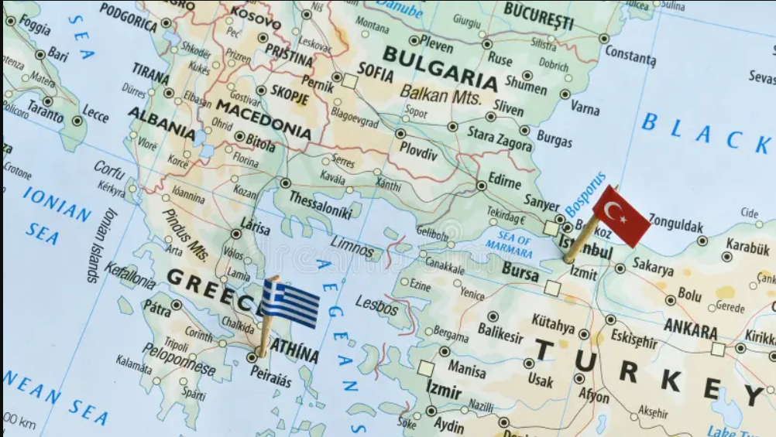
Greek – Turkish Relations, the demilitarization of the East Aegean islands and the Turkish casus belli – latest events
ΑΡΤΕΜΙΣ ΣΕΒΑΣΤΙΑΔΗ
Επιμέρους θέματα εξωτερικής πολιτικής

Slide 2
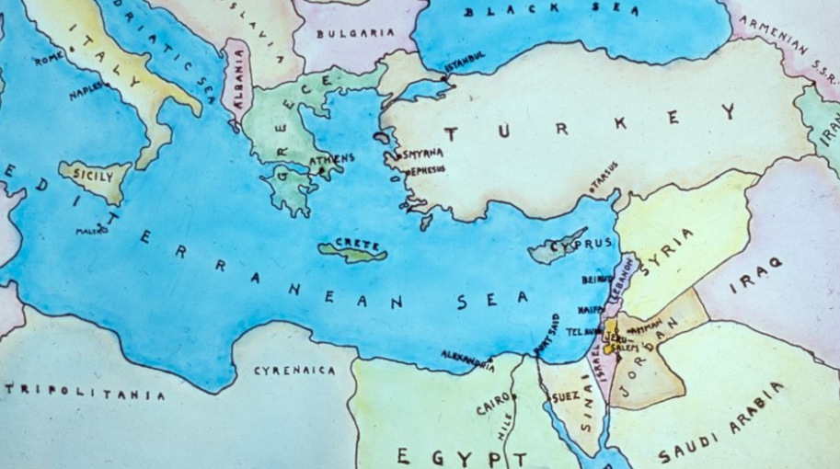
Research Focus
Greek–Turkish relations in the Aegean Sea
The legal regime of demilitarization in the East Aegean islands
The Turkish casus belli regarding the extension of territorial waters
The role of security perceptions in foreign policy decisions

Slide 3
Analytical Framework
The dispute is analyzed through three dimensions:
International treaties
Treaty of Lausanne (1923)
Montreux Convention (1936)
Paris Peace Treaty (1947)
International maritime law
UNCLOS (1982)
Security policy and alliance dynamics
UN Charter - Article 51 UN Charter (self-defense)
Arms export control act
Treaty of quarantee (1960)

Slide 4
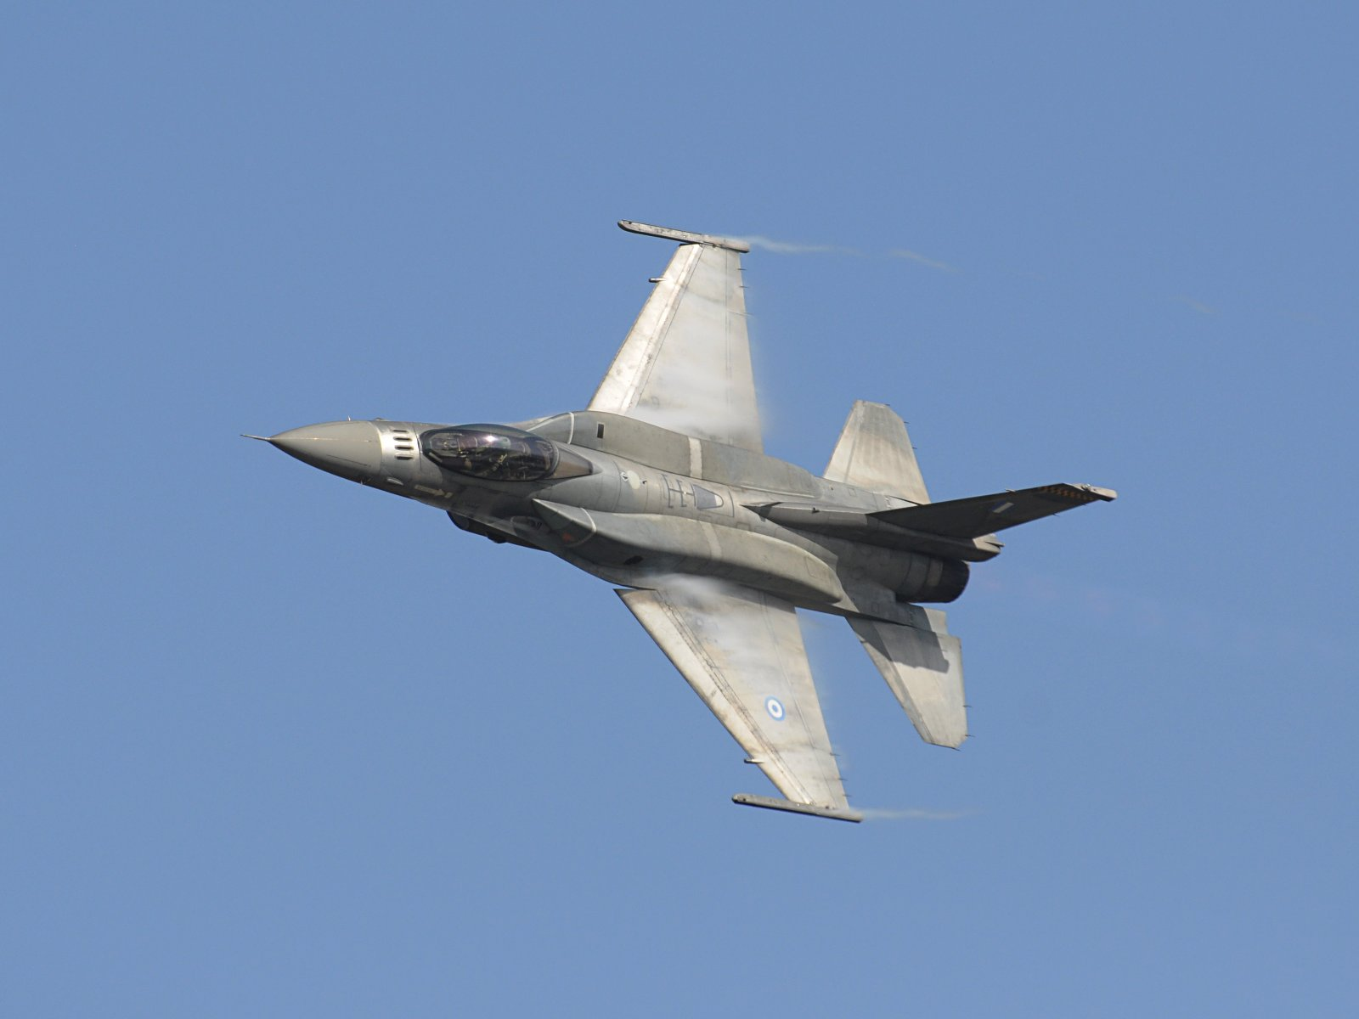
The current situation
Due to the ongoing war in the Middle East, Greece reinforced its defense posture while supporting allied countries.
The following developments illustrate how regional conflicts affect the Greek–Turkish strategic balance in the Eastern Mediterranean:
Feb 2, 2026 – F-16 deployed to Paphos
Mar 3, 2026 – Patriot deployed in Karpathos
Mar 4, 2026 – Frigates deployed with Centauros system to Cyprus
Greece also supports allied security infrastructure in Cyprus, including EU, British and US strategic facilities in the Eastern Mediterranean.

Slide 5
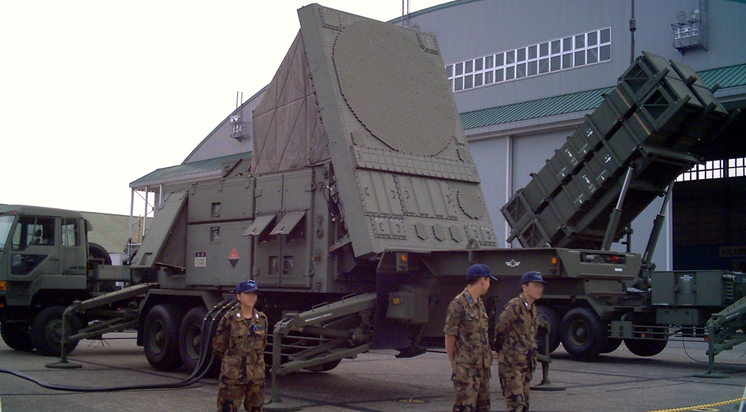
The attributes of these systems
Each of these systems has different capabilities and attributes:
F-16 fighter jets – dual-use aircraft, manufactured in the US
Belharra (FDI) and MEKO 200 HN frigates, focusing on defense
Centauros anti-drone defense system, used only for defense
Patriot missile defense system, used for missile interception

Slide 6
Historical background I
The Treaty of Lausanne (1923):
Mitilini, Samos, Ikaria and Chios are given to Greece. These islands remain demilitarized, just like the Bosphorus Straits and the islands of Imbros, Tenedos and Avlona.
The Dodecanese are given to Italy from Turkey.
The Montreux Convention (1936):
The Lausanne Treaty is getting replaced and the regime of the demilitarization of the Dardanelle Straits, Bosphorus and Marmora Sea is changing, making Turkey in charge of the security in these areas and consequently allowing their militarization.
Greece and the Aegean islands are not mentioned in this Convention at all.
The Paris Peace Treaty (1947):
The Dodecanese are given to Greece from Italy under a demilitarized regime. The involved parties are only Greece, Italy and the ally countries. Turkey is not a contracting party → treaty obligations do not apply to third states (Vienna Convention on the Law of Treaties, Art. 34 – res inter alios acta)

Slide 7
Historical background II
Article 51 of the UN:
According to Article 51 of the UN Charter, the right to self-defense exists only in the case of an armed attack and is subject to strict conditions, including immediate reporting to the Security Council.
United Nations Convention on the Law of the Sea (UNCLOS) (1982):
Every country that has signed this Convention agrees that the territorial seas extend up to 12 nautical miles. Turkey is not one of the 172 signing parties.
Arms export control act:
The US will approve or decline every use of the weapons made in their country from countries that possess these weapons.
Treaty of Guarantee (1960):
All of the guarantee – countries of Cyprus acknowledge its independence and will help the country to maintain its sovereignty.

Slide 8
Greece's Perspective
Greece invokes Article 51 in a broader security context, arguing that regional instability creates a threatening environment, requiring defensive measures. Greece has the right to support its allies (Cyprus, US military bases), while having the obligation to help Cyprus during an attack
The Montreux Convention altered the entirety of the Lausanne Treaty, therefore the demilitarization established in the latter is no longer active
The Paris Treaty does not concern Turkey at all, since the signing parties are Greece, Italy and the ally countries
Defensive systems are not considered a threat to Turkey because they are installed only for a possible attack during the US – Iran war.
Since the US hasn't confirmed or declined the sending of their F16s in Cyprus, Greece is entitled to send these aircrafts.

Slide 9
Turkey's Perspective
Turkey argues the Lausanne regime still applies to the Aegean islands since nothing is mentioned about Greece on the Montreux Convention
Greece is accused of militarizing the islands, taking advantage of the ongoing war on the Middle East
Turkey condemns the installation of the Patriot in Karpathos, while sending a formal letter to NATO regarding the Greek exploitation of the war
The Turkish Parliament has declared a casus belli in 1995 regarding the extension of territorial waters to 12 nautical miles
Greece needs permission from the US to send the F16s to Cyprus

Slide 10
Conclusion
The Aegean dispute is rooted in different interpretations of international treaties
Security concerns and alliance commitments shape the policies of both Greece and Turkey
The Turkish casus belli over the 12-nautical-mile extension remains a key source of tension
Regional crises, such as the Middle East conflict, can intensify the strategic rivalry

Slide 11
Thank you for your attention

Slide 12
Bibliography
https://www.dimosiodikaio.gr/wp-content/uploads/2025/07/dd_2025_1_stergiou.pdf
https://hephaestus.nup.ac.cy/bitstream/handle/11728/12601/%CE%96%CE%B9%CE%B1%CC%81%CE%BA%CE%B1%CF%82%20%CE%98%CE%B5%CE%BF%CC%81%CE%B4%CF%89%CF%81%CE%BF%CF%82%20-%20Thesis.pdf?isAllowed=y&sequence=1
https://pandemos-api.panteion.gr/server/api/core/bitstreams/35ae853e-2230-4579-9a97-7fe83d63d9df/content
https://www.cnn.gr/ellada/story/522358/efthasan-stin-karpatho-oi-patriot-eikones-apo-ti-metafora-ton-pyraylon
http://legal.un.org/repertory/art51/english/rep_supp2_vol2_art51.pdf
https://treaties.un.org/doc/Publication/UNTS/LON/Volume%20173/v173.pdf
https://www.mfa.gr/images/docs/kypriako/treaty_of_guarantee.pdf
https://www.govinfo.gov/content/pkg/COMPS-1061/pdf/COMPS-1061.pdf
https://www.dailysabah.com/politics/turkiye-criticizes-greece-over-militarization-of-aegean-islands/news
https://www.ekathimerini.com/politics/foreign-policy/1298566/turkey-reportedly-complains-about-karpathos-missiles-to-nato-us-and-eu/

