Slide 1
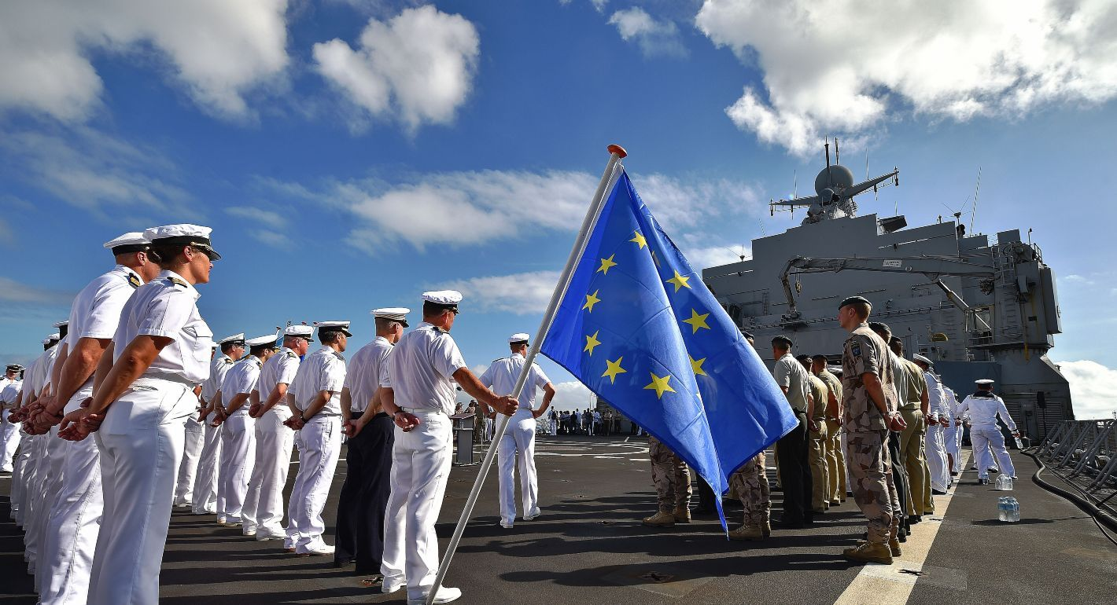
EU Common defense
VASILEIOS ANGELIDIS

Slide 2
Historical evolution
1950–1954
Failed Defense Community
1992
Treaty of Maastricht
1998–1999
Saint-Malo Declaration
1999
Cologne & Helsinki European Councils - launch European Security and Defence Policy (ESDP)
2003
Operation Artemis
2004
Establishment of the European Defence Agency (EDA)
2009
Treaty of Lisbon (enables CSDP)
2017
Launch of Permanent Structured Cooperation (PESCO)
2022–Present
2022–Present
Ukraine war

Slide 3

Common Security and Defence Policy
The Common Security and Defence Policy (CSDP) is a key element of the European Union’s Common Foreign and Security Policy (CFSP), enabling the EU to play a leading role in conflict prevention, crisis management and international peacekeeping.
Mission's goal
  Peacekeeping
  Conflict prevention
  Strengthening international security
  Training and advising foreign security forces
  Humanitarian and rescue tasks
Importance of the CSDP
  Eu strategic autonomy on security matters
  Collaboration for military research and funding

Slide 4
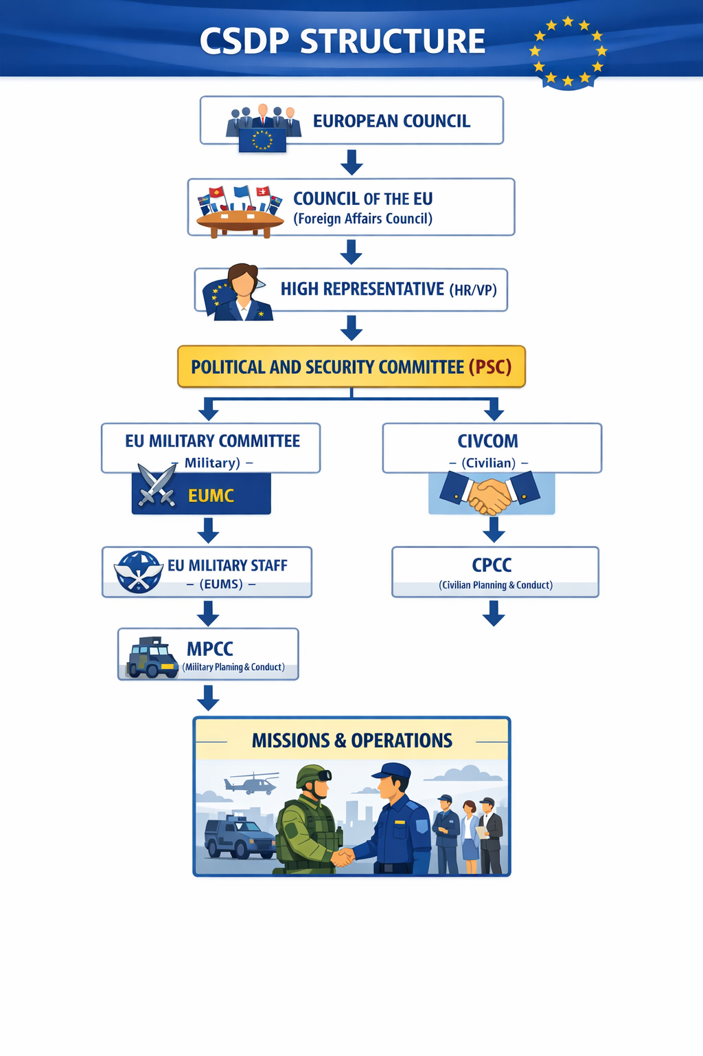
CSDP structure
The Political and Security Committee (PSC)
The European Union Military Committee (EUMC)
Committee for Civilian Aspects of Crisis Management (CIVCOM)

Slide 5
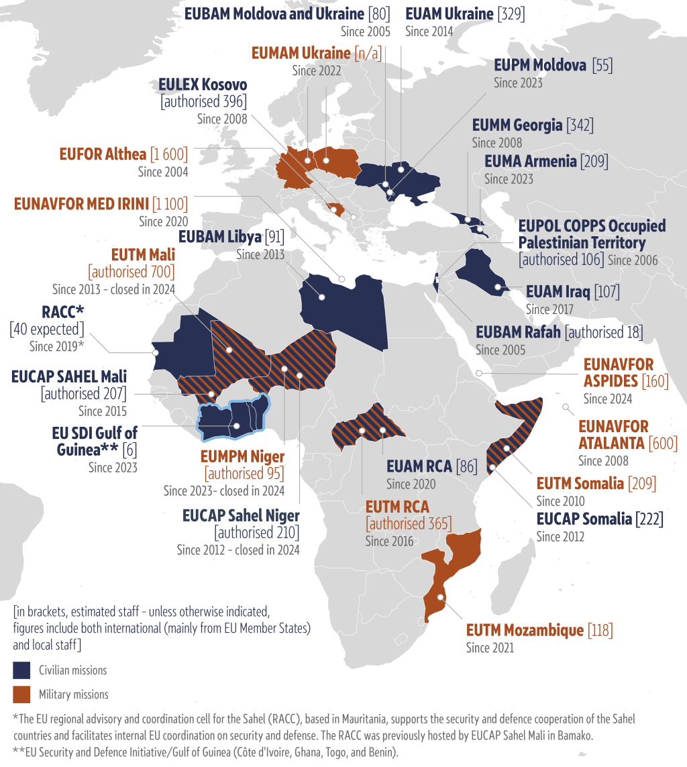
Military operations ongoing EUNAVFOR ASPIDES EUNAVFOR MED IRINI EUNAVFOR Atalanta EUFOR Althea EUMAM Ukraine EUTM/EUMAM Mozambique | Civilian missions ongoing EU SDI for West African countries of the Gulf of Guinea EUMA (Armenia) EUAM RCA EUAM Iraq EUAM Ukraine EUCAP Sahel Mali EUBAM Libya EUCAP Somalia EUMM Georgia EULEX Kosovo EUPOL COPPS EUBAM Rafah
Military missions recently closed down EUMPM Niger EUTM RCA EUTM Mali EUTM Somalia | Civilian missions recently closed down EUPM Moldova EUCAP Sahel Niger RACC Mauritania

Slide 6
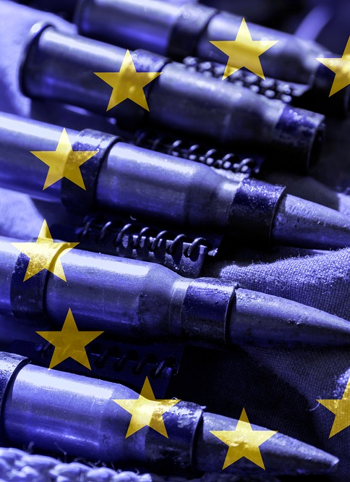
Funds
European Peace Facility (EPF) - Budget 2021–2027 €12 billion.
European Defence Fund - 2021–2027 budget of roughly €8 billion
European Defence Industry Programme (EDIP) - €1.5 billion
Act in Support of Ammunition Production (ASAP)- €500 million
Future Funds
ReArm Europe Plan/Readiness 2030
  Over €800 billion in defense investment by 2030
  features a €150 billion Security Action for Europe (SAFE)

Slide 7

European Defence Industrial Base
Rheinmetall - Military Vehicle Manufacturing (Panther)
Leonardo – Naval/Land Defense, Helicopters, Unmanned Systems, Air Defense
Airbus - Military Aircraft, Military Helicopters, Unmanned Aerial Systems (Eurofighter Typhoon)
BAE Systems
Thales - underwater warfare

Slide 8

Chalenges
Lack of political unity
member states often have different strategic cultures and interests
Unanimity requirement
Slow response time
Long bureaucratic procedures
Limited military capabilities
EU does not have a standing army but fragmented national forces
Funding constraints
USA FY2025 defense budget is approximately $919.2 billion.
Russia FY2025 defense budget is $145 billion
Chinas FY2025 defense budget is approximately $249 billion

Slide 9
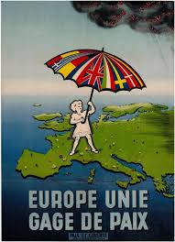
Bibliography
https://www.europarl.europa.eu/RegData/etudes/BRIE/2024/762478/EPRS_BRI(2024)762478_EN.pdf
https://www.europarl.europa.eu/thinktank/en/document/EPRS_BRI(2024)762478
https://epthinktank.eu/2024/10/29/eu-missions-and-operations-abroad/
https://www.b2eu-consulting.eu/news-detail/eu-missions-and-operations-eu-common-security-and-defence-policy-csdp
https://www.mfa.gr/brussels/en/permanent-representation-eu/greece-in-the-eu/external-relations-common-security-and-defence-policy-csdp.html
https://www.eeas.europa.eu/eeas/history-and-timeline-csdp_en#top
https://www.eeas.europa.eu/eeas/csdp-structure-instruments-and-agencies_en
https://www.eeas.europa.eu/eeas/common-security-and-defence-policy_en
https://www.eeas.europa.eu/eums_en
https://www.eeas.europa.eu/eeas/civilian-operations-headquarters_en
https://www.google.com/url?sa=i&source=web&rct=j&url=https://ec.europa.eu/commission/presscorner/detail/pt/qanda_25_790&ved=2ahUKEwjYtazO2fmTAxV-BNsEHbMdNSIQqYcPegQIBxAC&opi=89978449&cd&psig=AOvVaw2jHlcY-yGs-n4TdXUUV1RV&ust=1776680727378000
https://commission.europa.eu/topics/defence/future-european-defence_en
https://commission.europa.eu/topics/defence/future-european-defence_en
https://defence-industry-space.ec.europa.eu/eu-defence-industry/readiness-roadmap-2030_en
https://defence-industry-space.ec.europa.eu/eu-defence-industry/safe-security-action-europe_en

