Slide 1


War in Abkhazia
Nikolaos Papoutsidis
Department of Political Science and History

Slide 2
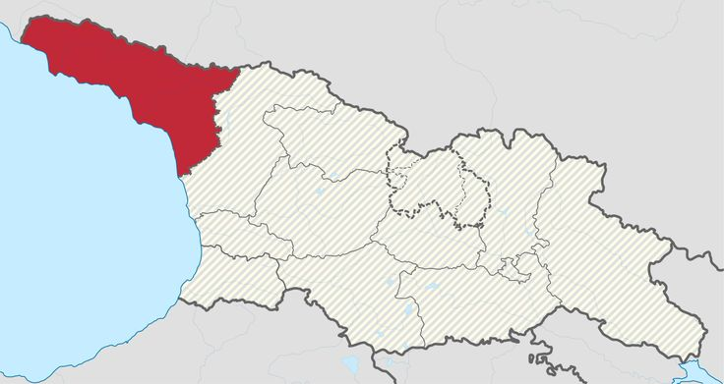
Introduction
Conflicts: 1992 – 1993 , 1998 , 2008
Opposing sides: Abkhazian separatists, CMPC, Russia – Georgia, Ukrainian Volunteers.
Death toll: 25.598 Troops and Civilians
285.000 people displaced

Slide 3
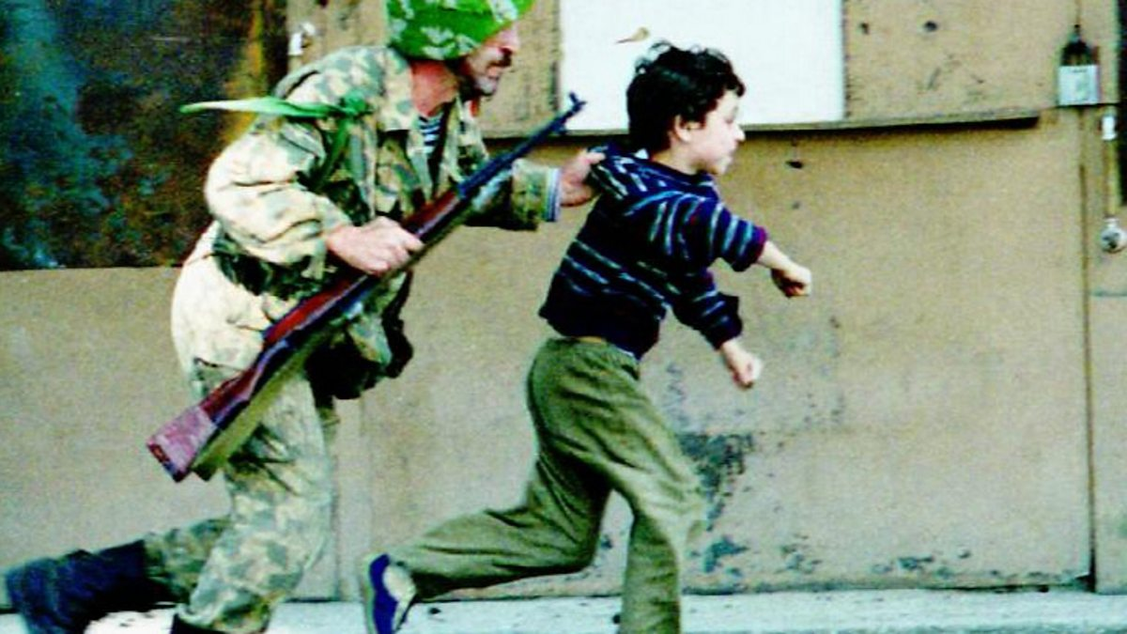
1992-1993 War
Reason: The 1992 conflict started in 10 of August after the fall of the Soviet Union. The Georgian state declared its indepedence trying to simultaneously claim Abkhazia in its territory. Abkhazia refused in an attempt to become an autonomous state, and the Georgian offensive began.
Death toll: 10.000 - 30.000 dead from both sides
250.000 Georgians displaced
Result: Abkhazians with unofficial russian and chechen support managed to win the war and place a de-facto autonomous state heavily relied on Russian military and economic support.

Slide 4
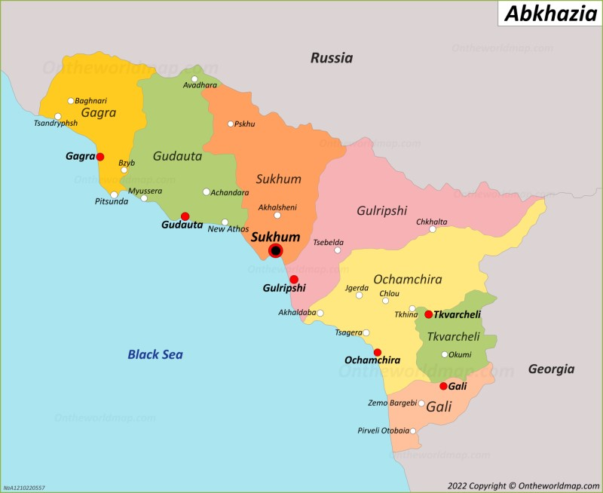
1998 Conflict
Guerilla Warfare: Georgian and Chechen guerrilas launched insurgences against abkhazian villages, with strong georgian presence, and abkhazian police responded. The whole conflict lasted 6 days, from 20 to 26 of May.
Death toll: 60 people from both sides
Result: Abkhazian victory and complete control over Gali territory.

Slide 5
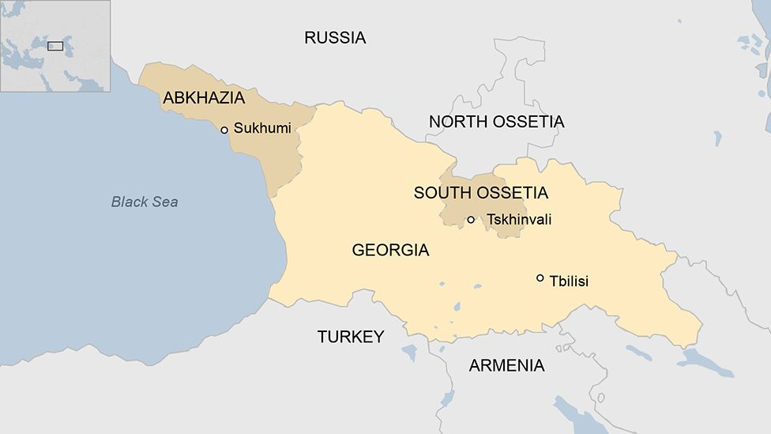
2008 Russo-Georgian War
In the 8th of October of 2008, Georgia starts an offensive in South Ossetia, in an attempt to block its road connecting it with Russian North Ossetia. After this, Georgia was planning to invade Abkhazia.
Result: The attack in South Ossetia lasted 3 days and the Georgian army was pushed back by russian and ossetian forces. The plan to attack Abkhazia failed too, after russian navy blocked the path to the georgian navy and damaged its fleet. The whole war lasted 6 days.
Death toll: 700-850 deaths.

Slide 6
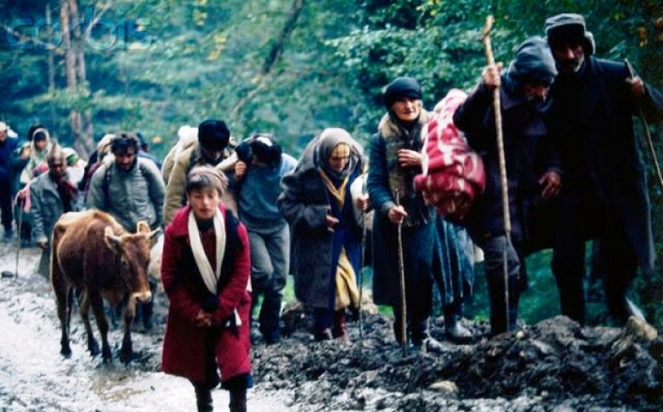
Human rights violations
Human rights violations were commited by both sides, starting by the 1992 conflict from the georgian forces. These consisted of:
Executions, sexual abuse, decapitation, mass murders,destruction of monuments, ethnic cleansing, looting and pillaging.
Personal testimonies:
<< In a house of an armenian family living next to us, georgian soldiers abused the 13 year old daughter and her mother while they forced her father and grandpa to watch. After this, they killed them too.>>
<<They (georgian soldiers) stood me up in a wall and were firing shots above my head just so they could have a laugh>>
<< They were decapitating people and were playing soccer with their heads>>

Slide 7
Bibliography:
War in Abkhazia (1992–1993) - Wikipedia
Abkhazia conflict - Wikipedia
https://youtu.be/tyEN3kR-uyY?is=BNASunLr6iu6o4xl

