Slide 1
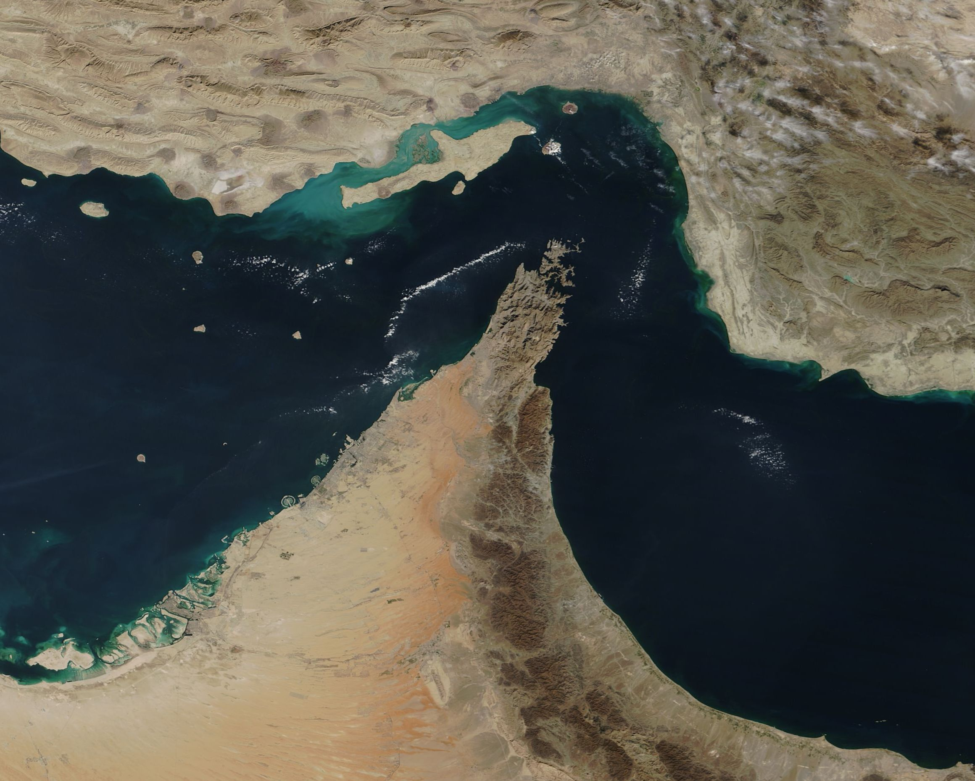
Conflict in the Middle East
How the October seventh attacks ignited a new round of confrontation between Israel and Hamas
Επιμέρους Θέματα Εξωτερικής Πολιτικής, Μay 2026
Georgios Kouklakis

Slide 2
What happened on October seventh 2023?
In the early hours of that day, the Gaza based terrorist organisation (recognised so by the E.U. but not the U.N.) Hamas, along with its allies ( Palestinian Islamic Jihad, Palestinian Mujahideen Movement and others) launched a coordinated attack from land, sea and air against Israel.
The attack commenced with a barage of at least 4.000 rockets and mortar shells mainly against civilian and less so on military targets. This action paved the way for approximately 6.000 Palestinian fighters/terrorists, who having breached the border wall on 119 points, entered Israel.
They moved towards several targets, kibbutzes (small communal towns), the Nova music festival and one military outpost, plus, they set up ambushes on highways.
The Israeli Defence Forces were taken aback by this development, but within a few hours the army and the airforce had commenced operations. On October tenth, the IDF announced that they had regained control of the attacked areas.
The humanitarian toll of the attack, was unlike anything Israel had ever experienced.

Slide 3
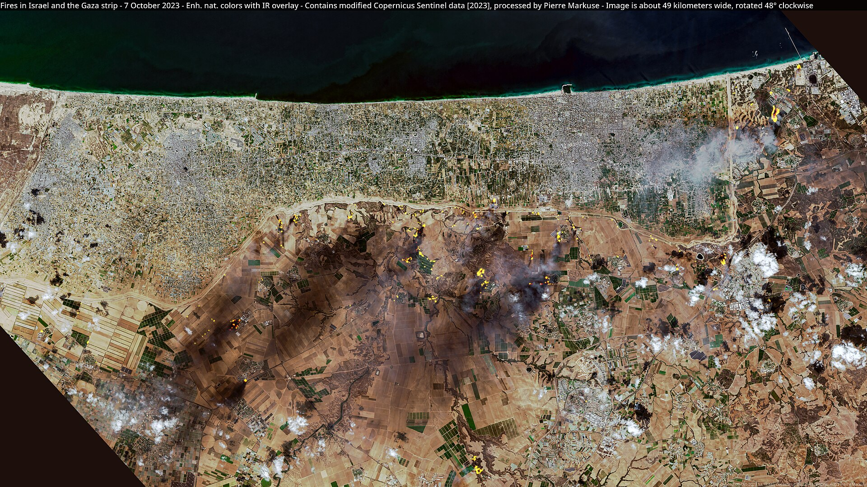

Slide 4
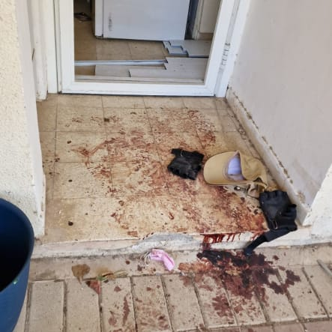
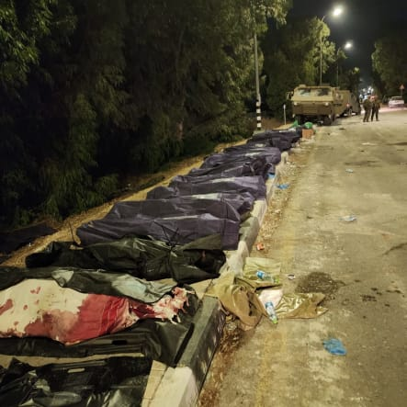
Casualties of October 7th
At least 1.200 people were killed according to U.N. sources
809 of whom were civilians and 68 of them were foreign nationals
40 were children and 25 were elderly over the age of 80
252 people were abducted by the Palestinians back to Gaza, 36 of whom were children. Only 168 returned alive and the bodies of the deceased ones were also given back, after the 2025 ceasfires.
After the attack, 150.000 Israelis who resided in areas close to the border, were forced to evacuate their homes. Some of them remained displaced for the entire duration of the conflict.

Slide 5
Israel’s response to the attack
A process of mobilisation began after the attack, which resulted in the immediate activation of tens of thousands of reservists, a number that rose to a staggering 360.000 by December.
Five opperational goals were announced by Israeli Prime Minister Netanyahu:
1. Regaining control of the areas that were infiltrated by Hamas
2. Preventing the outbreak of conflicts in other fronts in the Middle East
3. Destroying Hamas
4. Expanding international support for Israel, in order to secure freedom of action during the war
5. Re- establishing political solidarity within Israel.
Preparations began for a land invasion of Gaza.
The airforce began bombarding Hamas targets in the Gaza Strip since the morning of October seventh.
All aid going Gaza would be blocated, all the border crossings would shut down and Israel stopped producing electricity for Gaza (80% of the Strip’s power came from Israel).

Slide 6
Palestinian reaction to the attack
Palestinian National Authority (West Bank)
Hamas (Gaza)
President Abbas stated that the Palestinian people “have the right to defend themselves against the terror of settlers and occupation troops.”
In a letter he sent to his French counterpart in 2025, Abbas wrote: “What Hamas did in October 2023 in killing and taking civilians hostage is unacceptable and condemnable and Hamas must immediately release all hostages.”.
Al Arouri, a Hamas official told Aljazeera that the organisation aims to exchange the abductees from Israel with Palestinians that were detained in Israeli prisons.
He also added that the hostilities will not cease, until the “holy sites have been liberated”.
Another official, a month later, said that this kind of attacks will be repeated “until Israel is annihilated”.

Slide 7
Israeli counteroffensive, the invasion of Gaza
Before the invasion, Israel informed the U.N. that civilians residing in Northern Gaza, should evacuate to the southern part of the strip, something challenging because more than a million people lived in that area. Around 700.000 fled, but more than 300.000 remained.
Israel amassed a force of around 100.000 soldiers and began the incursion into Gaza on October 27th.
From then till Autumn of 2025, the Israeli army was conducting opperations inside the enclave, with the support of the airforce.
This air campaign has been described as the most destructive of the 21st century, and that is because of the extremely high number of casualities it has caused.
At least 72.000 Palestinians (military and civilian) have been killed since 2023 and the vast majority of those deaths have been caused by the airforce’s activities. Approximately 21.000 of them were children. Around 170.000 people have been injured.
Such a high death toll can be explained, by the utilization of new technologies in how war is being waged.

Slide 8
How the IDF uses AI technology on the battlefield
Israel’s intelligence services developed an ai system called “Lavender”. It acts as a database which cross-references and examines sources and produces information that are useful in identifying Hamas opperatives. Ever since 2023, more than 30.000 Palestinians had been listed as potential fighters.
There is also another system with a similar function, only it is used to suggest structures and buildings as possible targets and not humans, it is called “Gospel”.
It is worth noting that a dedicated group of officers will produce 50-100 targets every 300 days, while Gospel will do 200 in only 10 days.
The issue that arises with these new technologies, is how they are being used in practice.
During the first months of the conflict, the head of the Israeli airforce stated that Israel is only striking military targets, “but we are not being surgical”.
As it appears while Israel possesses guided weapons, it chooses not to waste them on low ranking Hamas militants. When they are being targeted, unguided bombs are being used against them, which results in civilian deaths and it is deemed acceptable, as +972 magazine reports, that up to 20 civilians get bombed per one low-ranking Hamas opperative. If the target is of a higher profile, the risk of killing more than 100 people would still not prevent it from going ahead.

Slide 9
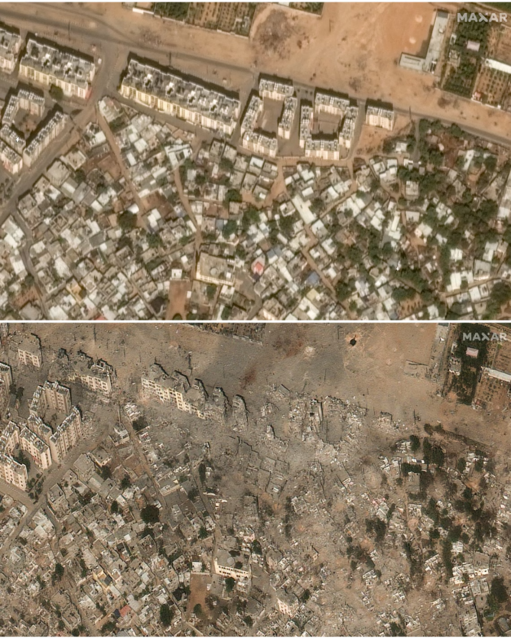

Slide 10
War crimes
Both sides have been accused of committing terrible war crimes during this conflict, with Israel’s most notable being the report of the Office of the High Commissioner for Human Rihgts, which concludes that Israel is committing genocide in Gaza, based on statements of the Israeli leadership, that are perceived as having genocidal intent. Organisations like Human Rights Watch Group and Amnesty International, are also accusing Israel for the same reason, but they are focusing on the high civilian death toll and the destruction of basic infrastructure in Gaza.
The International Court of Justice has issued two arrest warrants, one for the Israeli Prime Minister Netanyahu and one for the former Defence Minister Gallant. They are charged for being responsible for the use of starvation as a mean to wage war.
Hamas’s actions (taking civilians as hostages and using them as human shields and massacring civilians )have also been described as war crimes by OHCHR and Human Rights Watch, but due to the fact that Hamas is a non-state actor that is recognised by many as a terror goup, it is not clear if the laws of war apply to them, or if the UN conventions on terrorism are more suitable.

Slide 11
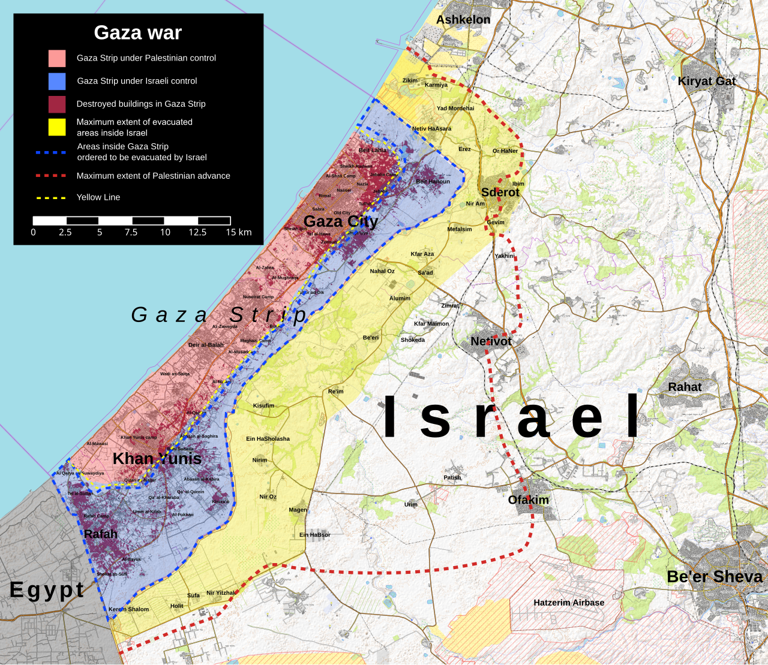
Current situation in Gaza
After a ceasefire was agreed in October after the mediation of the United States and Arab countries, Israel ended up gaining control of about 50% of the strip and is creating a buffer zone between Gaza and Israel.
The Palestinian population is being pushed towards the coastal provinces.
Aid is getting through though it appears not to be enough, since according to a UN report, people there are still facing hunger and malnutrition.

Slide 12
https://www.972mag.com/mass-assassination-factory-israel-calculated-bombing-gaza/
https://www.axios.com/2023/10/27/israel-hamas-ground-invasion-gaza
https://www.axios.com/2023/10/13/israel-gaza-hamas-evacuate-un-ground-operation
https://www.timesofisrael.com/in-first-palestinian-authoritys-abbas-condemns-hamas-october-7-attack/
https://www.haaretz.com/israel-news/2023-11-01/ty-article/hamas-official-we-will-repeat-october-7-attacks-until-israel-is-annihilated/0000018b-8b9d-db7e-af9b-ebdfbee90000
https://digitallibrary.un.org/record/4051246?v=pdf
https://www.aljazeera.com/news/2023/10/7/hamas-says-it-has-enough-israeli-captives-to-free-all-palestinian-prisoners
https://www.ochaopt.org/content/reported-impact-snapshot-gaza-strip-25-march-2026
https://www.npr.org/2023/12/14/1218643254/israel-is-using-an-ai-system-to-find-targets-in-gaza-experts-say-its-just-the-st
https://idsa.in/publisher/issuebrief/israel-hamas-war-2023-beyond-idfs-military-operations-lie-israels-intractable-challenges
https://www.theguardian.com/world/2024/apr/03/israel-defence-forces-response-to-claims-about-use-of-lavender-ai-database-in-gaza
https://www.theguardian.com/world/2024/apr/03/israel-gaza-ai-database-hamas-airstrikes
https://www.ohchr.org/sites/default/files/documents/hrbodies/hrcouncil/sessions-regular/session60/advance-version/a-hrc-60-crp-3.pdf
https://www.amnesty.org/en/latest/news/2024/12/amnesty-international-concludes-israel-is-committing-genocide-against-palestinians-in-gaza/
https://news.un.org/en/story/2025/12/1166638
https://www.fdd.org/analysis/2023/10/09/netanyahu-outlines-five-goals-of-counterattack-on-hamas/

