Slide 1
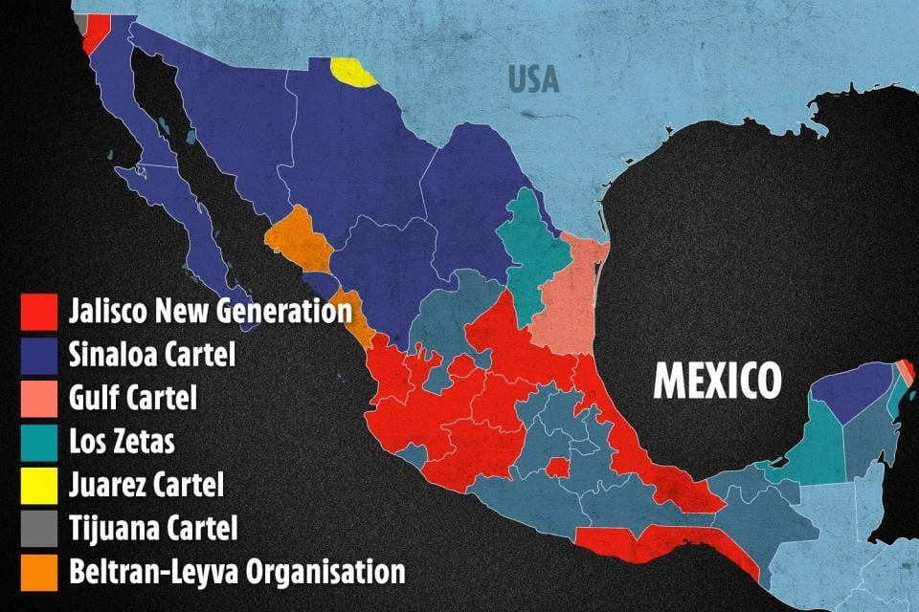

Slide 2
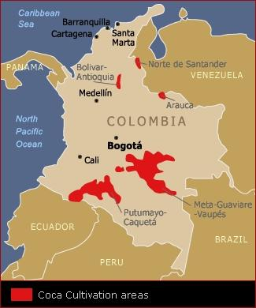
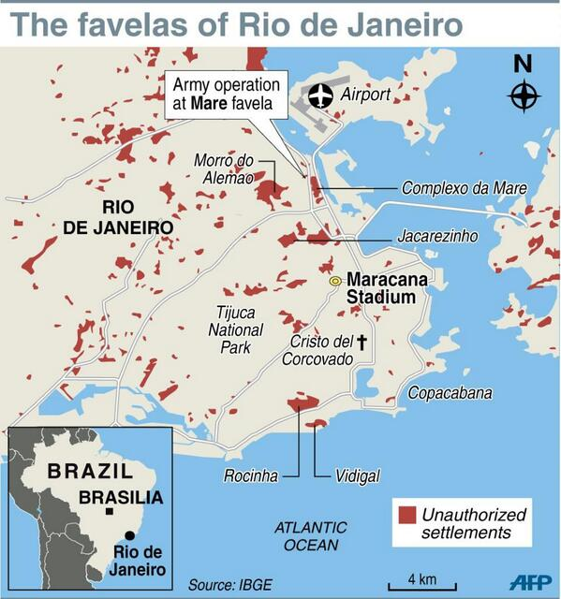

Slide 3
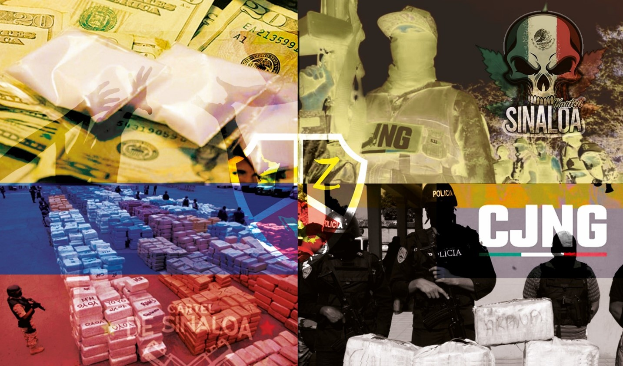
Narco Wars: The war between Worldwide Cartels and the Governments
The routes, the areas of clash and control and the tactics

Slide 4
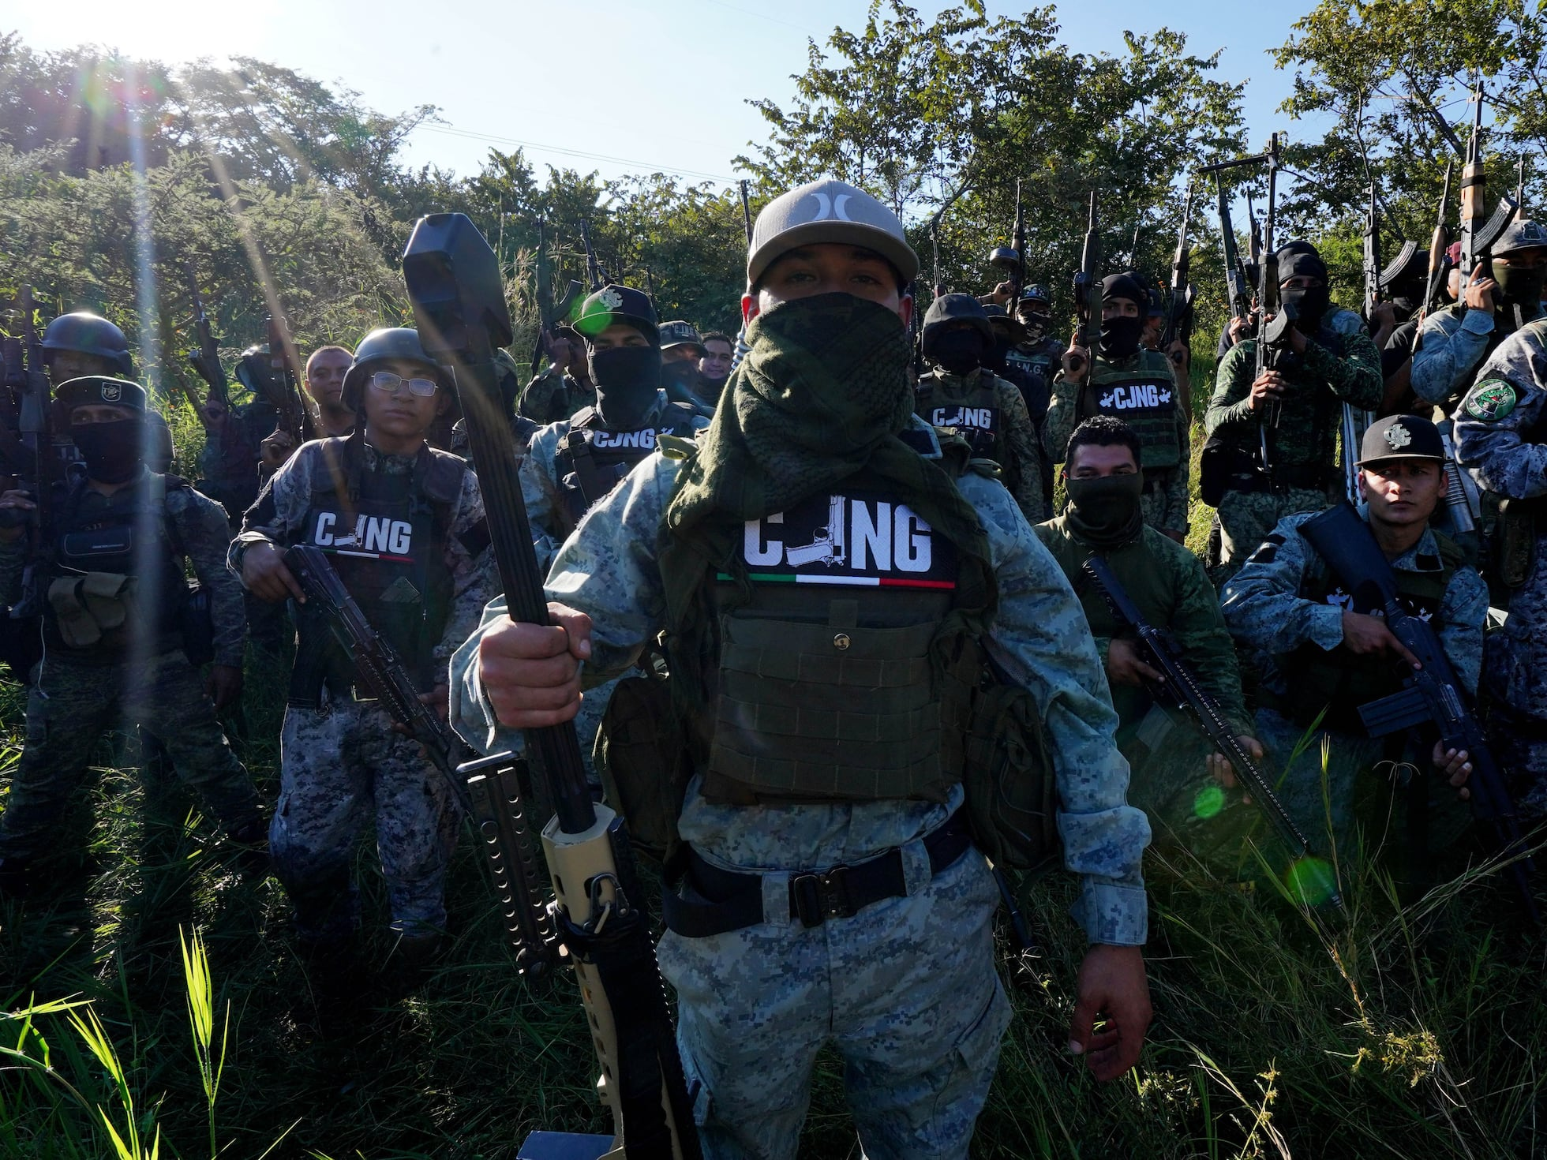

Chapter 1, The Cartels
In 2026 there are actively more than 50 Cartels running the drug empire. Notable Cartels in Mexico are Sinaola Cartel, the Jalisco New Generation Cartel (JNGC),and the Gulf Cartel.
In Brazil the biggest Cartels involved in the transportation of Cocaine is Primeiro Comando da Capital (PCC), Comando Vermelho amd Familia do Norte.
Central America has MS-13 and Barrio 18. Other Cartels in the Central America area can be found in Colombia and Venezuela.

Slide 5
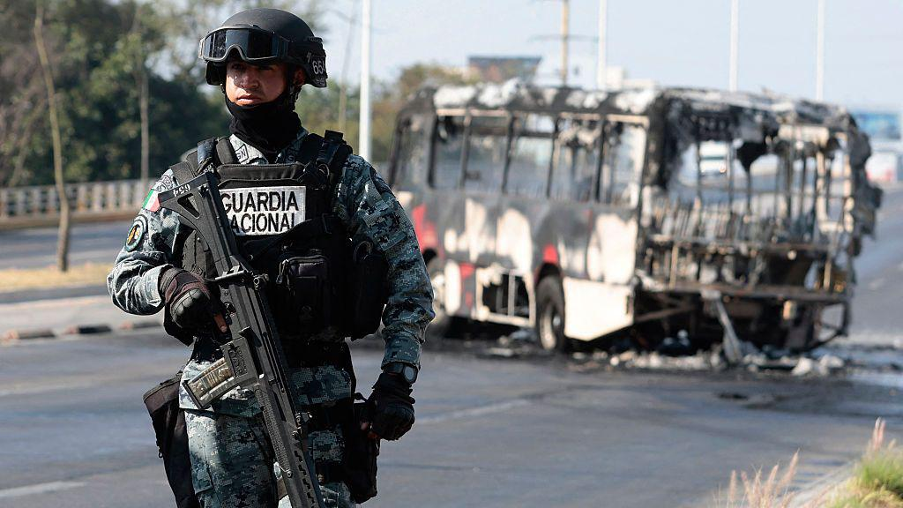
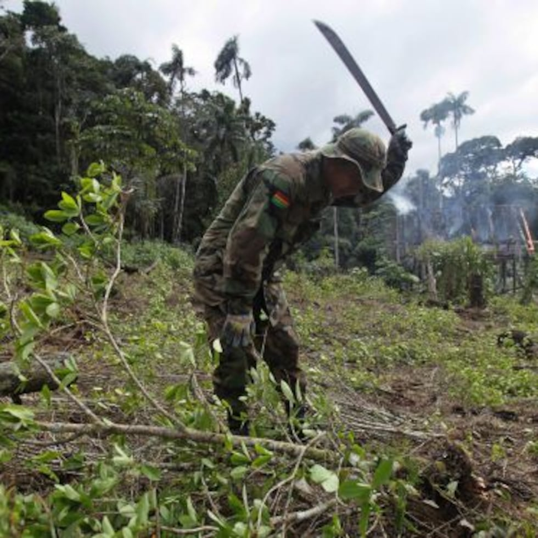
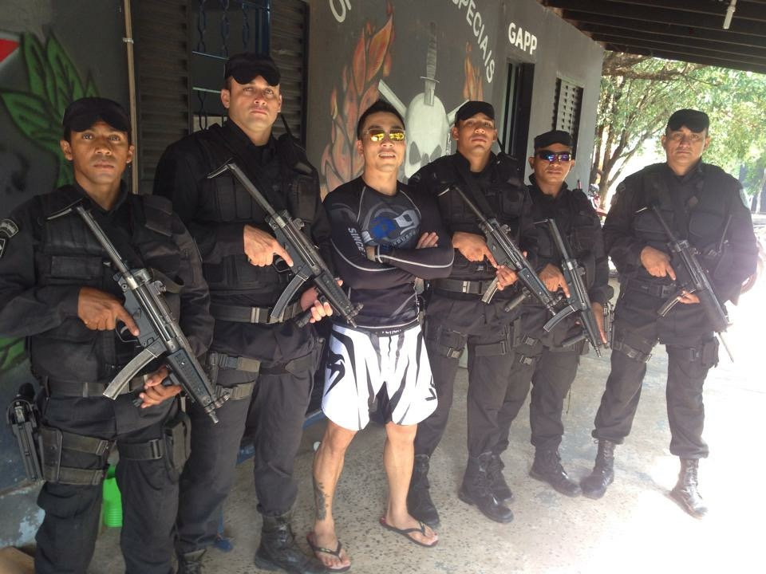
Chapter 2, The governments and their forces.
The core Forces against the narcoterrorism can be found in Mexico, The Army and Navy, the National Guard, the secret services and also federal forces or even rarely local law enforcement.
Brazil uses the “Polícia Militar”, “Polícia Federal” and the Brazilian Special Forces mainly used in Special operations
Colombia and Venezuela cannot harshly regulate the Cartels inside their countries due to fragmented and uneven responses around the area.

Slide 6
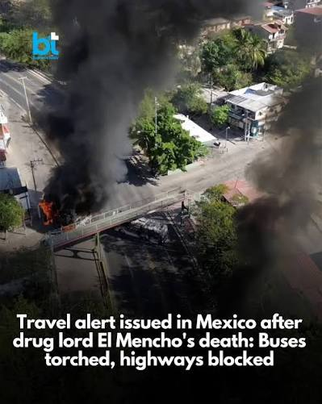
Chapter 3, The types of clashes with the Government and the biggest conflicts.
Mexico, The Cartels Running the Territories (Plazas) are evenly guerilla armed and run paramilitary tactics. With armed Vehicles, drones and reports mention the use of IEDs. Cartels usually Ambush the Mexican forces directly delivering precise hits to gain and/or protect territories and drug production areas. They use Military like roadblocks also known as Narco Blockades. They also use heavy artillery such as machine guns and 50 caliber rifles.
In Brazil the situation is even harsher. Cartels and government engage in urban style warfare in cities like Rio, police forces organize raids in urban areas packed with unarmed civilians and the casualties are often high.
Colombia uses an other approach, jungle operations and rural war tactics are being used in order to exterminate the Cartel production sites deep in the forests.
All the Cartels are avoiding full confrontation unless they are fully advantageous, they are not fully military trained and are more like insurgents. They use corruption over local law by bribing Police officers and use their local influence in territorial conflicts.
The Governments on the other hand have legal forces and military Power.
The Mexican Drug War (2006-2026) has claimed more than 300.000 deaths With ‘peak year’ being 2028 with 33.341 confirmed kills. Most recent example of Cartel violence in the Drug Wars was the Death of Cartel leader “El Mencho”. His death brought disappearings and waves of attacks as retaliation for the Lost Leader. One example is a conflict in Sinaola with more than 1.700 confirmed kills as “The Guardian” reported.
In Brazil the urban operations in Sāo Paulo and Rio have approximately 10-30 deaths per raid, major crackdowns can spike the numbers to 50+
The Colombian jungle clashes have Reports of 10-50 deaths.
The yearly number of confirmed deaths from Cartel Violence is around 20-30.000 nationwide.

Slide 7
Chapter 4, The future of narcoterrorism
Looking ahead, several broad scenarios are possible, but the most likely is neither total state victory nor complete cartel domination. Instead, the future points toward a persistent equilibrium of conflict: chronic violence at varying intensities, partial state control in some regions, and effective cartel dominance in others. In worst-case scenarios, certain areas could experience conditions resembling low-level insurgencies, where the state loses its monopoly on violence and criminal groups operate openly as governing entities. In more optimistic outcomes, institutional strengthening, anti-corruption efforts, and smarter policy approaches could reduce violence and limit cartel influence, though not eliminate it entirely.The key insight is that narcoterrorism is evolving into a system rather than a series of isolated conflicts. It adapts to pressure, integrates new technologies, crosses borders effortlessly, and embeds itself within social and political structures. Traditional approaches that treat it purely as a law enforcement or military problem are increasingly insufficient, because the phenomenon itself is not purely criminal or purely political—it is both, and neither. As long as the underlying economic incentives, governance gaps, and global demand structures remain in place, narcoterrorism will continue to evolve rather than disappear, shaping a future defined less by decisive battles and more by enduring, adaptive, and deeply interconnected forms of violence and control.

Slide 8
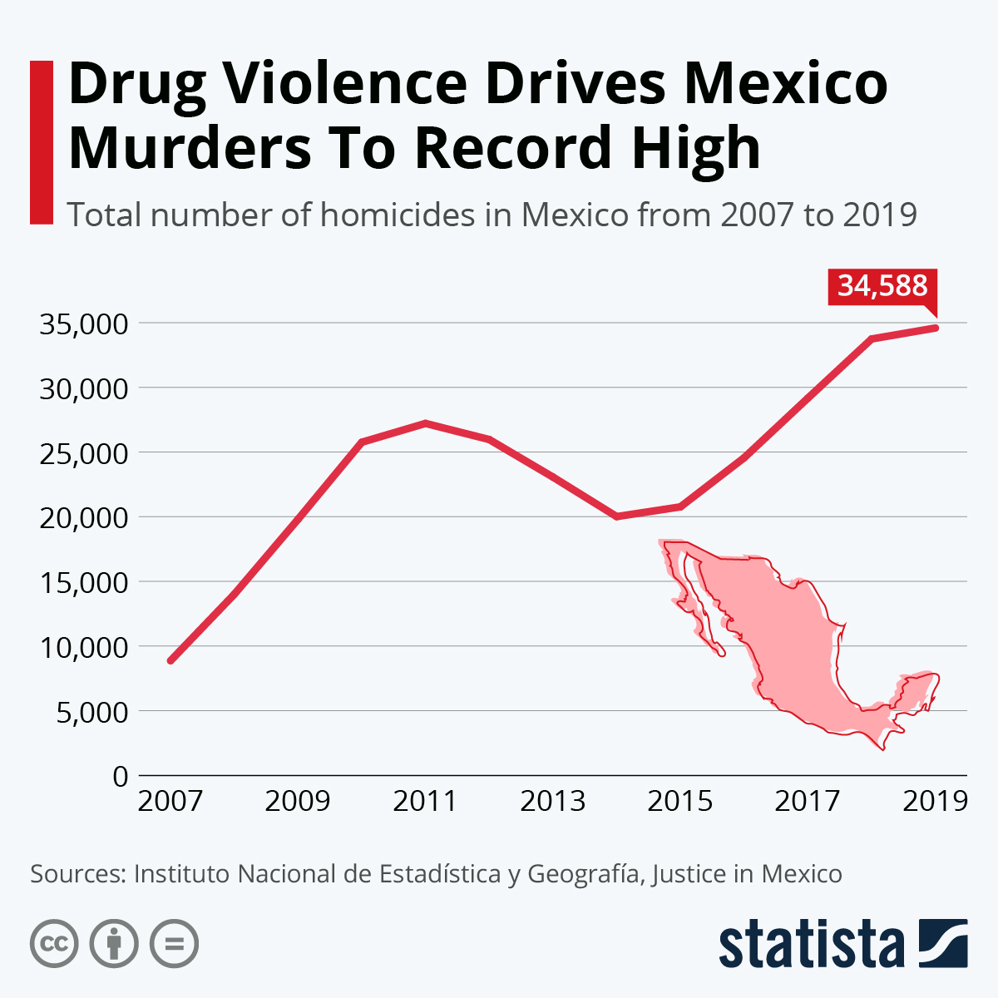
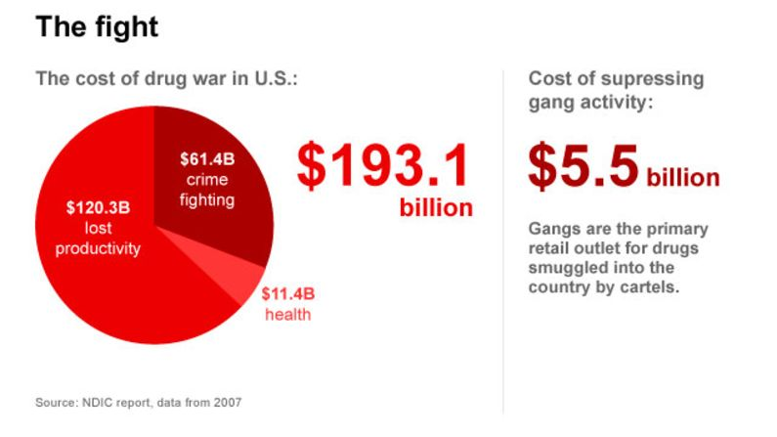
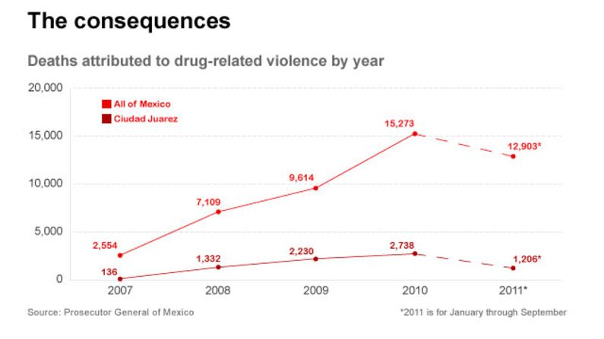

Slide 9
Sources
CNN: https://edition.cnn.com/2026/03/02/americas/jalisco-elmencho-buried-intl-hnk
DEA (cartels)
The Guardian: https://www.theguardian.com/world/2026/apr/30/mexico-jalisco-cartel-el-mencho-flores
Policia Federal (Brazil)
Wikipedia: National Army of Colombia, National Army of brazil
UN: https://www.unodc.org/unodc/data-and-analysis/world-drug-report-2025.html

