Slide 1
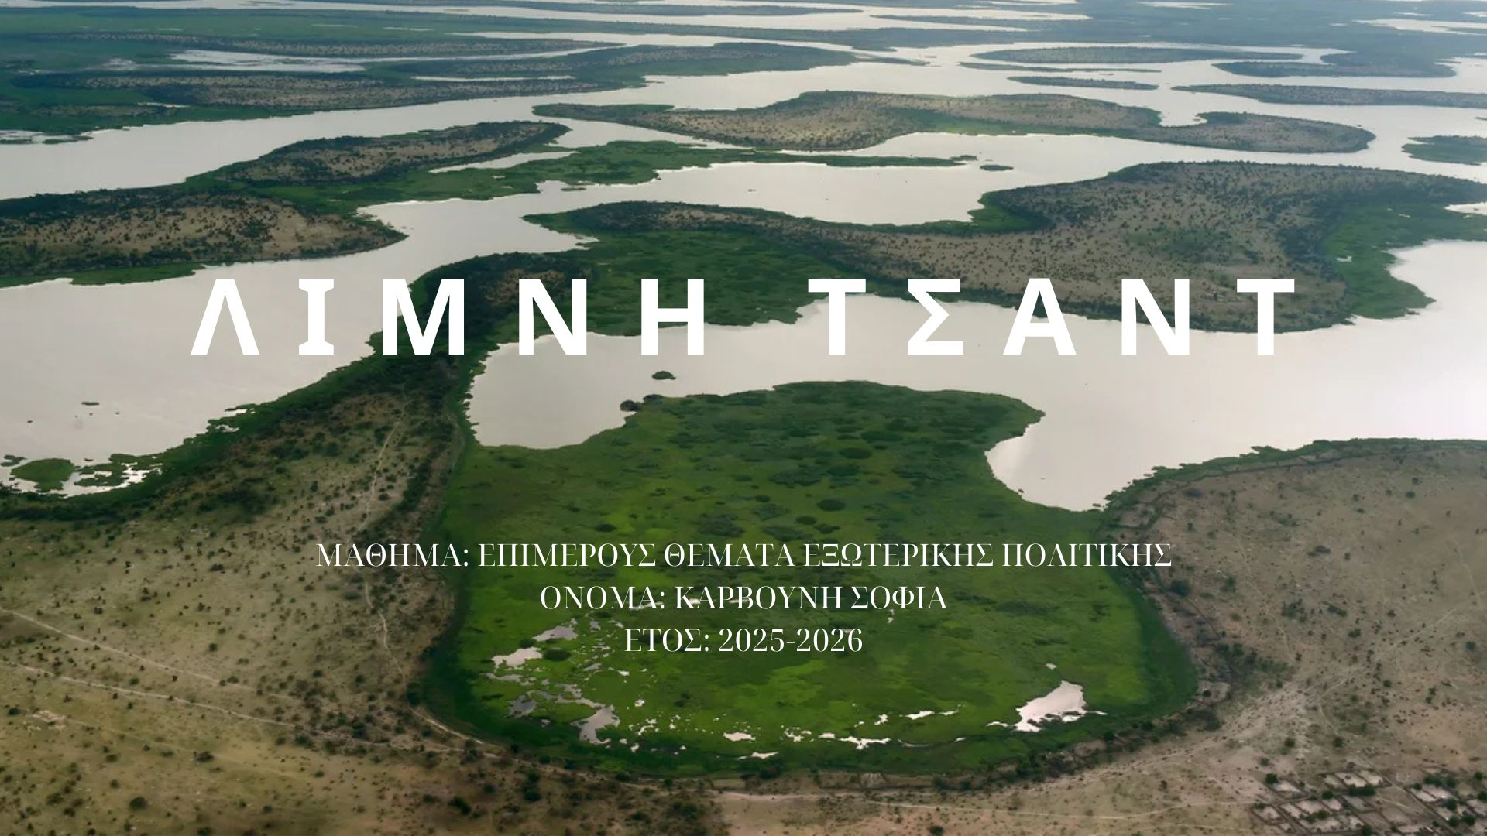

Slide 2
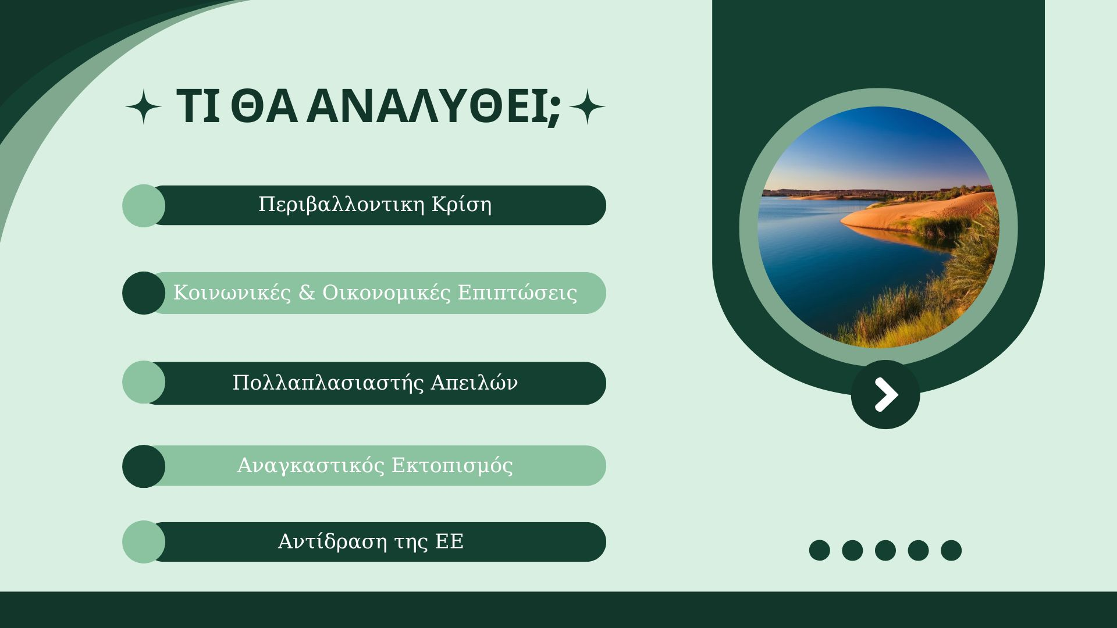

Slide 3
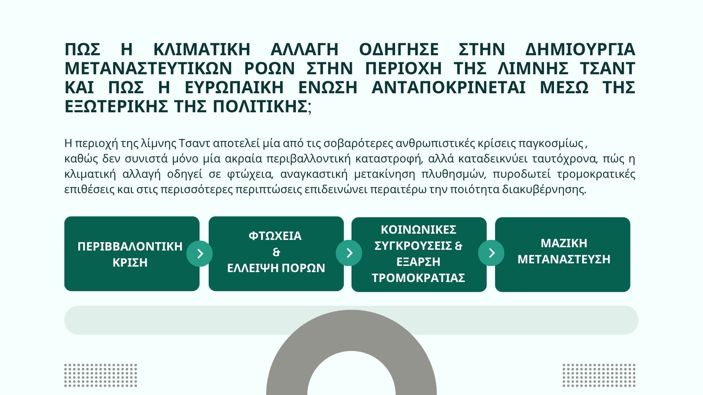

Slide 4
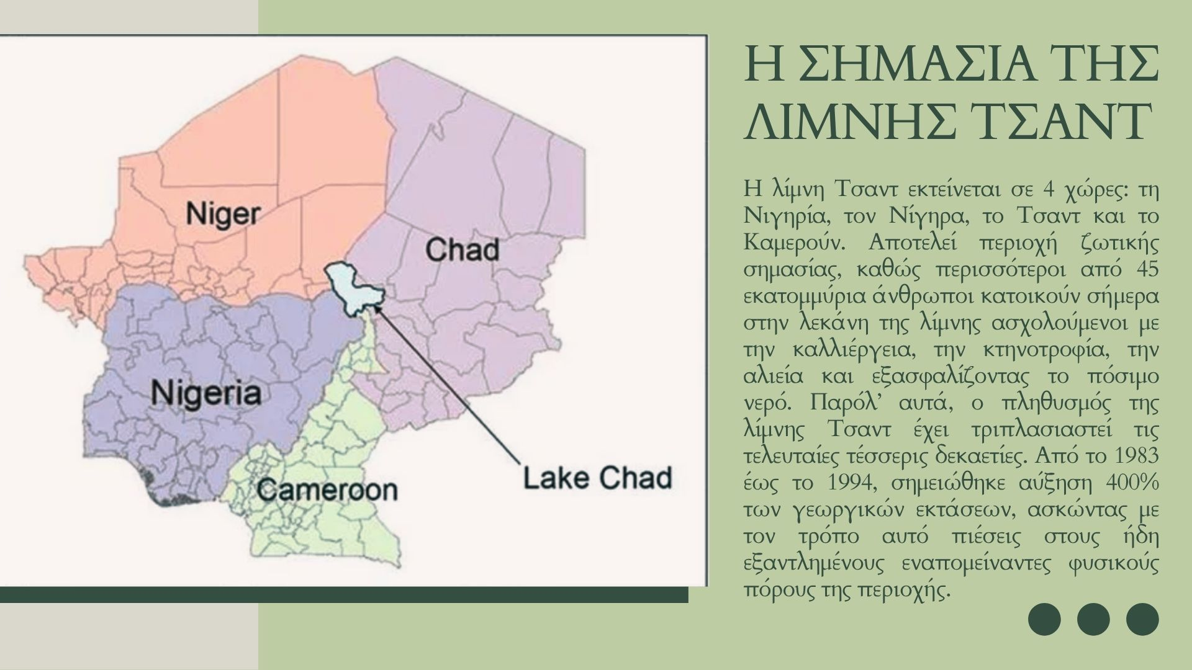

Slide 5
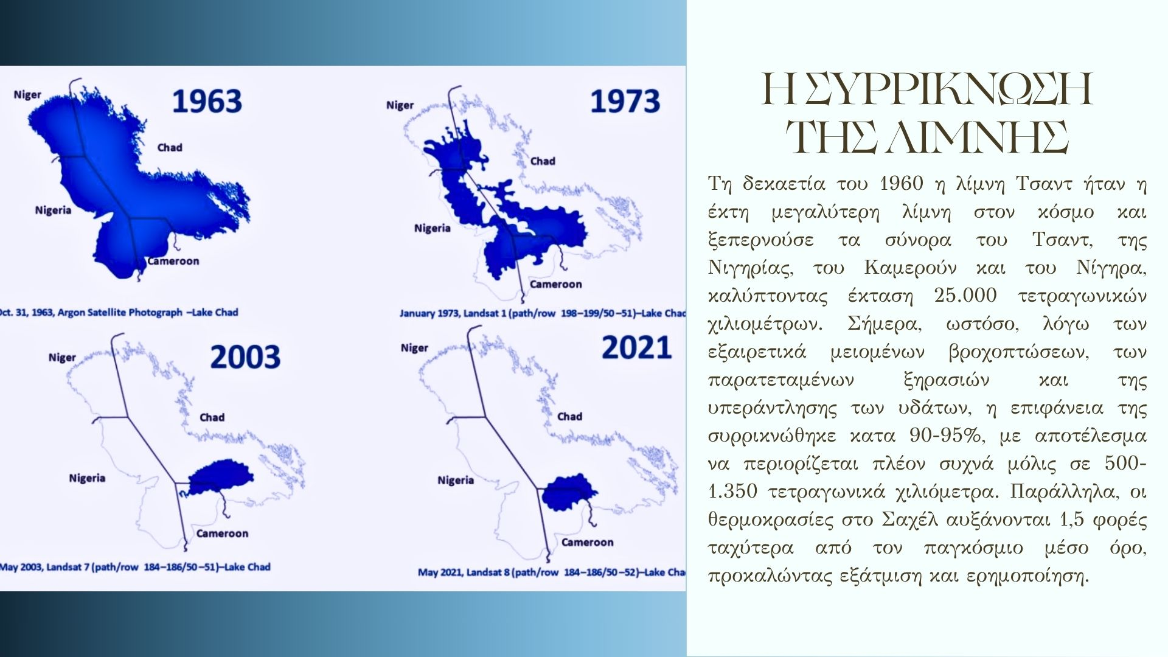

Slide 6
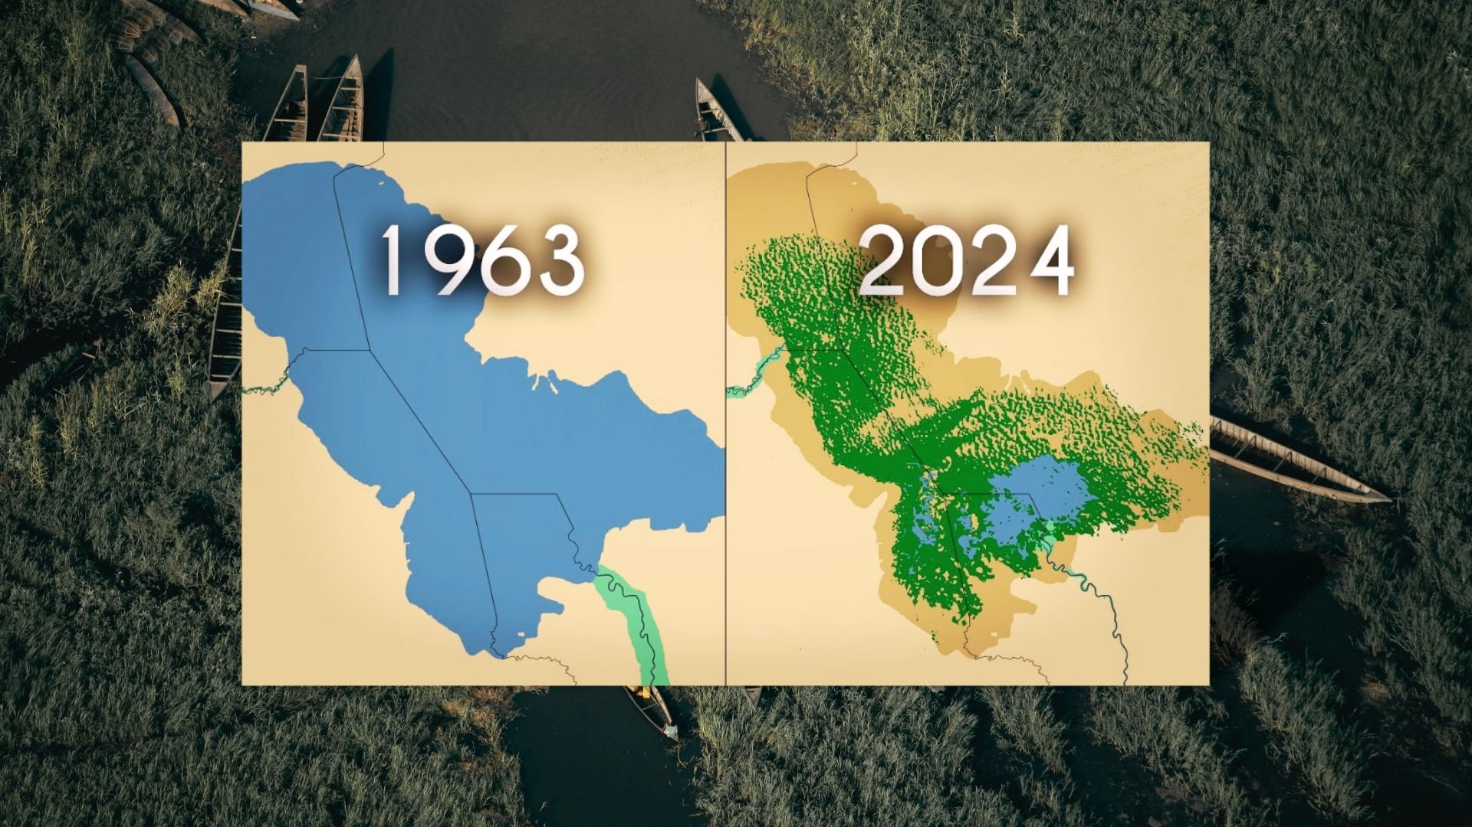

Slide 7
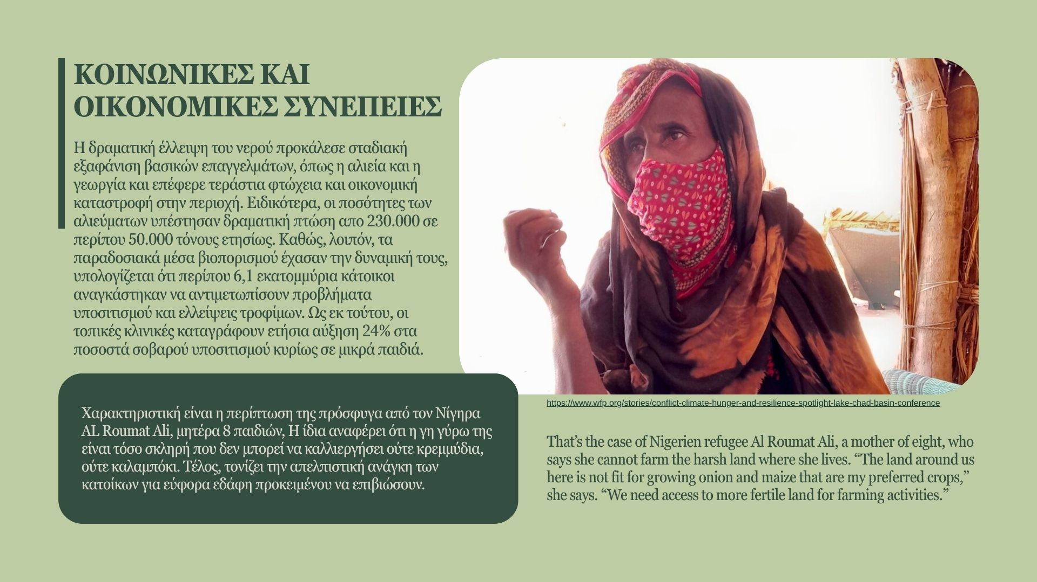

Slide 8
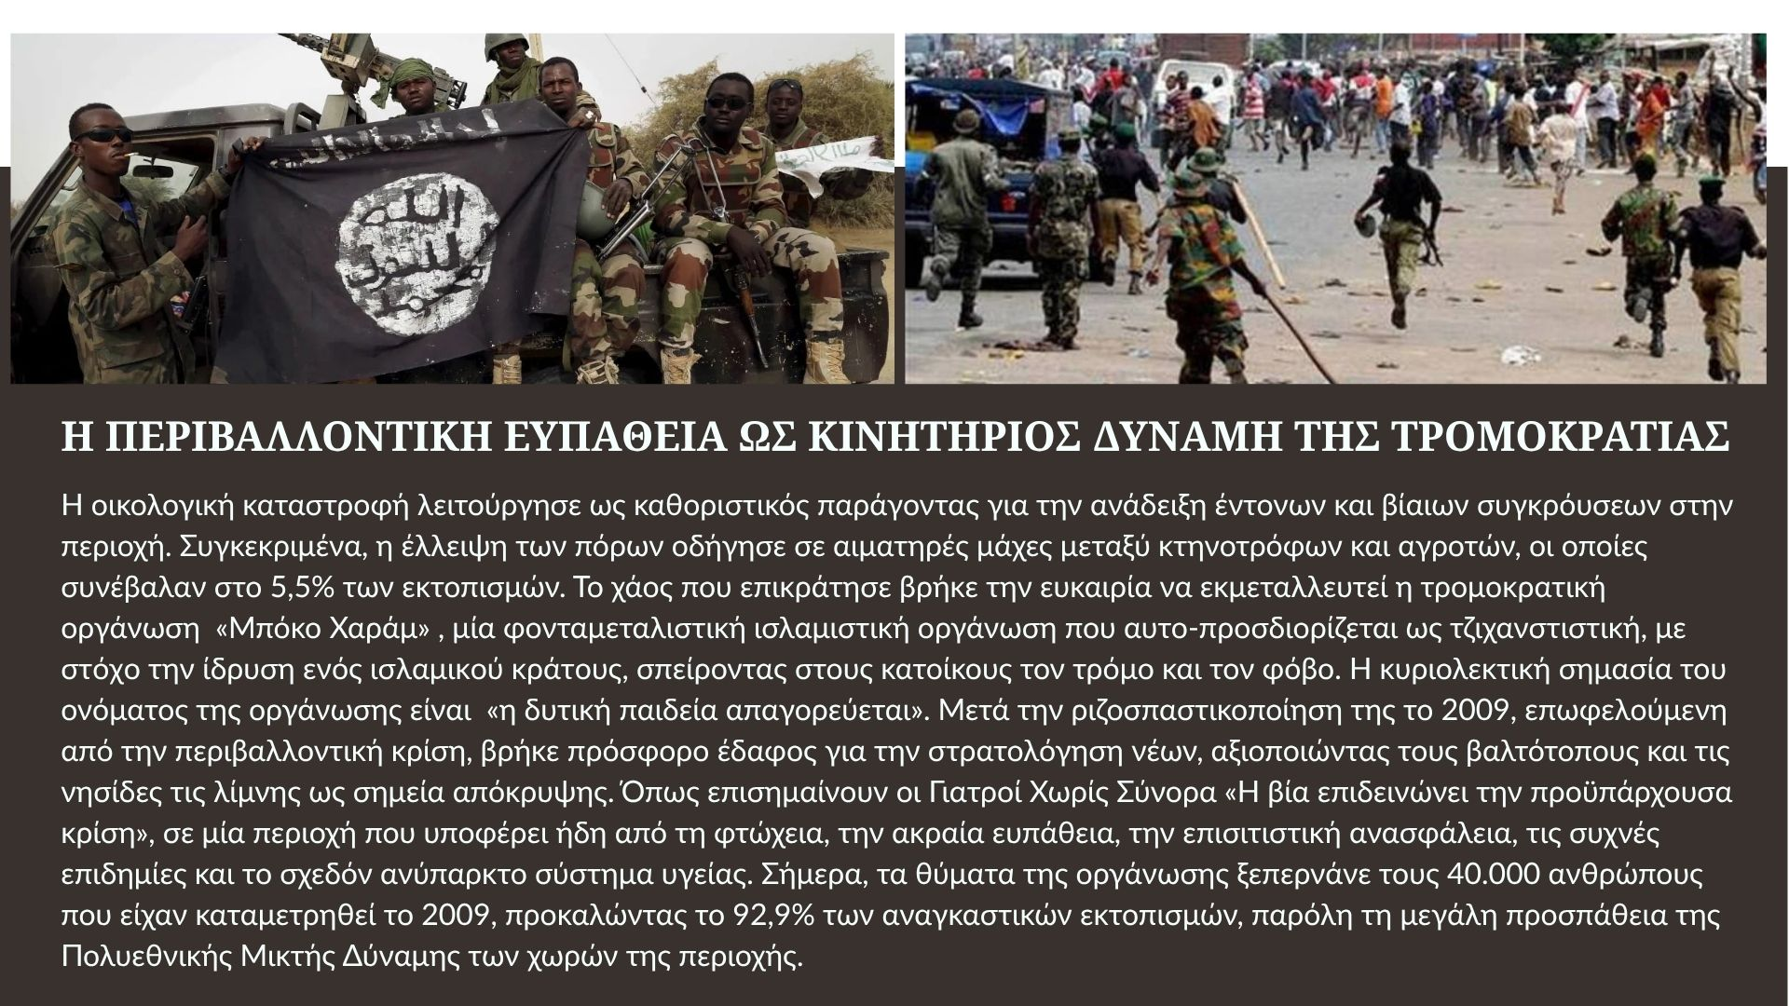

Slide 9
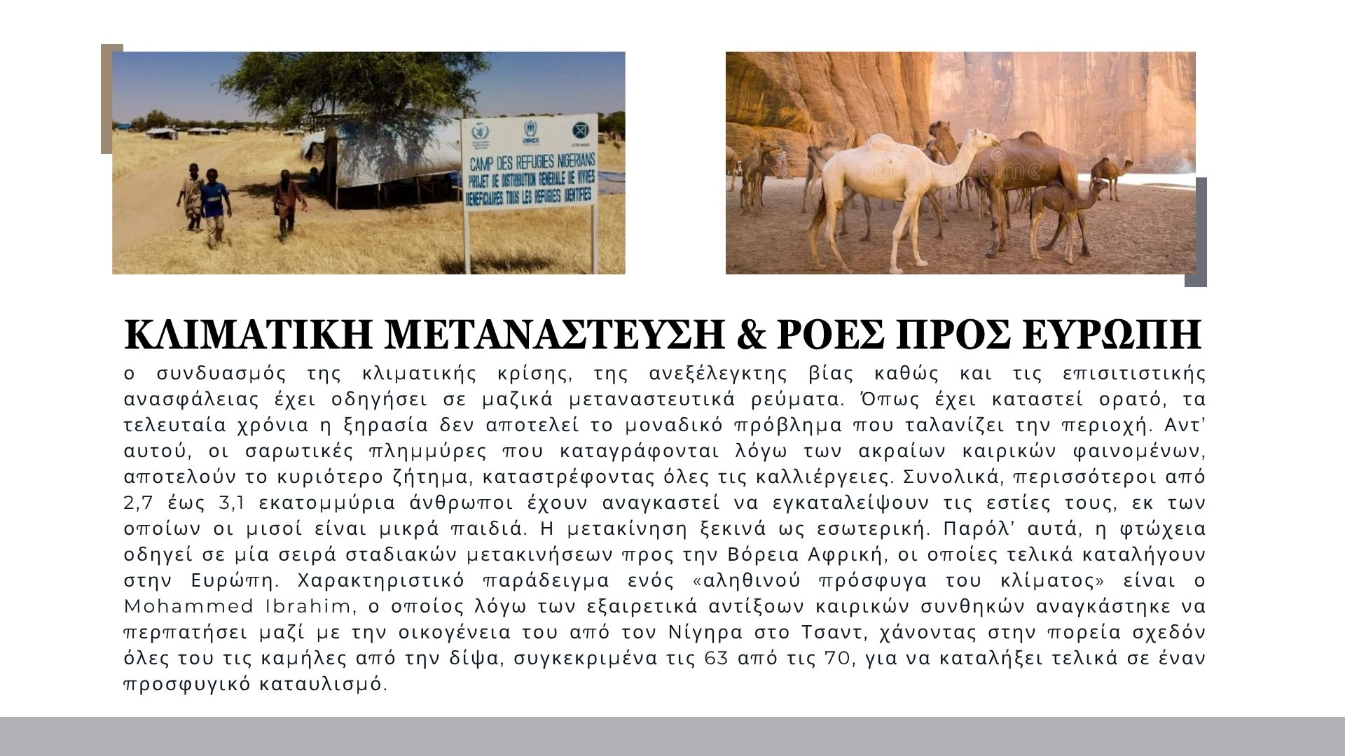

Slide 10


Slide 11
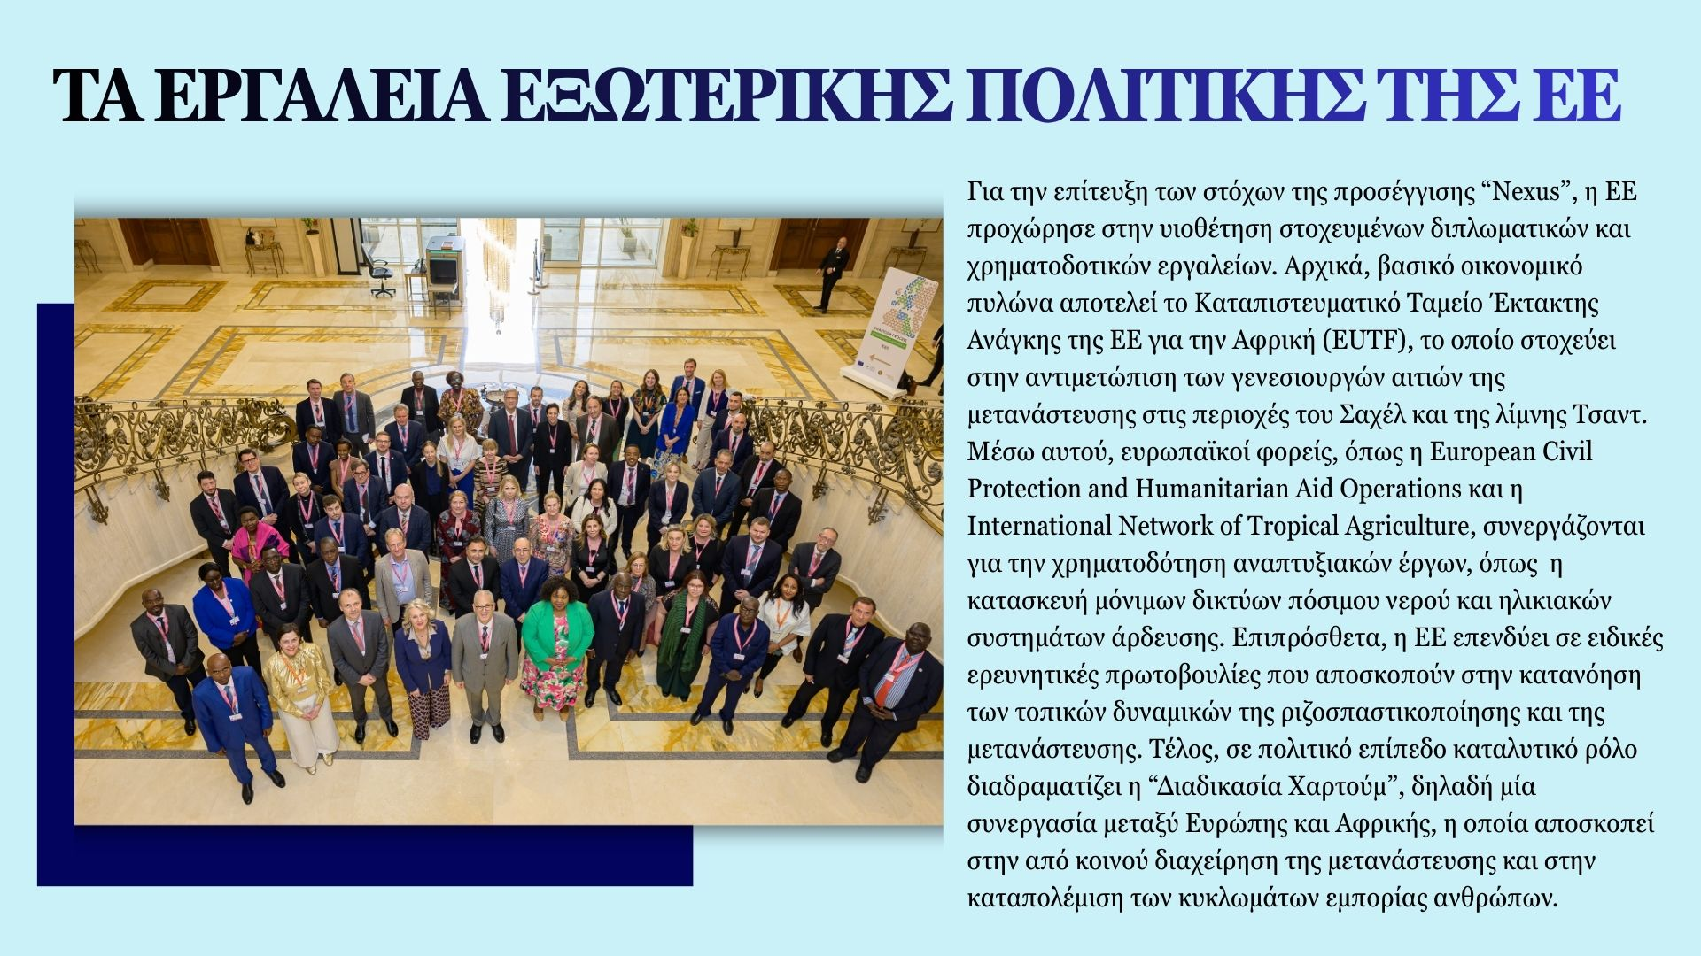

Slide 12
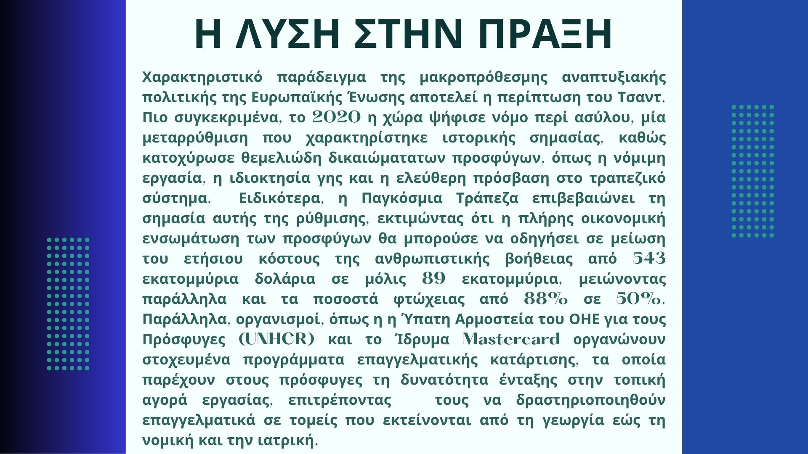

Slide 13
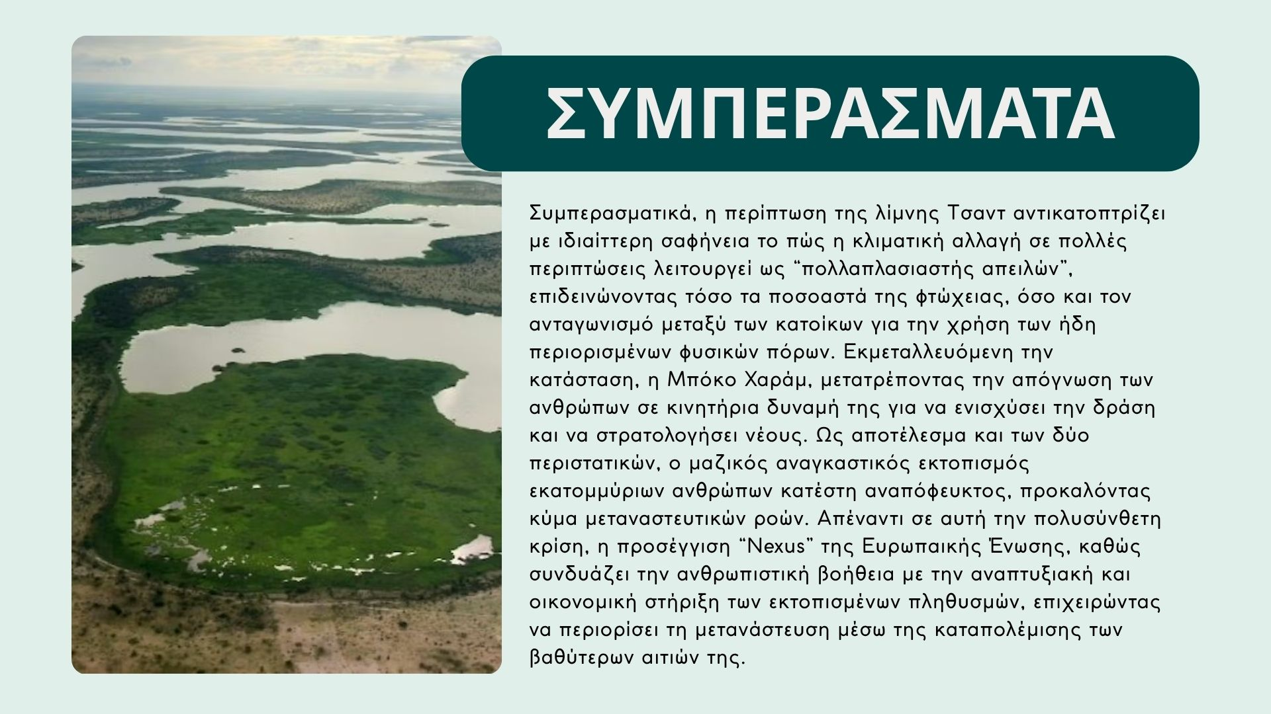

Slide 14
ΒΙΒΛΙΟΓΡΑΦΙΑ:
https://www.huffingtonpost.gr/diethnes/i-ipo-exafanisi-limni-tsant/
https://www.lifo.gr/now/world/sti-limni-tsant-exelissetai-mia-apo-tis-heiroteres-anthropistikes-katastrofes
https://el.wikipedia.org/wiki/%CE%9C%CF%80%CF%8C%CE%BA%CE%BF_%CE%A7%CE%B1%CF%81%CE%AC%CE%BC
https://www.protothema.gr/world/article/807123/tsad-i-boko-haram-ektelese-18-anthropous-kai-apigage-10-gunaikes/
https://www.ertnews.gr/eidiseis/diethni/nekroi-15-stratiotikoi-tou-tsant-se-maxes-me-tzixantistes-tis-mpoko-xaram/
https://www.capital.gr/diethni/3883639/tsant-nekroi-kai-traumaties-stis-taxeis-tis-mpoko-xaram-se-epidromes-tis-aeroporias/
https://www.lifo.gr/videos/lifo-picks/enas-alithinos-prosfygas-tis-klimatikis-allagis
https://news.mongabay.com/2025/02/lake-chad-isnt-shrinking-but-climate-change-is-causing-other-problems/
https://www.wfp.org/stories/conflict-climate-hunger-and-resilience-spotlight-lake-chad-basin-conference
https://civil-protection-humanitarian-aid.ec.europa.eu/where/africa/chad_en

Slide 15
ΒΙΒΛΙΟΓΡΑΦΙΑ:
https://www.unhcr.org/where-we-work/countries/chad?dataset=POP&yearsMode=range&selectedYears=%5B2012%2C2026%5D&level=OPR&category=PTY&fundingSource=ALS&compareBy=%5B%22category%22%5D&levelCompare=%5B%5B%22OTCD_ABC%22%5D%5D&viewType=chart&chartType=bar&contextualDataset=BUD&tableDataView=absolute
https://trust-fund-for-africa.europa.eu/where-we-work/regions-countries/sahel-lake-chad_en
https://amaniafrica-et.org/the-impact-of-climate-change-on-the-crisis-situation-in-the-lake-chad-basin-and-sahel-regions/
https://el.wikipedia.org/wiki/%CE%9B%CE%AF%CE%BC%CE%BD%CE%B7_%CE%A4%CF%83%CE%B1%CE%BD%CF%84
https://www.ciwaprogram.org/blog/harvesting-hope-how-communities-are-reviving-the-lake-chad-region/
https://www.esa.int/SPECIALS/Eduspace_Weather_GR/SEMPF8538NH_0.html
https://cyneapolis.com/ar/international/%CE%BD%CE%B9%CE%B3%CE%B7%CF%81%CE%AF%CE%B1-%CF%84%CE%B1-%CF%80%CE%BF%CF%83%CE%BF%CF%83%CF%84%CE%AC-%CF%85%CF%80%CE%BF%CF%83%CE%B9%CF%84%CE%B9%CF%83%CE%BC%CE%BF%CF%8D-%CE%B1%CF%85%CE%BE%CE%AC%CE%BD%CE%BF%CE%BD%CF%84%CE%B1%CE%B9-%CE%BA%CE%B1%CE%B8%CF%8E%CF%82-%CE%B7-%CE%AD%CE%BD%CE%BF%CF%80%CE%BB%CE%B7-%CF%83%CF%8D%CE%B3%CE%BA%CF%81%CE%BF%CF%85%CF%83%CE%B7-%CE%BA%CE%B1%CE%B9-%CE%B7-%CE%BA%CE%BB%CE%B9%CE%BC%CE%B1%CF%84%CE%B9%CE%BA%CE%AE-%CE%B1%CE%BB%CE%BB%CE%B1%CE%B3%CE%AE-%CE%B5%CE%BC%CF%80%CE%BF%CE%B4%CE%AF%CE%B6%CE%BF%CF%85%CE%BD-%CF%84%CE%B7%CE%BD-%CF%80%CE%B1%CF%81%CE%B1%CE%B3%CF%89%CE%B3%CE%AE-%CF%84%CF%81%CE%BF%CF%86%CE%AF%CE%BC%CF%89%CE%BD-%CF%83%CF%84%CE%B7%CE%BD-%CF%80%CE%B5%CF%81%CE%B9%CE%BF%CF%87%CE%AE-%CF%84%CE%B7%CF%82-%CE%BB%CE%AF%CE%BC%CE%BD%CE%B7%CF%82-%CF%84%CF%83%CE%B1%CE%BD%CF%84
https://climate-diplomacy.org/magazine/cooperation/tackling-security-and-climate-challenges-lake-chad-basin-requires
https://en.wikipedia.org/wiki/Khartoum_process
https://www.notismarias.gr/%CE%B7-%CE%B4%CE%B9%CE%B1%CE%B4%CE%B9%CE%BA%CE%B1%CF%83%CE%AF%CE%B1-%CF%84%CE%BF%CF%85-%CF%87%CE%B1%CF%81%CF%84%CE%BF%CF%8D%CE%BC-%CE%BA%CE%B1%CE%B9-%CE%B7-%CF%80%CF%81%CE%BF%CF%83%CE%B5%CF%87%CE%AE/
https://gr.euronews.com/2016/08/25/lake-chad-basin-thousands-of-children-in-danger-of-severe-acute-malnutrition

