Slide 1






special session (s53): “Promoting Circular Bioeconomy at the Regional Level: Potentials and Challenges”
The Status of Regional Bioeconomy: Developing a Multi-Criteria Assessment (MCA) Framework to Evaluate Regional Potential in the EU of 27
Panos Kalimeris, Georgios Maroulis, Panagiotis Koronaios (p), Antonios Rovolis

Slide 2

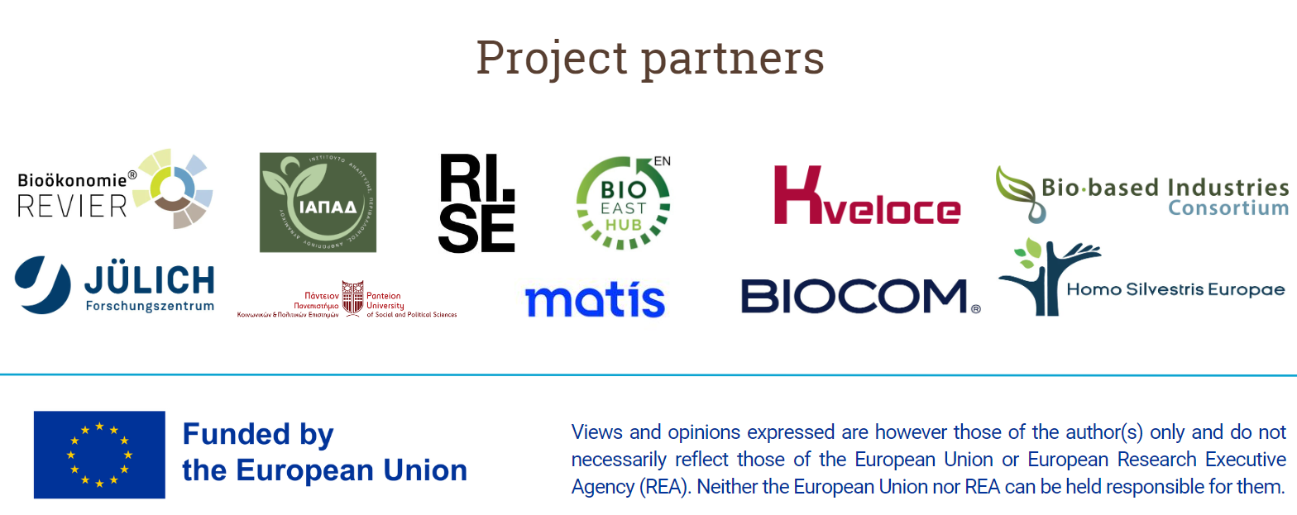

Slide 3
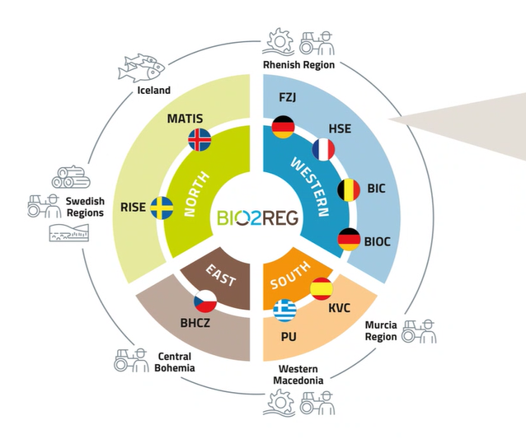
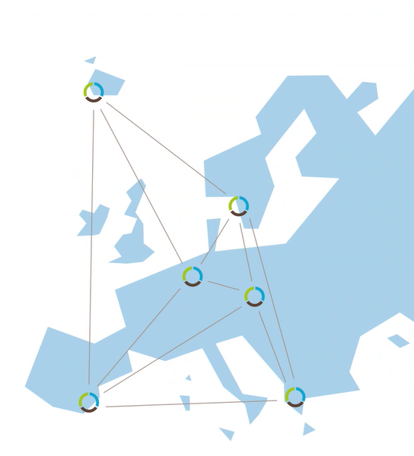


Slide 4
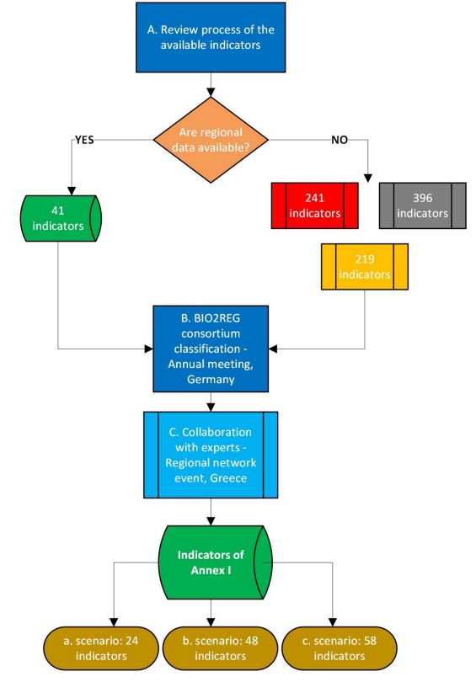

A flow chart of the process
Traffic Light Assessment
EU-27 regional (NUTSII) Ranking

Slide 5
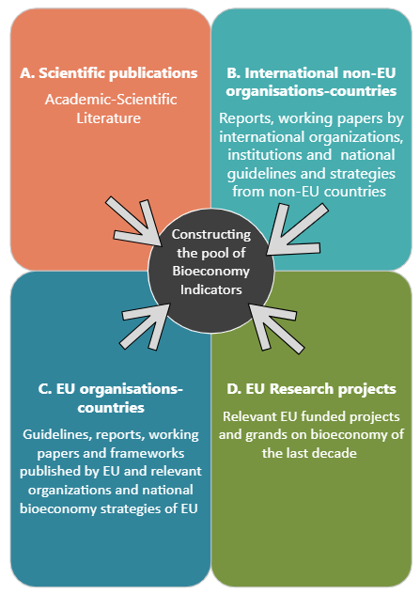
A. The four pillars of the review process

Slide 6
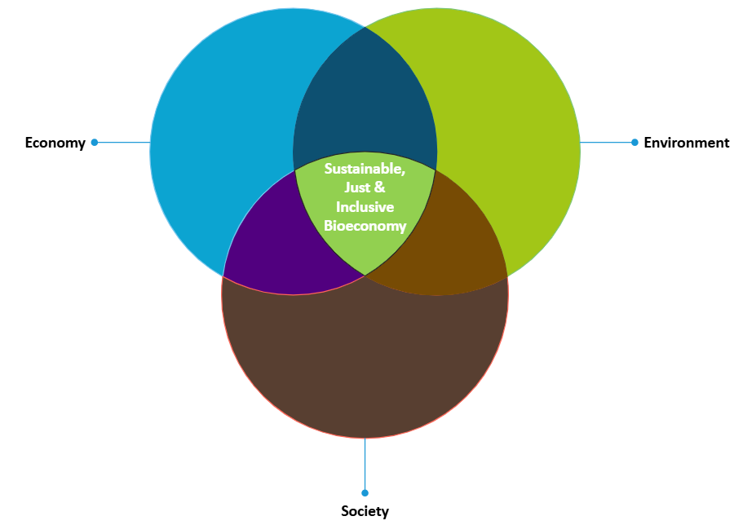
A. Grouping all indicators according to the three pillars of sustainability

Slide 7



A. The “traffic light” assessment in a nutshell
Proposed Indicator | Typology | Type of indicator | Source | EU Regional Availability (Traffic Light Assessment) | Source
A. Economy
e.g., turnover | In thousand €/ year | Quantitative |  | Existing in all EU regions | EU Eurostat
B. Society |  | Qualitative
e.g., employment | In FTEs |  |  | Not available data in All EU-regions
C. Environment |  | Descriptive
e.g., biomass production | In kg/hectare |  | A | Available in some EU regions
e.g., biomass production | In kg/ year |  | B | Grey (potential) indicators

Slide 8
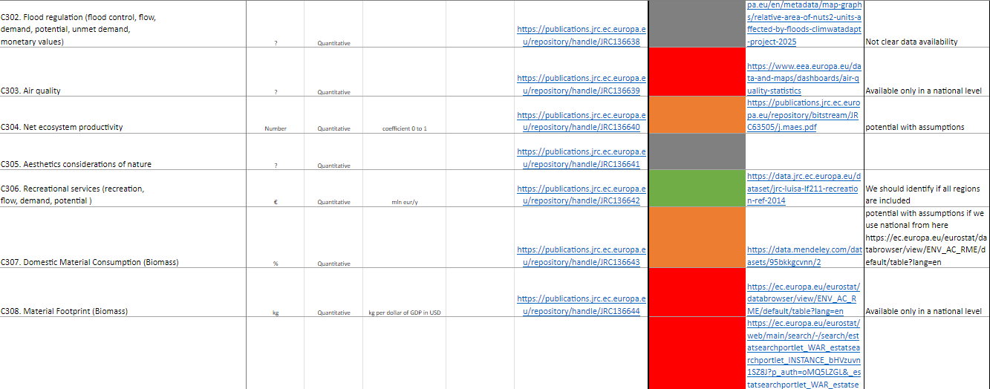
A. The “traffic light” assessment in a nutshell
The “killing process” in practice

Slide 9
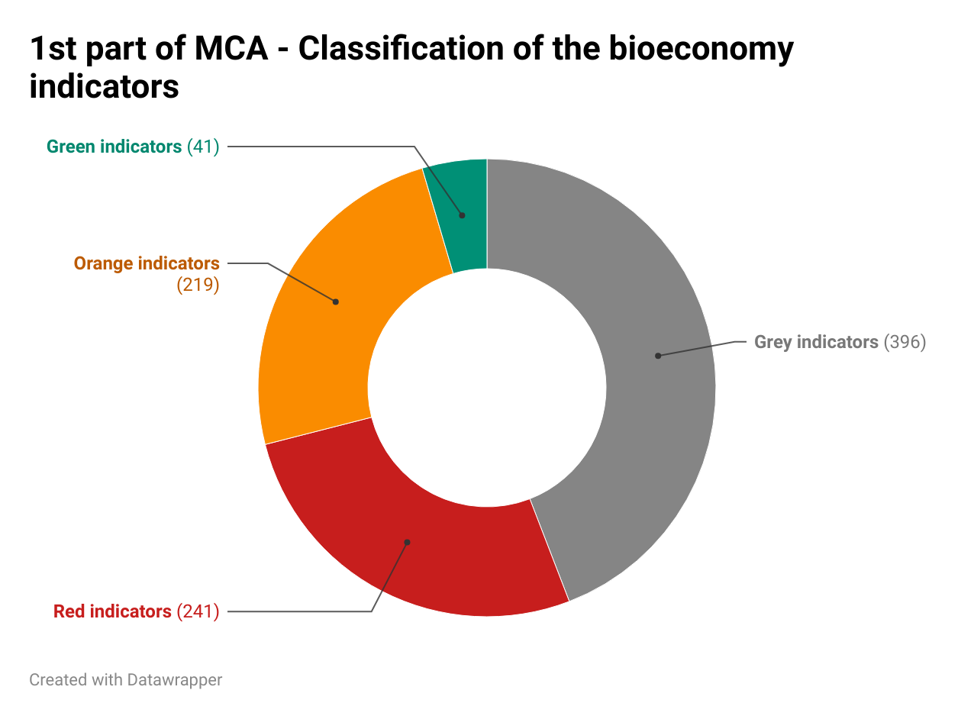
A. The “traffic light” assessment in a nutshell

Slide 10
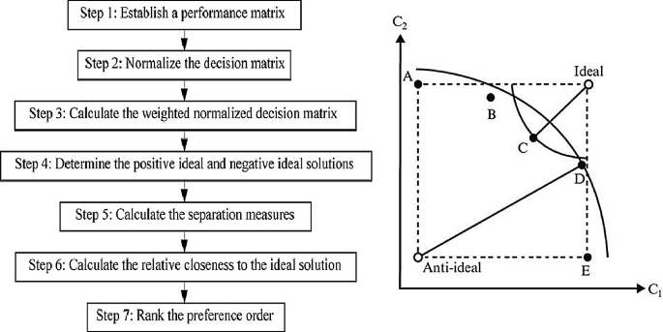
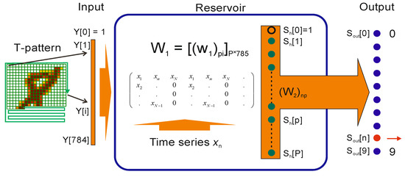
B. Regional ranking – THE Technique for Order of Preference by Similarity to Ideal Solution (TOPSIS) & Shannon Entropy Method
A. TOPSIS multi-criteria decision analysis
B. Shannon Entropy objective method of yielding the attribute weights of objective functions for decision making algorithms
Source: https://link.springer.com/chapter/10.1007/978-981-33-4745-8_5
Source: https://www.mdpi.com/1099-4300/23/11/1432

Slide 11
b. The examined scenarios
The Economy group scenario: Ranking is performed into three sub-groups, namely:
Pure economy indicators ranking (Only economy indicators)
Bioeconomy & innovation indicators ranking (Economy indicators + RCI indicators)
Sectoral bioeconomy indicators ranking (All sectors aggregated)
Society group scenario: Only society indicators ranking
Environment group scenario: Only environment indicators ranking
Bioeconomy per sector: A more targeted ranking per sector of bioeconomy (8 sectors)

Slide 12
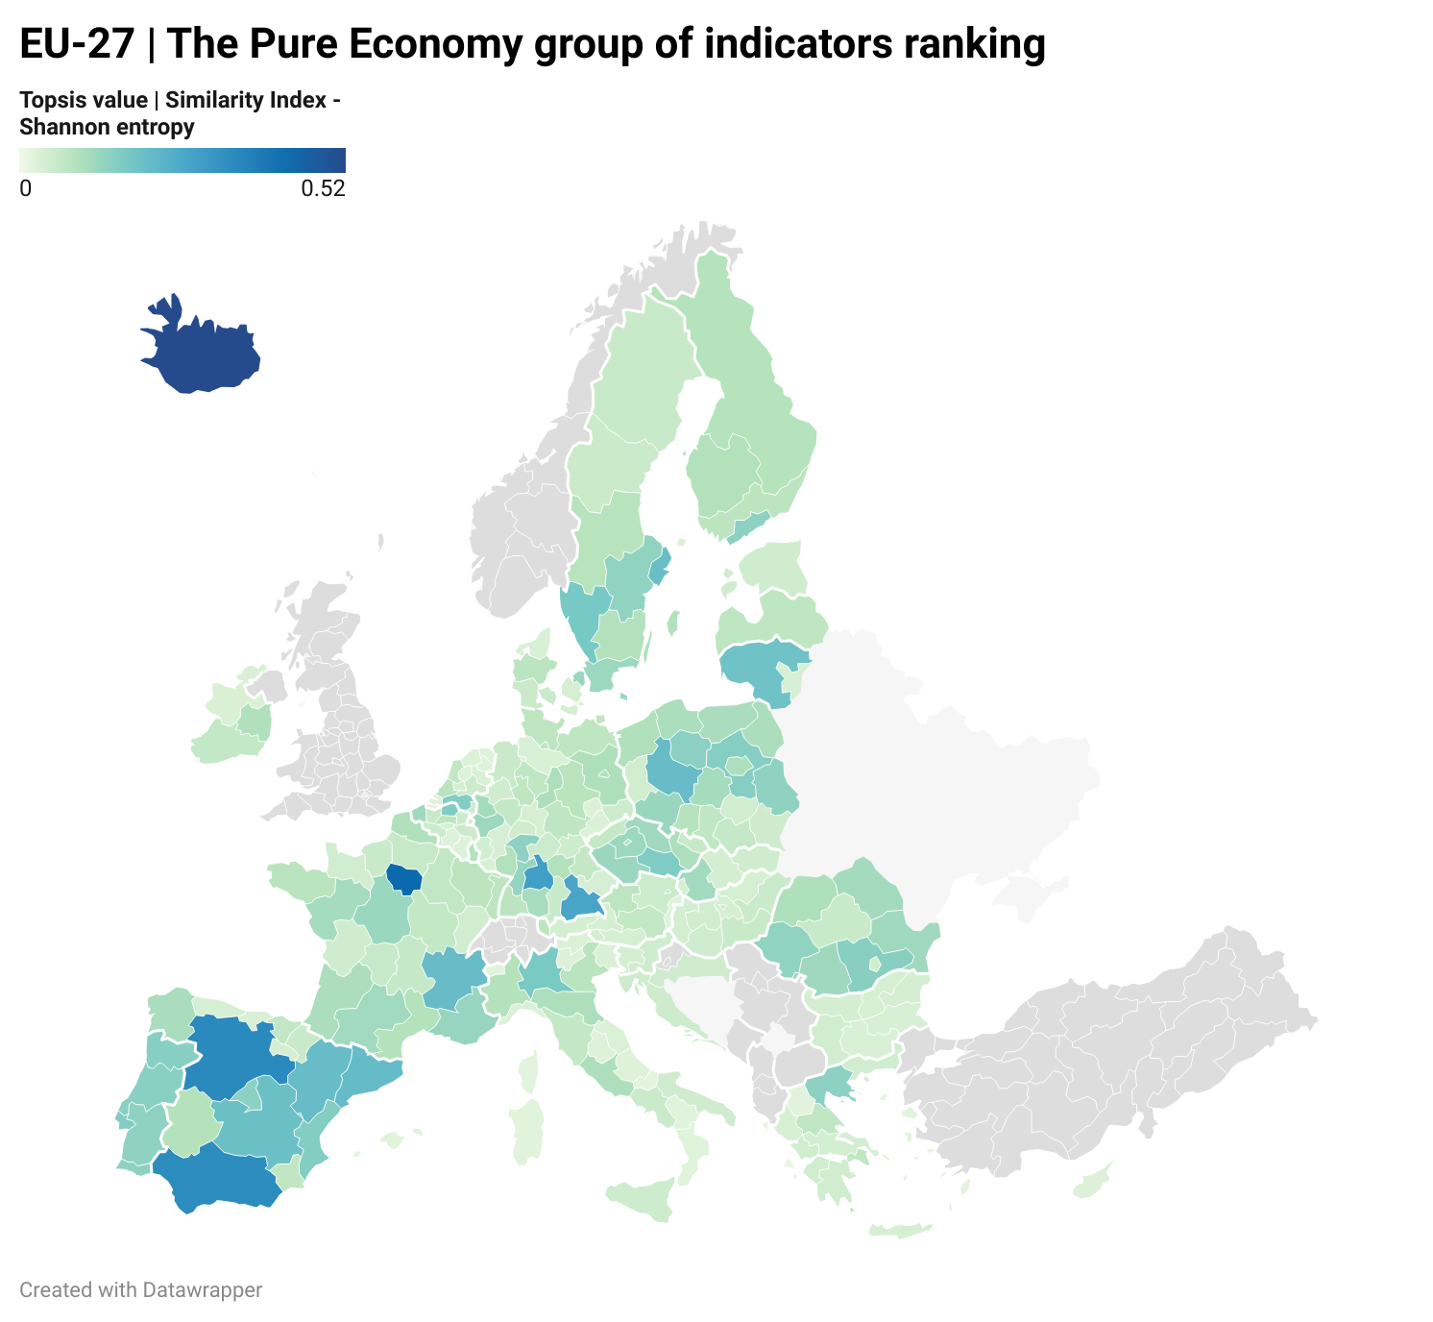
B. The economy group | 1. pure economy indicators ranking
Base Scenario |  | Modified TOPSIS – Shannon entropy
Region ID | Value | Region ID | Value
Île-de-France | 0.590 | Iceland | 0.520
Iceland | 0.367 | Île-de-France | 0.433
Oberbayern | 0.346 | Castile-Leon | 0.344
Stuttgart | 0.325 | Andalusia | 0.340
Castile-Leon | 0.319 | Stuttgart | 0.286

Slide 13
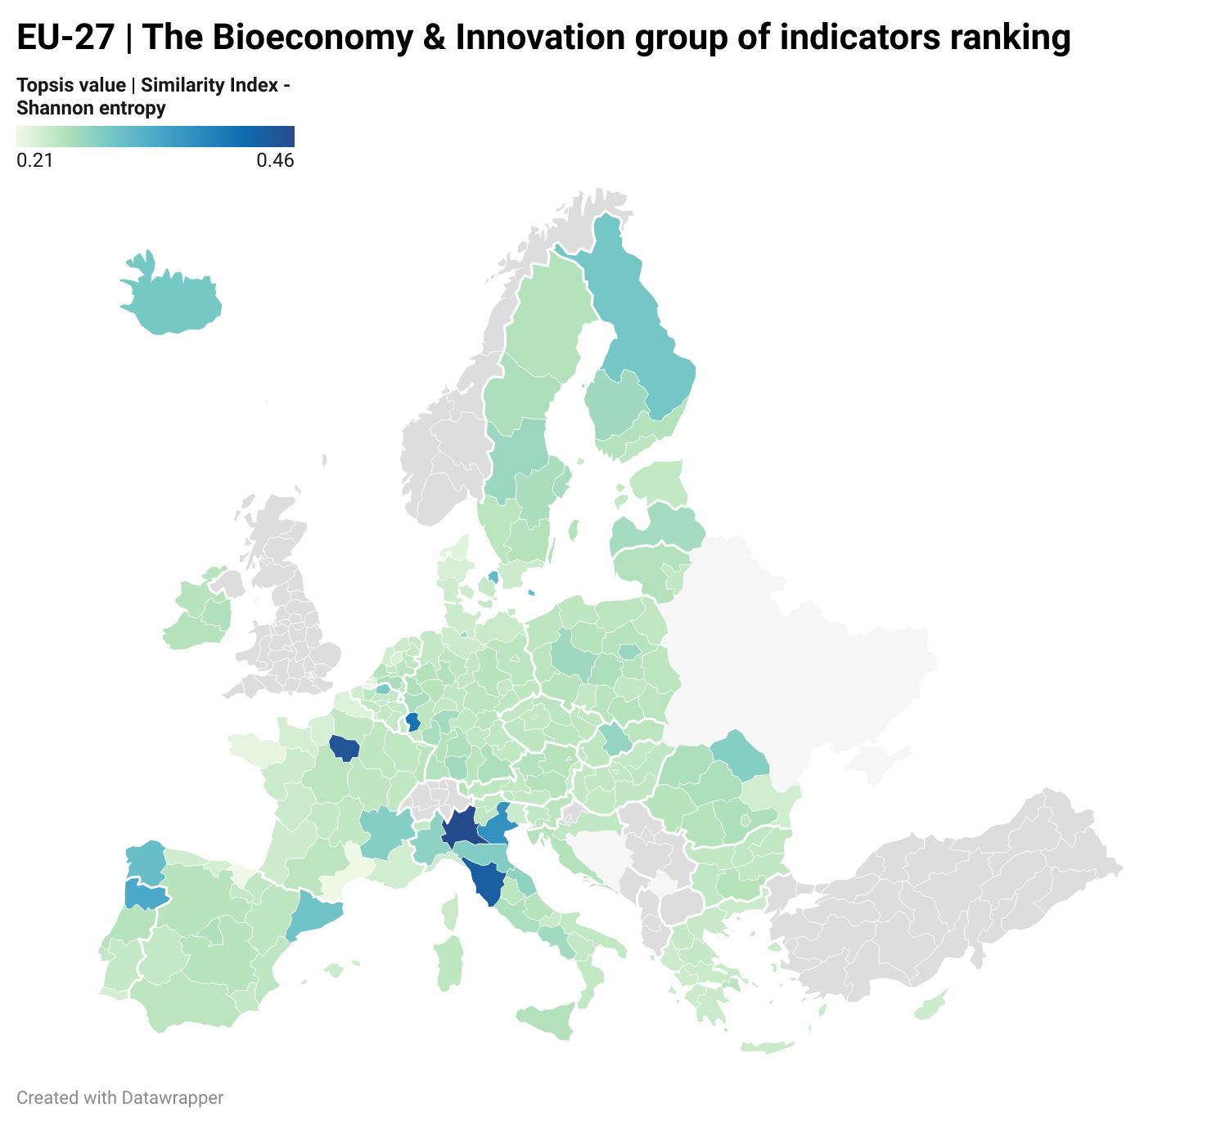
B. The economy group | 2. bioeconomy & innovation indicators ranking
Base Scenario |  | Modified TOPSIS – Shannon entropy
Region ID | Value | Region ID | Value
Île-de-France | 0.458 | Lombardy | 0.458
Lombardy | 0.448 | Île-de-France | 0.445
Tuscany | 0.369 | Tuscany | 0.431
Veneto | 0.353 | Trier | 0.404
Trier | 0.330 | Veneto | 0.3621

Slide 14
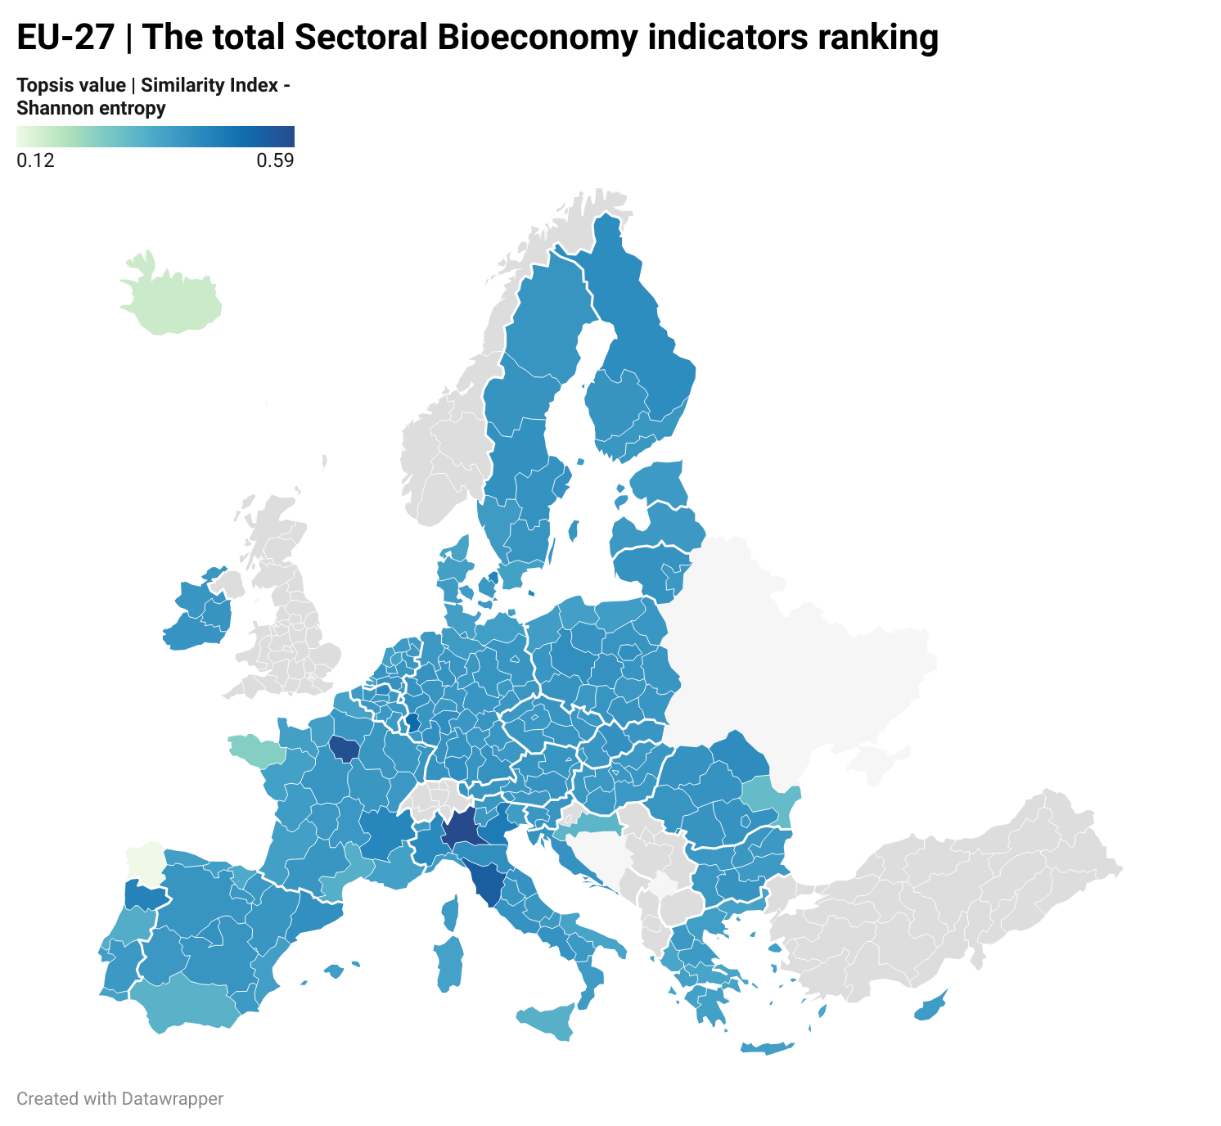
B. The economy group | 3. total sectoral bioeconomy indicators ranking
Base Scenario |  | Modified TOPSIS – Shannon entropy
Region ID | Value | Region ID | Value
Lombardy | 0.521 | Lombardy | 0.593
Île-de-France | 0.519 | Île-de-France | 0.580
Tuscany | 0.439 | Tuscany | 0.543
Veneto | 0.413 | Trier | 0.512
Trier | 0.399 | Veneto | 0.468

Slide 15
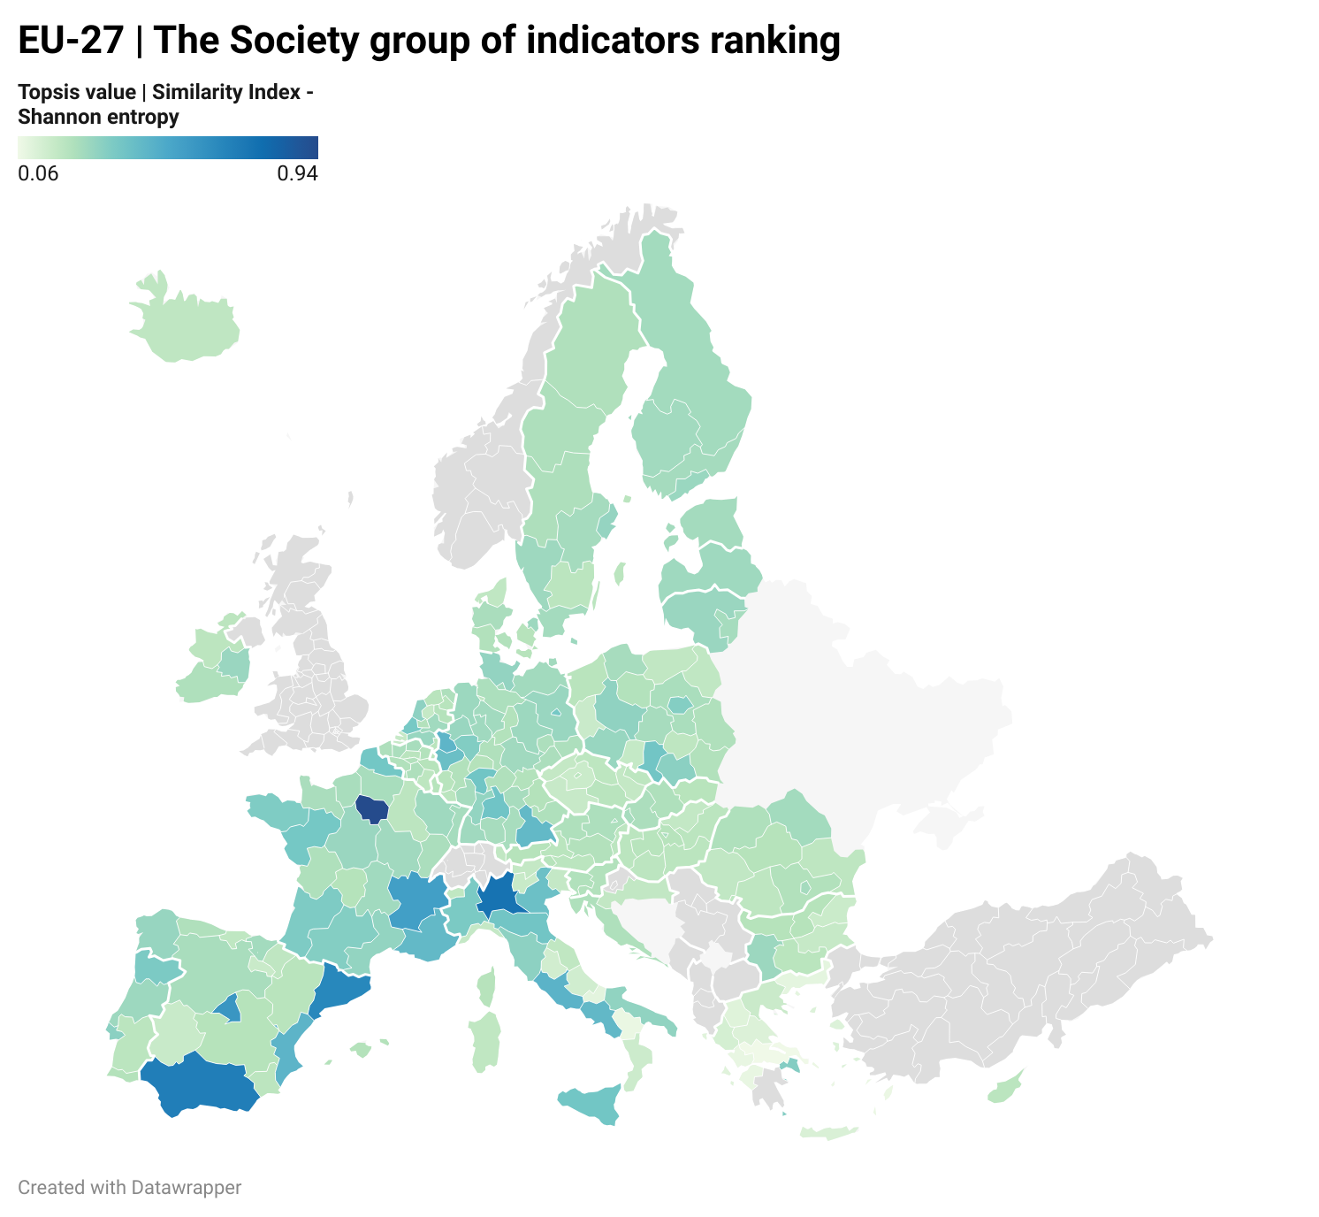
B. The society group
Base Scenario |  | Modified TOPSIS – Shannon entropy
Region ID | Value | Region ID | Value
Île-de-France | 0.890 | Île-de-France | 0.943
Lombardy | 0.696 | Lombardy | 0.751
Catalonia | 0.668 | Andalusia | 0.697
Andalusia | 0.664 | Catalonia | 0.654
Madrid | 0.623 | Madrid | 0.583

Slide 16
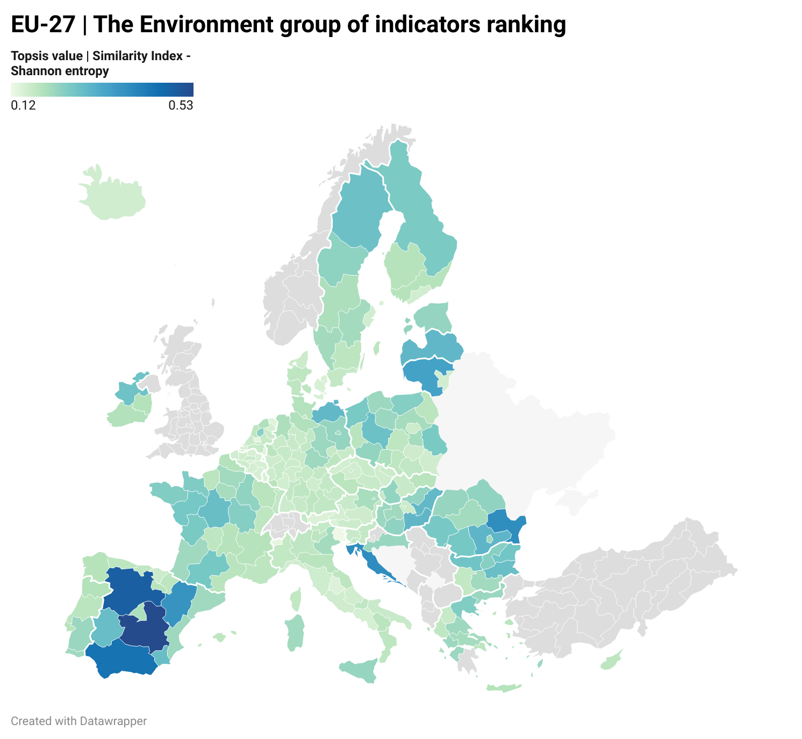
B. The environment group
Base Scenario |  | Modified TOPSIS – Shannon entropy
Region ID | Value | Region ID | Value
Castile-La Mancha | 0.476 | Castile-La Mancha | 0.534
Castile-Leon | 0.414 | Castile-Leon | 0.489
Andalusia | 0.403 | Andalusia | 0.443
Aragon | 0.390 | Adriatic Croatia | 0.385
Sud-Est | 0.384 | Sud-Est | 0.382

Slide 17
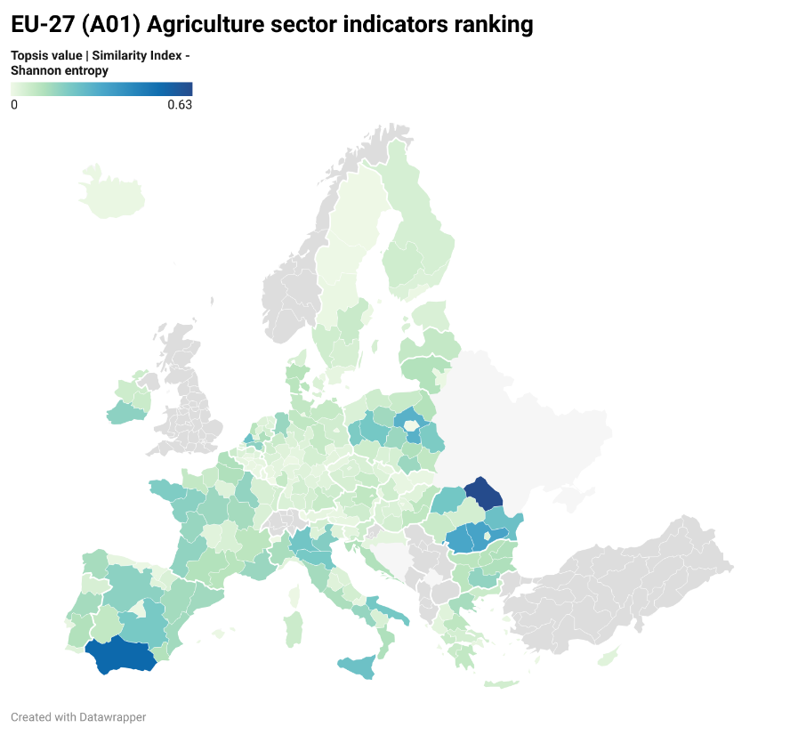
B. Bioeconomy per sector | Agriculture Sector
Base Scenario |  | Modified TOPSIS – Shannon entropy
Region ID | Value | Region ID | Value
Andalusia | 0.616 | Nord-Est | 0.632
Nord-Est | 0.535 | Andalusia | 0.531
South Holland | 0.295 | Sud-Muntenia | 0.332
Sud-Muntenia | 0.288 | Sud-Vest Oltenia | 0.321
Sud-Vest Oltenia | 0.274 | Mazowiecki regionalny (Masovian) | 0.285

Slide 18
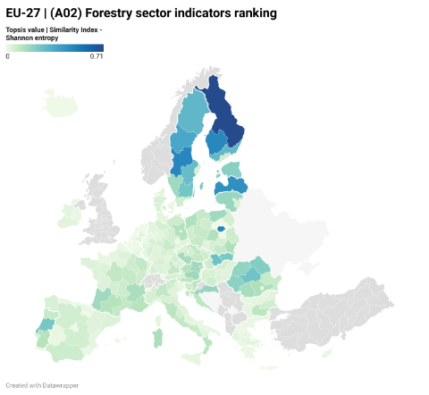
B. Bioeconomy per sector | forestry Sector
Base Scenario |  | Modified TOPSIS – Shannon entropy
Region ID | Value | Region ID | Value
North & East Finland | 0.681 | North & East Finland | 0.709
Warszawski stołeczny | 0.522 | Warszawski stołeczny | 0.491
North Middle Sweden | 0.483 | North Middle Sweden | 0.481
Latvia | 0.463 | Länsi-Suomi (Western Finland) | 0.478
Länsi-Suomi (Western Finland) | 0.458 | Latvia | 0.444

Slide 19
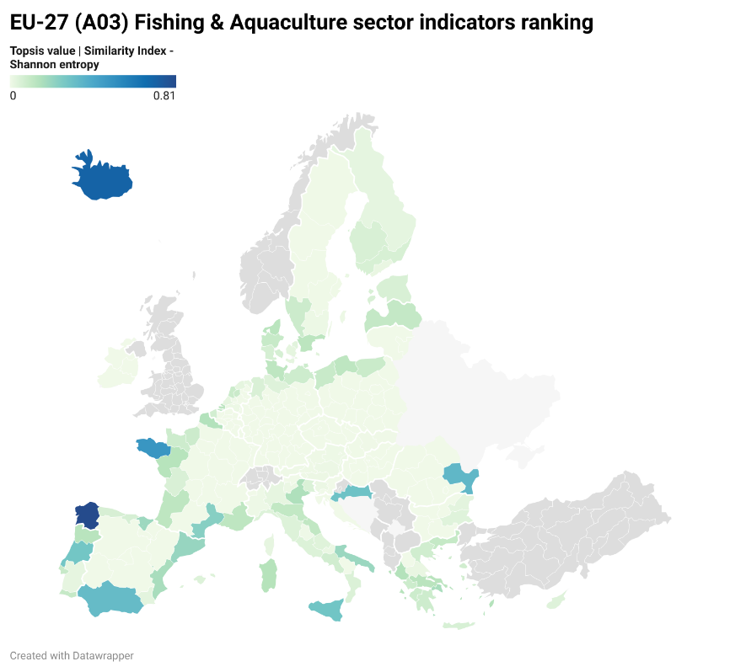
B. Bioeconomy per sector | fishing & aquaculture Sector
Base Scenario |  | Modified TOPSIS – Shannon entropy
Region ID | Value | Region ID | Value
Galicia | 0.814 | Galicia | 0.810
Iceland | 0.693 | Iceland | 0.705
Brittany | 0.484 | Brittany | 0.483
Sud-Est | 0.338 | Sud-Est | 0.343
Andalusia | 0.325 | Andalusia | 0.323

Slide 20
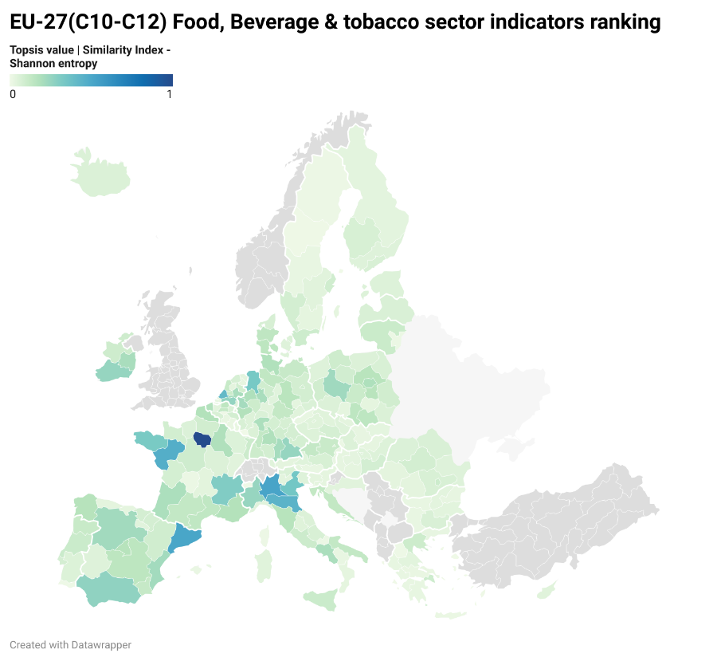
B. Bioeconomy per sector | food, beverage & tobacco Sector
Base Scenario |  | Modified TOPSIS – Shannon entropy
Region ID | Value | Region ID | Value
Île de France | 1 | Île de France | 1
Catalonia | 0.525 | Lombardy | 0.519
Lombardy | 0.516 | Catalonia | 0.511
Pays de la Loire | 0.485 | Pays de la Loire | 0.469
Emilia-Romagna | 0.442 | Emilia-Romagna | 0.444

Slide 21
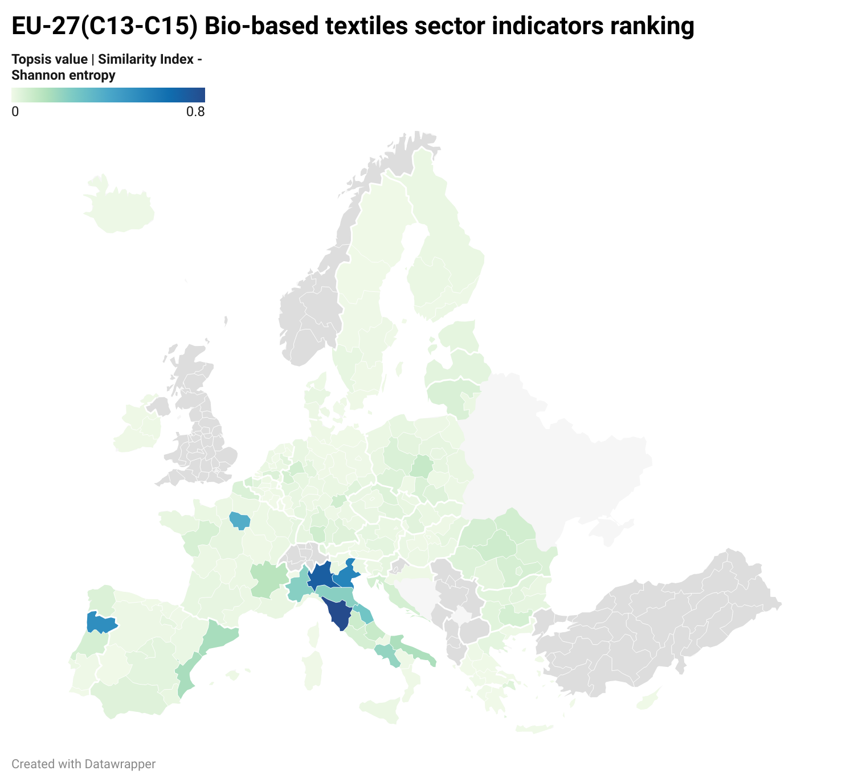
B. Bioeconomy per sector | bio-based textiles Sector
Base Scenario |  | Modified TOPSIS – Shannon entropy
Region ID | Value | Region ID | Value
Tuscany | 0.788 | Tuscany | 0.804
Lombardy | 0.699 | Lombardy | 0.720
Veneto | 0.539 | Veneto | 0.553
Norte | 0.536 | Norte | 0.515
Malta | 0.437 | Malta | 0.407

Slide 22
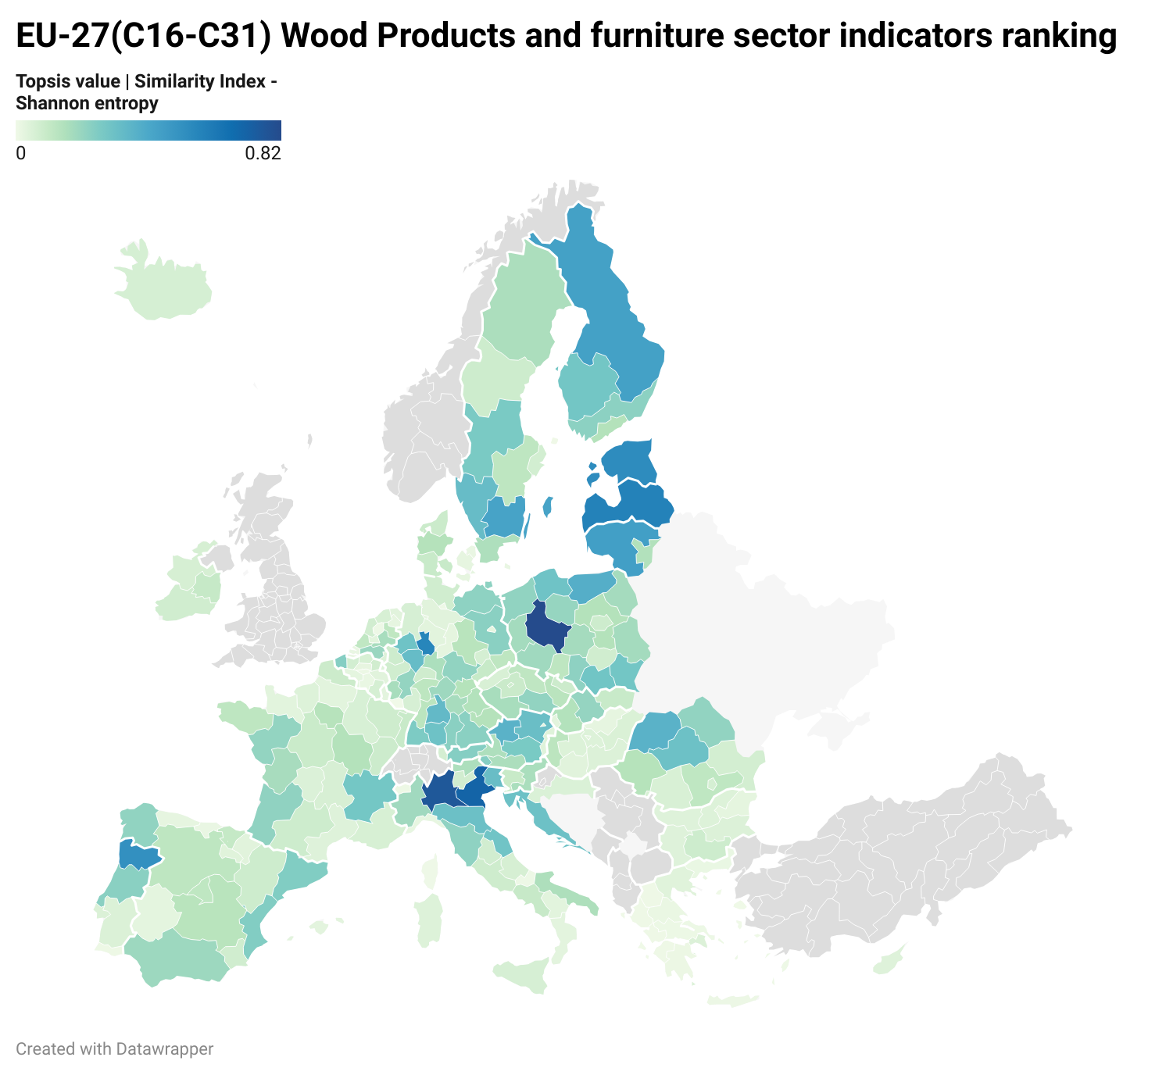
B. Bioeconomy per sector | wood products & furniture Sector
Base Scenario |  | Modified TOPSIS – Shannon entropy
Region ID | Value | Region ID | Value
Wielkopolskie (Greater Poland Voivodeship) | 0.827 | Wielkopolskie (Greater Poland Voivodeship) | 0.824
Lombardy | 0.764 | Lombardy | 0.768
Veneto | 0.708 | Veneto | 0.712
Latvia | 0.579 | Latvia | 0.580
Detmold | 0.563 | Detmold | 0.564

Slide 23
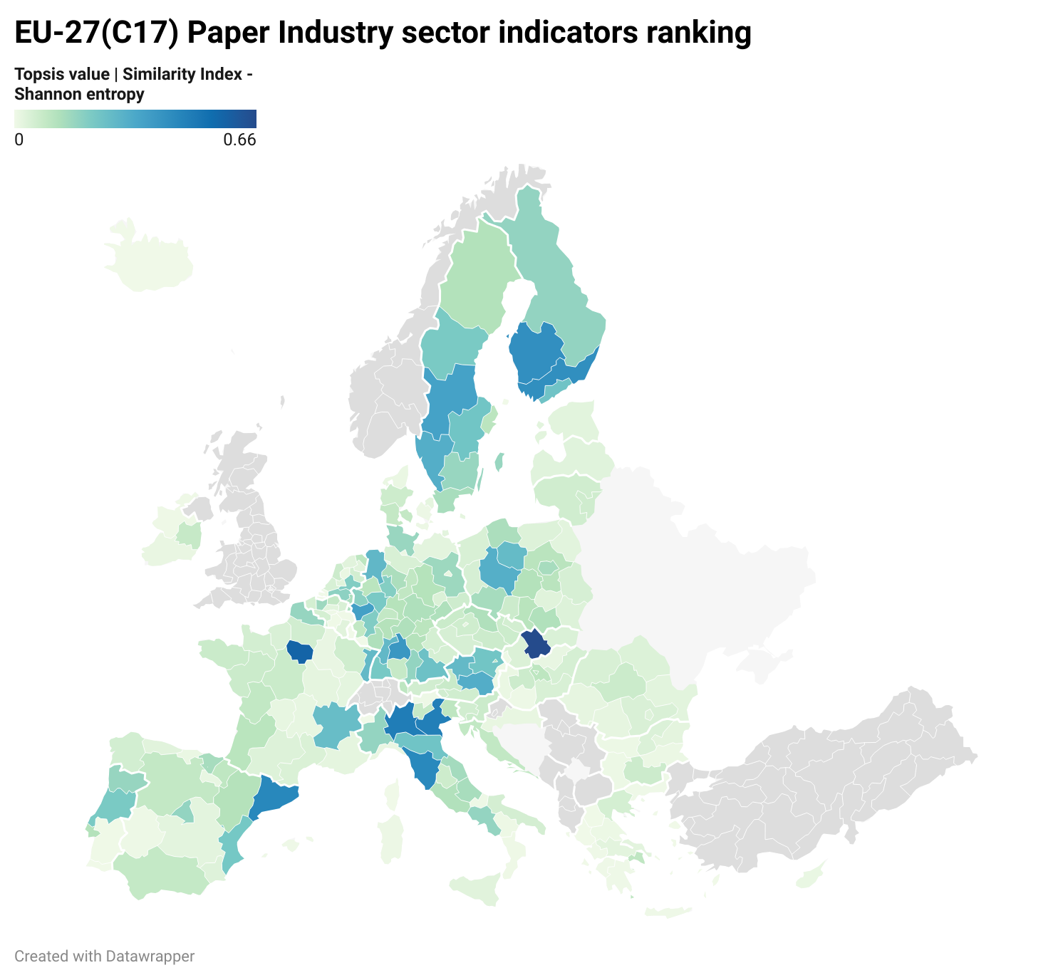
B. Bioeconomy per sector | paper industry Sector
Base Scenario |  | Modified TOPSIS – Shannon entropy
Region ID | Value | Region ID | Value
Central Slovakia | 0.610 | Central Slovakia | 0.658
Île de France | 0.596 | Île de France | 0.569
Lombardy | 0.517 | Lombardy | 0.479
Veneto | 0.491 | Veneto | 0.474
Catalonia | 0.470 | Catalonia | 0.442

Slide 24
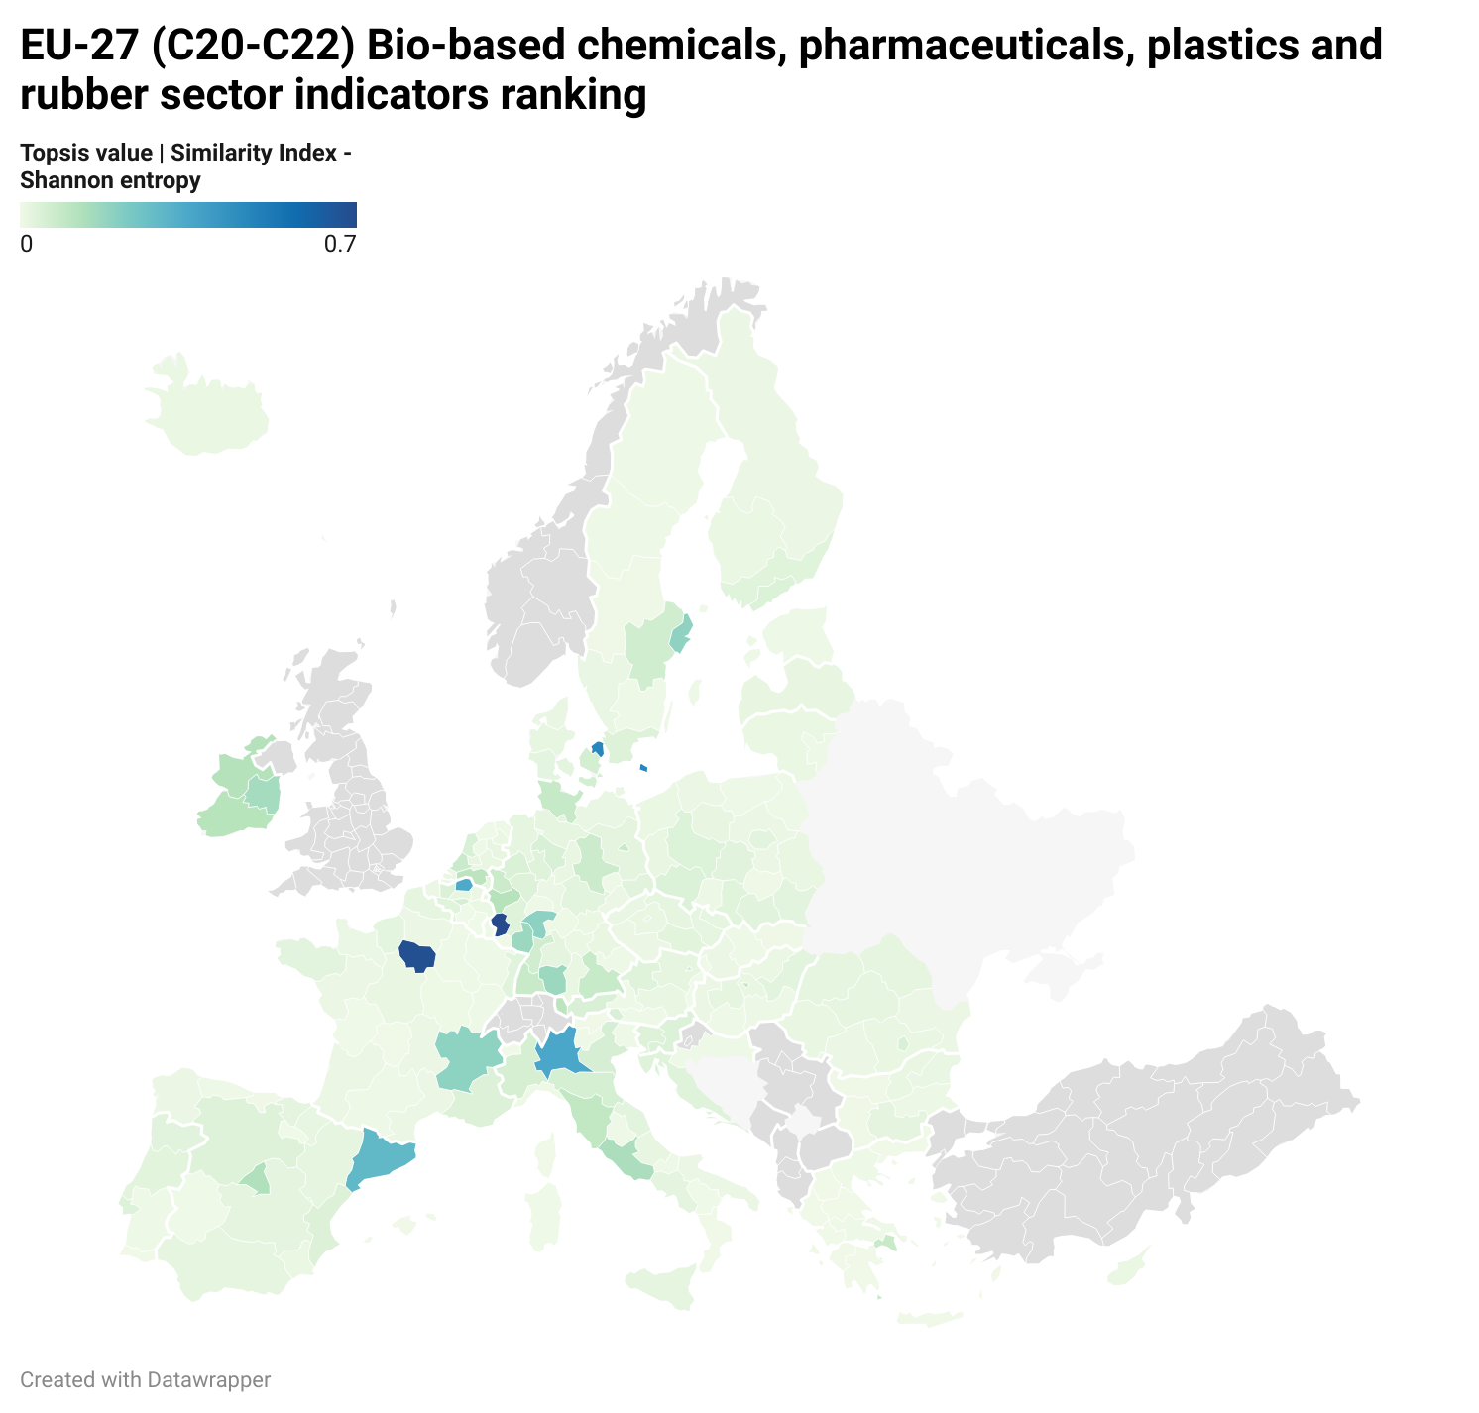
B. Bioeconomy per sector | bio-based chemicals, pharmaceuticals, plastics & rubber Sector
Base Scenario |  | Modified TOPSIS – Shannon entropy
Region ID | Value | Region ID | Value
Île de France | 0.733 | Trier | 0.698
Trier | 0.582 | Île de France | 0.680
Hovedstaden (Capital Region) | 0.447 | Hovedstaden (Capital Region) | 0.472
Lombardy | 0.386 | Lombardy | 0.352
Catalonia | 0.331 | Antwerp | 0.340

Slide 25
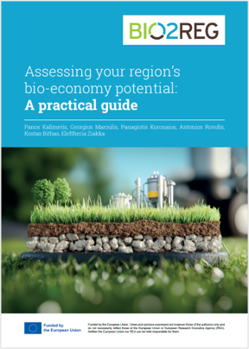
D1.3 Guide for regional stakeholders to implement regional MCA framework assessment
C. scenarios for bioeconomy development

Slide 26
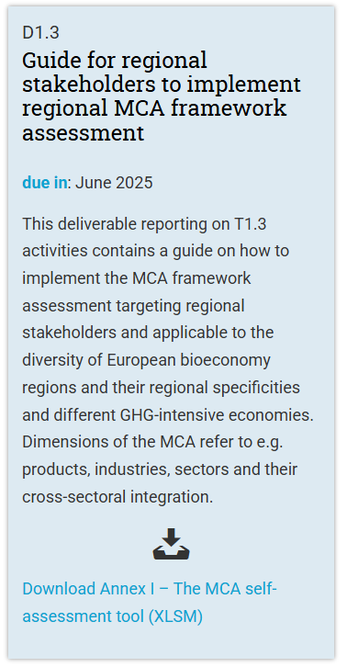

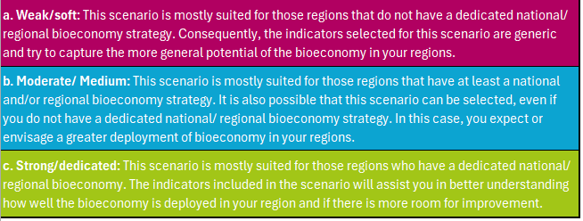
D1.3 Guide for regional stakeholders to implement regional MCA framework assessment
C. scenarios for bioeconomy development
Available here: https://bio2reg.eu/results/

Slide 27
Conclusions
An extensive four-pillars literature review was conducted, revealing ≈ 896 Indicators!
The final dataset narrowed down to 41 essential indicators for the regional NUTS II Level, using the traffic light assessment (TLA) to construct the green group of indicators
MCA Assessment and ranking of NUTS II Regions – TOPSIS method and Modified TOPSIS with Shannon Entropy Weights method
The regional MCA ranking provided results from 27 EU countries
Potential “champions” are revealed, depending on the examined scenarios
Good practices, know-how, policies could be transferred from the “champion” regions to the weakest ones
“Champion” regions could perform as a potential “blueprint” for the weakest regions to be transformed into bioeconomy model regions.
User-friendly Regional stakeholders guide (D1.3) of BIO2REG project is publicly available for more details on bioeconomy development scenarios, through a four-step approach and selected indicators.

Slide 28
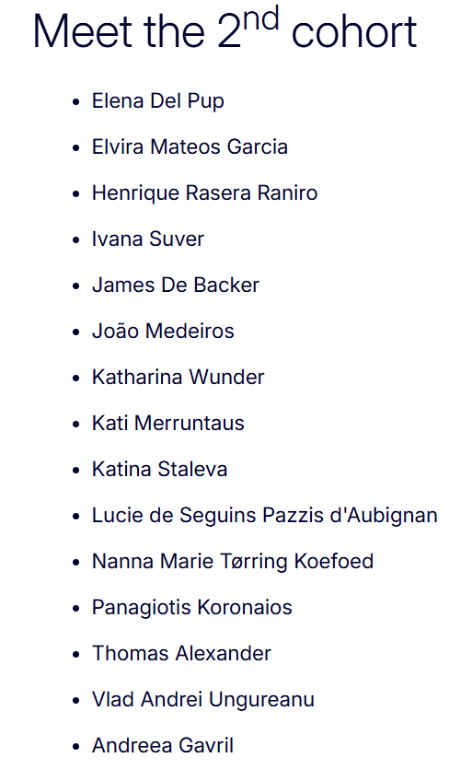
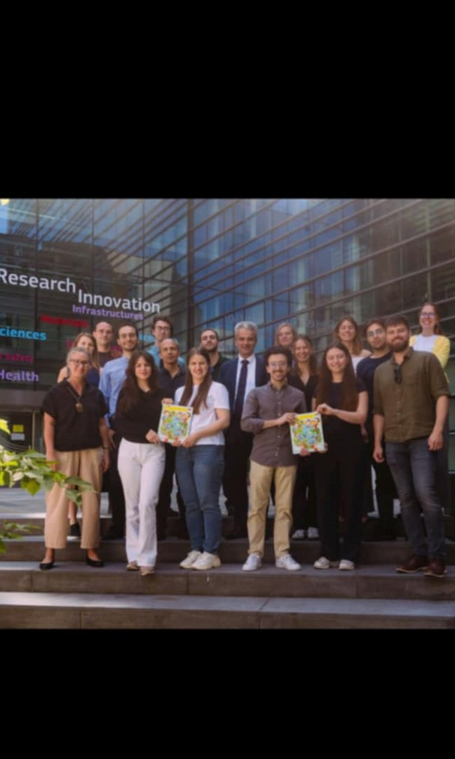
EU Bioeconomy Youth Ambassadors

Slide 29


Thank you for your time!
For more details, please contact:
p.kalimeris@panteion.gr; g.maroulis@panteion.gr; koronaiospanagiotis@gmail.com; rovolis@panteion.gr

