Slide 1
Circular Economy & Bioeconomy
Panagiotis Koronaios
PhD Candidate
Researcher in Institute of Urban Environment and Human Resources

Slide 2
Introduction
The anthropogenic activities and the production and consumption patterns of the modern societies had led to the creation of environmental problems.
Climate Crisis
Environmental Degradation
Biodiversity Loss
The environmental stress also affecting social and economic reality
Inequality
Social Welfare Loss

Slide 3
Introduction
As a result, there is an effort from international organizations, national authorities and other stakeholders to reverse the negative activities from our past actions in order to achieve sustainable development.
Sustainable Development: “development that meets the needs of the present without compromising the ability of future generations to meet their own needs”.
Examples
Sustainable Development Goals (UN)
European Green Deal (European Union)

Slide 4
The Ways To Achieve Sustainable Development

Slide 5
First Alternative Paradigm: Circular Economy
Circular Economy: An Economy which is restorative and regenerative by design
Opposition to the dominant and prevailing global linear economy.
Basic Elements:
To minimize the consumption of Natural Recourses
To maximize the use of waste
To prolong the life cycle of the products
The 4R framework: Reduce, Reuse, Recycle, Recovery

Slide 7
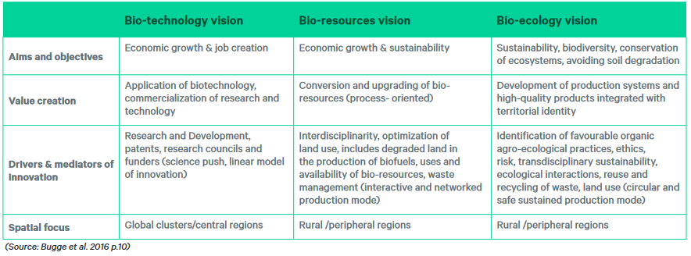
Second Alternative Paradigm: Bioeconomy
Definition: “Bioeconomy can be described as the model which aims to replace fossil resources with renewable ones in order to fulfil economy’s needs such as food, feed, materials and energy”
Bioeconomy Visions

Slide 8
Second Alternative Paradigm: Bioeconomy

Slide 9
Bioeconomy Worldwide
Approximately 50 countries have developed or currently developing bioeconomy strategies at a global level.
there is an increased number of publications referred to bioeconomy after 2010 until present, with the majority of academic output in bioeconomic fields located in Europe and North America
bioecology-oriented vision is less popular in national bioeconomy strategies in contrast with the bioresource approach which characterized as the most salient one followed by biotechnology visions
The domination of bioresource orientation at a strategic level is probably correlated with the dedication of European Union’s policy

Slide 10
Bioeconomy Worldwide
https://tableau.apps.fao.org/views/Bioeconomystrategiesdashboard/Globaloverview?%3Aembed=y&%3AisGuestRedirectFromVizportal=y

Slide 11
European Union’s Bioeconomy Strategy Goals
ensure food and nutrition security
manage natural resources sustainably
reduce dependence on non-renewable, unsustainable resources
limit and adapt to climate change
strengthen European competitiveness and create jobs

Slide 12
Future Orientation

Slide 13
Bioeconomy and Circular Economy in Practice
NP designs and produces bio-based and biodegradable polymers (bioplastics). produced from first generation biomass like sugars and starch extracted from cereals or sugar cane, but also from wastes or by-products of several industrial activities. (France)
Staramaki is a Social Cooperative based in Kilkis that utilizes the by-product of local wheat cultivation, to create a viable eco-friendly alternative to single-use plastic straws and at the same time create employment opportunities for vulnerable groups of people. Staramaki incorporates both environmental and social objectives, supporting the circular economy by capturing value from agricultural waste in order to produce a biomaterial. (Greece)

Slide 14
Enaleia: They train fishers to participate in the “Mediterranean CleanUp” project, making them to collect plastic from the bottom of the sea and to bring it to Enaleia to integrate it into the circular economy, but also to prevent their used plastic equipment to end up in the sea. Also, they provide training to fishermen to join the “Fish Smarter” project, teaching them how they can avoid overfishing, increasing their income, utilizing modern models like sustainable fishing tourism. (Greece)
The slippery, scaly skin of the Atlantic Cod is usually thrown out when the fish is harvested. But in a remote settlement on Iceland’s northwestern coast, a group of scientists is turning fish skin into human skin grafts. Founded in 2007, the Icelandic company Kerecis has developed fish-skin soft-tissue regeneration products that can be used to protect the body’s tissues and create an environment that facilitates tissue regeneration. (Iceland)

Slide 15
Barriers and Limitations
Sustainability Issues
The substitution of fossil-based resources with renewable ones will increase the demand for biomass leading to high pressure on land and water resources
Food vs Fuel
Land use change affects the local biodiversity and ecosystems
The indigenous flora and fauna could also be disturbed by invasive species
Regulatory Framework
Enabling Governance
Disabling Governance

Slide 16
Barriers and Limitations
Monitoring Issues
Absence of a global accepted terms
Lack of statistics depicting the percentage of biobased and non-biobased products as part of the total production
Hegemony of economic related targets and indicators
Demand Side
The transformational process requires the change of consumer behavior
Need for increase of public awareness about the benefits of bioeconomy and circular economy
Adoption of sustainable consumption patterns from consumers such as waste management, recycling

Slide 17
Conclusions
Alternative socio-economic models in order to shape a better world
Circular Economy & Bioeconomy
Circular Bioeconomy
Key characteristics: renewable resources, waste utilization, environmental protection
Non linear and knowledge-based models (Technology and Innovation)
Barriers and Limitations

Slide 18
Thank you for your Attention!
Questions and Answers
koronaiospanagiotis@gmail.com
Enabling regions to transition
https://bio2reg.eu/towards bioeconomy

