Slide 1
CHAPTER 8
THE LOGIT AND PROBIT MODELS

Slide 2
QUALITATIVE RESPONSE REGRESSION MODELS
Regression models involving nominal scale dependent variables (categories such us male or female, married or unamarried, employed or unemployed) are among a broader class of models known as qualitative response regression models.
Example
Smoker and no smoker. Suppose we want to find the factors that determine whether a person smokes or not.
The variable smoking status is a nominal variable.

Slide 3
QUALITATIVE RESPONSE REGRESSION MODELS
Here we will consider the simplest of such models, the binary or dichotomous or dummy dependent variable regression models.
Although variable binary regression models can be estimated with LS there are also more specialized methods such us logit and probit.
The following example shows why the LS method id not appropriate

Slide 4
EXAMPLE: TO SMOKE OR NOT TO SMOKE
We use a random sample of 1.196 US males (Table 8.1). The variables used are:
Smoker= 1 for smokers and 0 for nonsmokers
Age= age in years
Education= number of year schooling
Income= family income
Pcigs= price of cigarettes in individual states in 1979

Slide 5
EXAMPLE: TO SMOKE OR NOT TO SMOKE
Suppose we apply the method of ordinary least-squares (OLS) to determine smoking behavior (dependent variable) in relation to age, education, family income, and price of cigarettes. That is, we use the following model:
Which, for brevity of expression, we write as:
Model (8.2) is called a linear probability model (LPM) because the conditional expectation of the depending variable (smoking status), given the values of the explanatory variables, can be interpreted as the conditional probability that the event (ie. smoking) will occur.

Slide 6
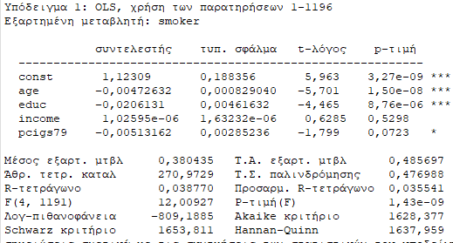
EXAMPLE: TO SMOKE OR NOT TO SMOKE
Running the regression we get:
Notice that all the variables, except income, are individually statistically significant at least at the 10% level of significance. Age, education, and price of cigarettes have negative impact on smoking, which may not be a surprising result. Collectively all the explanatory variables are statistically significant, for the estimated F-value of 12.00 has a p-value of almost zero. Recall that the F value tests the hypothesis that all the slope coefficients are simultaneously equal to zero.

Slide 7
EXAMPLE: TO SMOKE OR NOT TO SMOKE
Interpretation of the regression coefficients
If we hold all other variables constant, the probability of smoking decreases at the rate of 0.005 as a person ages, probably due to the adverse impact of smoking on health.
Likewise, ceteris paribus, an increase in schooling by one year decreases the probability of smoking by 0.02.
Similarly, if the price of cigarettes goes up by a dollar, the probability of smoking decreases by 0.005, holding all other variables constant.
The R² value of 0.038 seems very low, but one should not attach much importance to this because the dependent variable is nominal, taking only values of 1 and zero.

Slide 8
PROBLEMS WITH LINEAR PROBABILITY MODEL
The linear probability model (LPM) uses the OLS method to determine the probability of an outcome.
Problems:
1. The LPM assumes that the probability of the outcome moves linearly with the value of the explanatory variable, no matter how small or large that value is.
2. The probability value must lie between 0 and 1, yet there is no guarantee that the estimated probability values from the LPM will lie within these limits.
3. The usual assumption that the error term is normally distributed cannot hold when the dependent variable takes only values of 0 and 1, since it follows the binomial distribution.
4. The error term in the LPM is heteroscedastic, making the traditional significance tests suspect.

Slide 9
THE LOGIT MODEL
Suppose that in the decision of an individual to smoke or not to smoke depends on an unobservable utility index ; which depends on explanatory variables such as age, education, family income and price of cigarettes and expressed as:
where i = ith individual, u error term, and BX (defined in Eq. 8.2).
If the outcome decision depends on an unobservable utility index, then this index can be expressed as:
Y_{i} = 1 (a person smokes) if
Y_{i} = 0 (a person does not smoke) if
That is, if a person's utility index Ι exceeds the threshold level I*, he or she will smoke but if it is less that Ι*, that individual will not smoke.

Slide 10
THE LOGIT MODEL
If a person’s utility index I exceeds the threshold level I*, the dichotomous outcome Y=1, and if not, then Y=0:
Now this probability depends on the (probability) distribution of Y_{i}, which in turn depends on the probability distribution of the error term, u_{i}.

Slide 11
THE LOGIT MODEL (CONT.)
If the probability is symmetric around zero, then the previous equation can be written as:
Therefore:
P_{i} depends on the particular probability distribution of u_{i} which is assumed to follow a cumulative probability distribution
Remember that the probability that a random variable takes a value less than some specified value is given by the cumulative distribution function (CDF) of that variable.
Recall from elementary statistics that the cumulative distribution function of a random variable X, F(X), is defined as: where x is a particular value of X

Slide 12
THE LOGIT MODEL (CONT.)
The logit model assumes that the probability distribution of u_{i} follows the logistic probability distribution, which for our example can be written as:
(8.7)
where P_{i} is the probability of smoking (ie Y_{i}=1) and + u_{i} (8.8)
The probability that P(Y=0), that is, the person is not a smoker, is given by :
(8.9)

Slide 13
THE LOGIT MODEL (CONT.)
The ratio of the two probabilities is the odds ratio in favor of the outcome (that is the probability that a person is a smoker against the probability that he/she is not):
(8.10)
The log of the odds ratio (logit) is given as:
(8.11)
Eq. (8.11) states that the log of the odds ratio is a linear function of the Bs as well as the Xs. L_{i} is know as the logιt (log of the odds ratio) and hence the name logit model. It is interesting to observe that the linear probability model (LPM) discussed previously assumes that P_{i} is linearly related to X; whereas the logit model assumes that the log of the odds ratio is linearly related to X_{i}.

Slide 14
CHARACTERISTICS OF LOGIT MODEL
1. As P_{i} goes from 0 to 1, L_{i} goes from -∞ to ∞.
2. Although L_{i} is linear in X_{i}, the probabilities themselves are not.
3. If L_{i} is positive, when the value of the explanatory variable(s) increases, the odds of the outcome increase. If it negative, the odds of the outcome decrease.
4. The interpretation of the logit model is as follows: Each slope coefficient shows how the log of the odds in favor of the outcome changes as the value of the X variable changes by a unit.
5. Once the coefficients of the logit model are estimated, we can easily compute the probabilities of the outcome.
6. In the LPM the slope coefficient measures the marginal effect of a unit change in the explanatory variable on the probability of the outcome(e.g smoking), holding other variables constant. In the logit model, the marginal effect of a unit change in the explanatory variable not only depends on the coefficient of that variable but also on the level of probability from which the change is measured. The latter depends on the values of all the explanatory variables in the model.

Slide 15
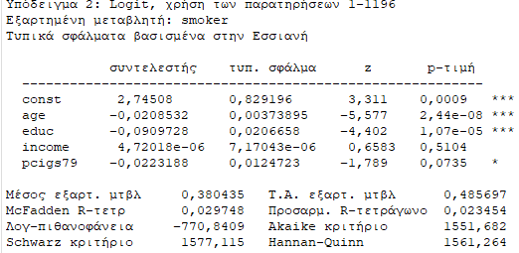
Estimation of the logit model
For our smoker example, we have data on 1,196 individuals and the estimation of a logit model gives as:

Slide 16
Interpretation of the logit model results
The variables age and education are highly statistically significant and have the expected signs.
As age increases, the value of the logit decreases, perhaps due to health concerns that is, as people age, they are less likely to smoke.
Likewise, more educated people are less likely to smoke, perhaps due to the ill effects of smoking.
The price of cigarettes has the expected negative sign and is significant at about the 7% level.
Ceteris paribus, the higher the price of cigarettes, the lower is the probability of smoking.
Income has no statistically visible impact on smoking, perhaps because expenditure on cigarettes may be a small proportion of family income.

Slide 17
Interpretation of the logit model results
The interpretation of the various coefficients is as follows: holding other variables constant, if, for example, education increases by one year, the average logit value goes down by almost 0.09, that is, the log of odds in favor of smoking goes down by about 0.09.
What we would like to know is the probability of smoking, given values of the explanatory variables. But this can be computed from Eq. (8.7):
To illustrate, take smoker #2 from Table 8.1(excel) also. His data are as follows: age =28, educ = 15, income=12,500 and pcigs79= 60.0. Inserting these values in Eq. (8.7) add the constant term:
That is, the probability that a person with the given characteristics is a smoker is about 38%.

Slide 18
Interpretation of the logit model results
Can we compute the marginal effect of an explanatory variable on the probability of smoking, holding all other variables constant?
Suppose we want to find out, the effect of a unit change in age on the probability of smoking
This was very straightforward in the LPM, but it is not that simple with logit or probit models, because the change in probability of smoking if age changes by a unit (say, a year) depends not only on the coefficient of the age variable but also on the level of probability from which the change is measured
But the latter depends on values of all the explanatory variables.

Slide 19
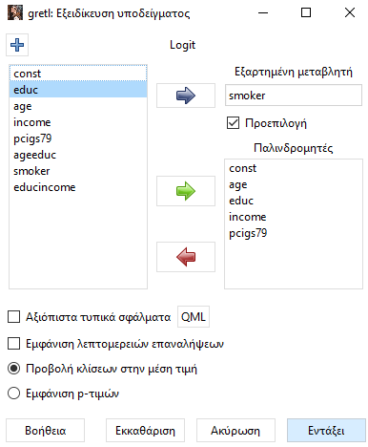
Estimating marginal effects in Gretl

Slide 20
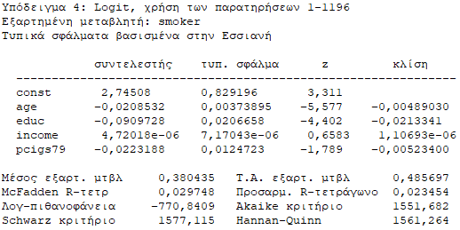
Estimating marginal effects in Gretl
Slope: The changing probability of the depending variable when each individual variable increases by one unit while holding all other variables at their means.

Slide 21
Technical notes
Goodness of fit measures: R², is not very meaningful when the dependent variable takes values of 1 or 0. Similar measures McFadden R² (pseudo R²)
In binary regression models matters are the expected signs of the regression coefficients and their statistical and or practical significance.
We can also test the null hypothesis that all the coefficients are simultaneously zero with the likelihood ratio (LR) statistic, which is the equivalent of the F-test in the linear regression model.

Slide 22
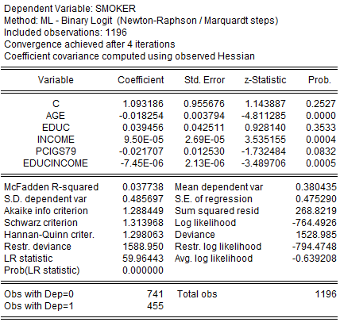
Smoker example-Model refinement
Do people with a higher level of education and higher level of income smoke less or more than people with other characteristics?
To allow for this, we can introduce the multiplicative or interactive effect of the two variables as an additional explanatory variable.

Slide 23
Smoker example-Model refinement
In the previous example individually education had a significant negative impact on the logit (and therefore on the probability of smoking) and income had no statistically significant impact.
Now education by itself has no statistically significant impact on the logit, but income has highly significant positive impact.
But if you consider the interactive term, education multiplied by income, it has significant negative impact on the logit.
That is, persons with higher education who also have higher incomes are less likely to be smokers than those who are more educated only or have higher incomes only.
What this suggests is that the impact of one variable on the probability of smoking may be attenuated or reinforced by the presence of other variable(s).

Slide 24
THE PROBIT MODEL
In the probit model, the error term follows a normal distribution.
Given the assumption of normality, the probability that is less than or equal to I_{i} can be computed from the standard normal cumulative distribution function (CDF) as:
F, the standard normal CDF, can be written as:
If we multiply the probit coefficient by about 1.81 ( ), we will get approximately the logit coefficient.
The marginal effect is given by the coefficient of the variable multiplied by the value of the normal density function evaluated for all the X values for that individual.

Slide 25
LOGIT vs PROBIT
Logit and probit models generally give similar results.
The main difference between the two models is that the logistic distribution has slightly fatter tails.
The conditional probability P_{i} approaches 0 or 1 at a slower rate in logit than in probit.
In practice there is no compelling reason to choose one over the other.
Many researchers choose the logit over the probit because of its comparative mathematical simplicity.

