Slide 1
CHAPTER 2
FUNCTIONAL FORMS
OF REGRESSION MODELS

Slide 2
GOODNESS OF FIT, Adjusted- R²
One disadvantage of R², is that it is an increasing function of the number of regressors.
The adjusted-R² takes into account the number of regressors included in the model, and is computed from the (unadjusted) R² as follows:
The term "adjusted" means adjusted for the degrees of freedom, which depend on the number of regressors (k) in the model.
Adjusted-R² is often used to compare two or more regression models that have the same dependent variable.

Slide 3
HYPOTHESIS TESTING: F TEST
Testing the following hypothesis is equivalent to testing the hypothesis that all the slope coefficients are 0:
H₀: R² = 0
H₁: R² ≠ 0
Calculate the following and use the F table to obtain the critical F value with k-1 degrees of freedom in the numerator and n-k degrees of freedom in the denominator for a given level of significance (k denotes the number of parameters in the model):
If this value is greater than the critical F value, reject H₀.

Slide 4
Example 1
In this example we look at a cross-section of 1,289 persons interviewed in March 1995 to study the factors that determine hourly wage (in dollars) in this sample (Table1_1).
The variables used in the analysis are defined as follows:
Wage: Hourly wage in dollars, which is the dependent variable.
The explanatory variables, or regressors, are as follows:
Female: Gender, coded 1 for female, 0 for male Nonwhite: Race, coded 1 for nonwhite workers, 0 for white workers
Union: Union status, coded 1 if in a union job, 0 otherwise Education: Education (in years)
Exper: Potential work experience (in years), defined as age minus years of schooling minus 6. (It is assumed that schooling starts at age 6)
Education: Education (in years)

Slide 5
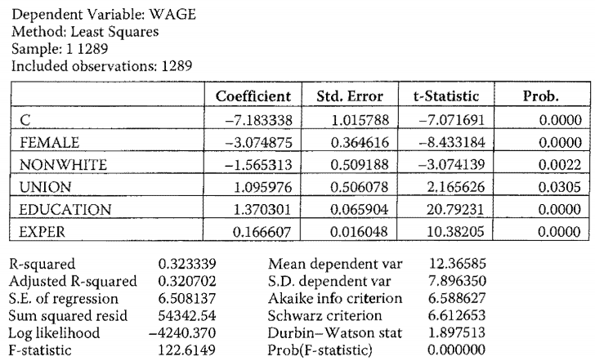
Example 1

Slide 6
Example 1
For each coefficient, the null hypothesis is that the population value of that coefficient (the big B) is zero, that is, the particular regressor has no influence on the regressand
For a p-value of 5%, each of the estimated coefficients is statistically significantly different from zero, that is, each is an important determinant of hourly wage.
The female coefficient of -3.07 means, holding all other variables constant, that the average female hourly wage is lower than the average male hourly wage by about 3 dollars.
The education coefficient suggests that the average hourly wages increases by about $1.37 for every additional year of education,

Slide 7
Example 1
The F-test: the hypothesis that all the slope coefficients in the wage regression are simultaneously equal to zero can be rejected
Using the equation:

Slide 8
MODELS LINEAR IN PARAMETERS BUT NOT LINEAR IN VARIABLES
Log-linear or double-log models where the regressand as well as the regressors are all in logarithmic form.
Log-lin models in which the regressand is logarithmic but the regressors can be in log or linear form.
Lin-log models in which the regressand is in linear form, but one or more regressors are in log form.
Reciprocal models in which the regressors are in inverse form.
Standardized variable regression models

Slide 9
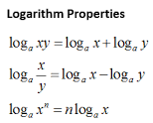
LOG-LINEAR, DOUBLE LOG, OR CONSTANT ELASTICITY MODELS
The Cobb-Douglas Production Function:
can be transformed into a linear model (in parameters B₂ and B₃) by taking natural logs of both sides:
The slope coefficients can be interpreted as elasticities.
If (B₂ + B₃) = 1, we have constant returns to scale.
If (B₂ + B₃) > 1, we have increasing returns to scale.
If (B₂ + B₃) < 1, we have decreasing returns to scale.

Slide 10
THE COBB-DOUGLAS PRODUCTION FUNCTION FOR THE USA
To illustrate the CD function, we present in Table 2.1 data on output (as measured by value added, in thousands of dollars), labor input (worker hours, in thousands), and capital input (capital expenditure, in thousands of dollars) for the US manufacturing sector.
The data is cross-sectional, covering 50 states and Washington, DC, for the year 2005.
The OLS regression results are given in Table 2.2. below:

Slide 11
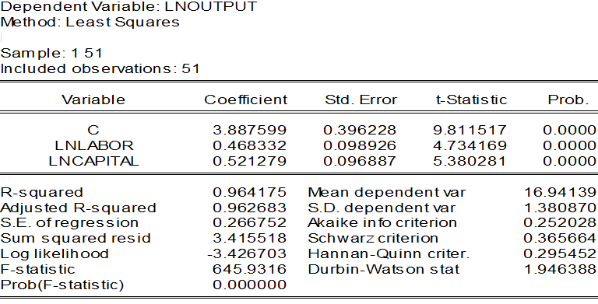
THE COBB-DOUGLAS PRODUCTION FUNCTION FOR THE USA

Slide 12
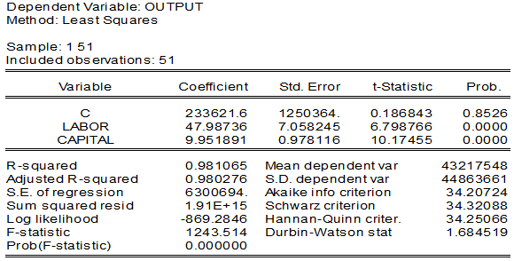
THE COBB-DOUGLAS PRODUCTION FUNCTION FOR THE USA
If we consider the linear production function:
Output_{i} = A₁ + A₂Labor_{i} + A₂Capital_{i} +u_{t}

Slide 13
THE COBB-DOUGLAS PRODUCTION FUNCTION FOR THE USA
The labor and capital coefficients in this regression are statistically highly significant.
- if labor by a unit, the output by about 48 units,
- if capital input by a unit, output, on average, goes up by about 10 units.
Which is a better model, the linear model or the log-linear one?
-We cannot compare the R² values of the two models, because to compare the R²s of any two models the dependent variable must be the same in the two models.

Slide 14
TESTING VALIDITY OF LINEAR RESTRICTIONS
(unrestricted regression-URS)
Testing for constant returns to scale on CD production function.
B₂+ B₃=1 (linear restriction)
We incorporate this restriction directly into the estimating procedure:
We can write: B₂=1-B₃
Substitute in log-linear Cobb-Douglas production:
InQ_{i}=A+(1-B₃)InL_{i}+B₃InK_{i}+u_{i}

Slide 15
TESTING VALIDITY OF LINEAR RESTRICTIONS
Collecting terms:
InQ_{i} - InL_{i} = A+B₃(InL_{i} - InL_{i} )+u_{i}
Using the properties of logarithms:
(restricted regression-RS)
where Q_{i}/L_{i} output-labor ratio, or labor productivity, and K_{i} /L_{i} capital-labor ratio.
Once we estimate RS by OLS, we can obtain the estimated value of B₃, from which we can easily obtain the value of B₂ (remember B₂ + B₃=1).

Slide 16
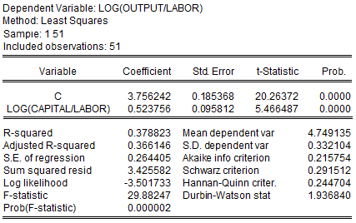
TESTING VALIDITY OF LINEAR RESTRICTIONS
Is the linear restriction valid?
capital-labor ratio by 1 %, labor productivity by about 1/2%. In other words, the elasticity of labor productivity with respect to capital-labor ratio is 1/2, and this elasticity coefficient is highly significant
Note that the R² of about 0.38 is not directly comparable with the R² value of the unrestricted regression because the dependent variables in the two models are different.

Slide 17
TESTING VALIDITY OF LINEAR RESTRICTIONS
To test the validity of the linear regression, we first define:
RSSR = residual sum of squares from the restricted regression, (RS)
RSSUR= residual sum of squares from the unrestricted regression, (URS)
m = number of linear restrictions (1 in the present example)
k = number of parameters in the unrestricted regression (3 in the present example)
n = number of observations (51 in the present example).

Slide 18
TESTING VALIDITY OF LINEAR RESTRICTIONS
F-statistic:
which follows the F probability distribution of statistics, where m and (n-k) are the numerator and denominator degrees of freedom. The F ratio is always nonnegative.
If the computed F exceeds the critical F value at the chosen level of significance and the appropriate degrees of freedom, we reject the null hypothesis; otherwise, we do not reject it.

Slide 19
TESTING VALIDITY OF LINEAR RESTRICTIONS
If we substitute RSS_{UR} =3.4155, RSS_{R}= 3.4255, m =1 and n= 51 in the F-ratio, will find that the estimated F-value is about 0.142,
For 1 df in the numerator and 48 df in the denominator, this F value is not significant;
Therefore the conclusion in the present example is that the estimated Cobb-Douglas production function probably exhibits constant returns to scale.
Note: that the F testing procedure outlined above is valid only for linear restriction,' it is not valid for testing nonlinear restriction(s), such as B₂B₃=1.

Slide 20
LOG-LIN OR GROWTH MODELS
Growth rate of key economic variables (GDP, money supply, population, employment etc)
Suppose we want to measure the rate of growth of real GDP for the USA for the period 1960-2007 (Table2_5)
The rate of growth of real GDP:
can be transformed into a linear model by taking natural logs of both sides:

Slide 21
LOG-LIN OR GROWTH MODELS
Letting B₁ = ln RGDP₁₉₆₀ and B₂ = ln (l+r), this can be rewritten as:
ln RGDP_{t} = B₁ +B₂ t+u_{t} (log-lin model)
Model above is called a semilog model because only one variable (in this case the regressand) appears in the logarithmic form, whereas the regressor (time here) is in the level or linear form
B₂ measures the constant proportional or relative change in the regressand for a given absolute change in the value of the regressor:
In practice we multiply B₂ by 100 to compute the percentage change, or the growth rate;

Slide 22
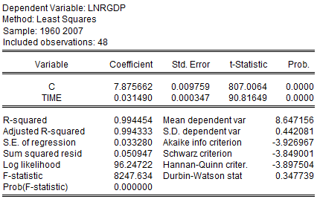
LOG-LIN OR GROWTH MODELS
Using the data on Real GDP for the USA for 1960-2007, we obtain the results given below.
[Insert Table 2.6 about here]
These results show that over the period of 1960-2007 the USA's real GDP had been increasing at the rate of 3.15% per year. This growth rate is statistically significant, for the estimated t value of about 90.82 is highly significant.

Slide 23
STANDARDIZED VARIABLES
The regressand and regressors are not necessarily
expressed in the same unit of measurement.
Standardization is the process of putting different variables on the same scale.
We can avoid the problem of having variables measured in different units by expressing them in standardized form:
where S_{Y} and S_{X} are the sample standard deviations and and are the sample means of Y and X, respectively

Slide 24
STANDARDIZED VARIABLES
The mean value of a standardized variable is always zero and its standard deviation value is always 1.
The standard deviation is the average deviation of a random variable from its mean
A unit increase in a variable is equal to its standard deviation
Thus, a standardized coefficient β_{k} tells you what multiple or fraction of a typical deviation in y_{t} is caused by a typical deviation in the k-th regressor.

Slide 25
STANDARDIZED VARIABLES
Suppose you run the following regression:
The slope coefficient in this regression is interpreted as follows: if the standardized regressor increases by one standard deviation unit, on average, the standardized regressand increases by standard deviation units.
Note: unlike the usual OLS regression, we measure the impact of a regressor not in terms of the original units in which Y and X are measured, but in standard deviation units.

Slide 26
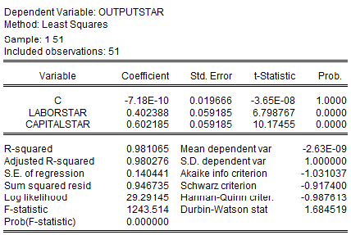
STANDARDIZED VARIABLES
To illustrate, we revisit the linear production function for the USA considered earlier (see Table 2_3) and reestimate it using standardized output, labor and capital variables.
LABORSTAR (CAPITAL STAR) coefficient = 0.40 (0.60) means that if the labor (capital) input increases by one standard deviation unit, the average value of output goes up by about 0.40 (0.60) standard deviation units
Relatively speaking, capital has more impact on output than labor.

Slide 27
MEASURES OF GOODNESS OF FIT
R²: Measures the proportion of the variation in the regressand explained by the regressors.
Akaike’s Information Criterion (AIC): Adds harsher penalty for adding more variables to the model, defined as:
The model with the lowest AIC is usually chosen.
Schwarz’s Information Criterion (SIC): Alternative to the AIC criterion, expressed as:
The penalty factor here is harsher than that of AIC.

Slide 28
REGRESSION THROUGH THE ORIGIN
Also known as a zero intercept model.
Example is the well-known capital asset pricing model (CAPM) of portfolio theory:
where ER_{i} = expected rate of return on security i, ERm = expected rate of return on a market portfolio, r_{f} = risk-free rate of return, β = the Beta coefficient, a measure of systematic risk that cannot be eliminated through portfolio diversification.
The beta coefficient measures the extent to which the ith security’s risk-adjusted rate of return moves with the risk-adjusted market rate of return.
Beta coefficient greater than 1: Suggests a volatile security
Beta coefficient of less than 1: Suggests a defensive security

Slide 29
REGRESSION THROUGH THE ORIGIN
Sums of squares and cross-product terms are raw terms (they are not expressed as deviations of the variables from their mean values):
Setting Y_{i}=R_{i}-r_{f}= rate of return on security i in excess of the risk-free rate of return X_{i}=R_{m}-r_{f}= rate of return on the market in excess of the risk-free rate of return
The market model can be expressed as: . Using OLS,
In zero-intercept model the sums of squares and cross-product terms are raw terms, in the sense that they are not expressed as deviations of the variables from their mean values.
var(b₂) =

